Slide 1

QuickBus
An Online Bus Ticket Booking Website
Presented By:
∙ Abhinap Singh ∙ Darvesh Chhatani ∙ Ishika Tanwani ∙ Janak Advani ∙ Kushlendra Kumar Gupta

Slide 2

Agenda
Project Objective
Problem Domain
Solution Domain
Use Case Diagram
Tools & Technologies Used
Demonstration

Slide 3
Project Objective
Passenger -
should be able to search bus
should be able to see available seats
should be able to book seat
should be able to cancel booking
Bus Operator -
should be able to view bookings
should be able to accept or cancel booking
should be able to search booking based on booking id
Admin –
should be able to add new passenger/bus operator
should be able to view all passenger/bus operator
should be able to search passenger/bus operator
should be able to remove passenger/bus operator

Slide 4
Problem Domain
Inefficient and time-consuming bus ticket booking process for passengers
Lack of transparency in seat availability and pricing
Inability to view and cancel bookings easily for passengers
Real-time visibility of seat availability and booking status for bus operators
Difficulty in finding suitable bus schedules and seats
Inability to manage and track bookings efficiently for bus operators

Slide 5
Solution Domain
User-friendly interface with easy navigation and clear instructions for booking tickets and managing reservations.
Responsive and fast website with compatibility across different devices and platforms.
Real-time updates on seat availability and booking status for passengers and bus operators.
Comprehensive booking management system for bus operators to efficiently manage reservations and schedules.
Configurable system settings and customizable services for admins to modify the system based on changing needs.

Slide 6
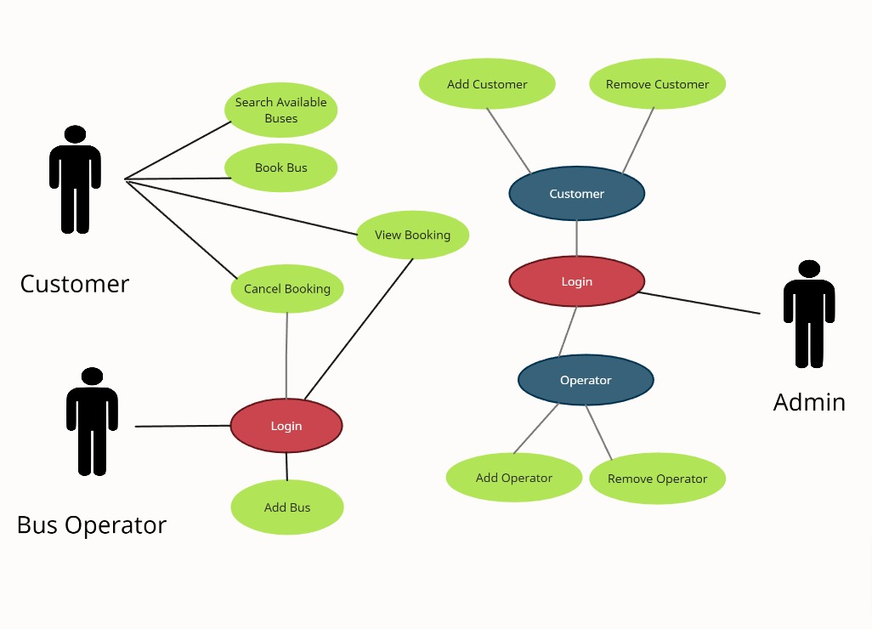
Use case Diagram

Slide 7
Technologies & Tools Used
FrontEnd
HTML 5
CSS 3
JavaScript
React
Axios
BackEnd
Springboot
Oracle
Java
Other Tools
POSTMAN
Eclipse
VSCode

Slide 8
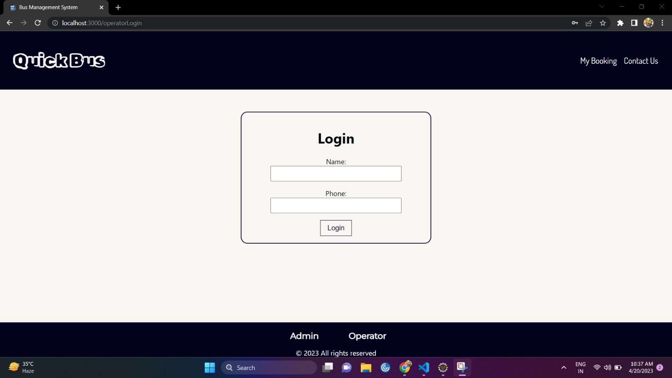
Project Demonstration (Login Page)

Slide 9
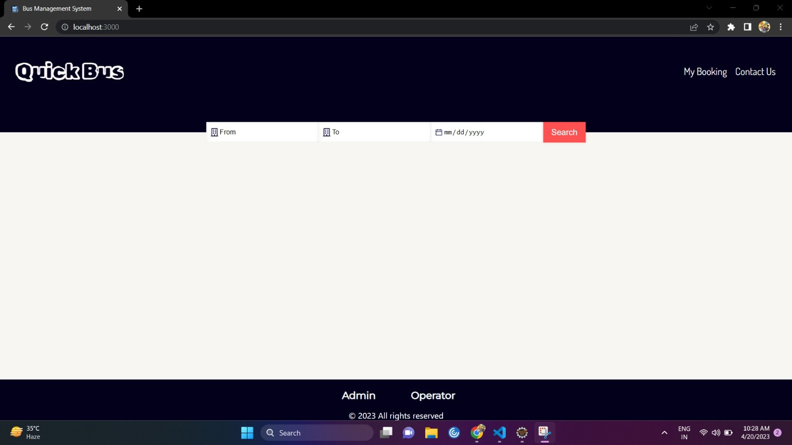
Project Demonstration (Home Page)

Slide 10
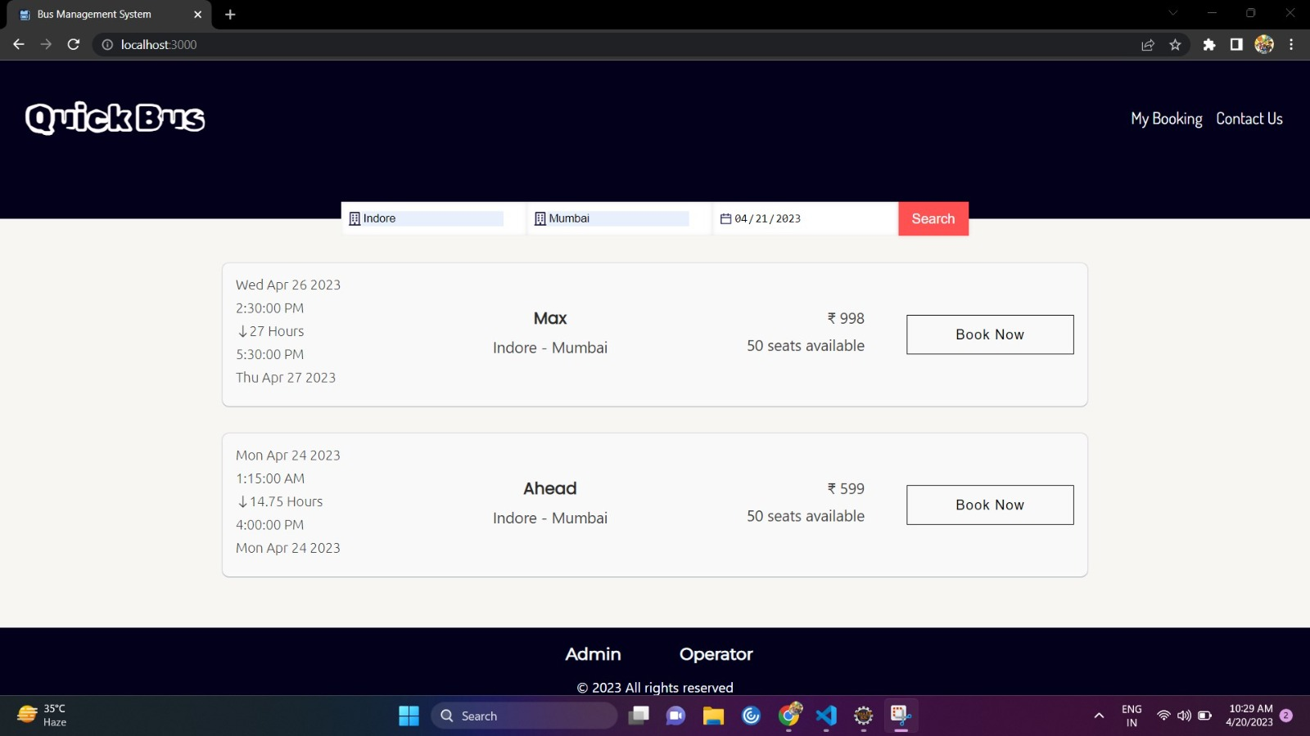
Project Demonstration (View Booking)

Slide 11
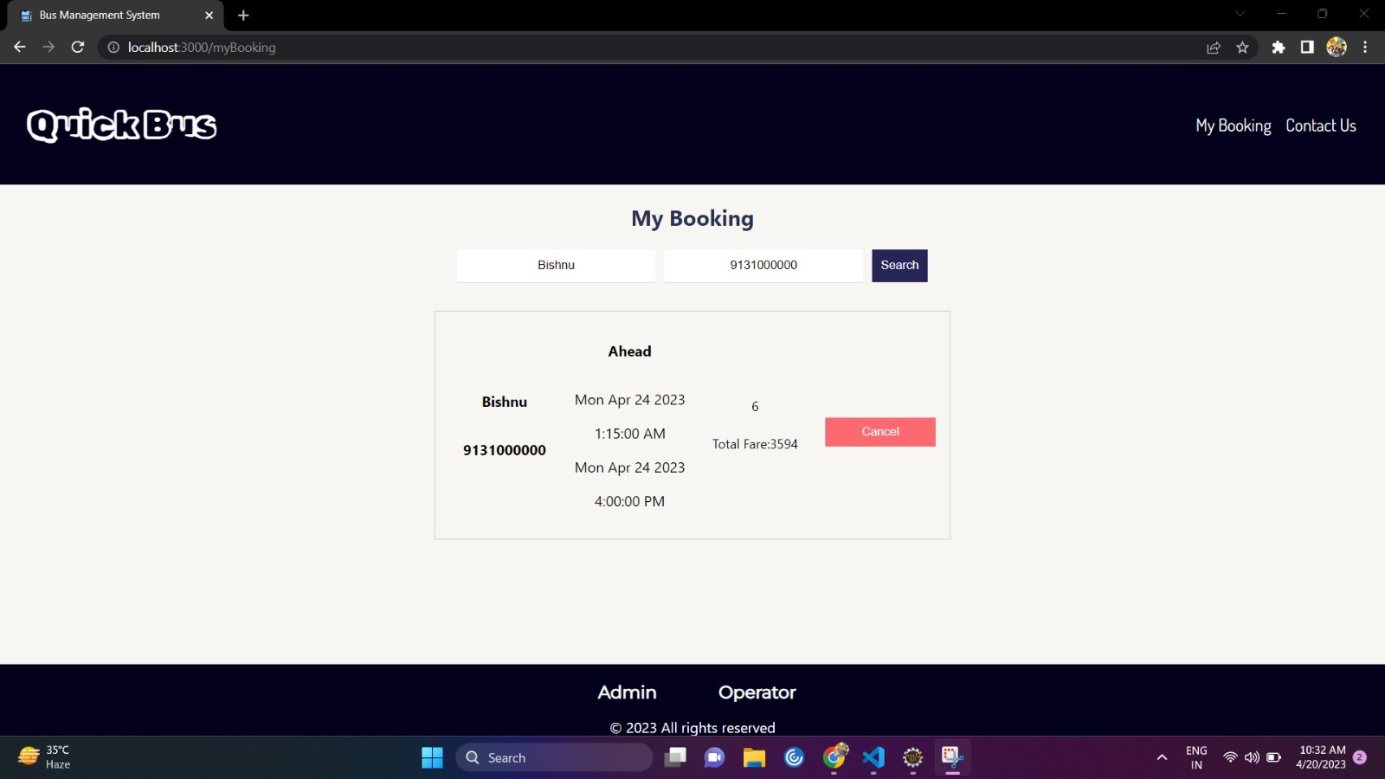
Project Demonstration (My Booking)

Slide 12
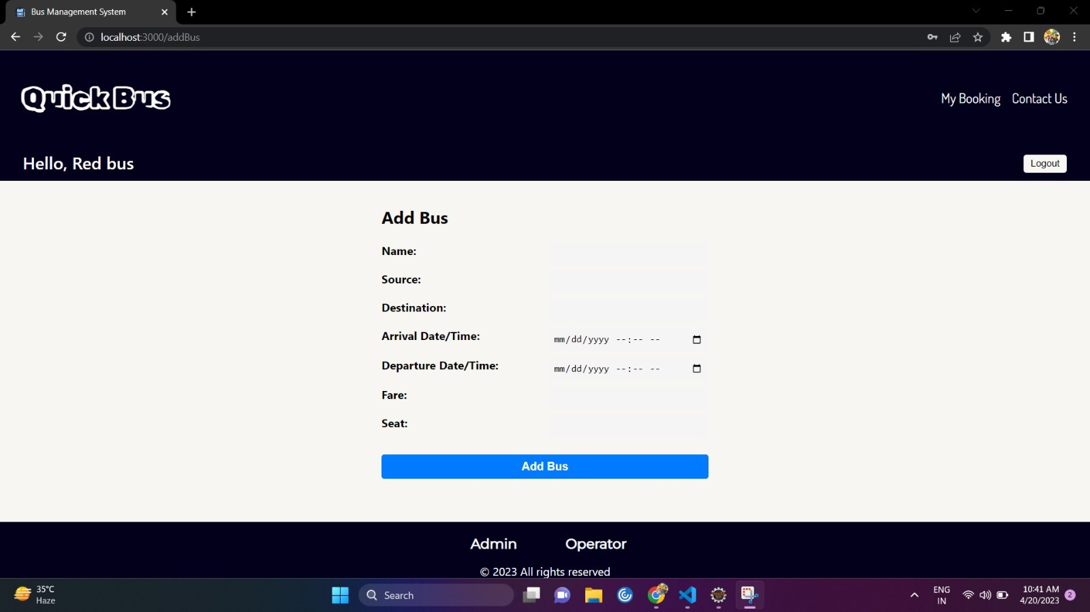
Project Demonstration (Add Bus)

Slide 13
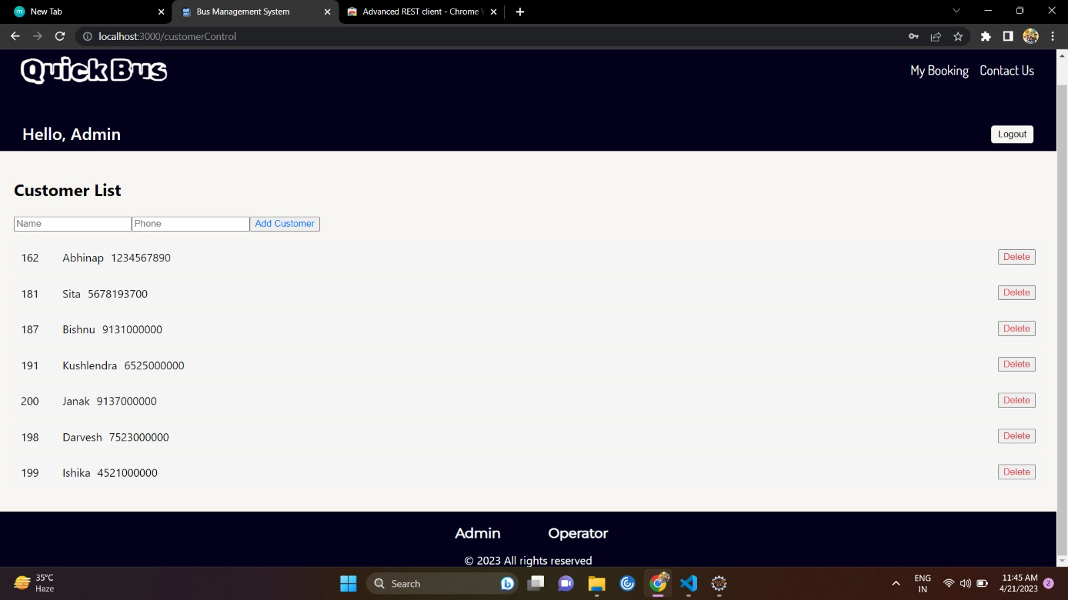
Project Demonstration (Customer List)

Slide 14
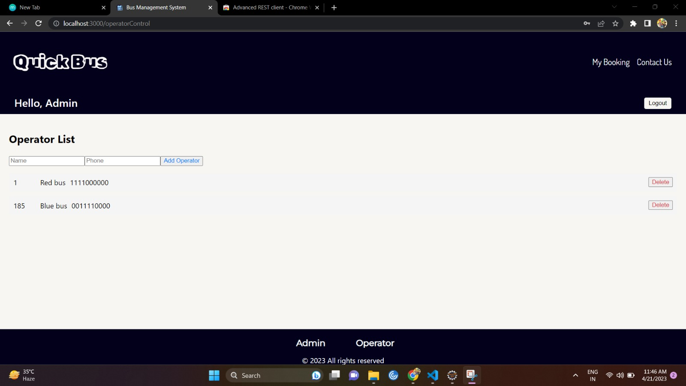
Project Demonstration (Operator List)

Slide 15

Thank You!

