Slide 1

Customer Shopping Behavior — Snapshot
Analysis of 3,900 transactions to uncover patterns, segments, and product insights

Slide 2

Dataset Overview
Size
Key Features
Missing Data
Rows: 3,900 · Columns: 18
Demographics, Purchase details, Behavior, Ratings
37 values missing in Review Rating

Slide 3

Data Prep & Feature Engineering
01
Cleaning
Loaded with pandas; df.info() & .describe()
02
Imputation
Imputed Review Rating with category median
03
Engineered
age_group, purchase_frequency_days
04
Standardized
Renamed columns to snake_case

Slide 4

Database Integration
Cleaned DataFrame loaded into PostgreSQL for SQL analysis
Checks
Use
Verified discount_applied vs promo_code_used → dropped promo_code_used
SQL queries to answer revenue, product, and segment questions

Slide 5
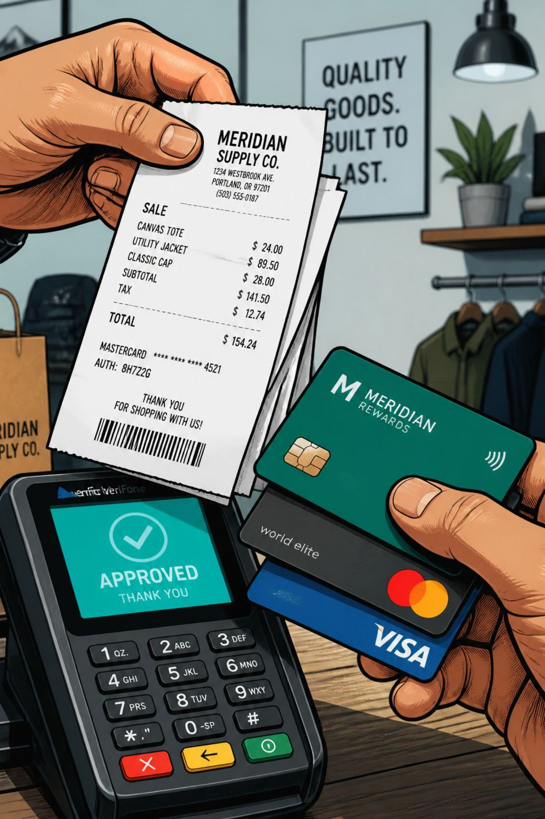



Revenue Highlights (SQL)
By Gender
Female: 75,191 · Male: 157,890
High-Spending Discount Users
839 rows identified — discounts but above-average spend
Shipping
Standard avg: 58.46 · Express avg: 60.48

Slide 6


Top Products & Discount Dependence
Top Rated
Discount-Dependent
Gloves 3.86 · Sandals 3.84 · Boots 3.82 · Hat 3.80 · Skirt 3.78
Hat 50% · Sneakers 49.66% · Coat 49.07% · Sweater 48.17% · Pants 47.37%

Slide 7

Customer Segments
Loyal
3,116 customers
New
83 customers
Returning
701 customers
Repeat buyers (>5 purchases): subscribers — Yes 958 · No 2,518

Slide 8
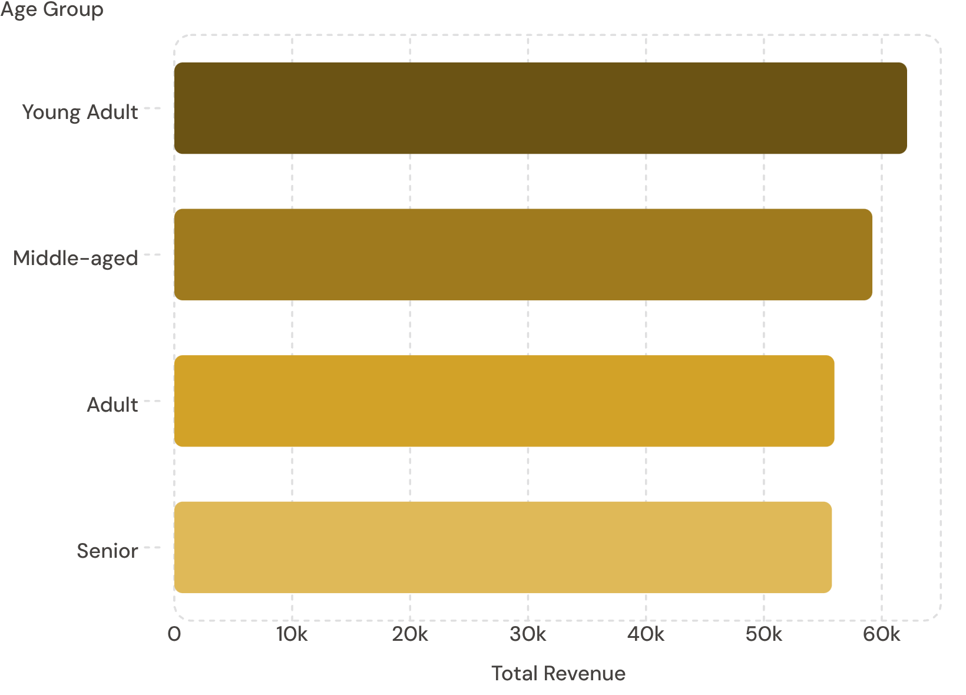

Age Groups & Revenue
Target high-revenue age groups for focused campaigns

Slide 9
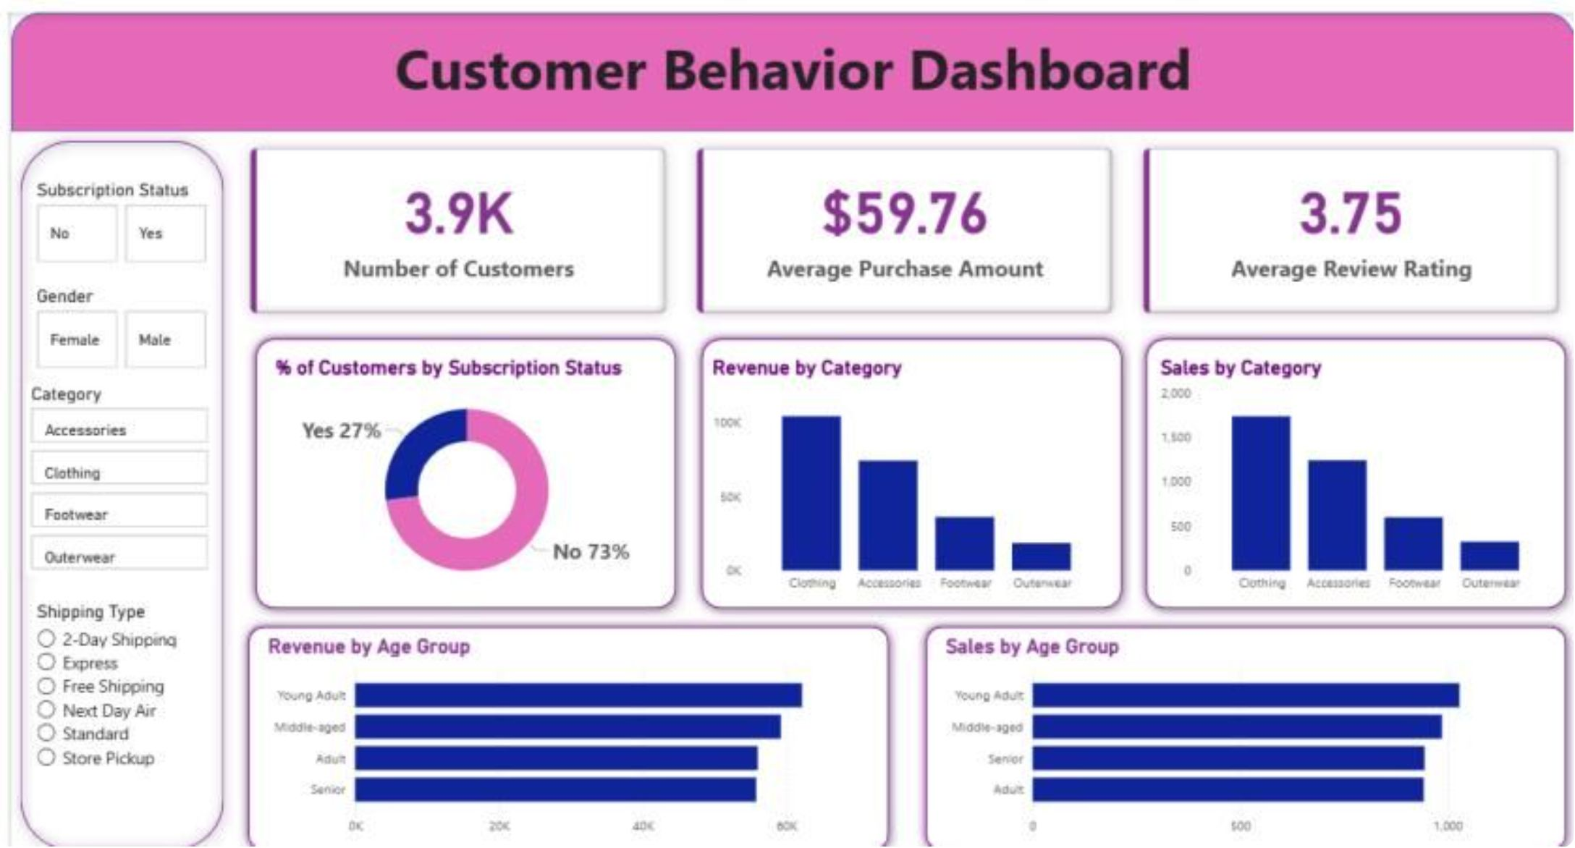
Power BI Dashboard — Key Metrics
Summary Stats
3.9K customers · Avg purchase $59.76 · Avg rating 3.75
Subscription
Yes 27% · No 73%
Top Categories
Clothing (Revenue ~90K, Sales ~1800) · Accessories · Footwear · Outerwear

Slide 10


Recommendations
Boost Subscriptions
Reward Loyalty
Review Discounts
Product Positioning
Programs to move repeat buyers into Loyal segment
Promote exclusive subscriber benefits
Balance discount-driven sales with margin control
Highlight top-rated & best-selling items in campaigns
Targeted Marketing
Focus on high-revenue age groups and express-shipping users

