Slide 1
CS Systems Course Tracker 2021
Ahmed Darwich, Zach Pallota, John Dailey

Slide 2
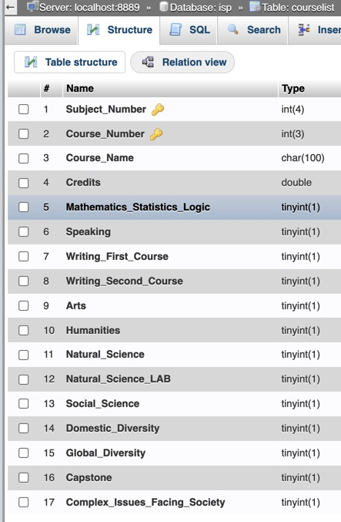
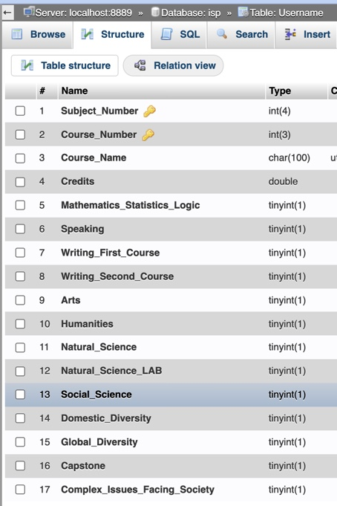
Diagrams of system design
Backend
SQL Table
Primary Keys are Subject_Number and Course Number
Frontend
Starts Empty,
Unique User selects course from CourseList Table
Communicates with backend and sets course in Username Sql Table
Compares User Selected Courses with Degree Requirements for Computer Science Systems Track

Slide 3


Implementations tools
SQL Backend
Creates the two tables for comparison and Data Storage
HTML Webpage
Creates basic setup of web application
PHP/ jquery
Allows for interaction between user and backend
Allows us to select courses from CourseList Table and Store user classes in Username
Allows for unique users
Css/bootstrap/ajax
Allows for simplistic style approach to allow users to quickly understand their academic standing in terms of graduation
Better color scheme consistent with University of Akron’s blue and gold

Slide 4
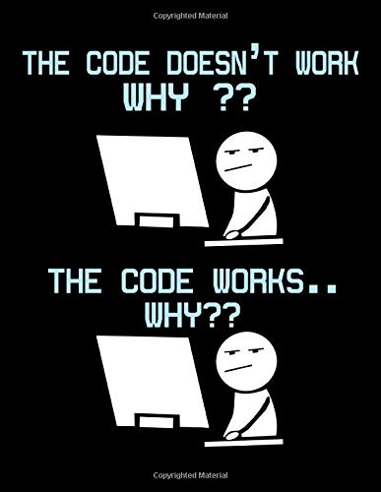
Issues Encountered
Integration within PHP using SQL, HTML, CSS, Ajax, and Bootstrap
Understanding how to incorporate all tools for complete web application
Organization
So many divs and inheritance issues with CSS
Inline blocks
Basic display format of html pages led to difficulty styling

Slide 5

Conclusions
As a team, we learned new aspects of web applications
Learned how to integrate tools to create a complete product that matched our business values
Organizational tools in web applications can be confusing and time consuming
Split between frontend and backend can lead to confusing work and development time loss
Created a simplistic approach to view a students degree progress
Much easier to utilize rather than the degree progress report in my akron

