Slide 1
AWS Fundamentals
NN 13-01-2020
Frank Brink

Slide 2
Agenda
Public Cloud Introduction
AWS Characteristics
AWS Resources Diagram
AWS Services
  S3
  VPC
  EC2
  RDS
Cost Estimation
Summary and Q&A

Slide 3
Give a-ways for this 1-day AWS Primer
How easy and fast to create resources: Public-Cloud Wow effect
AWS Services are rarely alone - they are highly dependent
AWS console as your single (and visual) point of control
  It visualizes all resources - no matter how created
  The basis of your billing – all billing items should be found
Introduction of a resource diagram with draw.io to visualize the dependencies between resources

Slide 4
Cloud Terminology and Context
Cloud deployment models
  Private Cloud
  Public Cloud
  Hybrid Cloud
  Amazon Web Services (AWS) emphasizes on Public Cloud
  Public cloud fundamentals will be discussed later
Public Cloud Categories
  Saas (Software as a Service), e.g. HRM
  Paas (Platform as a Service), e.g. Database, Middleware
  Iaas (Infrastructure as a Service) e.g. compute, storage, network
  Amazon Web Services (AWS) delivers cloud services in all above categories.
  AWS promotes the delivery of Saas services by Partners through AWS marketplace

Slide 5

Public Cloud fundamentals
Self Service and Easy Access
Pay per Use/Utility
Immediate availability
Global availability through regions/zones
  Enabling anywhere, anything, anytime experience
Elastic & Scalable
Virtualization and automation
Support of standard protocols (HTTP, REST, SOAP, Docker, K8s,…)
Resource pooling through multi-tenant architectures
The User Experience changes much more rapidly
Cost Estimators
Economy of scale
  Competitive compute & storage pricing
  Wide variety of services
  Wide variety of capabilities within services (e.g. Security)
GUI, API and Command line interfaces to manage cloud services

Slide 6
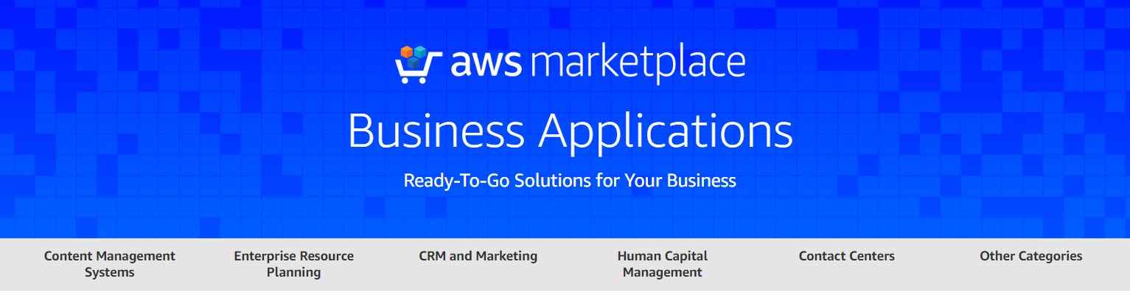
AWS Characteristics
Part of Amazon inc.
AWS contributes 13% of total Amazon revenue (Apr. 2019)
Public Cloud provider since 2002
Wide range of cloud services (Paas&Iaas)
  > 25 Categories
    Compute, Storage, Database, IoT, Containers, …
  > 165 Services (April 2019)
    EC2, S3, RDS, CloudWatch, EKS
Saas offering for a large part through AWS marketplace
Support of wide range OpenSource technologies
  Docker, k8s, Javascript, java, python, …
D&R capabilities through Regions and Availability zones
UI and/or API (CLI, REST, SOAP)
Notes:
Marketleader of Public Cloud Services (30%) check

Slide 7
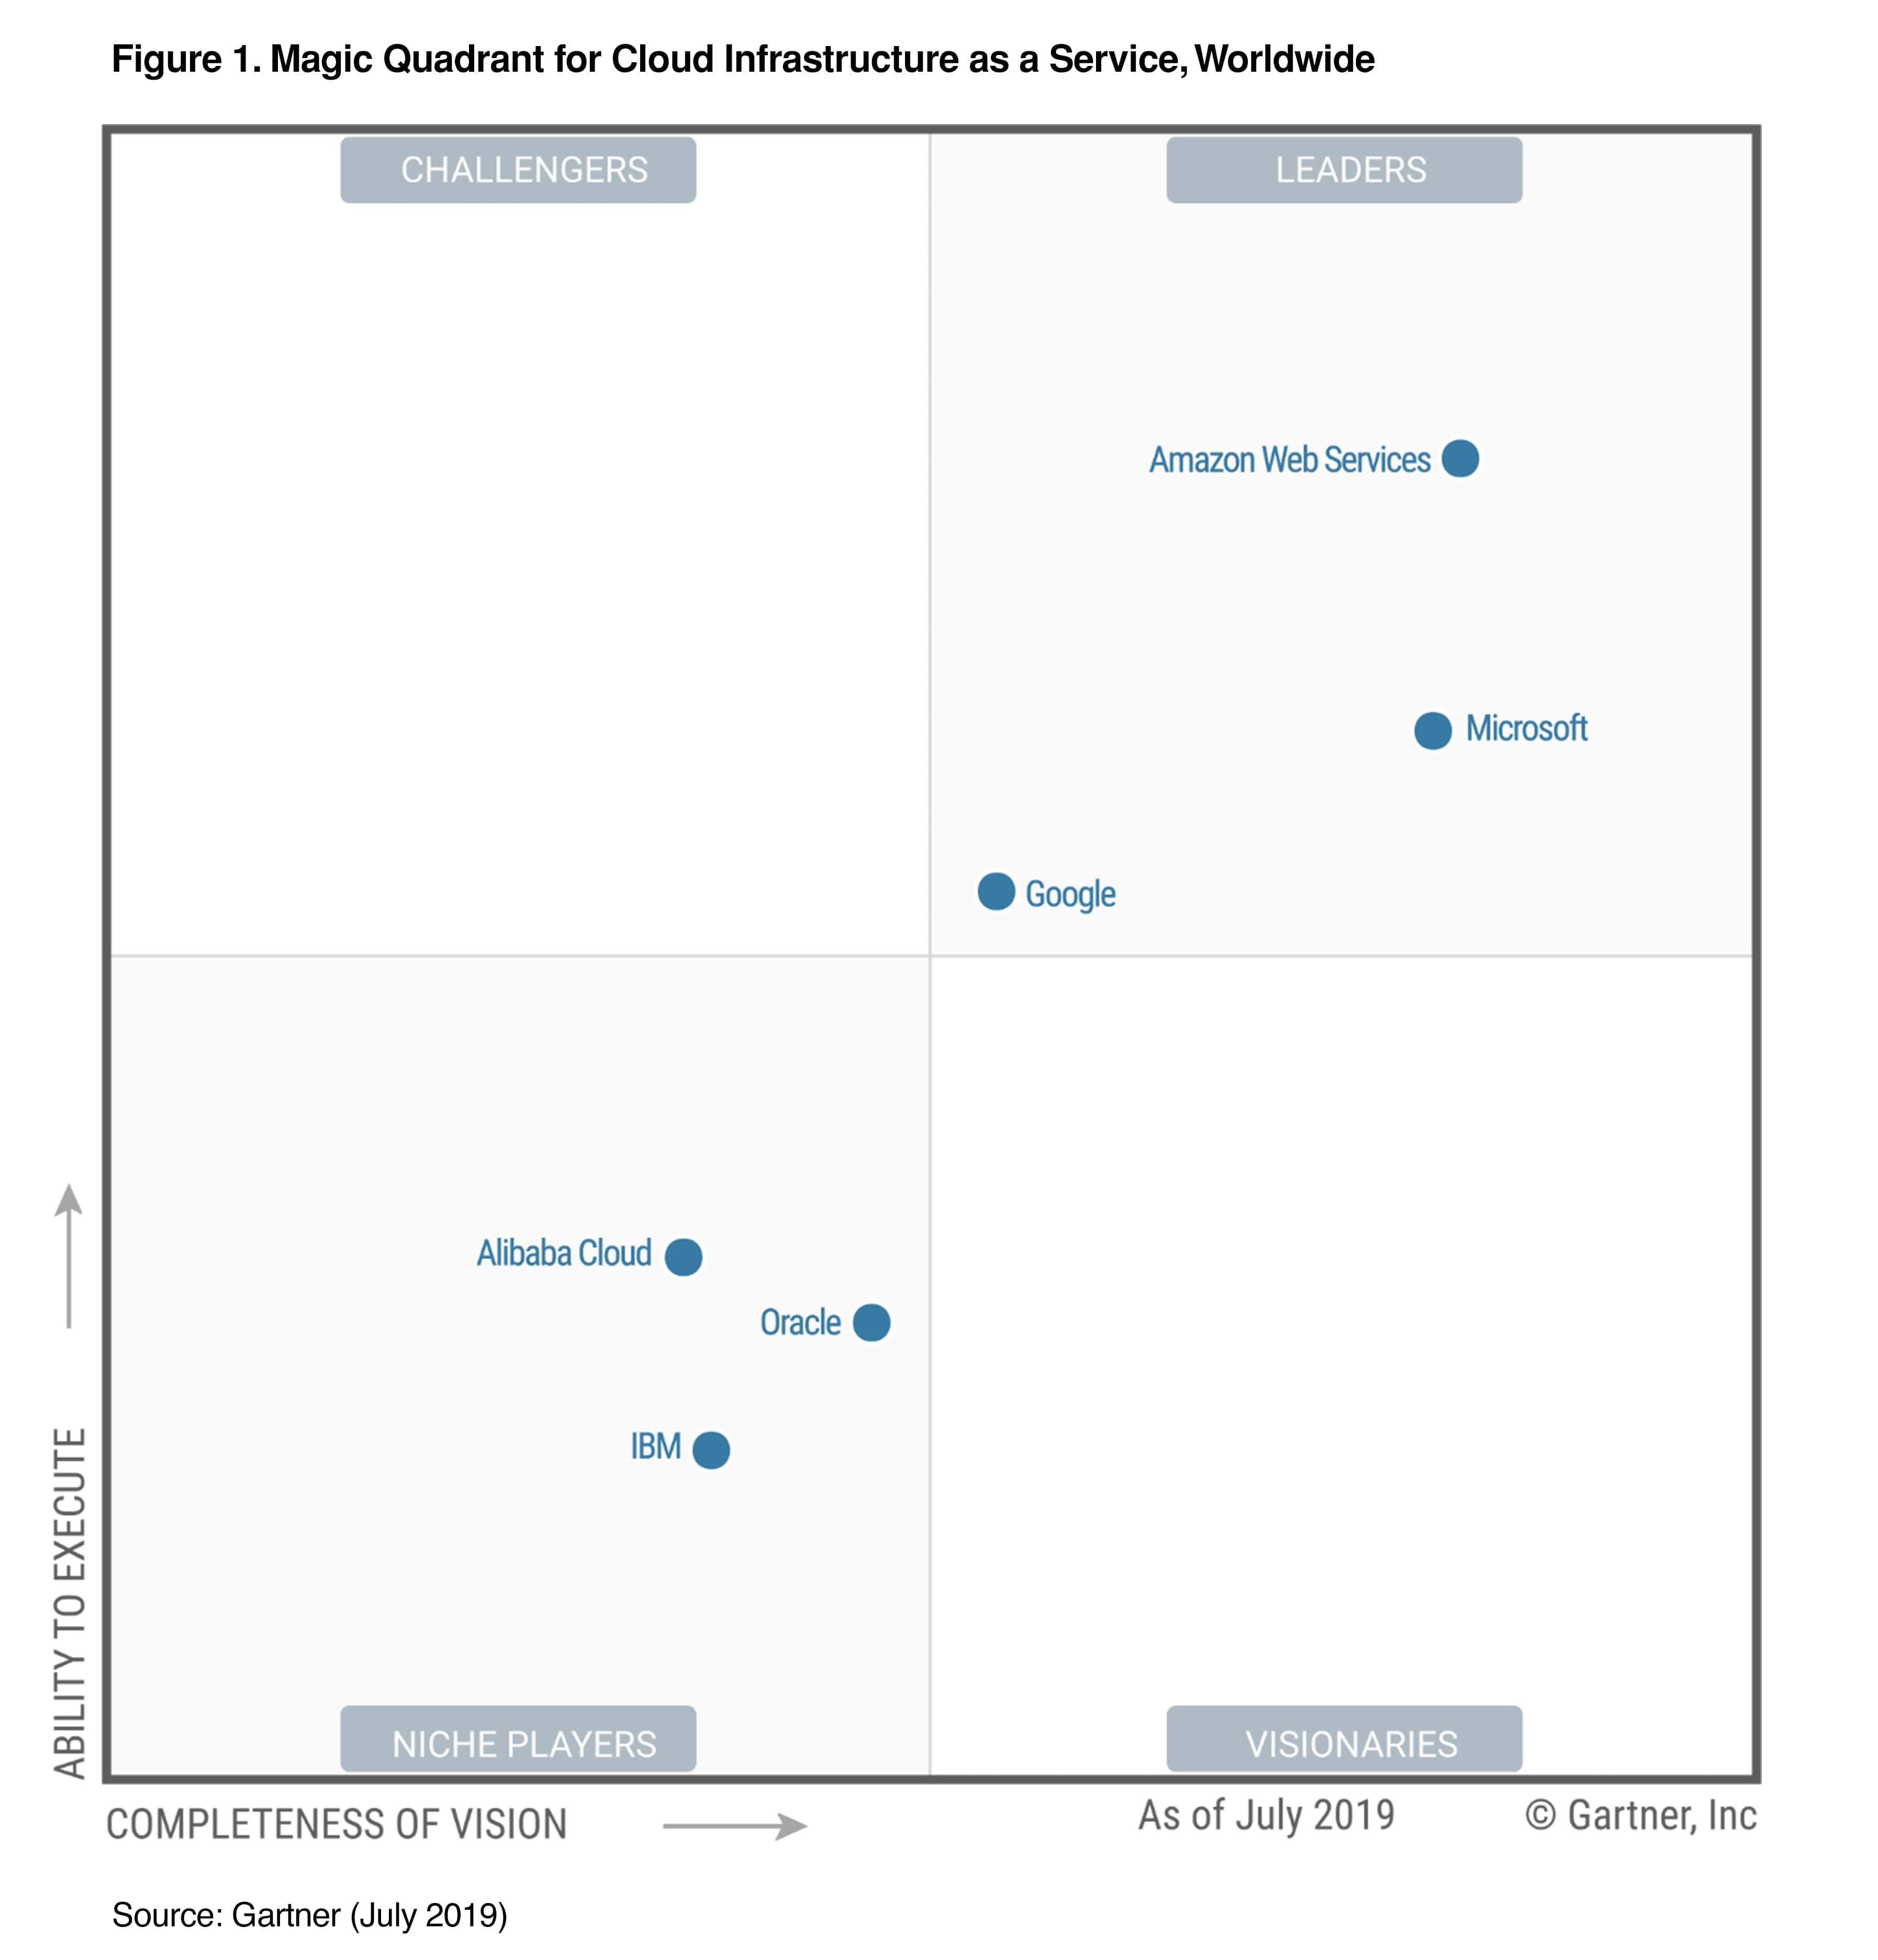
AWS Marketshare (Iaas perspective)
Notes:
Marketleader of Public Cloud Services (30%) check

Slide 8
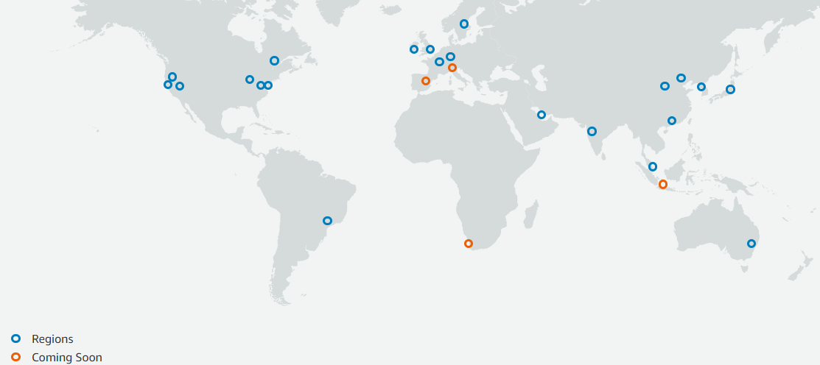
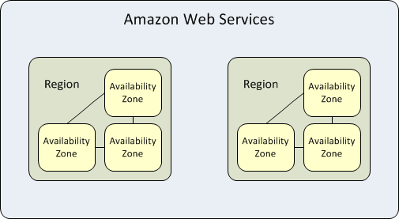
Regions & Availability Zones (AZ)
Global
  Accounts
  IAM artifacts (users, groups, roles)
Regions (>20)
  E.g. Ireland, Frankfurt
    eu-west-1, eu-central-1
  Placeholder of AWS services
  S3 Storage (mirrored across AZ’s)
  Not all services available in each region
AZ’s (as in Datacenter(s)) >60
  E.g. eu-west-1a, eu-west-1b,
  eu-west-1c
  Location of AWS service instances
Foundation for
  Resilience (elasticity)
  HA and D&R architecture

Slide 9
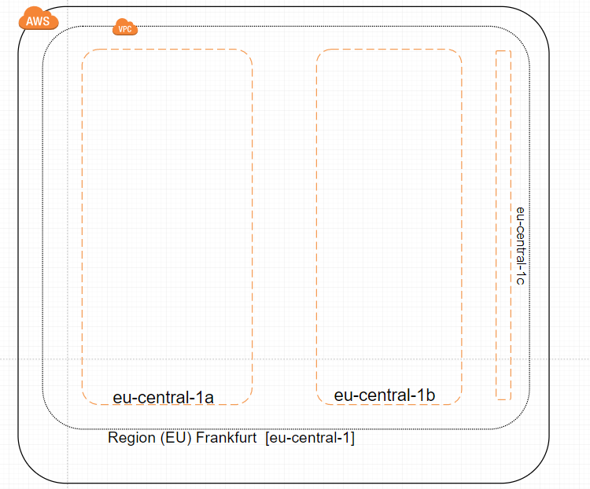
Regions & Availability Zones (AZ): Frankfurt

Slide 10
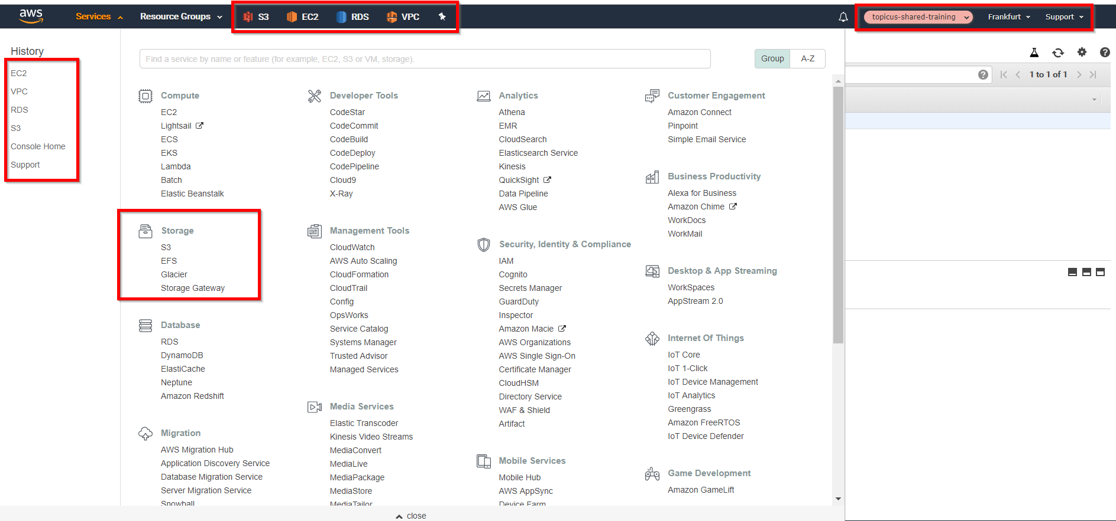
Demo: AWS Console: Services
Account
Region
Support
Center
“Pinned” AWS services

Slide 11
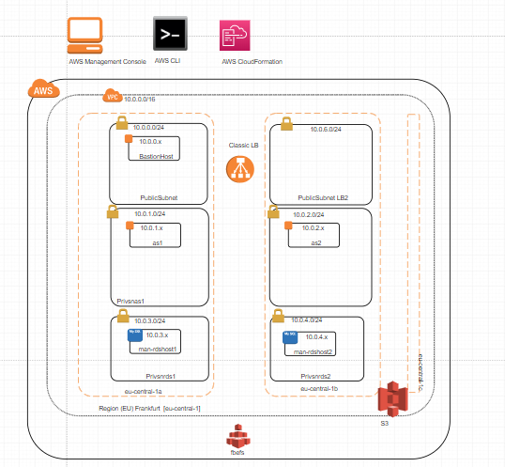
AWS Management Console
GUI to create/update/delete primary and secondary AWS services
  Primary: e.g. Compute, VPC
  Secondary: e.g. Subnet(s)
Define relationships between primary and secondary services
Service instances are created within a region (e.g. S3, VPC)
or within and AZ (e.g. compute instance)
Requires fine-grained access rights via groups/roles and eventually policies

Slide 12
Practice 2 Exploring AWS

Slide 13
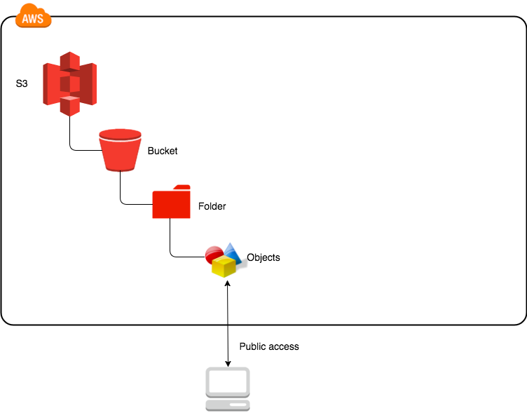
AWS S3 (storage)
S3 Basics
  S3=Simple Storage Service
  High durability
  through zone
  replication
  Storing objects within buckets
  S3 Namespace
    Buckets (unique name across users)
    Keys (each objects has an unique key)
https://kpndemo24102019.s3.eu-central-1.amazonaws.com/KPNdemo.txt
|Bucketname |AZ |AWS |folder/file

Slide 14
AWS S3 (storage) – cont’d
Other S3 capabilities
  Encryption
  Server Side Logging
  Versioning
  Object Lifecycle Management
  Pubic/private
Storage S3 Classes
  S3 Standard
  Infrequent Access Storage
  Amazon S3 Select
  One Zone-Infrequent Access
  Amazon Glacier
S3 Pricing determined by
  Storage itself per class – see above
  Class storage differs per region
  Request pricing buckets/objects
  Data Transfer Pricing (outgoing)

Slide 15
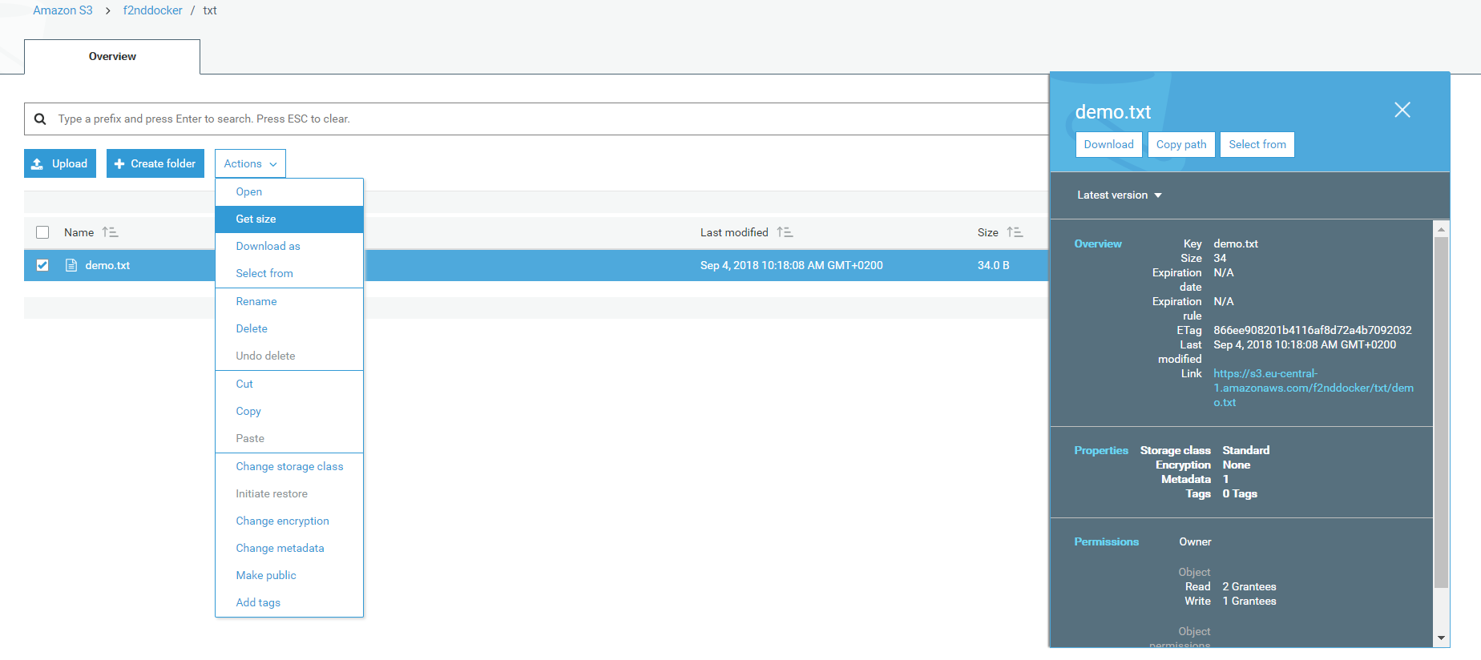
Demo: AWS S3

Slide 16
Practice 3 S3

Slide 17
Regions & Availability Zones (AZ)

Slide 18
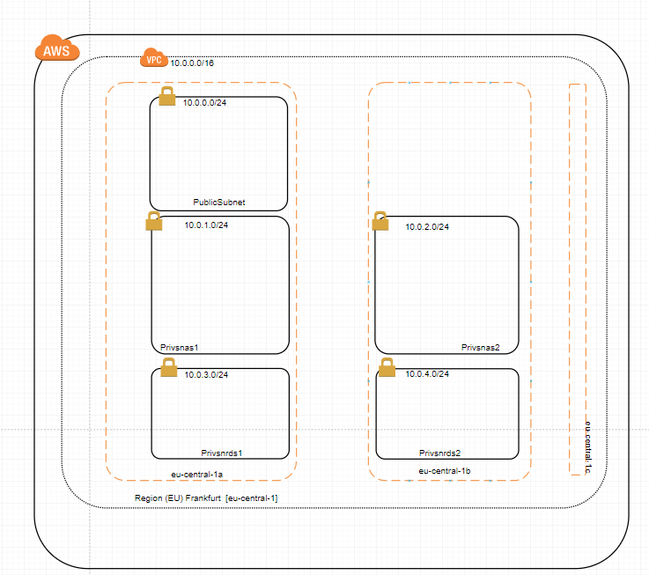
Production Network Topology
AWS VPC Fundament
AWS
  Region(s)
    VPC (within a Region)
      CIDR: 10.0.0.0/16
      Zones
        Public Subnet
          CIDR: 10.0.0.0/24
        Private Subnet
          CIDR: 10.0.1.0/24
          CIDR: 10.0.2.0/24
          CIDR: 10.0.3.0/24
          CIDR: 10.0.4.0/24

Slide 19
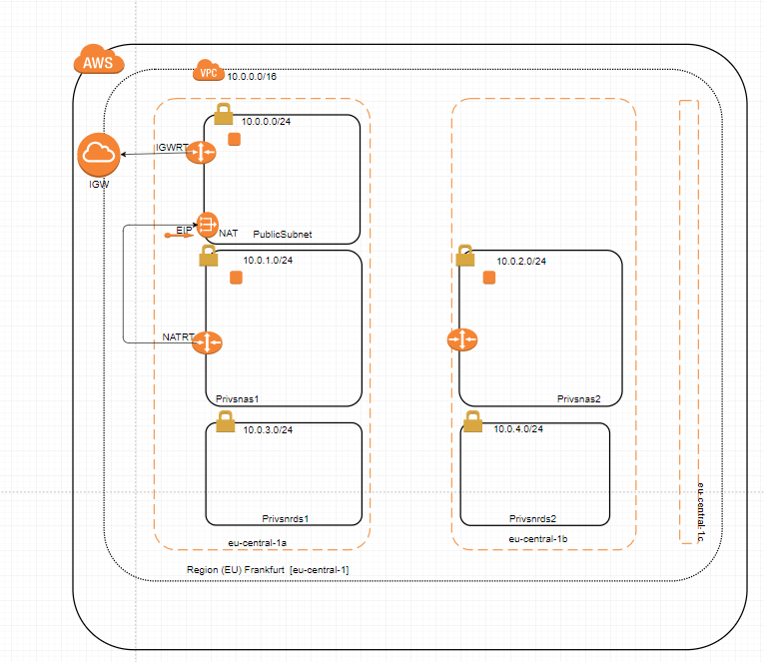
Production Network Topology
AWS VPC IGW & NAT
IGW: Internet Gateway
  Only one per VPC
  Referenced
  in a Route table
  Route table is associated
  with a Public Subnet
  Allows outgoing/incoming internet traffic
NAT: Network Access Table
    Associated with a Public Subnet
    Referenced in a Route table
    Route table is associated
    with a Private Subnet
    Allows outgoing internet traffic

Slide 20
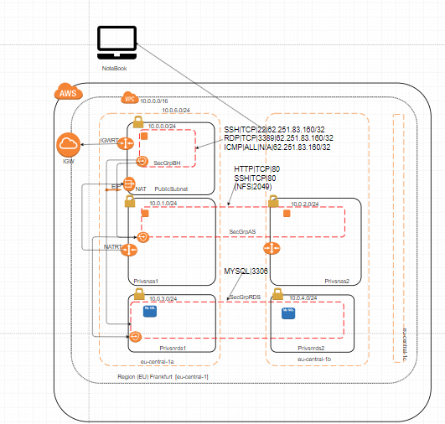
Production Network Topology
AWS VPC building blocks
VPC
  Security Groups
    Inbound/outbound
    rules
    To be associated with
    instances
  Availability Zones
    Public/Private Subnet
      Route tables
        IGW usage
        NAT usage
      Compute Instances

Slide 21
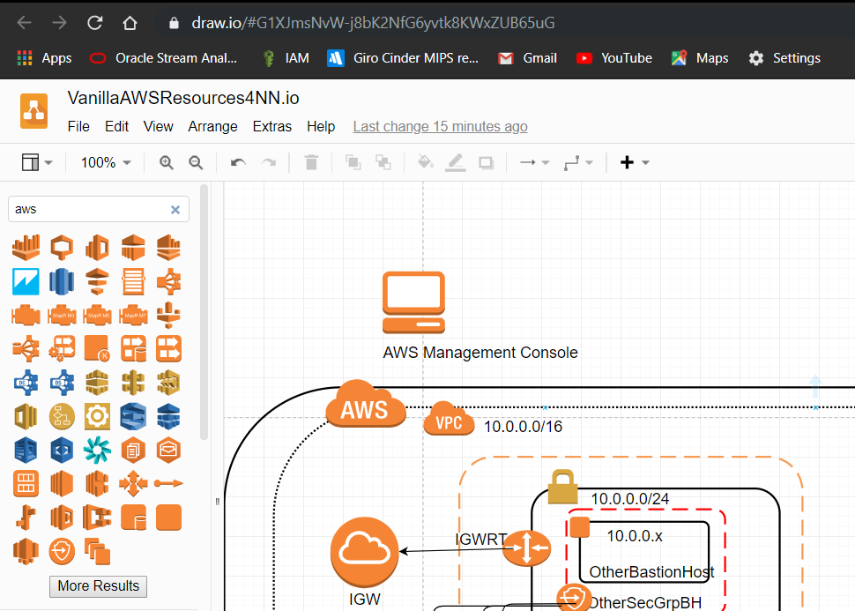
Draw.io
“Visio” in a browser – also available as a Windows client
Latest version 12.3.9
Powered by JGraph
Requires a Google Account (Browser version)
Huge library of AWS icons (but also Azure, GCP)
Widely used to visualize the dependencies between AWS resources
AFAIK no reversed engineering tool that creates a AWS resources design/visualization

Slide 22
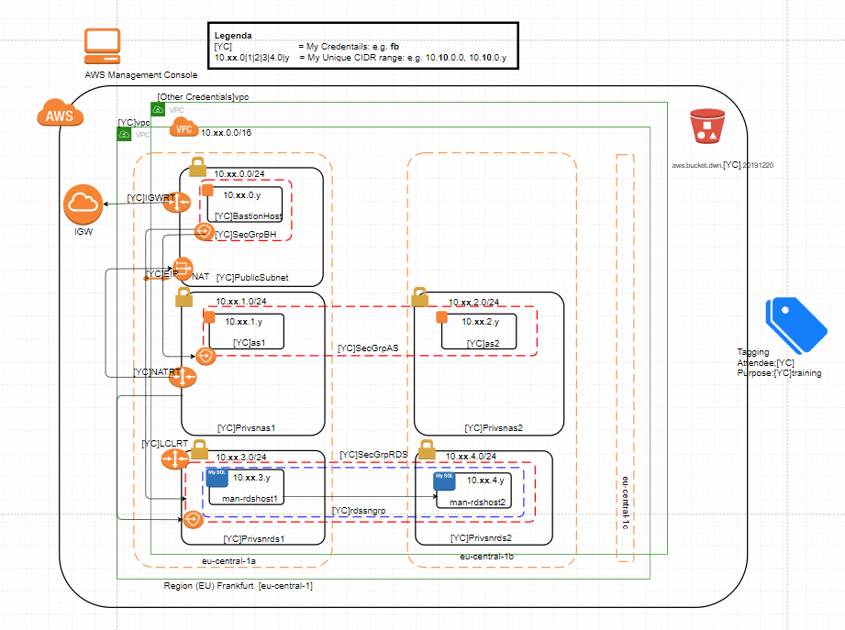
Practice 4 AWS Resources Diagram

Slide 23
Practice 5 VPC

Slide 24
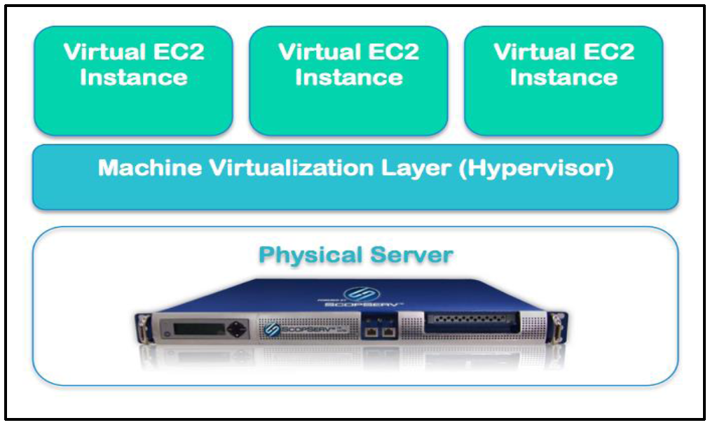
EC2
Basic Architecture of EC2 (Elastic Compute Generation 2)
  Huge farm of virtual servers hosted in wide variety of DC’s
  Client can request a (virtual) compute instance via webservice with variable
    RAM Size
    CPU
    OS Flavor (e.g. Linux, Windows, Solaris)
Virtualization as underlying technology
  Reduce hardware costs
  Simplification of IT operations
  (much) faster provisioning
  Provides more flexibility
  Lower costs
  Enhanced security

Slide 25
EC2 – cont’d
EC2 Instance types (or shapes)
  Standard
  Micro ( to support microservices)
  High CPU versus High Memory
  Cluster Compute (High Performance network-bound applications)
  Cluster GPU (same as Cluster Compute plus high rendering power)
Amazon Machine Image (AMI)
  Virtual Machine with a given OS and many applications
    Oracle Database on Oracle Linux
    Apache Server on Ubuntu
  Public versus private AMI’s
  AWS (hardened/managed) AMI images (minimize security leaks)
  Similar to pre-build appliances build with Virtual Boxes but tied to AWS
  Becoming less popular by the popularity of Docker?
Notes:
SSH=Secure Shell

Slide 26
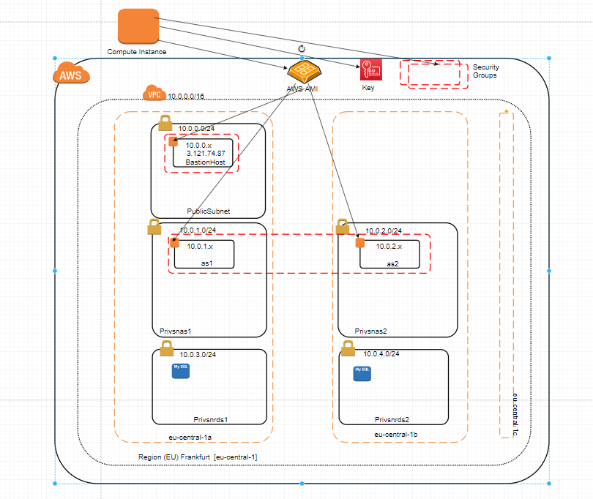
AWS Compute Instances
Based on a AMI
(Amazon Machine Image)
Choose shape
(CPU, memory, Diskspace)
OS (e.g. Linux, Windows)
Must be created within a (private/public) subnet
Requires a public/private key
Must be associated with a
security group
Receives its private IP from the associated subnet (CIDR)
Can receive a public IP

Slide 27
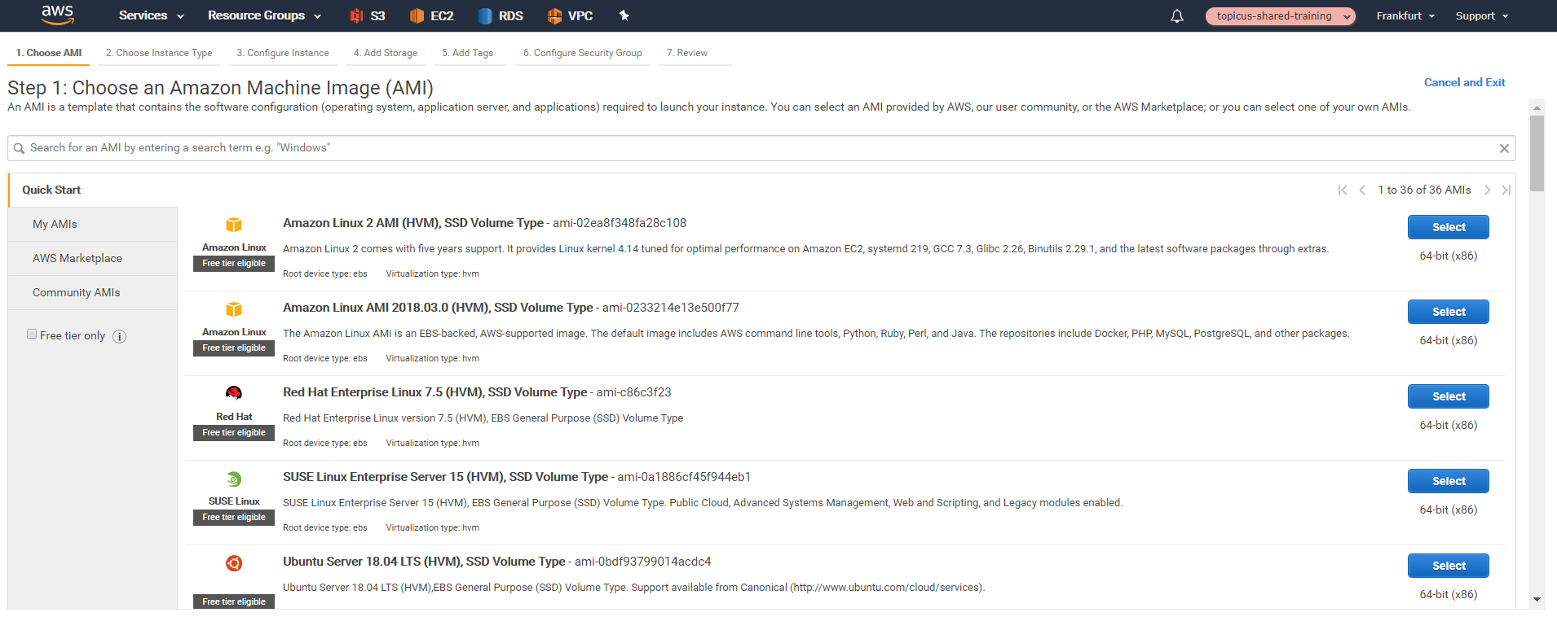
Demo: AWS EC2

Slide 28
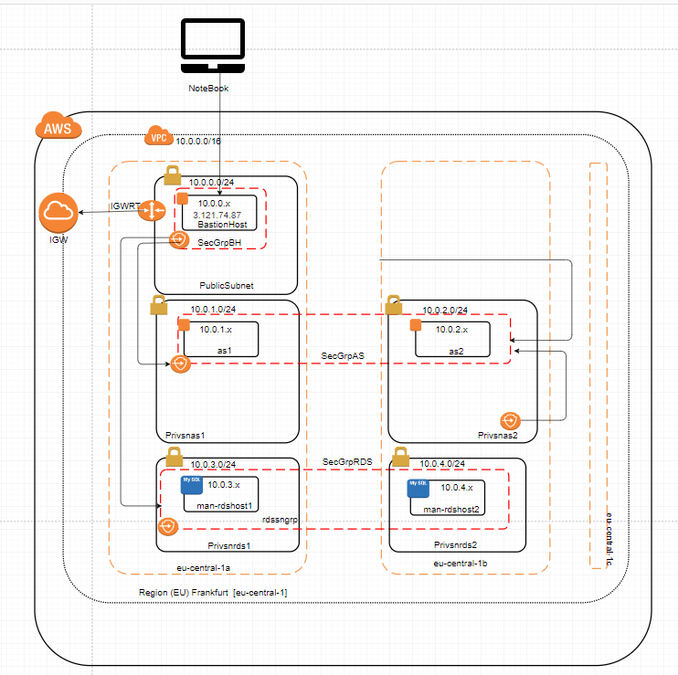
Production Network Topology
AWS VPC Bastion/Jump Host
Must be created within Public
Subnet
Bastion host requires a Public IP
Choose your favorite OS
Usage of Windows tooling via
tunneling
Inbound/outbound internet
through the IGW association
AS access (SSH) via
AS security group
Mysql access via
RDS security group

Slide 29
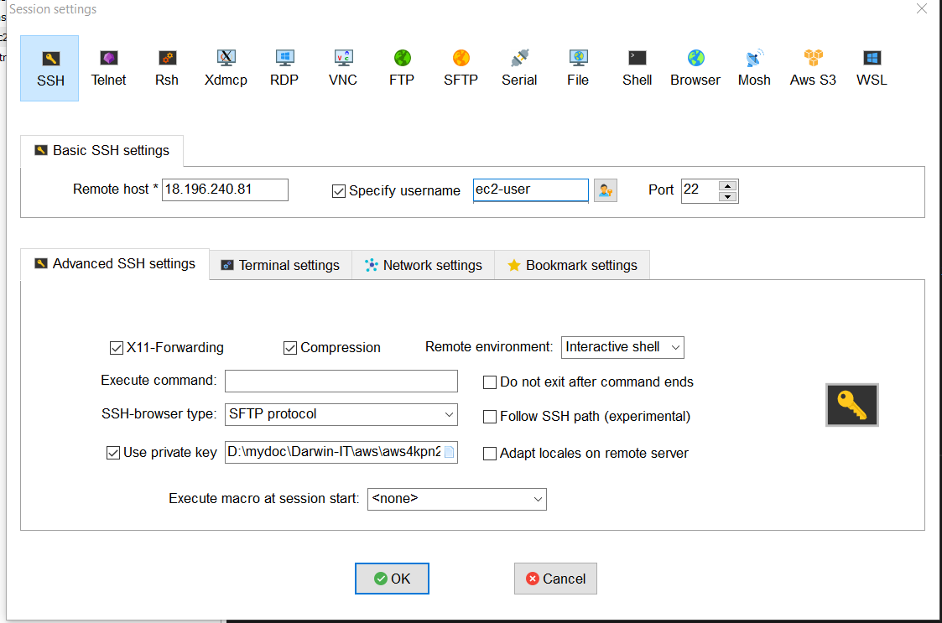
Production Network Topology
Access bastionhost via SSH (or RDS)
Start Bastionhost Instance
SSH connection
  Get Public IP address
  Get OS user (ec2-user)
  The private key
  Connect to the bastion host instance

Slide 30
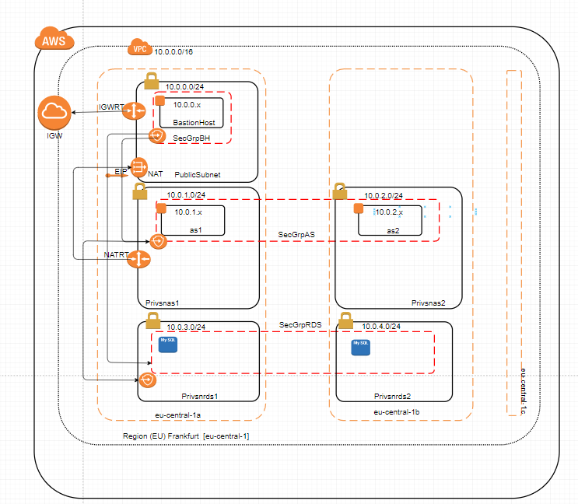
Production Network Topology
AWS VPC Application Servers
Should be created within a
Private Subnet
Private IP addressing determined
via subnet (CIDR)
Maintenance access (SSH)
through Bastion Host
Inbound internet access
prohibited
(eventually via LB on port 80)
Outbound internet access through NAT (e.g. OS updates)
Above access rights are setup via security groups
Multiple Application Servers
for HA purposes in multiple zones

Slide 31
Practice 6a EC2: BastionHost

Slide 32
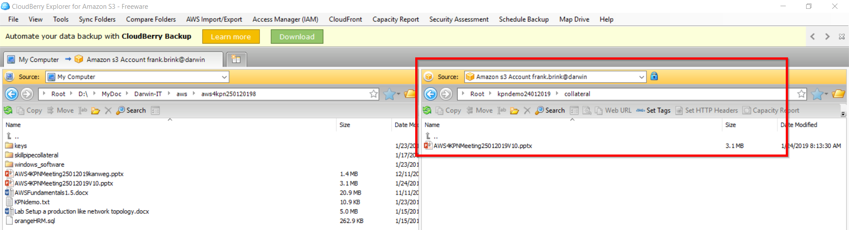
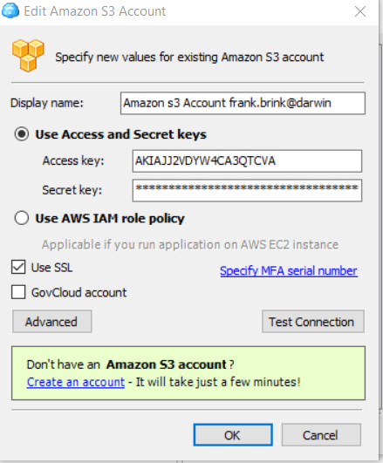
Demo: AWS S3 CloudBerry

Slide 33
Practice 6a EC2: BastionHost

Slide 34
Practice 6b EC2: Application Server

Slide 35
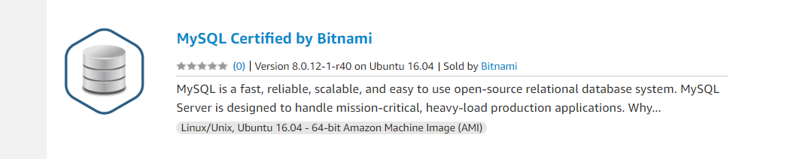
RDS Consumption Models
On EC2 instance
  Create VM; upload, install & config and manage DB: DIY
  Pricing: BYOL
Amazon Machine Image (AMI)
  Build RDS AMI yourself or re-use community AMI
  Pricing: BYOL
RDS Managed
  DB Build and fully managed by AWS
  Pricing: BYOL or licensed
Docker
  Leverage an existing docker image or build RDS via docker build scripts
  Manage Docker instance: DIY
  Pricing: BYOL
Market Place
  Build and managed by 3rd party
  Pricing: Licensed
Notes:
SSH=Secure Shell

Slide 36
RDS Services
Amazon RDS Capabilities (as in Paas)
  Easy/fast to setup
  Patching, Backup and Recovery
  API’s for scaling storage and compute resources
  Amazon Aurora, MySQL, Oracle, PostgreSQL, Microsoft SQL, and Maria DB server databases
  Pay per use model, with no upfront cost
  DB replicas across AZ’s
  OOTB Monitoring
Notes:
A

Slide 37
RDS Characteristics
RDS Access
  = an EC2 instance
  Access via database endpoints
License models
  License included
  BYOL
HA/DR
  Through Multi-AZ deployment
  Standby Replica (R/W versus Read)
Backup
  Snapshots (user triggered and/or automated)
  Regular scheduled backups
Pricing models
  Reserved Instances (Monthly Fee) -> Prod
  On-Demand instances (PAYG) -> Dev/Tst
Notes:
A

Slide 38
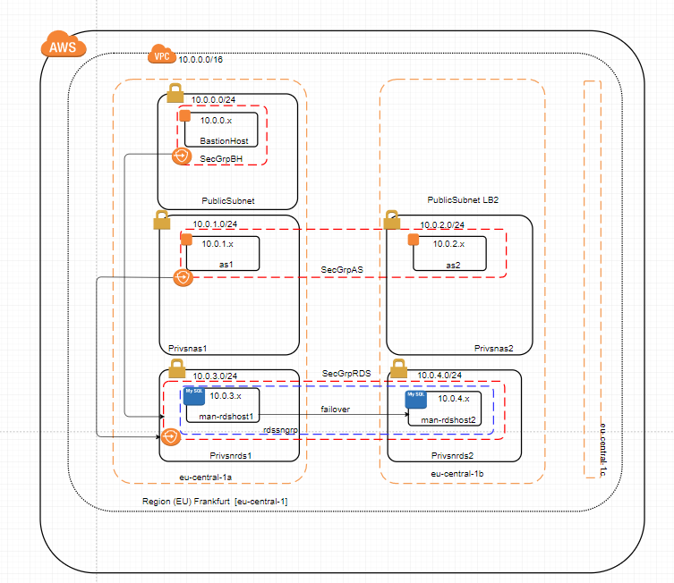
Production Network Topology
AWS VPC RDS (Databases)
Should be created within (another)
Private Subnet
Private IP addressing determined
via subnet (CIDR)
Maintenance access (MySQL port)
through Bastion Host
Inbound internet access
prohibited
(Only accessible via AS on runtime)
Outbound internet access
not necessary: Managed RDS
Above access rights are setup
via security groups
Multiple RDSs’ for HA purposes
(failover) in multiple zones grouped in
a subnet network group
Notes:
Challenge: how to maintain/reach AS and RDS instances through the internet

Slide 39
Practice 7 RDS

Slide 40
AWS Cost Estimators
Multiple Cost Estimators
  https://calculator.s3.amazonaws.com/index.html (V1)
  https://calculator.aws/#/ (v2, wizard like)
Difference in output of the V1 and V2 (wizard like) cost estimators
Only in USD
Prices varies per region! Choose region
Align your actual (to be) used instance types with the instance types in the cost estimator
No warning if you forget specific costs
Improve your estimates by aligning your monthly billing with the Cost Estimator
Not all services (sub-components) may be available within Cost Estimator
No linkage with existing services
  you are not logged-in during your cost estimation
Save your estimates and/or export to csv file
Notes:
Momentum
-------------
Users
Wide variety of devices requires a wide variety of underlying technologies
Application layer
Global apps require global coverage -> Cross region datacenters
Low-Level Software resources
Mismatch between license costs & actual usage
Low-Level Hardware resources
Lack of flexibility often results in overcapacity
Physical layer
CaPex within infrastructure upfront
To summarize
(New) initiatives (i.e. digital transformation) are (too) time consuming and (too) expensive on an on-premises platform
Public Cloud Characteristics
-------------------------------
Self Service and Easy Access
Pay per Use/Utility
Immediate availability
Global availability on any device (anywhere, anything) anytime
Elastic & Scalable
Virtualization and automation
Support of standard protocols (HTTP, REST, SOAP)
Resource pooling through multi-tenant architectures
Economy of scale
Competitive compute & storage pricing
Wide variety of services
Wide variety of capabilities within services (e.g. Security)

Slide 41
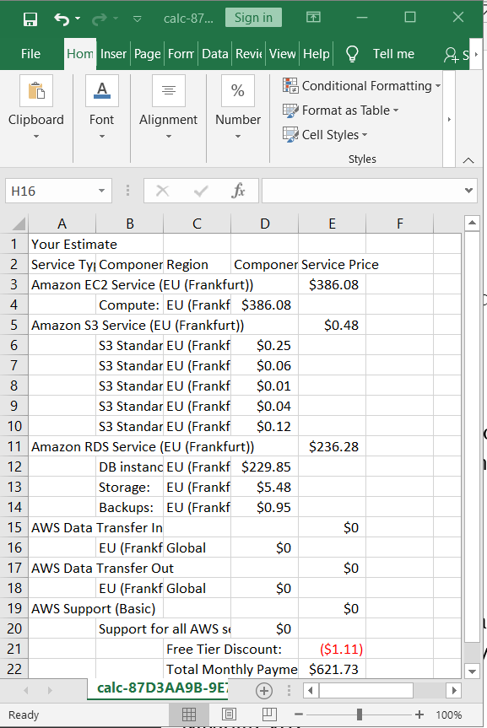
Practice 8 Cost Estimators
Choose your (Favorite) Cost Estimator
  V1, Section 8.1
  https://calculator.s3.amazonaws.com/index.html
  V2, Section 8.2
  https://calculator.aws/#/

Slide 42
Summary and Evaluation
Easiness/fastness of spinning AWS resources: Wow?
Dependency between AWS Services
Added-value using draw.io upfront?
AWS Console: pleasant user experience?
Predictability of costs using the cost estimators?
Notes:
Momentum
-------------
Users
Wide variety of devices requires a wide variety of underlying technologies
Application layer
Global apps require global coverage -> Cross region datacenters
Low-Level Software resources
Mismatch between license costs & actual usage
Low-Level Hardware resources
Lack of flexibility often results in overcapacity
Physical layer
CaPex within infrastructure upfront
To summarize
(New) initiatives (i.e. digital transformation) are (too) time consuming and (too) expensive on an on-premises platform
Public Cloud Characteristics
-------------------------------
Self Service and Easy Access
Pay per Use/Utility
Immediate availability
Global availability on any device (anywhere, anything) anytime
Elastic & Scalable
Virtualization and automation
Support of standard protocols (HTTP, REST, SOAP)
Resource pooling through multi-tenant architectures
Economy of scale
Competitive compute & storage pricing
Wide variety of services
Wide variety of capabilities within services (e.g. Security)

Slide 43

Q&A
…

Slide 44
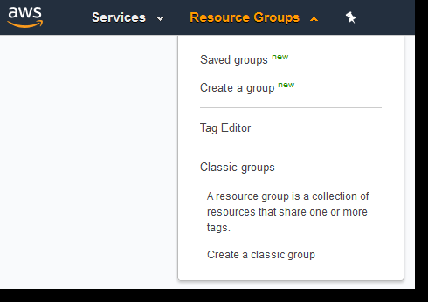
Tagging & Resource groups
Resource Groups
  A collection of AWS resources that are all in the same AWS region, that match criteria provided in a query, and that share one or more tags or portions of tags
Tags
  Keys that help identify and sort your resources within your organization
To visualize your resources (compute, storage) in the AWS console
Examples
  a DTAP classification
  Projects
  Departments
  Platforms (e.g. Windows, Linux)

Slide 45
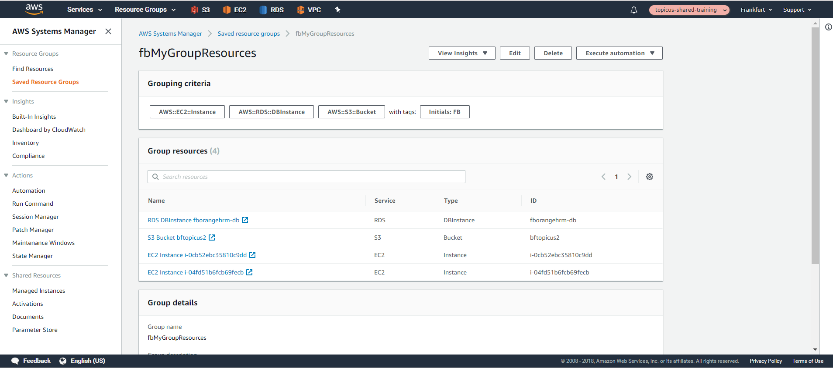
Demo: Resource Groups

