Slide 1
Virtualization
Martien van den Akker
Frank Brink
March 2018

Slide 2
Agenda
1
Introduction
Virtualization types
Docker versus (traditional) Virtualization
Vagrant
Docker
Hands-on practices
Findings
2
3
4
5
6
7
Notes:
2

Slide 3
History of Deployments
Deployments as in installation/configuration of software
OS - infrastructure
Database, Middleware – Platforms – binaries and instances
Custom applications – Java, Apex, Webservices, …
Before 1995
Install/configure OS on bare metal: Unix, Linux, AIX, Windows
(silent) installs of platform software
Interactive deployment of custom applications
Characteristics: fixed resource allocation per bare metal/OS (memory, cpu, storage)
1995-2015
Virtualization of OS (VMWare, Image: persistence of container: container: an instance of an image
Scripting installs and configuration of platform software (e.g. wlst)
Automation of application software (e.g. ANT)
Characteristics: dynamic resource allocation on (OS) virtualization layer (memory, cpu, storage)
After 2015
Automation of Iaas, Paas and custom application software in context of CD/CI through virtualization and scripting
Characteristics: dynamic resource allocation on lowest virtualization layer (memory, cpu, storage)

Slide 4
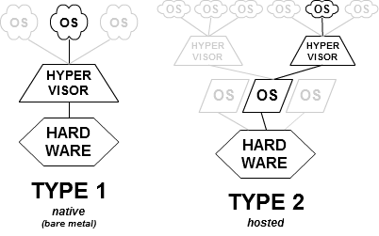
Hypervisor Characteristics
Virtualization requires an hypervisor
Hypervisor
A virtual machine monitor (VMM) is computer software, firmware or hardware
Creates and runs virtual machines (called guest machines)
Optimized (as in dynamic) management of resources: CPU, Memory, NIC and Disks
Term (coined in 1970!) comes from supervisor of the supervisor (latter aka kernel of the OS)
Most popular Hypervisors
Xen
VMWare server, workstation
Oracle VM, Virtual Box
Windows Hyper-V
Two types of hypervisors: bare metal and hosted More details next slide
Docker requires a hypervisor and an OS

Slide 5
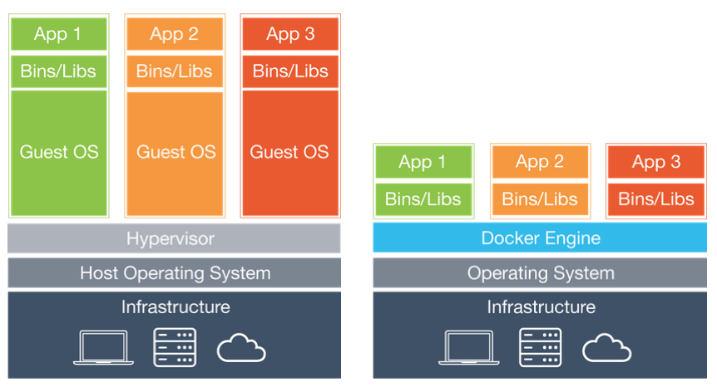
Virtualization Types
App 1
App 2
App 1
App 2
App 1
App 2
App 1
App 2
Docker
OS 1 Windows
OS 2 Linux
Guest OS 1 Windows
Guest OS 2 Linux
Guest OS 2 Windows, Linux
Hypervisor
Oracle VM
VMWare esxi, Hyper-V
Hypervisor
Virtual Box VMWare Server/WS
Hypervisor
Virtual Box, Hyper-v
Hyper-V or Virtual Box
Host OS
Windows, Linux
Host OS
Windows, Linux
Host OS
Windows, Linux
HW Infrastructure
CPU, Storage, Network, Memory
HW Infrastructure
CPU, Storage, Network, Memory
HW Infrastructure
CPU, Storage, Network, Memory
HW Infrastructure
CPU, Storage, Network, Memory
0. No Virtualization Bare Metal
1. Type 1 Virtualization Bare metal Hypervisor
2. Type 2 Virtualization Hosted Hypervisor
3. Docker
Notes:
No Virtuallization
Apps running on top of an OS like Windows, Linux, Mac OS
Fixed resource allocation
Opposite of lean, mean, speedy, re-usable, portable, …
No Hypervisor – resource management by OS (kernel)
HyperVisor Type 1 (bare metal HyperVisor)
Apps running on top of a guest OS/Hypervisor/HW aka Baremetal hypervisor
Examples: Oracle VM Server, VMWare esxi, Windows Hyper-V
Hypervisor contains small/minimalized OS
1 or more applications are running within a single OS with possiible dependancies/collasions
HyperVisor Type 2 (hosted HyperVisor)
Apps running on top of a guest OS/Hypervisor/host OS/HW aka hosted hypervisor
Examples: VMWare Server/Workstation, Oracle Virtual Box
Hypervisor runs on top of OS
1 or more applications are running within a single OS with possiible dependancies/collasions
Allow multiple (different) OS’s on a single hypervisor
Docker Containers
(containerized) apps running on top of Docker/Hypervisor/(host/guest) OS/HW
Requires a hyperviosr (type 1 or type 2) and an OS
Each application is running independant of other applications but sharing the OS resources

Slide 6
Docker on a Windows Platform Deployment Alternatives
App 1
App 2
App 1
App 2
App 3
Docker for Windows
Docker for Linux
OS
Windows
Guest OS Linux (e.g. Ubuntu Oracle linux)
Hypervisor (T1)
Hyper-v
Vagrant
Hypervisor (T2)
Virtual Box
Host OS
Windows
HW Infrastructure
CPU, Storage, Network, Memory
HW Infrastructure
CPU, Storage, Network, Memory
3a. Docker for Windows with Hyper-V (Bare Metal Virtualization)
3b. Docker for Linux with Virtual Box (Hosted Virtualization)

Slide 7
Preference for Hosted Virtualization on a Windows box (3b)
Preferred deployment reasons (type 2 hypervisor)
Alignment of host os with underlying Docker os: Linux
No portability issues like directory names/paths, upper/lowercase
Extended resource management within Virtual Box (versus Hyper-V)
Additional management capabillities of Docker installed on a Linux platform versus the Windows Docker service
re-allocate the docker runtime (storage) environment
Despite the disadvantages
Additional host Windows os as the Virtual Box platform

Slide 8
Docker versus Virtualization Types 1 &2
App 1
App 2
App 1
App 2
Docker
Guest OS 1 Windows
Guest OS 2 Linux
OS
Windows, Linux
Hypervisor VMWare, Oracle VM/VirtualBox
Hypervisor VB, Hyper-V
OS
Windows, Linux
OS
Windows, Linux
HW Infrastructure
CPU, Storage, Network, Memory
HW Infrastructure
CPU, Storage, Network, Memory
Virtualization Type 1&2
Docker

Slide 9
Docker Characteristics
Released in 2013
Virtualization on app level (versus on OS level) Sharing the OS across the containers
Based on Linux libs/OS Note there is also a (not as popular) Windows Docker flavour
Open-Source
Requires a hypervisor and an OS

Slide 10
Docker Popularity
Speed: smaller footprint, enabling quick and lightweight deployment and startup
Portability/re-use capability: they can run on any OS (e.g. Windows, Linux distributions)
Scale: by spinning additional containers (could be managed by Kubernetes)
Micro-services support: opposite of monolithic technology like hypervisors/bare metal)
Independancy: pack your container app with all required libraries
Popularity of Open-Source back in 2013
Leaner and meaner than hypervisors
Support of DevOps principles: emphasizes agility, flexibility and scalability in software delivery
Automating the creation of runtime environments through coding (e.g. Vagrant, Docker Build)
Massive availability of containerized apps in public registries (e.g search for Tomcat > 10k hits)

Slide 11
Docker & Cloud
Oracle Cloud provides a Paas like Container cloud service
VM Docker installation and engine
VM to store your (own) containers
(private/Public) registry to publish your containers
UI like Kitematic to manage all the above
AWS, Google and Azure provides similar container cloud services and additional tooling (e.g. Kubernetes)
It fits perfectly in the scaling capabilities of Docker
Spin additional containers when needed
For containers in the cloud you basically need a (linux) image with a Docker install/engine - thus easily to be provided by a - simple - Iaas service
Added value of CCS: Additional tooling
Threads: Not the latest Docker release

Slide 12
Docker Threads
Complexity of another (Docker) layer
Size of container (image) can grow fast - specifcally after modifcations
Workaround: rebuild your own container rather than re-use
No “garbage” collection in public (and private?) registries
No enforced naming and documentation standards within public registries
Which published Tomcat container (out of > 10k) fits your needs?
All containers share the same (OS) kernel – a kernel error effects all containers
(low) Adoption of Open-Source in a secure (banking) environment
Security risks/shortcomings – it requires root rights to run a container

Slide 13
Agenda
1
Introduction
Virtualization types
Docker versus (traditional) Virtualization
Vagrant
Docker
Hands-on practices
Findings
2
3
4
5
6
7
Notes:
13

Slide 14
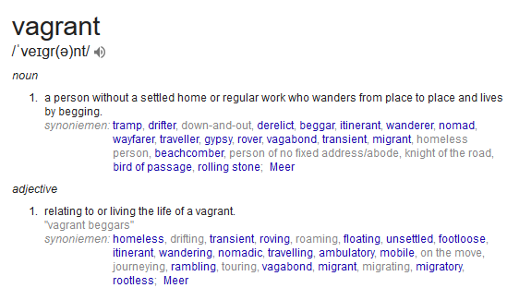
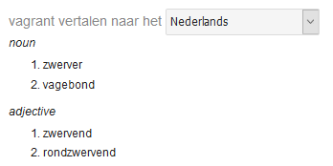
Vagrant

Slide 15
Vagrant is
Open-source software product for building and maintaining portable virtual software development environments
Try to simplify software configuration management of virtualizations
To increase development productivity.

Slide 16
Vagrant Why?
Creating and maintaining VM’s is a tedious job:
Upgrades of OS
Upgrades of Software
States of the configuration
Vagrant:
Automates creation of VM’s
Automates provisioning of VM’s
Abstracts
the configuration of the VM
the installation/setup of the software within the VM

Slide 17
Vagrant Architecture
Building block concepts:
Providers:
VirtualBox
Hyper-V
Docker
Vmware
AWS

Slide 18
Vagrant Architecture
Building block concepts:
Providers:
Shell
Docker
Vmware
AWS
Services to set up and create VMs
Provisioners:
Shell
Ansible
Puppet
Chef
Tools to customize the configuration of VM

Slide 19
Vagrant Project
Project folder
Contains Vagrantfile with all the configuration
Box
Downloadable from repo, or custom box
Contains a VM, with OS installed in it
Vagrant user with sudo rights, and insecure key (replaced on startup)
NAT network adapter

Slide 20
Vagrant commands
Command | Meaning
init | Initializes current folder with an initial Vagrantfile
box | Manages boxes with subcommands
package | Packages a VM from provider into a box
up | Creates a vm from a box if non-existent, starts up the VM, and provisions it if not already done
halt | Stops the VM
suspends | Suspends the VM
destroy | Removes the VM

Slide 21
Vagrant commands cont.
Command | Meaning
ssh | Starts a secure shell connection, logs on as vagrant user
provision | Reruns the provisioning of the VM

Slide 22
Vagrant box sub commands
Command | Meaning
add | This adds a box with the given address to Vagrant
remove | This command removes a box from Vagrant
update | Updates a box from a VM

Slide 23
Agenda
1
Introduction
Virtualization types
Docker versus (traditional) Virtualization
Vagrant
Docker
Hands-on practices
Findings
2
3
4
5
6
7
Notes:
23

Slide 24
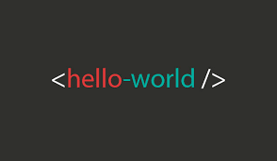
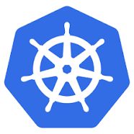
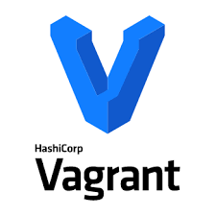
Hands-On Practices with Vagrant and Docker
B. Docker Practice
Oracle DB Apex
ORDS
TomCat ORDS JVM
A. Vagrant Practice
Kitematic 0.17.3
Docker for Liunx (17.12.0-ce)
Guest OS Linux/Ubuntu 16.04
SSH
Hypervisor
Virtual Box 5.2.6
2.0.2
Host OS
Windows
HW Infrastructure
CPU, Storage, Network, Memory

Slide 25
Docker Crash Course
Docker CLI & KiteMatic
Docker command line interface
E.g. docker run -d -it --name openjdk8ubuntu openjdkubuntu:latest
KiteMatic (GUI interface for the docker CLI)
Images & Containers
Image: persistence of container: container: an instance of an image
As in Java classes (image) and instantiating a class (container)
Build & Dockerfile
(local) creation of a docker image through a docker build file (Dockerfile)
Docker engine
The binary that creates and runs the Docker container from the Docker image file.
Registries
Local or Public registry for storing docker images (e.g. https://hub.docker.com, github.com)
Volumes
Leveraging the local file system to capture data outside the container: <local dir:container dir>
docker run --name oracle … -v ~/docker/oracle:/opt/oracle/oradata …

Slide 26
(some) Docker CLI commands
Command | Meaning
--help | Online help
run | Creates/starts/executes a container (from a local/public published image) e.g. docker run -d -it --name openjdk8ubuntu openjdkubuntu:latest
start/stop | Re-run a stopped container/stopping a running container – must be preceded by the docker run command
Build | The creation of an docker image – based on another docker image through a build file: Dockerfile e.g. docker build -t ords:3.0.12 .
Exec | opens a ssh session within a running container (optionally) followed by executing a binary within the container e.g. docker exec -it DORA12201_1 bash -c “source /home/oracle/.bashrc; sqlplus /nolog”
images | List of local stored docker images
ps -a | List of running containers (currently and in the past)
logs --details | Container running output
rm | Removal of (stopped) containers
Rmi | Removal of images without running containers

Slide 27



Lab Experience
?
Notes:
w
27

Slide 28


Register on Docker related sites
https://hub.docker.com
https://github.com
https://container-registry.oracle.com
Oracle Docker configurations, images, and examples of Dockerfiles
Docker for Liunx
Guest OS Linux/Ubuntu
Hypervisor
Virtual Box
Host OS
Windows
Notes:
Register yourself in above mentioned sites

Slide 29
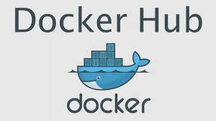
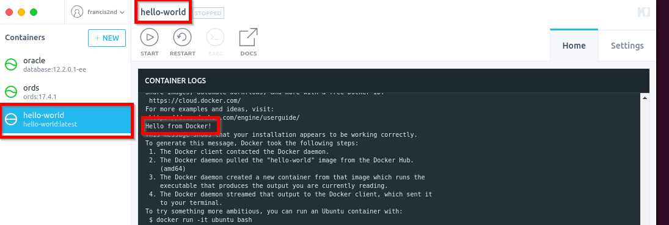

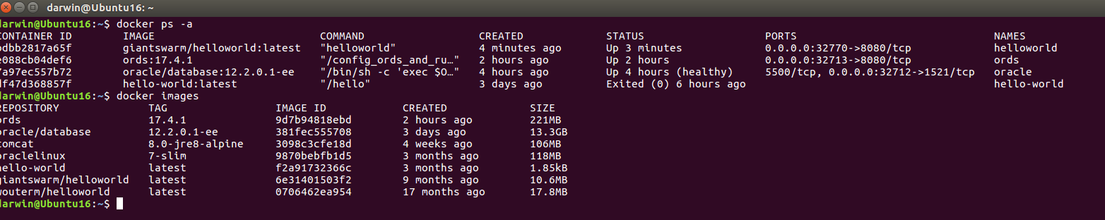
HealtCheck with helloworld
HelloWorld
Docker for Liunx
Guest OS Linux/Ubuntu
Hypervisor
Virtual Box
Host OS
Windows
Notes:
Start Kitematic
Press New: and search for helloworld
Press create on your favored HelloWorld container
A Docker image will be downloaded and executed (implicit through docker run) within the KiteMatic UI
Verify within Ubuntu terminal:
docker ps –a (which docker containers are running and/or have been run)
docker images (which helloworld containers are locally available)
Optional: docker rm <container name>
Optional: docker rmi <image name>
Verify within /data/docker/overlay2 – your runtime docker storage - (recent) created container directories

Slide 30
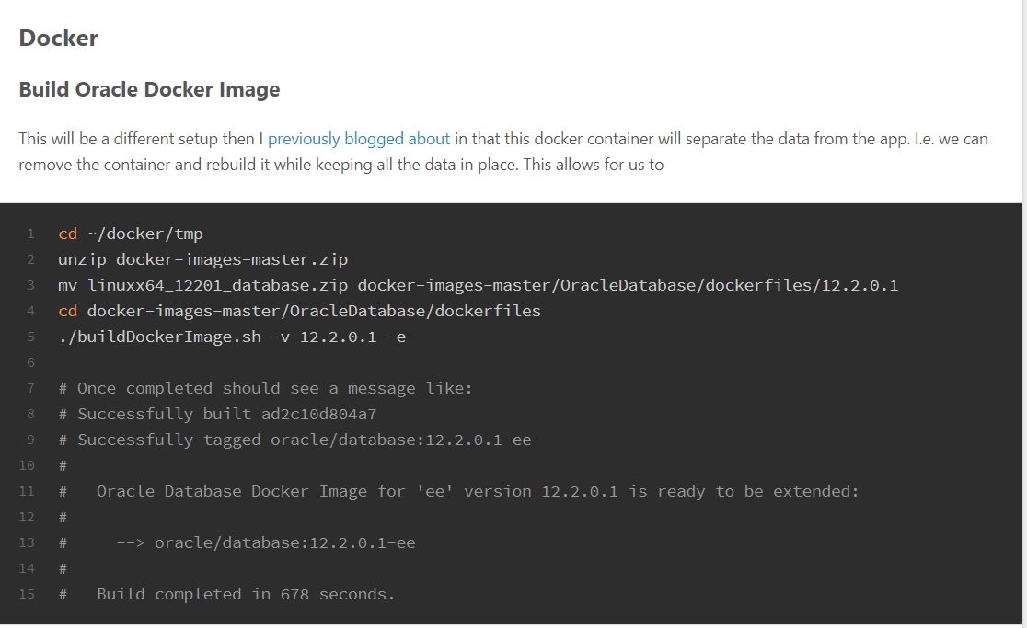
Build Oracle DB container
Apex
ORDS
1. Building
Oracle DB Apex
docker-images-master
DB.zip
(docker) Build Oracle DB container
Docker for Liunx
Guest OS Linux/Ubuntu
Hypervisor
Virtual Box
Host OS
Windows
Notes:
Follow the instructions within https://www.talkapex.com/2017/10/docker-oracle-and-apex/
Starting with
Build Oracle Docker Image (build a containerized Oracle database)
until
Build Oracle Docker Image

Slide 31
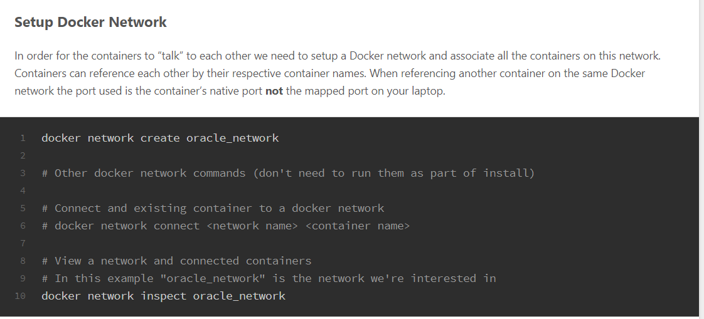
Create Network for ODB & Tomcat container
Oracle DB Apex
TomCat ORDS JVM
Oracle Network
Docker for Liunx
Guest OS Linux/Ubuntu
Hypervisor
Virtual Box
Host OS
Windows
Notes:
Follow the instructions within https://www.talkapex.com/2017/10/docker-oracle-and-apex/
Starting with
Setup Docker Network

Slide 32
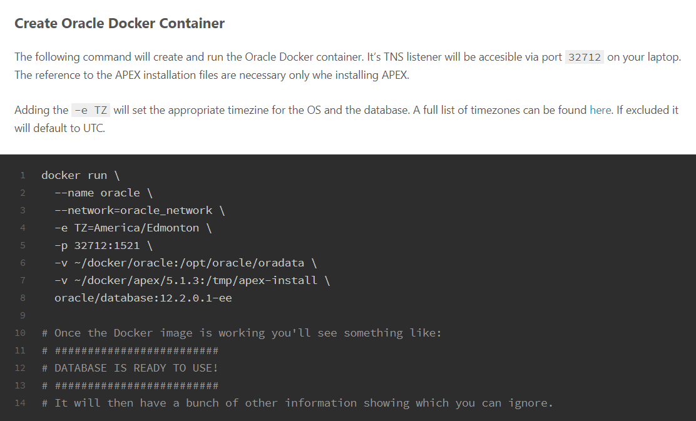
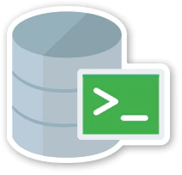
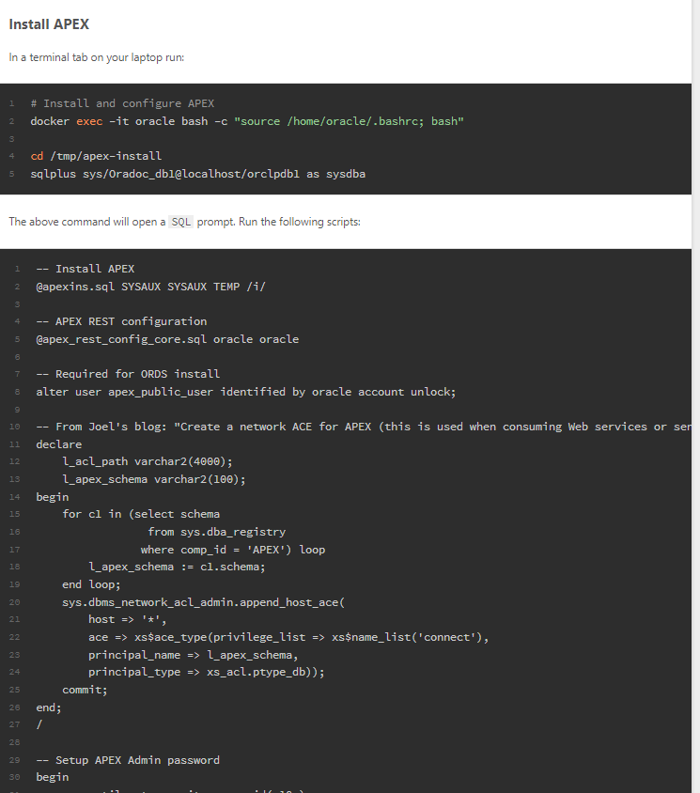
Run (Create) Oracle DB container & Load Apex Scripts
2. Loading
Oracle DB Apex
1.Running
Apex Volumes
Docker for Liunx
Guest OS Linux/Ubuntu
Hypervisor
Virtual Box
Host OS
Windows
Notes:
Follow the instructions within https://www.talkapex.com/2017/10/docker-oracle-and-apex/
Starting with
Create Oracle Docker Container (Running a containerized Oracle database)
docker run --name oracle --network=oracle_network -e TZ=Europe/Amsterdam -p 32712:1521 -v /data/mydocker/docker/oracle:/opt/oracle/oradata -v /data/mydocker/docker/apex/apex:/tmp/apex-install oracle/database:12.2.0.1-ee
until
Install APEX
-- Setup APEX Admin password
You may want to replace the admin email with your email:
begin
apex_util.set_security_group_id( 10 );
apex_util.create_user(
p_user_name => 'ADMIN',
p_email_address => 'frank.brink@darwin-it.nl',
p_web_password => 'welcome1',
p_developer_privs => 'ADMIN' );
apex_util.set_security_group_id( null );
commit;
end;
/

Slide 33
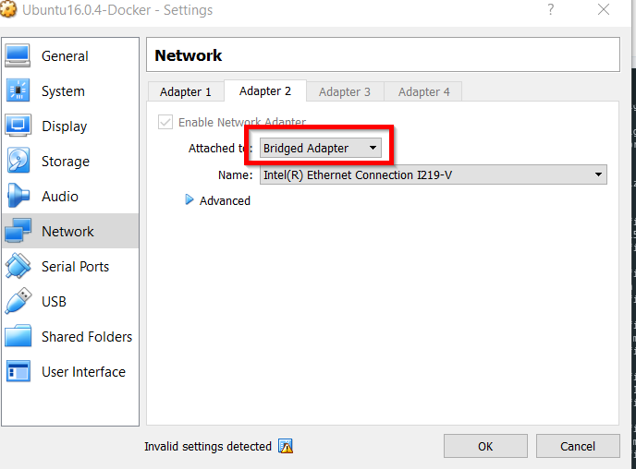
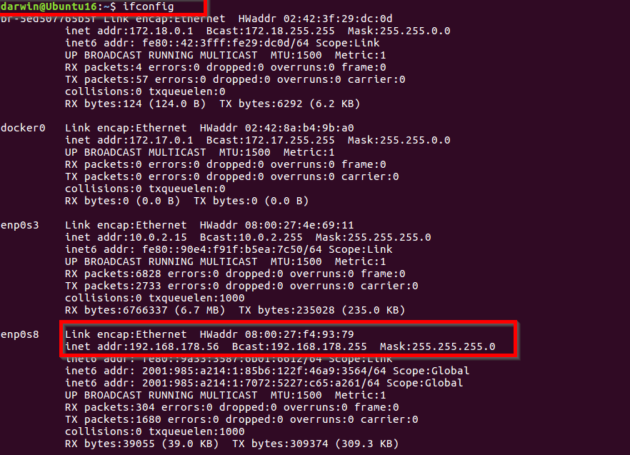
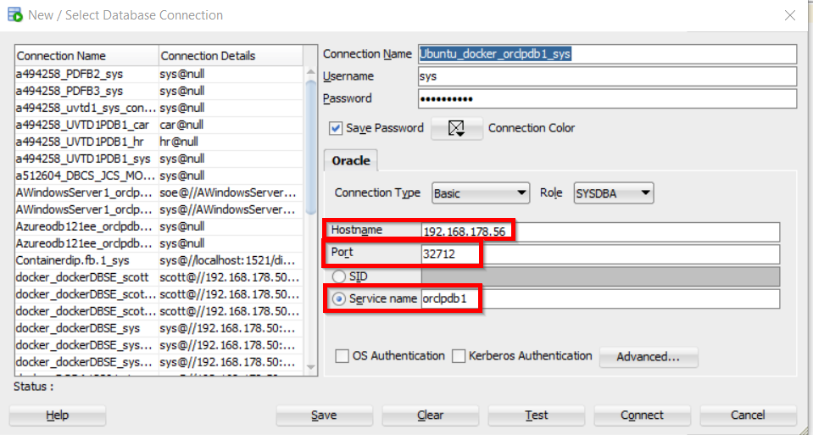
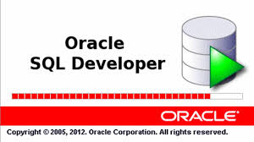
Extra: Connect with SQLDeveloper (Windows) to a containerized Database
Oracle DB Apex
Through a bridged adapter on VB
Docker for Liunx
Guest OS Linux/Ubuntu
Hypervisor
Virtual Box
Host OS
Windows
Notes:
Steps:
Set-up bridged adapter in VB with localhost
Get ip-address from Ubuntu through ifconfig
Open SQLDeveloper
Provide sys credentials pw=Oradoc_db1 (set – after the docker create/run command via docker exec oracle ./setPassword.sh Oradoc_db1
Hostname=IP Address
Port=Port-forwarding from docker run command
Servicename=orclpdb1 (defined within the container build)

Slide 34
Extra: Connect with SQLDeveloper (Windows) to a containerized Database – cont’d
Oracle DB Apex
ORDS
Through a bridged adapter on VB
Docker for Liunx
Guest OS Linux/Ubuntu
Hypervisor
Virtual Box
Host OS
Windows
docker run --name oracle --network=oracle_network -e TZ=Europe/Amsterdam -p 32712:1521 …
Notes:
Retrieval connection details: see notes previous slide

Slide 35
Build & Run Tomcat container as ORDS JVM - overview
Tomcat container
TomCat ORDS JVM
Ords.war
Dockerfile
config_ords_and_run_catalina.sh
(docker) Build Tomcat container
Docker for Liunx
Guest OS Linux/Ubuntu
Hypervisor
Virtual Box
Host OS
Windows

Slide 36
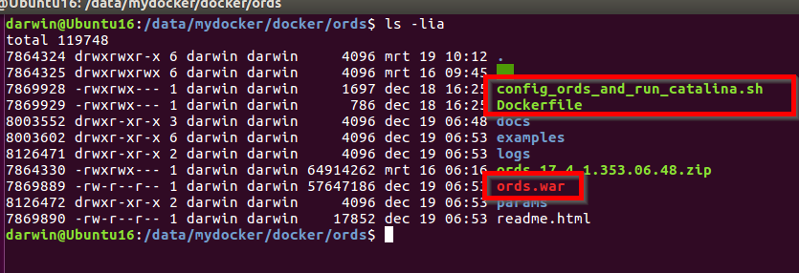
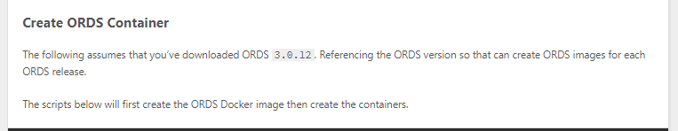
Build Tomcat container as ORDS JVM – cont’d
TomCat ORDS JVM
(docker) Build Tomcat container
1. Building
Docker for Liunx
Notes:
Follow the instructions within https://www.talkapex.com/2017/10/docker-oracle-and-apex/ Blog
Starting with
Create ORDS Container as of docker run -t -i \ ..

Slide 37
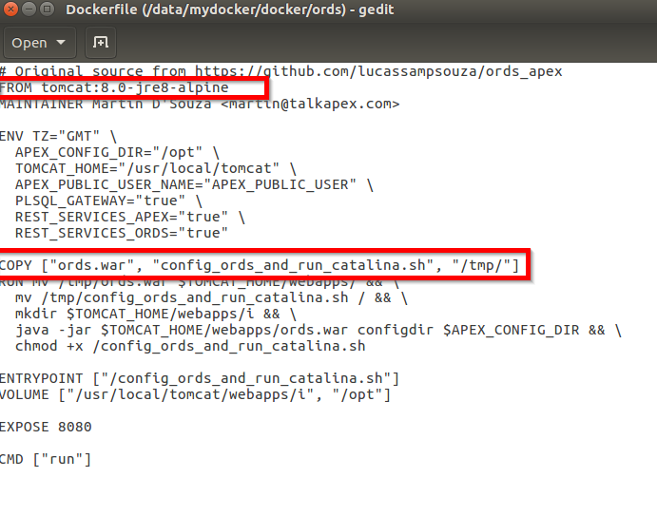
Dockerfile – cont’d
Tomcat container
TomCat ORDS JVM
Ords.war
Dockerfile
config_ords_and_run_catalina.sh
(docker) Build Tomcat container
Docker for Liunx
Guest OS Linux/Ubuntu
Hypervisor
Virtual Box
Host OS
Windows

Slide 38
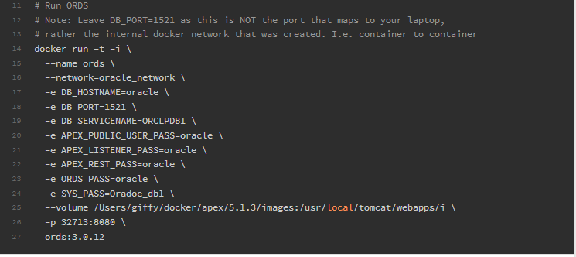
Run Tomcat container as ORDS JVM
Oracle DB Apex
TomCat ORDS JVM
oracle_network
Docker for Liunx
Notes:
Follow the instructions within https://www.talkapex.com/2017/10/docker-oracle-and-apex/
Starting with
Create ORDS Container – as of the docker run command
Replace the volume values with your shares as displayed below: docker run -t -i --name ords --network=oracle_network -e DB_HOSTNAME=oracle -e DB_PORT=1521 -e DB_SERVICENAME=ORCLPDB1 -e APEX_PUBLIC_USER_PASS=oracle -e APEX_LISTENER_PASS=oracle -e APEX_REST_PASS=oracle -e ORDS_PASS=oracle -e SYS_PASS=Oradoc_db1 --volume /data/mydocker/docker/apex/apex/images:/usr/local/tomcat/webapps/i -p 32713:8080 ords:17.4.1
Check your (running) docker containers with:
docker ps
Check your docker images with:
docker images

Slide 39
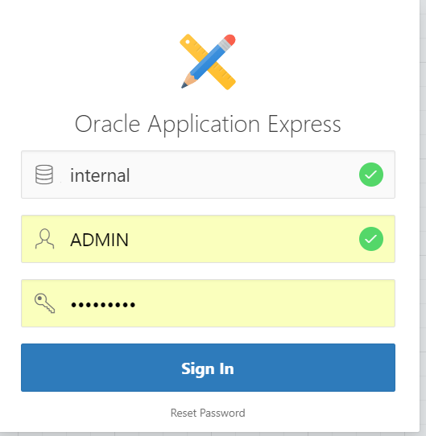
Run Apex/ORDS
Oracle DB Apex
Oracle Credentials
TomCat ORDS JVM
PW: oracle?
Reset password – see slide notes
Oracle Network
Docker for Liunx
192.168.178.56:32713/ords/
Guest OS Linux/Ubuntu
Hypervisor
Virtual Box
Application access outside VB via bridged network adapter, see slide notes
Host OS
Windows
Notes:
Access an application within VB from Windows requires an additional bridged network adapter
goto VB Machine/Settings/network
Enable additional adapter and choose bridged adapter
Your Ubuntu instance receives an another IP address
Access your containerized application with <IP Address>☹forwarded
2. Reset password admin
#run shell within oracle! container
docker exec -it oracle bash -c "source /home/oracle/.bashrc; bash“
#goto shared apex volume directory within the oracle container shell
cd /tmp/apex-install
#run sqlplus within shell as sys
sqlplus sys/Oradoc_db1@localhost/orclpdb1 as sysdba
#execute change admin APEX password (from the shared apex-install) directory
@apxchpwd

Slide 40

Findings
Docker versus Virtual Box: pros and cons?
Every application suitable for Docker?
Imagine a SOA course on a thin(nest) notebook – all design and runtime components as Docker containers in the cloud – it only requires a ssh connection: will that work?
Would you pack Java libs in each container or share them across containers?
Or where is the optimum cutting edge?
Any preference for Docker on a Windows platform?
Bare Metal versus Hosted Virtualization (VB/Ubuntu Flavor)
Agree/Disagree/appreciation?
Steep/Flat learning curve
Speed of deployment/startup
Portability
Scaling capabilities
No DevOps without containers?
No microservices without containers?
Too complex wit so many tools to manage your CI/CD?

