Slide 1
Virtual Cloud Network in a OKE Context
Martien van den Akker
Frank Brink
October 2019
(c) 2019 Darwin IT-Professionals B.V.

Slide 2


VCN, AD’s, Public and Private Subnets, OKE Cluster and OKE Nodes
ORACLE CLOUD DATA CENTER REGION (Frankfurt)
AVAILABILITY DOMAIN-1
AVAILABILITY DOMAIN-2
AVAILABILITY DOMAIN-3
10.0.10.4
10.0.10.2
10.0.10.3
OKE-1
OKE-2
OKE-0
OKE Cluster
Wkr Security List
Regional Private SUBNET A,10.0.10.0/24
LB Security List
130.61.12.8
LB
Regional Public SUBNET A,10.0.20.0/24
OKE VCN, 10.0.0.0/16
Medreck8s Compartment

Slide 3
Generated Security Lists per (regional subnet) applicable for all nodes within SN
Stateless Ingress rules for a limited set ip address – all protocols
Stateful Ingress rules for all nodes on port 22
Stateful Ingress rules for a limited set ip address –for a specific set of ports
Statefull Egress rules to all (worldwide) ip address for all protocols
Stateless Egress rules to a limited set (internal) ip address – all protocols
ORACLE CLOUD DATA CENTER REGION (Frankfurt)
AVAILABILITY DOMAIN-1
AVAILABILITY DOMAIN-2
AVAILABILITY DOMAIN-3
10.0.10.4
10.0.10.2
10.0.10.3
OKE-1
OKE-2
OKE-0
OKE Cluster
Wkr Security List
Regional Private SUBNET A,10.0.10.0/24
Stateless Ingress rules for all worldwide ip address – all protocols
Statefull Ingress rules for all worldwide ip address – on port 80 and 443
Stateless Egress rules to all (worldwide) ip address for all protocols
Statefull Egress rules to a limited set (internal) ip address on port 10256
LB Security List
130.61.12.8
LB
Regional Public SUBNET A,10.0.20.0/24
OKE VCN, 10.0.0.0/16
Medreck8s Compartment

Slide 4

Weblogic domain on OKE Cluster
ORACLE CLOUD DATA CENTER REGION (Frankfurt)
AVAILABILITY DOMAIN-1
AVAILABILITY DOMAIN-2
AVAILABILITY DOMAIN-3
AdmSrv
10.244.2.45
10.0.10.4
10.0.10.2
10.0.10.3
Srv-2
10.244.0.56
Srv-3
10.244.1.40
Srv-1
10.244.2.46
OKE-1
OKE-2
OKE-0
OKE Cluster
Get K8s pods for medrec-domain-ns
NAME READY STATUS RESTARTS AGE IP NODE NOMINATED NODE READINESS GATES
medrec-domain-adminserver 1/1 Running 0 106m 10.244.1.61 10.0.10.3 <none> <none>
medrec-domain-medrec-server1 1/1 Running 0 105m 10.244.1.62 10.0.10.3 <none> <none>
medrec-domain-medrec-server2 1/1 Running 0 105m 10.244.2.54 10.0.10.4 <none> <none>
Wkr Security List
Regional Private SUBNET A,10.0.10.0/24
LB Security List
130.61.12.8
LB
Regional Public SUBNET A,10.0.20.0/24
OKE VCN, 10.0.0.0/16
Medreck8s Compartment

Slide 5
Creation of a managed database on a private subnet (and a BH for maintenance)
ORACLE CLOUD DATA CENTER REGION (Frankfurt)
AVAILABILITY DOMAIN-1
AVAILABILITY DOMAIN-2
AVAILABILITY DOMAIN-3
10.0.10.6
Wkr Security List
DBHost
Regional Private SUBNET A,10.0.10.0/24
10.0.20.2
130.61.91.64
BastionHost
LB Security List
Regional Public SUBNET A,10.0.20.0/24
OKE VCN, 10.0.0.0/16
Medreck8s Compartment

Slide 6
Managed Database Creation
Private Subnet (use PSN created by the OKE cluster)
Database Shape/Edition/Release/BYOL versus fully licenses
VM.Standard1.1;SE/19.x/BYOL
Access
Design Time via BH (tunneling)
Runtime (Weblogic within OKE cluster) via k8s service
Security lists and/or Security groups
Incoming (ingress) traffic: which node/ip/protocol?
PDB/CDB (default multitenant since release 19.x)
OCI Console provides connect String to CDB
PDB connect string
Select *v$Services
SSH to DBHOST
Query listener status

Slide 7


Design time connection to managed database in private subnet
ORACLE CLOUD DATA CENTER REGION (Frankfurt)
AVAILABILITY DOMAIN-1
AVAILABILITY DOMAIN-2
AVAILABILITY DOMAIN-3
10.0.10.6
Wkr Security List
DBHost
Regional Private SUBNET A,10.0.10.0/24
10.0.20.2
130.61.91.64
BastionHost
LB Security List
Regional Public SUBNET A,10.0.20.0/24
OKE VCN, 10.0.0.0/16
Medreck8s Compartment

Slide 8
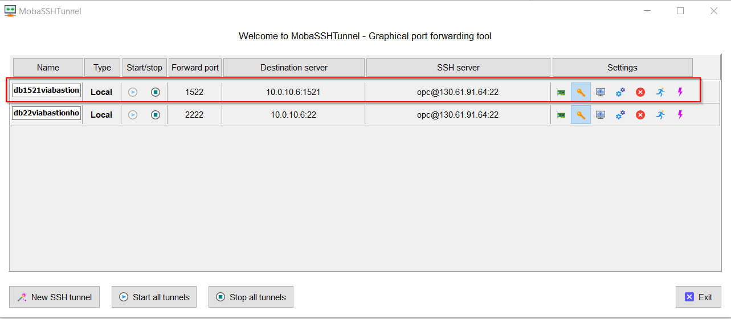
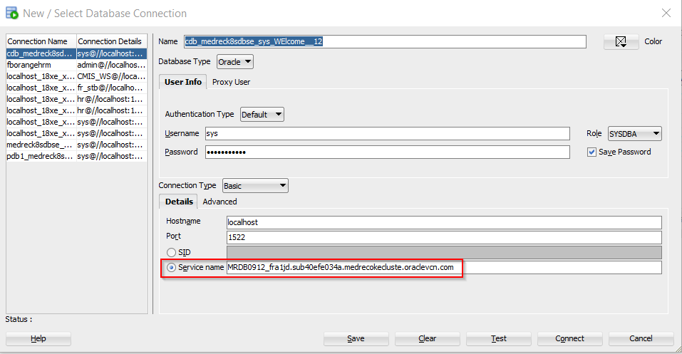
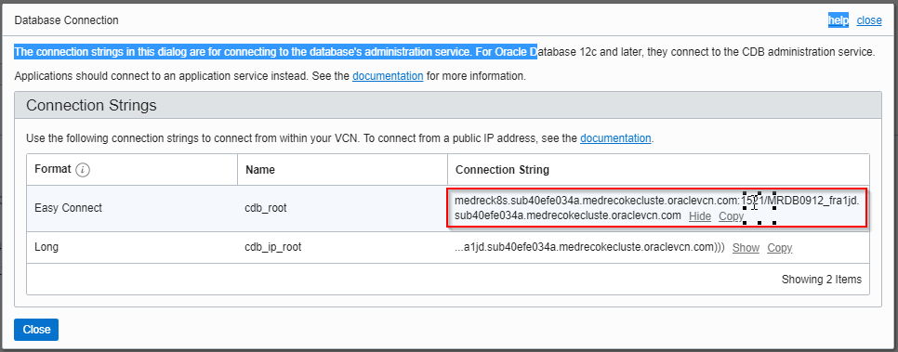
Design Time Connection (tunneling)

Slide 9

Runtime access to a managed database (outside the OKE cluster) via k8s service
ORACLE CLOUD DATA CENTER REGION (Frankfurt)
AVAILABILITY DOMAIN-1
AVAILABILITY DOMAIN-2
AVAILABILITY DOMAIN-3
AdmSrv
10.244.2.45
10.0.10.4
10.0.10.2
10.0.10.3
Srv-2
10.244.0.56
Srv-3
10.244.1.40
Srv-1
10.244.2.46
OKE-1
OKE-2
OKE-0
10.0.10.6
OKE Cluster
medrecdbhostname sk8s service op 1521
Wkr Security List
DBHost
Regional Private SUBNET A,10.0.10.0/24
LB Security List
130.61.12.8
LB
Regional Public SUBNET A,10.0.20.0/24
OKE VCN, 10.0.0.0/16
Medreck8s Compartment

Slide 10
Network Security rules via additional security groups (next to security lists)
ORACLE CLOUD DATA CENTER REGION (Frankfurt)
Ingress:SecGrpBHIng|22
Egress:0.0.0.0/0|all
AVAILABILITY DOMAIN-1
AVAILABILITY DOMAIN-2
AVAILABILITY DOMAIN-3
10.0.10.4
SecGrpWL
SecGrpWL
SecGrpWL
AdmSrv
10.244.2.45
10.0.10.2
Srv-3
10.244.1.40
10.0.10.3
Srv-2
10.244.0.56
Srv-1
10.244.2.46
OKE-1
OKE-2
OKE-0
10.0.10.6
OKE Cluster
Ingres:SecGrpBH|1521
Ingres: SecGrpBHICMP
Ingres:SecGrpWL:1521
medrecdbhostname sk8s service op 1521
Wkr Security List
DBHost
SecGrpDB
Regional Private SUBNET A,10.0.10.0/24
Ingress:0.0.0.0/0|22 (SSH)
Ingress:0.0.0.0/03389 (RDP)
Ingress:0.0.0.0/0ICMP
10.0.20.2
130.61.91.64
BastionHost
SecGrpBH
LB Security List
130.61.12.8
LB
Regional Public SUBNET A,10.0.20.0/24
OKE VCN, 10.0.0.0/16
Medreck8s Compartment

Slide 11
VCN, OKE Cluster, Public and Private Subnets and Nodes
ORACLE CLOUD DATA CENTER REGION (Frankfurt)
Ingress:SecGrpBHIng|22
Egress:0.0.0.0/0|all
AVAILABILITY DOMAIN-1
AVAILABILITY DOMAIN-2
AVAILABILITY DOMAIN-3
10.0.10.4
SecGrpWL
SecGrpWL
SecGrpWL
Ingres:SecGrpBH|1521
Ingres: SecGrpBHICMP
Ingress:SecGrpWL:1521
AdmSrv
10.244.2.45
10.0.10.2
Srv-3
10.244.1.40
10.0.10.3
Srv-2
10.244.0.56
Srv-1
10.244.2.46
OKE-1
OKE-2
OKE-0
Ingress:10.0.10.0/24|All Ingress:10.0.11.0/24|All Ingress:10.0.12.0/24|All
Stateless NO:
Ingress:10.0.0.0/16|22 Ingress:10.0.20.0/16| 30385;10256;30606
Egress: all
10.0.10.6
OKE Cluster
medrecdbhostname sk8s service op 1521
Wkr Security List
DBHost
SecGrpDB
Regional Private SUBNET A,10.0.10.0/24
Ingress:0.0.0.0/0|22 (SSH)
Ingress:0.0.0.0/03389 (RDP)
Ingress:0.0.0.0/0ICMP
10.0.20.2
130.61.91.64
BastionHost
Ingress:0.0.0.0.0|80;443
Egress: all
Egress:10.0.10.0/24|10256
SecGrpBH
LB Security List
130.61.12.8
LB
Regional Public SUBNET A,10.0.20.0/24
OKE VCN, 10.0.0.0/16
Medreck8s Compartment

