Slide 1
Images for Kactus context helps
March 2013
Created by Erno Salminen

Slide 2
Purpose
Images orientate users better than text
They provide simplified overlook what is the main idea in each editor

Slide 3
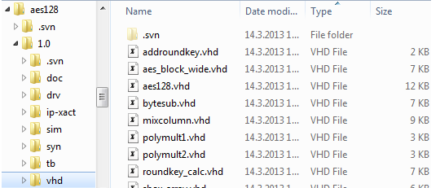
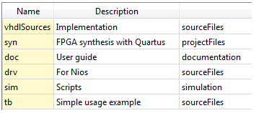
Filesets

Slide 4

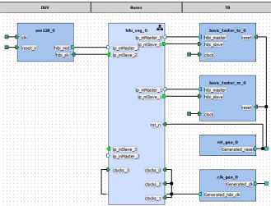
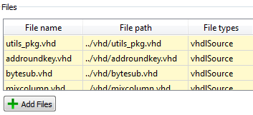
component AccelA
Fileset
Design
View V0
(non-hier)
Fileset ref.
View V1 (hier)
Hier. ref.

Slide 5
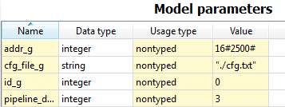
Generic editor
library ieee;
use ieee.std_logic_1164.all;
entity bar is
generic (
id_g : integer;
addr_g : integer;
cfg_file_g : string := "";
pipeline_depth_g : integer;
. . .
);
port ( . . .
sad

Slide 6
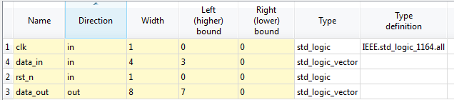
Ports editor
library ieee;
use ieee.std_logic_1164.all;
entity foo is
port (
clk : in std_logic;
rst_n : in std_logic;
data_in : in std_logic_vector (3 downto 0);
data_out : out std_logic_vector (7 downto 0)
);
end foo;
Relation between code and Kactus should be obvious

Slide 7
Memory map
component AccelA
memory map MM0
r0
slave RegsIF
r1
r2
memory map MM1
mem
a

Slide 8
Address space
component CPU0
component NetN
component Acc0
addr space AS0
memmap
seg0
seg1
master MainIF
component Acc1
memmap
a

Slide 9
component Foo
master bus interface MBIF
port Data_out
port Req_out
port Ack_in
port maps
=

