Slide 1
Images for Kactus context helps
March 2013
Created by Erno Salminen

Slide 2
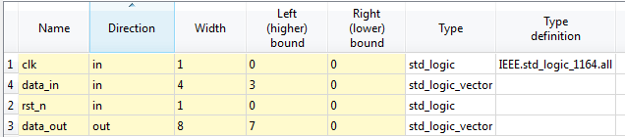
Ports editor
library ieee;
use ieee.std_logic_1164.all;
entity foo is
port (
clk : in std_logic;
rst_n : in std_logic;
data_in : in std_logic_vector (3 downto 0);
data_out : out std_logic_vector (7 downto 0)
);
end foo;
Relation between code and Kactus should be obvious

Slide 3
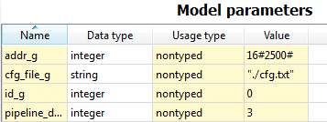
library ieee;
use ieee.std_logic_1164.all;
entity bar is
generic (
id_g : integer;
addr_g : integer;
cfg_file_g : string := "";
pipeline_depth_g : integer;
. . .
);
port ( . . .
sad

Slide 4
a

