Slide 1
APLAZALOH
Call Center Campaign
Sales Drivers
Linear regression report translated into operational management
Driver #1
Friction
Use
Effective talk time
High ACW
Daily supervision
Aplazaloh Campaign | Operational linear regression
Objective: convert the statistical finding into concrete actions for supervisors and sales agents.
1

Slide 2
Executive message
What the operation should clearly retain
Central conclusion
Control point
Correct reading
Sales are mainly explained by effective talk time: +4.75 expected sales for each additional talked hour.
ACW works as friction: +1 hour of ACW is associated with -4.06 expected sales.
The final simple model explains approx. 93.7% of the observed variation in Q_VENTAS.
Key idea
The visible engine of sales is effective commercial conversation.
The final model uses only two variables: T_HABLADO_HORAS and T_ACW_HORAS.
Operational message: more useful conversation; less post-call friction.
Aplazaloh Campaign | Operational linear regression
2

Slide 3
What was used to reach the result
Analytical base and decision criteria for the final model
Unit
Target
Variables
Models
Supervisor - day - campaign
52 final observations
Q_VENTAS
Volume, time, and efficiency
Full time, simple time, efficiency, and volume
Evaluation criteria
Adjusted R²: comparable explanatory power across models.
AIC/BIC: lower complexity with good fit; lower is better.
p-value: individual significance of each variable.
Final decision: simple time model for clarity, strength, and actionability.
6,138
records
698
agent-day
52
supervisor-day
Final simple
model
→
→
→
Aplazaloh Campaign | Operational linear regression
3

Slide 4
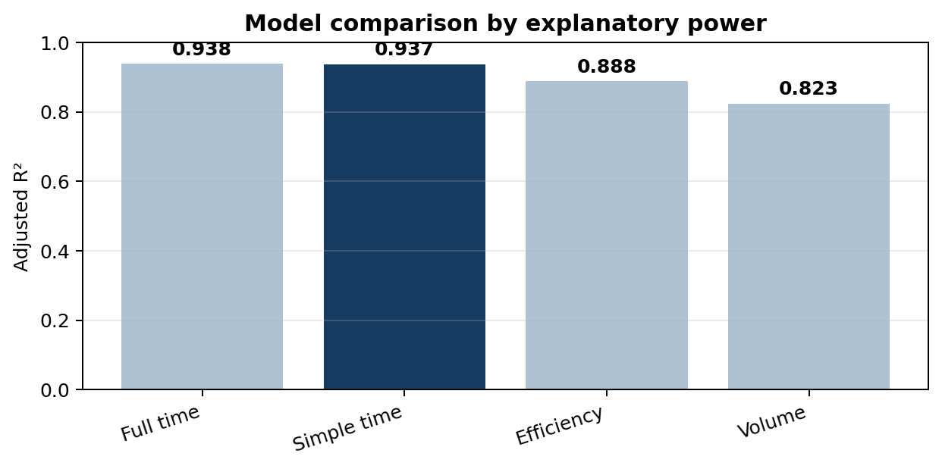
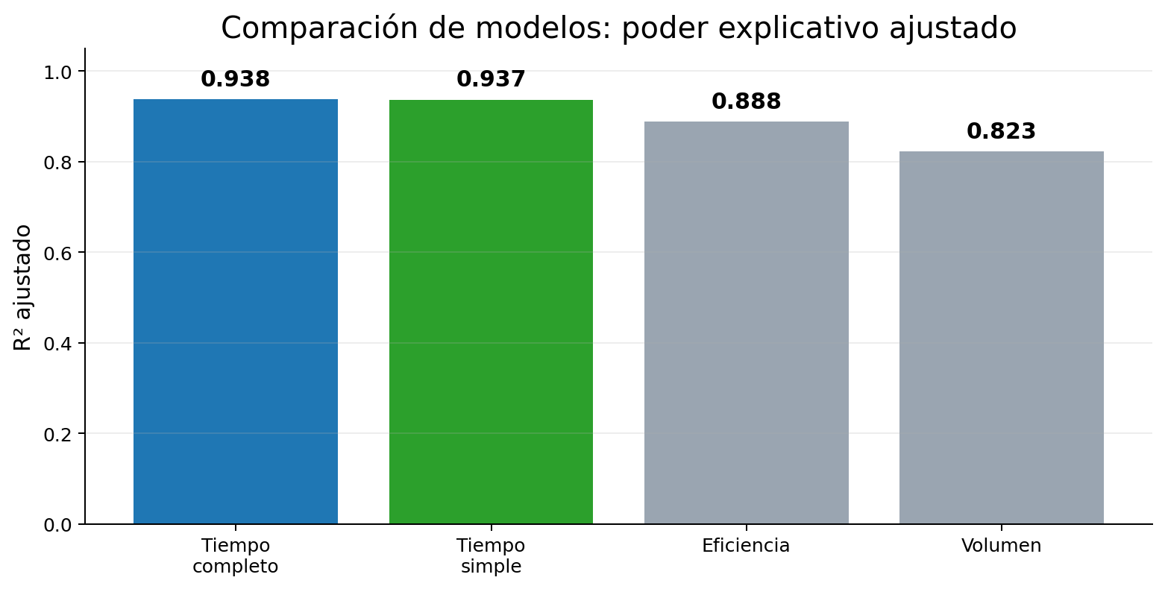
Model comparison
Why the simple time model is the most defensible
Result
The simple time model has adjusted R² = 0.9372, practically equal to the full time model.
Executive reading
With only two variables, it explains almost the same as the full model and improves the management reading.
Implication
Management should prioritize productive conversation and control ACW as operational friction.
Aplazaloh Campaign | Operational linear regression
4

Slide 5
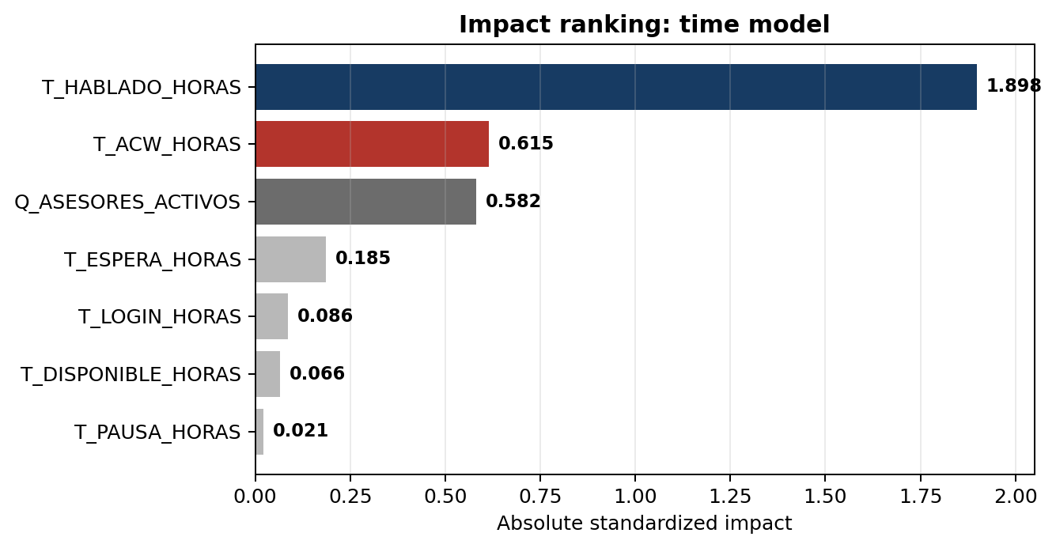
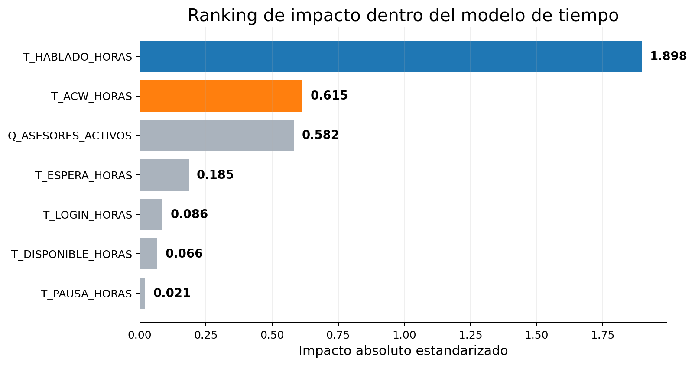
Main driver: talk time
Impact ranking within the time model
Interpretation
T_HABLADO_HORAS concentrates the strongest signal in the time model.
Its standardized impact is 1.898, far above the other variables.
T_ACW_HORAS appears as the second relevant variable, but with a negative effect.
Operational reading: selling more does not depend only on being connected, but on converting the day into effective commercial conversation.
Aplazaloh Campaign | Operational linear regression
5

Slide 6
Operational translation
Why talk time drives sales
1. Real contact
2. Offer explained
3. Objections
The agent manages to speak with the customer, not just dial or wait.
Benefits, conditions, and next steps are communicated.
The call allows doubts to be resolved and the close to be supported.
Controlled ACW
Recommended KPI
Post-call registration is necessary, but if it expands too much it consumes commercial capacity.
Sales per talked hour: measures real commercial productivity, not just operational presence.
Management phrase: “more useful conversation, less post-call friction”.
Aplazaloh Campaign | Operational linear regression
6

Slide 7
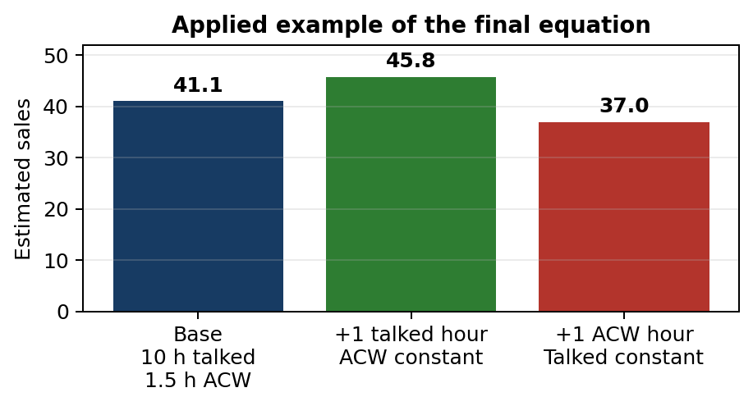
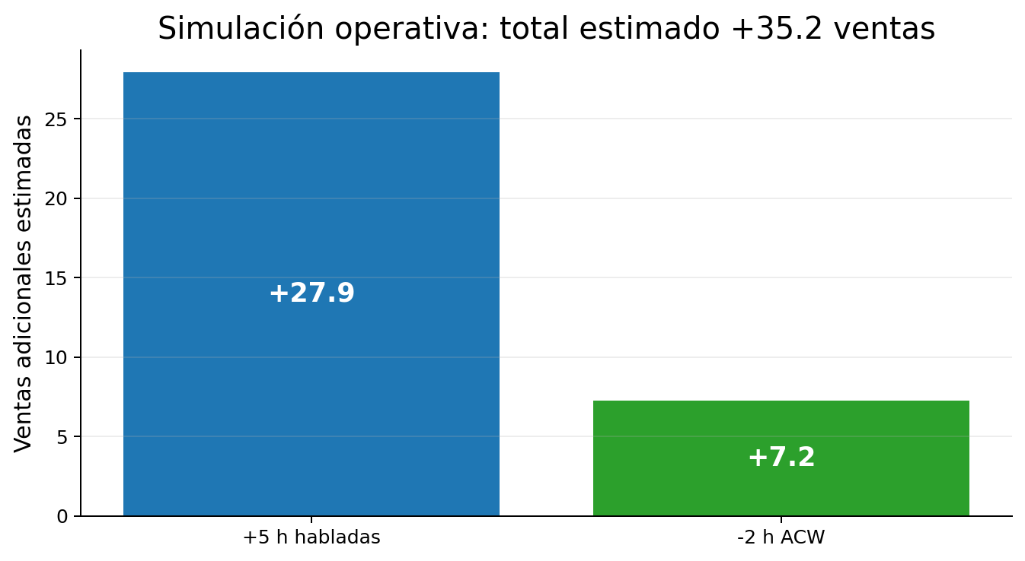
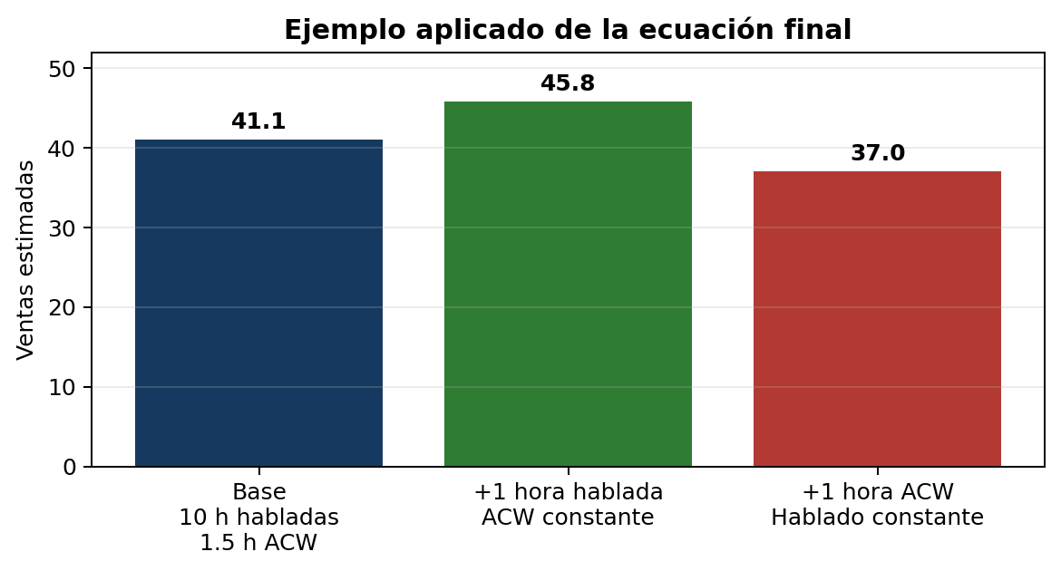
Equation and simulation
How to read coefficients without turning them into a mechanical promise
Q_VENTAS = -0.329279 + 4.749583·T_HABLADO_HORAS - 4.062390·T_ACW_HORAS
+4.75
-4.06
expected sales for 1 additional talked hour
expected sales for 1 additional ACW hour
Applied example: 10 talked hours and 1.5 h ACW ≈ 41.07 estimated sales.
Sensitivity: +1 talked hour rises to 45.82; +1 ACW hour falls to 37.01 estimated sales.
Aplazaloh Campaign | Operational linear regression
7

Slide 8
Recommended daily management
Minimum dashboard for supervisors
KPI
What it measures
Operational decision
T_HABLADO_HORAS
Effective commercial conversation
Increase useful sales time
T_ACW_HORAS
Post-call time
Audit friction and disposition coding
Sales / talked hour
Real productivity
Compare agents fairly
Q_VENTAS
Daily sales result
Compare actual vs estimated
Operational gap
Difference vs expected pattern
Detect management deviations
Do not manage only by login: login without conversation is installed capacity, not executed sales.
Aplazaloh Campaign | Operational linear regression
8

Slide 9
How to use the model in daily management
Separate operational signal from noise and avoid mechanical conclusions
Correct use
Management rule
Use the model as an operational compass: it shows historical association, not an exact sales promise.
Increasing effective conversation must be the priority; uncontrolled ACW growth should trigger review.
Readings to review daily
Supervision objective
T_HABLADO_HORAS
T_ACW_HORAS
Q_VENTAS
Sales per talked hour
Gap vs estimated sales
Identify which supervisors or agents convert their day into effective conversation better.
Detect excessive ACW due to registration, disposition coding, or hidden operational pauses.
Make decisions with evidence, not corridor intuition.
Aplazaloh Campaign | Operational linear regression
9

Slide 10
Operational action plan
Focus for supervisors and sales agents
Supervisors
Sales agents
Analytics
Review talk time, ACW, and sales per talked hour daily. Identify friction by agent and time slot.
Increase useful conversation: real contact, clear offer, resolved objections, and disciplined closing.
Monitor the gap between actual and estimated sales to detect operational deviations.
Final conclusion
With the available data, Aplazaloh should manage sales through two levers: maximize effective commercial conversation and reduce unnecessary ACW without compromising registration quality. The final simple model is clear, strong, and actionable.
Aplazaloh Campaign | Operational linear regression
10

