Slide 1

Istio

Slide 2
Prerequisites
What is Sidecar container in kubernetes ?
What is Services & Types in kubernetes ?
What is Envoy Proxy ?

Slide 3
What is Service Mesh ?
Understand the problem to understand the solution
What is monolithic application ?
What is Microservices application ?

Slide 4
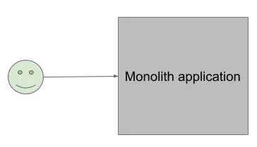
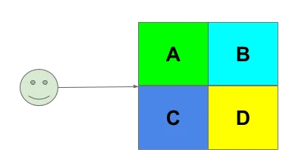
Monoliths Application
Monolith application means one program, built as one binary and ran as one process.

Slide 5
Disadvantages of Monoliths Application
Hard to scale
Hard to release
Reduced technology flexibility

Slide 6
Microservices to the rescue
“Microservices” is a software design pattern that favors breaking down an application into independent, de-coupled from each other, components.
De-coupled means that they have their codebase and run as standalone programs but interconnected via some communication interface.
This interface is usually network.

Slide 7
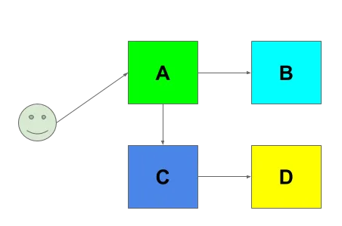
High Level Understanding
Monolith becoming “Microservices,” services A, B, C, D interoperate over the network now.

Slide 8
Advantages of Microservices
You can scale each service independently from each other.
You can de-couple release cycles of each service.
You are free to write each service using the technology of your choice, as long as they use the same communication interface between them.

Slide 9
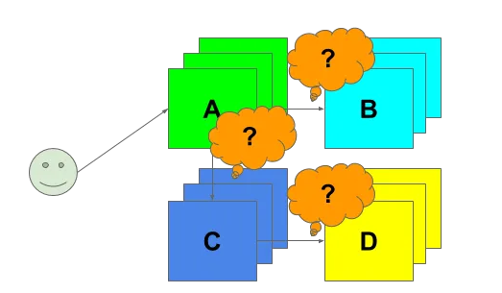
Service Mesh & Brand new issues to resolve
Traffic management
Security & Policies management
Observability

Slide 10
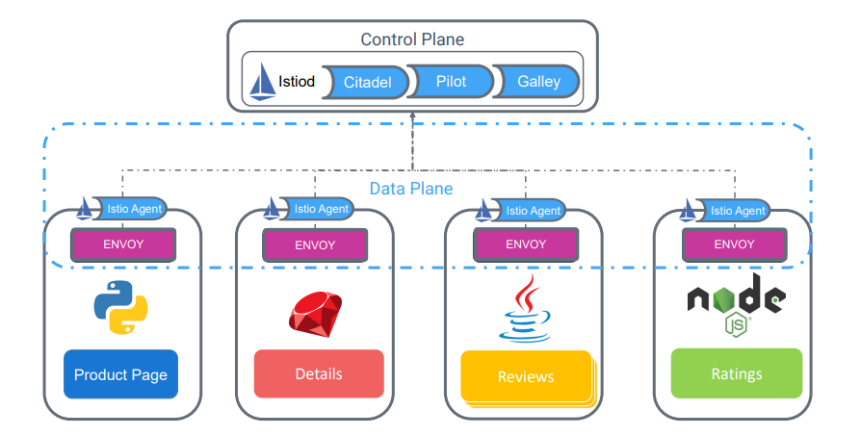
Istio Architecture

Slide 11
Gateways in Istio
Istio Gateway is a component of the Istio service mesh that is responsible for managing external traffic into the mesh.
It acts as an entry point into the service mesh for external traffic, and provides features such as load balancing, SSL/TLS termination, and routing to services within the mesh.
Istio Gateway can be configured to support different protocols such as HTTP, HTTPS, and TCP
It uses virtual services and destination rules to route traffic to the appropriate services within the mesh based on the incoming requests..

Slide 12
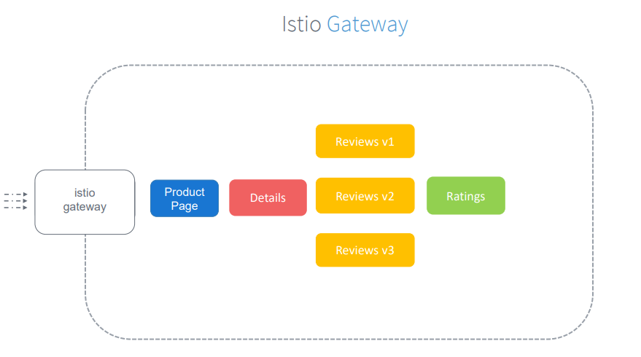

Slide 13
Virtual Service in Istio
Istio Virtual Services are a component of the Istio service mesh that allow you to define how traffic should be routed to specific services based on rules and conditions.
Virtual Services allow you to define traffic routing rules based on HTTP headers, paths, and hostnames.
Virtual Services are defined using YAML files, which specify the routing rules for incoming traffic.

Slide 14
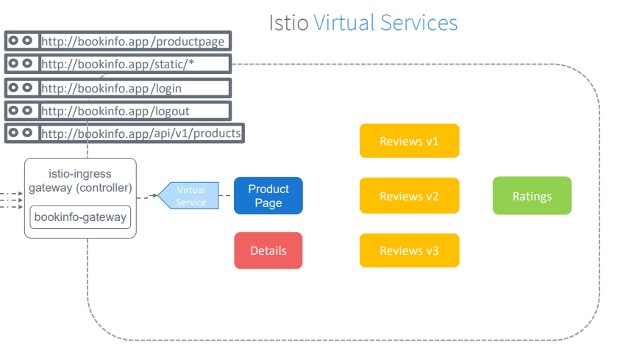

Slide 15
Demo

Slide 16
THANK YOU

