Slide 1



SlrpEV
Smart Learning Research Pilot for Electric Vehicles
Quarterly Update
December 2022

Slide 2
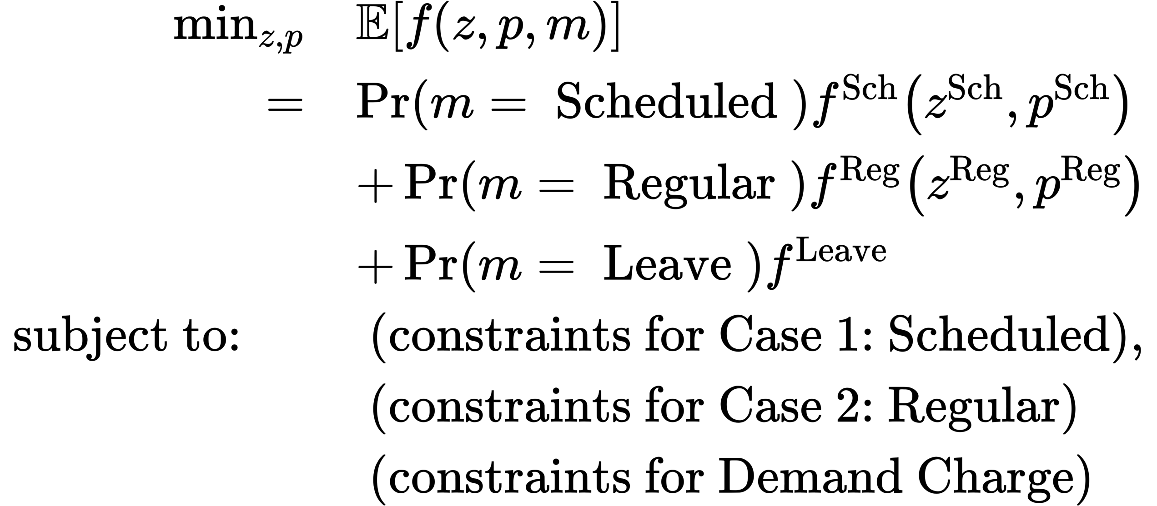
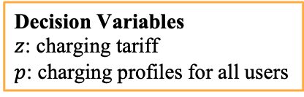
Optimization Model
Decision Variables
$z$: charging tariff
$p$: charging profiles for all users
Goal: minimize the expected costs for regular/scheduled charging and leave, considering the existing users in the station and demand charge.
Consider drivers arrival hour, energy demand and duration constraints.

Slide 3
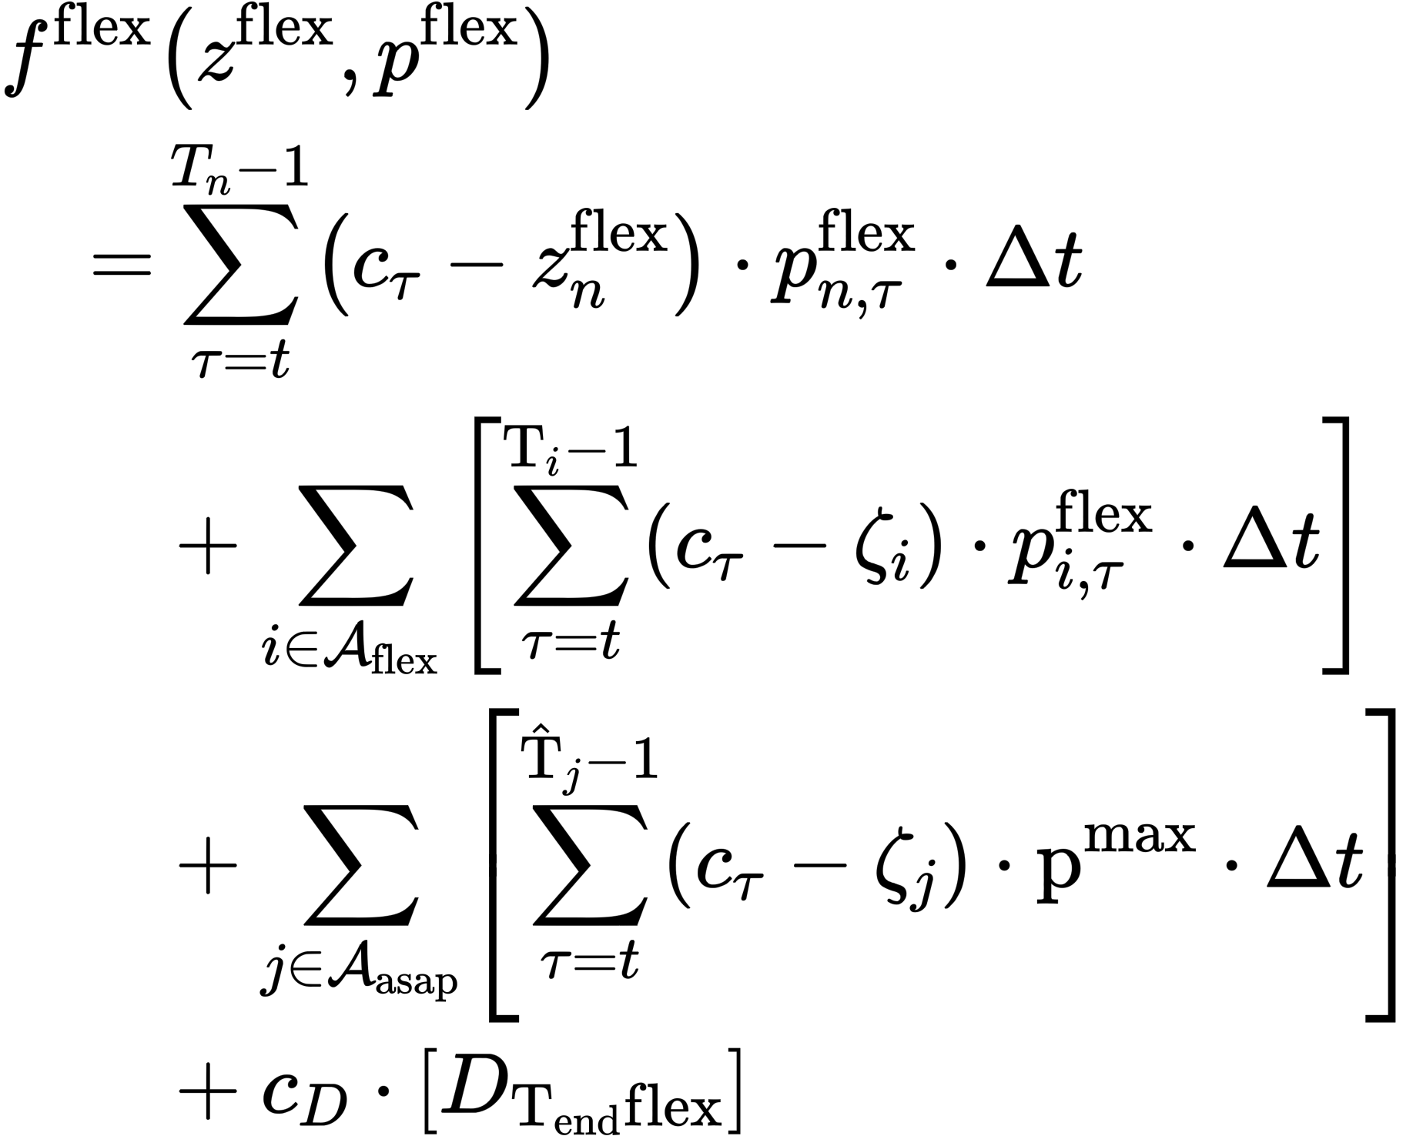
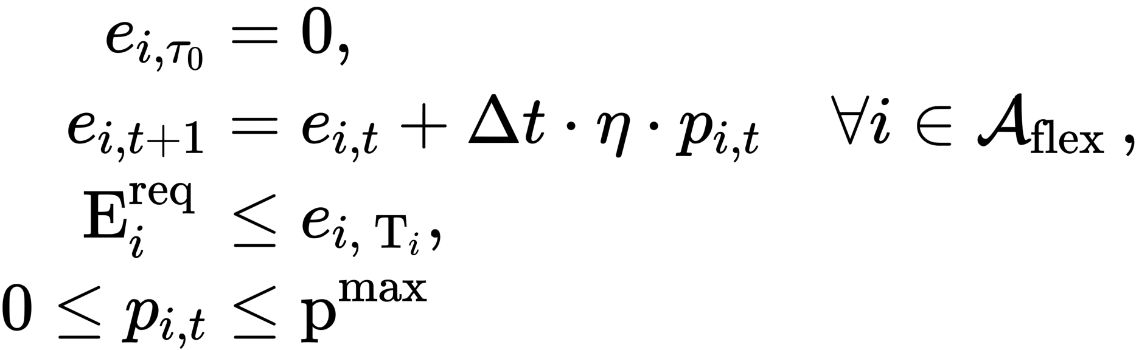
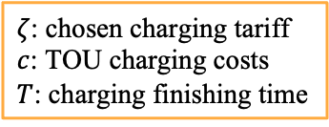
Case 1: Scheduled Charging
$ζ$: chosen charging tariff
$c$: TOU charging costs
$T$: charging finishing time
Objective: minimize cost for delivering variable power for all existing scheduled users.
Constraints:
1. Battery dynamics;
2. Meet energy demand until
departure;
3. Consider max power.
Existing scheduled users
Existing regular users
Demand charge
Subject to

Slide 4
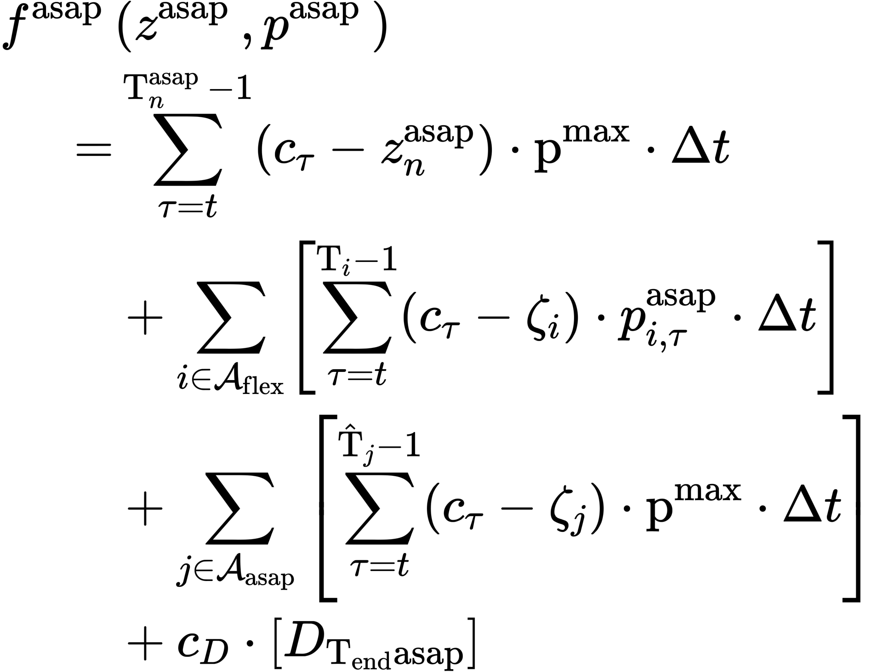
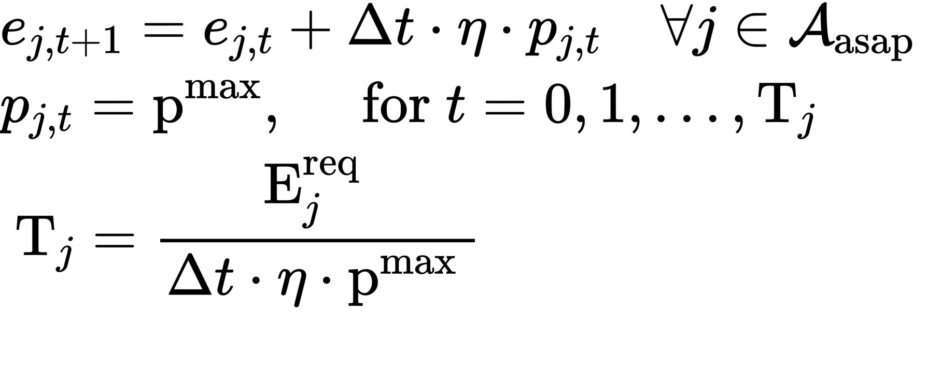
Case 2: Regular Charing
$ζ$: chosen charging tariff
$c$: TOU charging costs
$T$: charging finishing time
Objective: minimize cost for delivering constant maximum power until the departure or battery is full.
Constraints:
1. Battery dynamics;
2. Charging at maximum.
Subject to
Notes:
300 Cents / kwh.

Slide 5
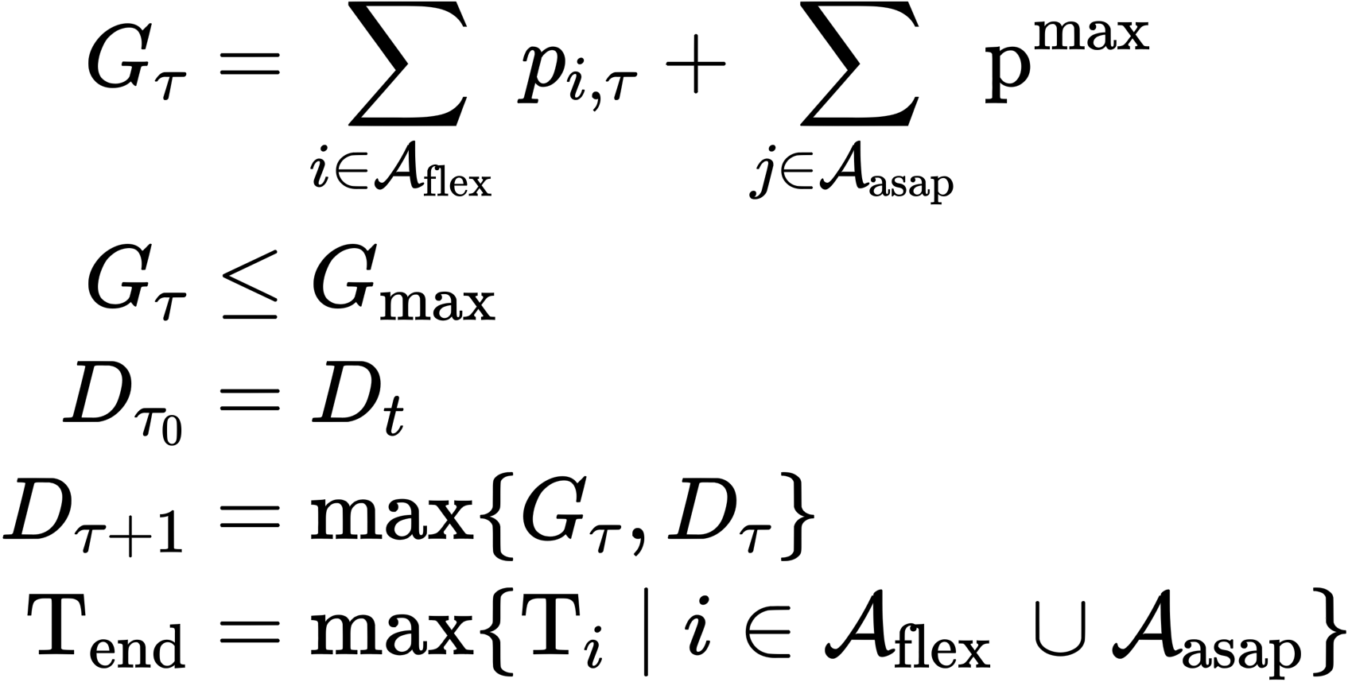
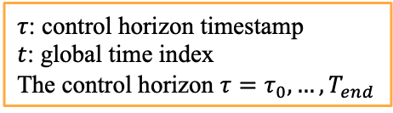
Demand Charge Formulation
$τ$: control horizon timestamp
$t$: global time index
The control horizon $τ=τ_{0},…,T_{end}$
total station charging load
station maximum power limit
control horizon initialization
demand charge update
control horizon length
Demand charge is modeled by tracking the maximum total power consumption seen up to the current time.

