Slide 1



SlrpEV
Smart Learning Research Pilot for Electric Vehicles
Quarterly Update
December 2022

Slide 2
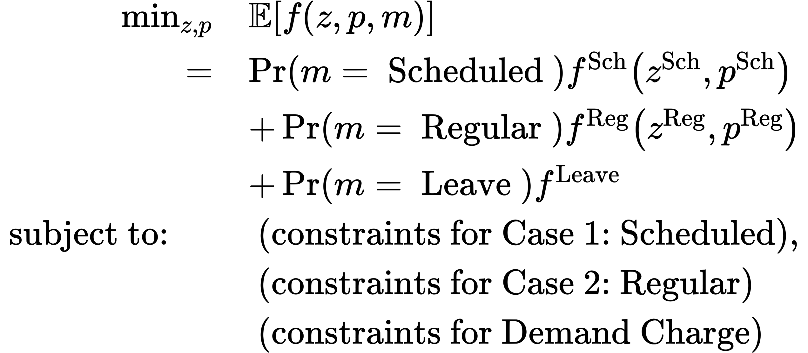
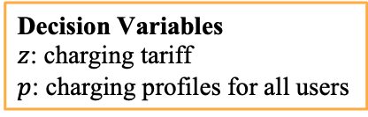
Optimization Model
Decision Variables
$z$: charging tariff
$p$: charging profiles for all users
Goal: minimize the expected costs for regular/scheduled charging and leave, considering the existing users in the station and demand charge.
Consider drivers arrival hour, energy demand and duration constraints.

Slide 3
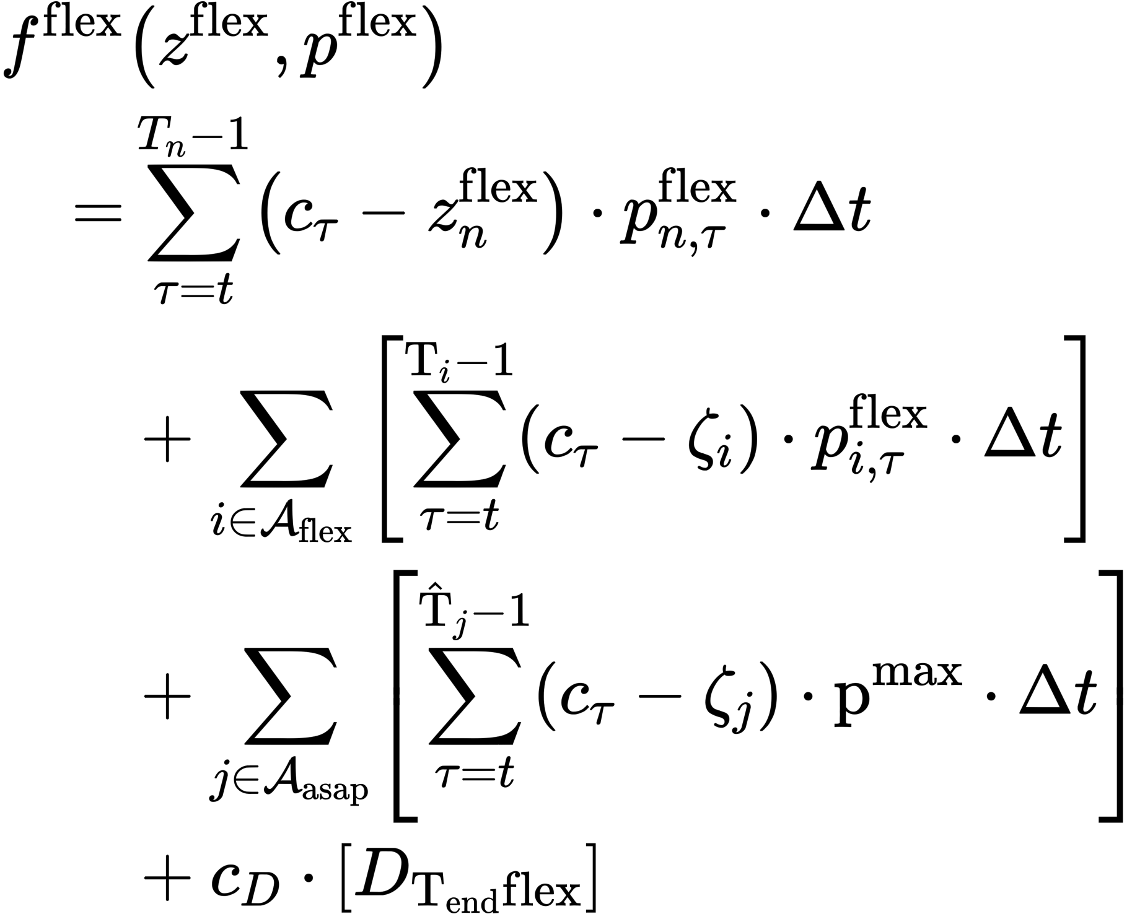
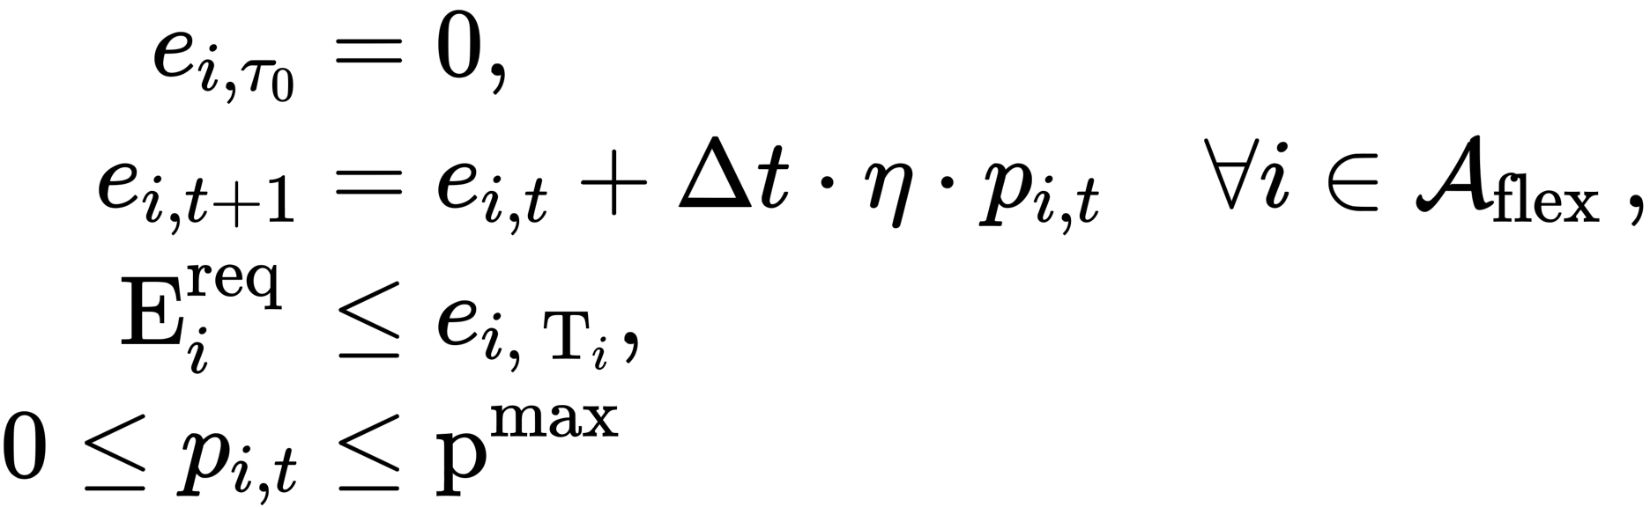
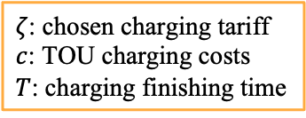
Case 1: Scheduled Charging
$ζ$: chosen charging tariff
$c$: TOU charging costs
$T$: charging finishing time
Objective: minimize cost for delivering variable power for all existing scheduled users.
Constraints:
1. Battery dynamics;
2. Meet energy demand until
departure;
3. Consider max power.
Existing scheduled users
Existing regular users
Demand charge
Subject to

Slide 4
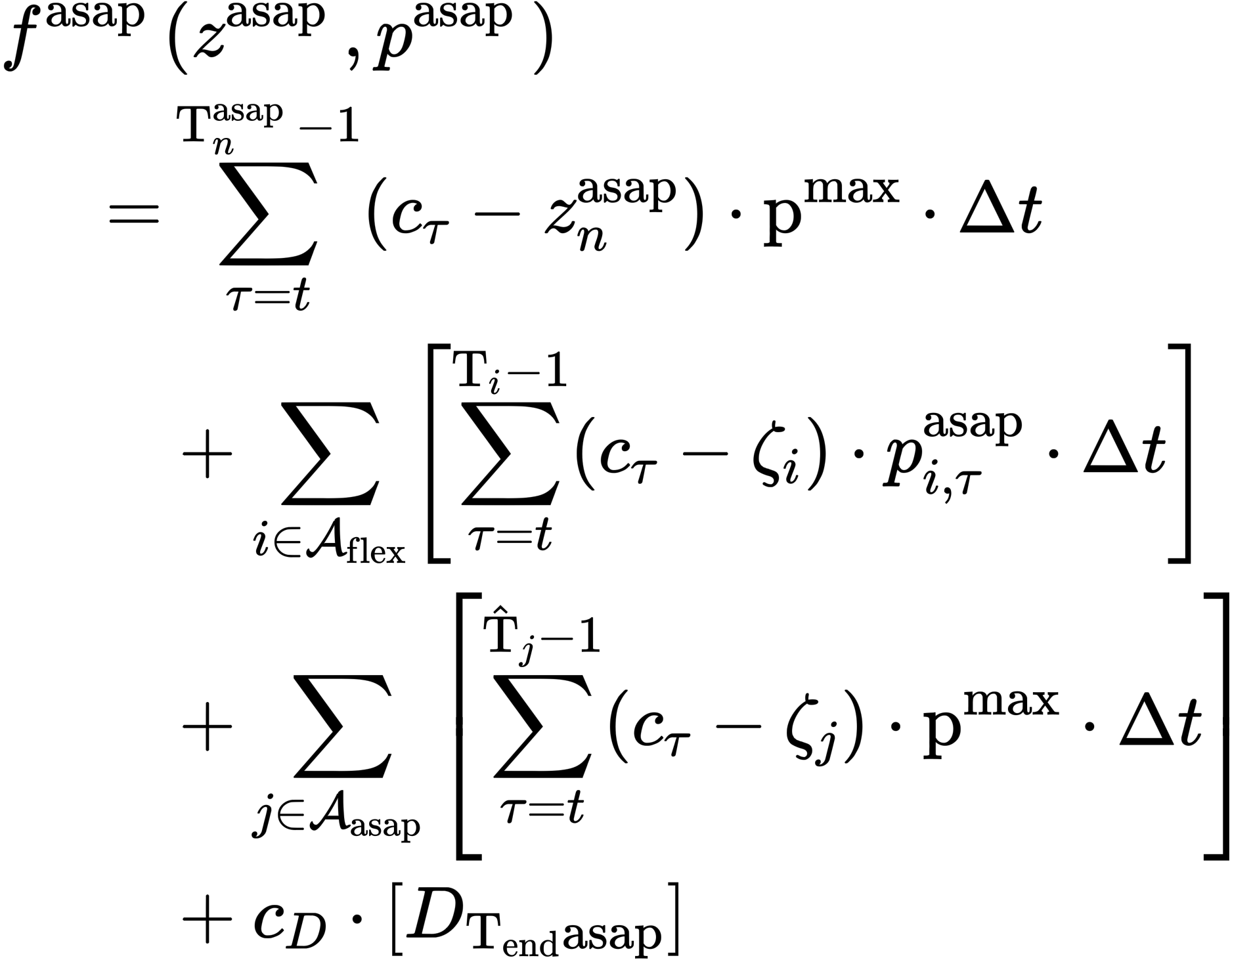
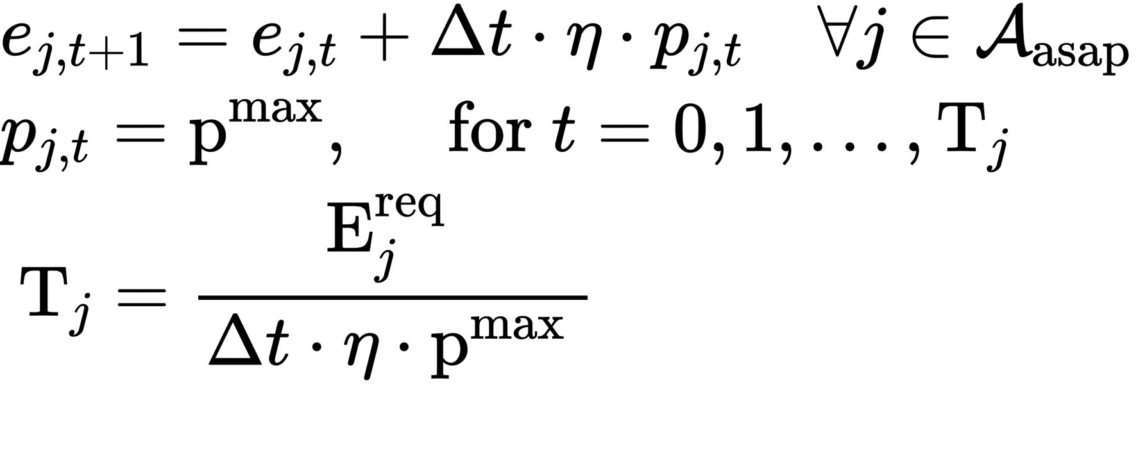
Case 2: Regular Charing
$ζ$: chosen charging tariff
$c$: TOU charging costs
$T$: charging finishing time
Objective: minimize cost for delivering constant maximum power until the departure or battery is full.
Constraints:
1. Battery dynamics;
2. Charging at maximum.
Subject to
Notes:
300 Cents / kwh.

Slide 5
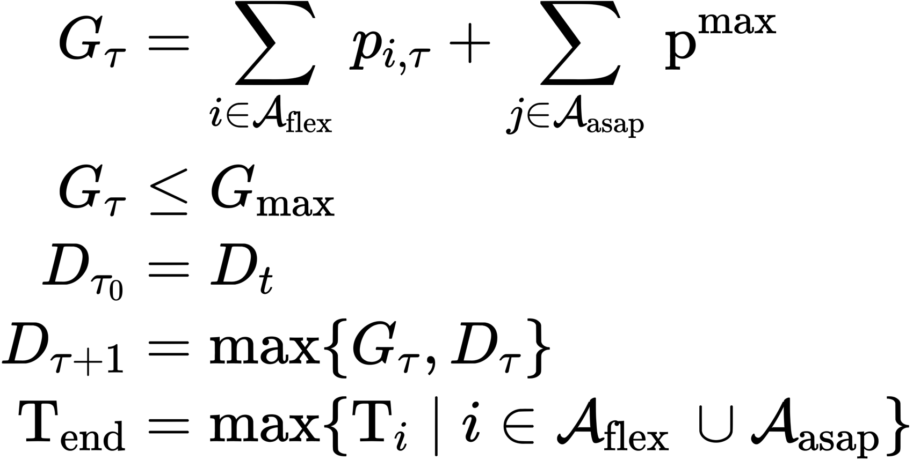
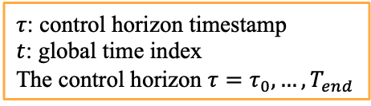
Demand Charge Formulation
$τ$: control horizon timestamp
$t$: global time index
The control horizon $τ=τ_{0},…,T_{end}$
total station charging load
station maximum power limit
control horizon initialization
demand charge update
control horizon length
Demand charge is modeled by tracking the maximum total power consumption seen up to the current time.

Slide 6
Numerical Tests
Day 1 Simulation Settings
Demand charge cost: 300(cents/kWh)
Time-of-user Tariff:
Off-peak 0.175 cents / kWh
4 - 9 pm: Peak 0.367 cents / kWh
9 am - 2 pm: super off-peak 0.49 $ / kWh to cents / kWh
10 Users, in total 260kW·h.

Slide 7


Interface
Class Problem init ( time, #arrival interval e_need, #energy needed duration, #duration interval station_pow_max, #chargers power rate user_power_rate, #vehicle power rate )
DCM Parameters
Class Parameters
Init (
z0, | #initial guess of price vector
Ts, | #discretization steps
Eff, | #charging efficiency
soft_v_eta, | #fenchel transform
opt_eps, | #stopping criteria
TOU, | #time of use electricity rate
Cost_dc ) | #demand charge rate
Class Optimization_station
Implements:
Block Coordinate Descent Algorithm
init ( Problem,
Parameters,
Station, # station existing user information
K # current time stamp
)
Returns
z,
p,
Station.
#optimal charging tariff #optimal power schedule
#updated station information
Driver’s Problem
Optimization Parameters
Decision Variables
1. Can be replaced with other behavioral models
2. Supports multiple user segments.

Slide 8
Interface(Data Types)
Class Problem init ( time, # int (interval) e_need, # float (kWh) duration, # stay duration (interval) station_pow_max, # float (kW) user_power_rate, # floar (kW) )
DCM Parameters
Class Parameters
Init (
z0, | # array (sch,reg,1)
Ts, | # float, 0.25
Eff, | # float
soft_v_eta, | # float
opt_eps, | # float
TOU, | # array, discretized
 | # according to Ts
)
Class Optimization
init ( Problem, Parameter
Station
K)
#Python Class #Python Class
#dict
#float
Implements:
Block Coordinate Descent Algorithm
Returns
z,
z_hr,
p,
station
# float (cents/ kWh) # float (cents/ hr)
# float (kW)
# dict
Driver’s Problem
Optimization Parameters
Decision Variables
1. Can be replaced with other behavioral models
2. Supports multiple user segments.

