Slide 1

Home Webserver

Slide 2

Overview
RPI headless
Docker
SSH
DNS (local/internet)
NAT
Reverse-Proxies/NGNIX

Slide 3
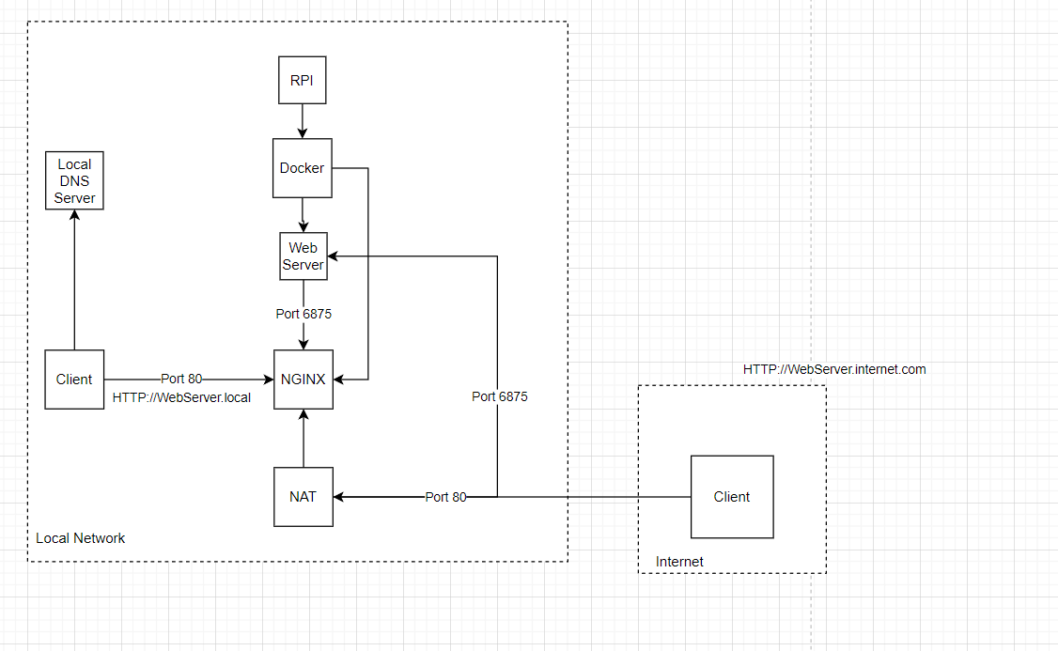
Architecture

Slide 4
Headless RPI/Flashing
Rasbpian lite img
Add blank ssh file to /boot
Setup WiFi by adding a wpa supplicant in /boot
(wpa_supplicant ref)

Slide 5
Setup your user
useradd dmiller (Not to be mistaken with adduser :O)
usermod -aG sudo dmiller (Adds my user to the sudoers group)
(NOTE: Group changes and Permissions require logging in and out)

Slide 6
SSH Keys
Uses asymmetric encryption (Private and Public keys)
You can give your public keys to whoever you want (Craigslist? 😉)
The public key encrypts messages that only the private key can decrypt

Slide 7
How do I share my keys?
You add it to the authorized_keys file inside a users .ssh folder
e.g. ssh-copy-id dmiller@192.168.1.184
Or you can manually move the key

Slide 8
Cleaning up the Pi user
Log out of all the terminals
(You can't have any active processes tied to the user account
'kill –9 PID' would also work).
sudo deluser -remove-home pi
(We want to nuke the home dir so we can save the 40kb of space the profile takes up)

Slide 9
Installing docker
sudo apt-get update
This updates the package lists for the different raspbian package repos
curl -fsSL https://get.docker.com -o get-docker.sh
Grabs an install script from docker
sudo sh get-docker.sh
Executes the script using the shell interperter
sudo systemctl enable docker && sudo systemctl start docker
Enable ensures the service is on next boot and start turns it on so we can start using it :)

Slide 10
Docker Permissions
sudo usermod -aG docker $(whoami)
$() is command substitution $(command). It means the command is executed and its output is assigned to the $ which representsa variable
This command adds our user to the docker group so we can run commands

Slide 11
Install docker-compose
sudo apt-get install libffi-dev libssl-dev
sudo apt install python3-dev
sudo apt-get install -y python3 python3-pip
sudo pip3 install docker-compose
(Not the recommend way to install docker-compose)
(We're using pip to install docker-compose to be lazy. Otherwise we need to pull the binary and setup the path stuff ourselves)

Slide 12
Cool.. Let's setup git
sudo apt-get install git
git config --global user.email "git@darylmiller.me"
git config --global user.name "Daryl Miller"

Slide 13
Setting up book stack
This is a documentation/wifi service to get you started with documenting your home setup :).
https://hub.docker.com/r/linuxserver/bookstack
(Docker-compose.yml is in repo with notes from presentation)

Slide 14
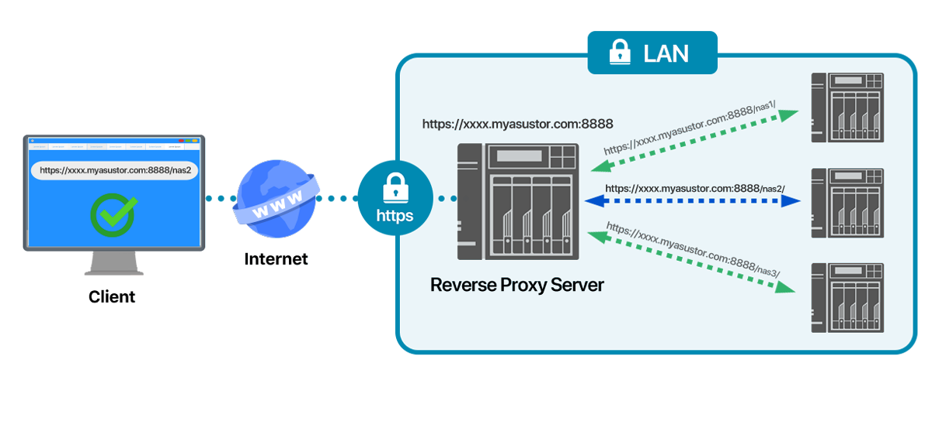
NGINX – What is a reverse proxy?
Can act as load balancer, reverse proxy and web server
33% of all websites on the internet run on NGINX
(Probably more, security pros obscure nmap probes)
(Refer to docker-compose in attached repo for setup)

Slide 15
NAT – What is good for?
In the before times everyone had a publicly routable IP address
NAT is why we have private IPs
Class A: 10.0.0.0 — 10.255.255.255
Class B: 172.16.0.0 — 172.31.255.255
Class C: 192.168.0.0 — 192.168.255.255
(Queue phone numbers analogy)

Slide 16
NAT - Continued
So now you know what NAT is? How do we route traffic to our webserver in our private network?
That's where ports come in! You map a port number e.g. 80 to an ip address on the router. So, when your router gets request on port 80 it forward to the ip address of the webserver.

Slide 17
Carrier Grade NAT
Carrier-grade NAT (CGNAT, also known as large-scale NAT), is a method of sharing a single unique public IP address with multiple services to allow providers to extend their pool of usable IPv4 addresses
(You can't host webservers at home on the internet if you have CGNAT using this presentation)

Slide 18
DNS
It maps friendly domain names hard to remember/dynamic 'things' e.g. an IP address.
What's easier to remember http://142.250.70.132 or www.google.com?
DNS maps tons of different records not just webservers.
Email
Txt (Normally used for ownership verification/magic)
PTR (Want to know what domain is attached to an IP?)
NS
Special mention dynamic DNS

Slide 19
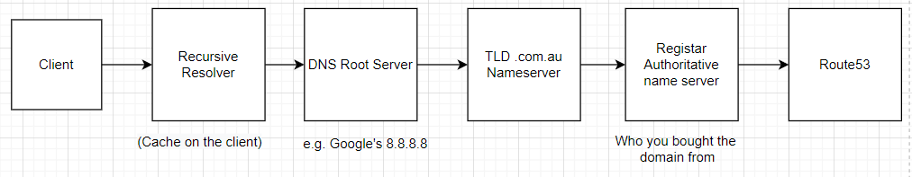
How does DNS resolve?

Slide 20

Improvements

Slide 21
Containers
Look at tools like portainer to manage your containers for you (Updates, health etc)
Docker is fine for POC/Home stuff but I'd shy away from using it as your container orchestrator in production refer to Kubernetes/AWS ECS for the real world.

Slide 22
Web Server
NGINX setup isn't setup using best practices. It's a very much quick and dirty setup (which is okay!)
Tools like Certbot and LetsEncrypt would allow us for free layer our applications with SSL. You can also easily setup certificate renewal
(If we don't use SSL all our super secret stuff is PAINtext PlainText*)

Slide 23
RPI Setup
If I had to do more than one Pi, you can use tools like Ansible to spin up multiple 'worker nodes' in an hour or two of tinkering. It allows you to deploy things like git/docker from yaml workflow files like github actions.

Slide 24

Questions?

