Slide 1
StudySync
Match with a compatible classmate. We book the session and set up your shared notes.
Daryl Carter • Manuel Arellano • Najib Abdulkadir
SEO Tech Developer Program — Project 2

Slide 2
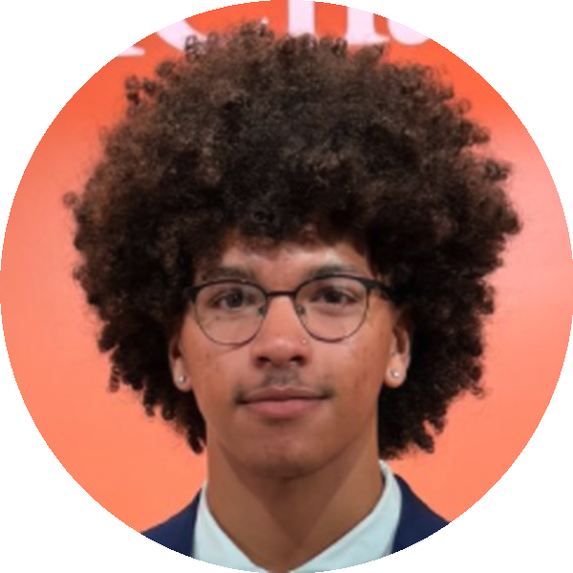
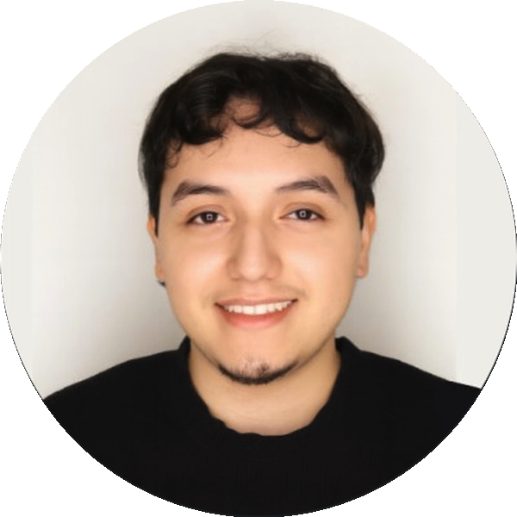
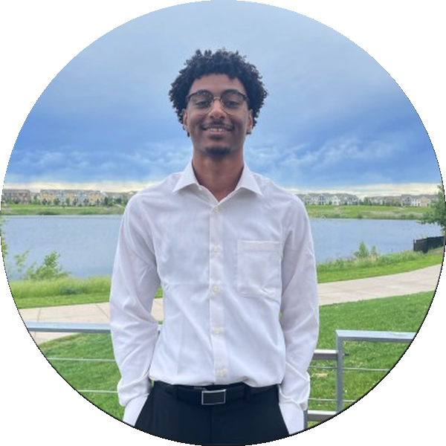
THE TEAM
Our Team
Daryl Carter
Manuel Arellano
Najib Abdulkadir
Backend & APIs
Database & Matching Engine
Frontend
UNCG — Computer Science
darylkcarterjr@gmail.com
UT Arlington — Computer Science
University of St. Thomas — Computer Science
StudySync
2

Slide 3
WHY THIS MATTERS
Background Information
01
Even in systems designed around student availability, nearly half of students (48.5%) still report scheduling as their top obstacle to effective study groups.
Inclusive Study Group Formation at Scale, arXiv 2022
02
Obstacles to finding study partners negatively affect students' sense of belonging, participation, and learning outcomes.
ASEE survey of 157 undergraduate engineering/CS students
03
Students in Freshman Interest Groups had higher graduation and re-enrollment rates — social fit, not just topic overlap, drove the benefit.
Freshman Interest Groups research, 12,500+ student responses
StudySync
3

Slide 4
THE PROBLEM
Problem Statement
Students struggle to find compatible study partners — matching happens informally through class chats or word of mouth, missing anyone outside your circle.
Existing tools filter by enrolled course only. They don't account for whether two students actually keep compatible schedules or study habits.
Once a group forms, there's no built-in way to actually book the time or share notes — that coordination still happens manually, if it happens at all.
StudySync
4

Slide 5
POSITIONING
What Makes Us Different
Unlike course-only matchers or generic scheduling tools —
Compatibility scoring, not just enrollment
Both sides confirm the session
Weighted match on availability overlap, shared courses, study style, and pace — not just "same class."
A proposal only books once the invited partner explicitly accepts — never a one-sided commitment.
Shared notes, created automatically
Fails gracefully, and stays cancellable
A Notion page is created for the pair the moment their match is accepted — no manual setup.
If Calendar or Notion is disconnected, the match still confirms. Either side can cancel or decline at any time.
StudySync
5

Slide 6
THE FLOW
How It Works
1
2
3
4
Connect
Match
Propose & Respond
Auto-book
Student signs in and connects Google Calendar + Notion via OAuth 2.0
→
Compatibility engine ranks candidates and shows the actual overlapping free-time windows
→
Student proposes a session time; the invited partner accepts or declines
→
On acceptance, the backend books a Calendar event (both attendees invited) and creates a shared Notion page
A pending invite can be declined, and a confirmed session can be cancelled — either way, both participants always see the current status.
StudySync
6

Slide 7
TECH STACK
Software & Languages
Backend
Frontend
APIs (OAuth 2.0)
Testing
Python 3
HTML
Google Calendar API
pytest / unittest
Flask
CSS
Notion API
92 passing tests
SQLAlchemy
JavaScript
SQLite
StudySync
7

Slide 8
UNDER THE HOOD
Key Features
OAuth Authentication
Compatibility Engine
Two-Sided Booking
Google Calendar login + token refresh
Weighted scoring: availability, course, study style, pace
Propose → invited partner accepts or declines
Notion login with CSRF state validation
Symmetric & bounded 0–100 score (tested)
Both participants get a real Calendar invite
Graceful degradation if either API fails
Real overlapping time windows shown, not just a count
Cancel anytime; booking outcome persists
StudySync
8

Slide 9
TECHNICAL IMPLEMENTATION
System Architecture
Frontend
Flask Backend
External APIs
HTML / CSS / JS
Auth routes
Google Calendar
Match routes
Notion
Matching engine
SQLite Database
User · Course · Availability
Preference · Match
OAuthToken · MatchProposal
StudySync
9

Slide 10
TECHNICAL IMPLEMENTATION
Database Design
User
id, name, email — central entity; has many Availability slots, one Preference, many Courses
Course
id, name, code — many-to-many with User via a join table
Availability
id, user_id, day_of_week, start_hour, end_hour — one row per free-time block
Preference
id, user_id (unique), study_style, pace — one-to-one with User
Match
id, user_a_id, user_b_id, score, status, created_at — score stored at match time as an audit trail
OAuthToken
id, user_id (FK), provider, access_token, refresh_token, expires_at
MatchProposal
id, match_id (unique FK) — session time/topic, booking outcome, and each side's dismiss flag; added without touching Match's schema
StudySync
10

Slide 11
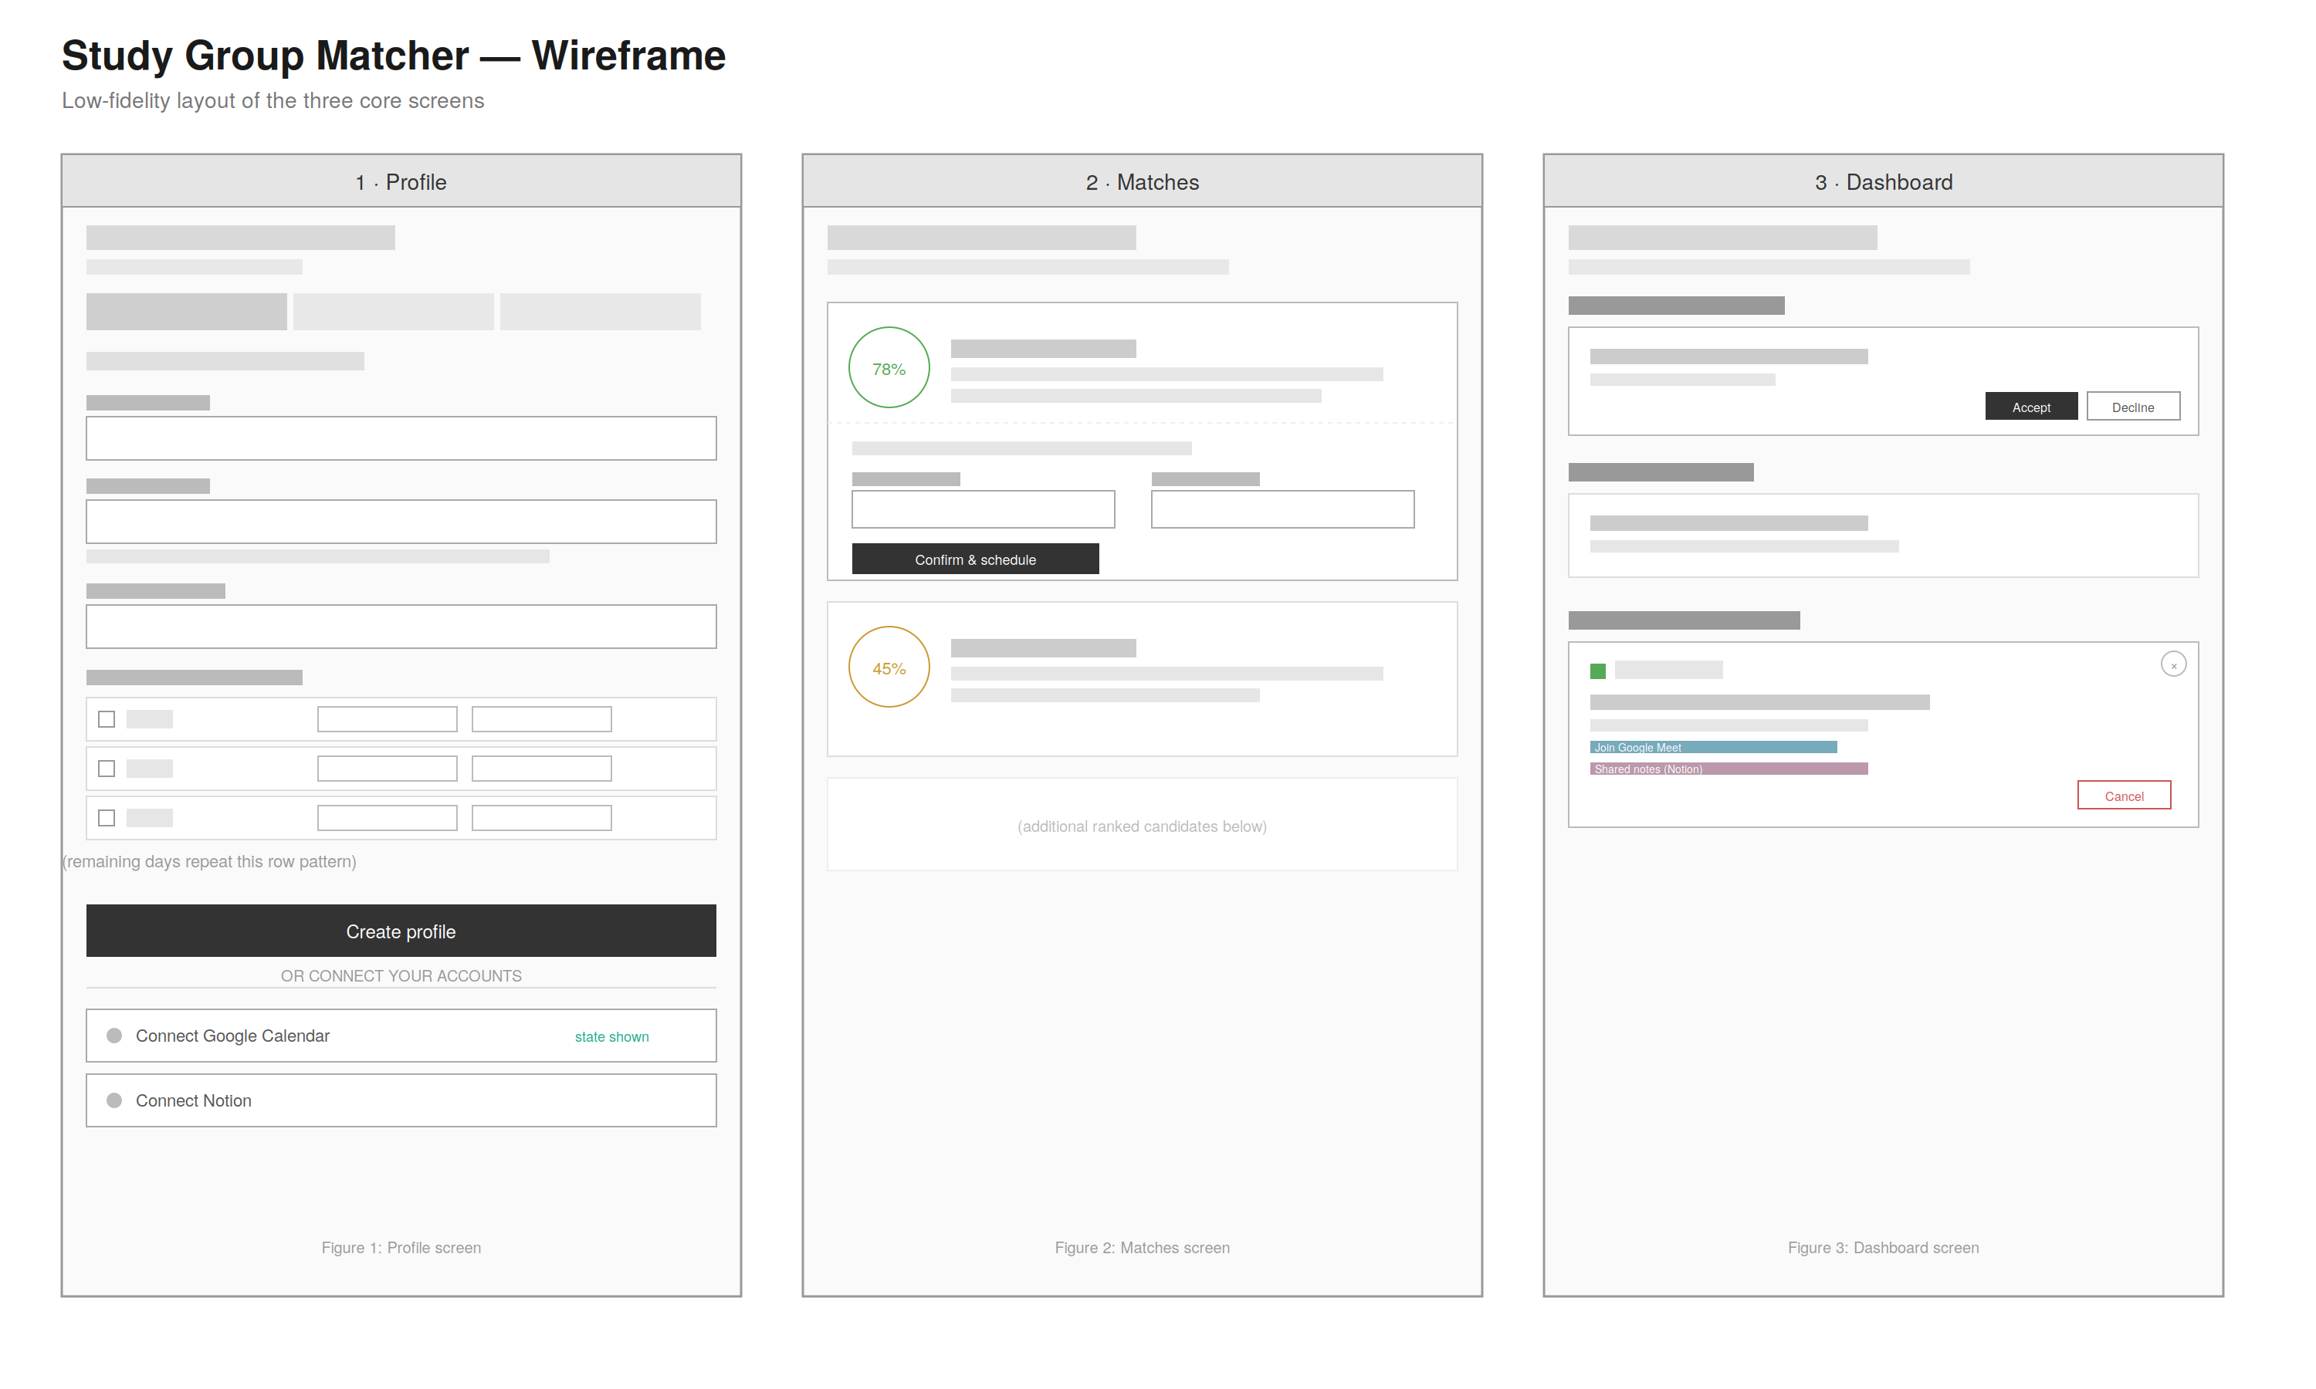
DESIGN
Wireframe
StudySync
11

Slide 12
PROCESS
Agile Development Process
Planning
Collaboration
Testing Strategy
Kanban board for task tracking
Backend: OAuth, matching, routes
92 automated tests
Git feature branches per component
Database: schema + scoring engine
Success + failure-path coverage
Pull requests for review before merging
Frontend: UI/UX implementation
Live two-browser smoke tests against real Google/Notion accounts
StudySync
12

Slide 13
HONEST RETROSPECTIVE
Risks and Challenges
Third-party platform limitations
Zoom's OAuth app type blocked loopback redirect URIs; Azure App Registration required an organizational tenant we didn't have access to. We pivoted to Notion for the second integration rather than lose more time.
Coordinating a shared API contract across parallel work
The match-confirmation payload changed as the database and scoring engine were wired in. Frontend work built against an earlier version, requiring a reconciliation pass — reinforced the value of locking a contract before building in parallel.
Local dev environment conflicts
macOS AirPlay Receiver silently occupies port 5000, the Flask default — cost real debugging time before we traced it to a system service, not our code.
OAuth session/cookie scoping
localhost and 127.0.0.1 are treated as different origins by the browser, breaking session-based CSRF state checks between login and callback until we standardized on one hostname per provider.
StudySync
13

Slide 14
Code Demo
Live: connect accounts → propose a match → partner accepts → booked event + shared notes

Slide 15
WHAT'S NEXT
Future Enhancements
Real "Sign in with Google" identity
Replace the temporary user_id stand-in with session-based login tied to Google's own identity.
Real-time updates
Notify a match's other participant the moment someone accepts, declines, or cancels, instead of requiring a manual page refresh.
Rate limiting, input sanitization & production WSGI server
Harden the deployment path beyond the Flask development server, and sanitize profile input before rendering it.
Mobile app
Extend beyond the web frontend for on-the-go matching.
StudySync
15

Slide 16
Thank You
Questions?

