Slide 1



Deactivation link
Activation link
Exclusive link
Game Time
-If 1st half, starts from 00:00
-If 2nd half, starts from 45:00
00:00
1st Half
2nd Half
Game Phases
Specific Actions
In Possession
Out of Possession
Home Team
Away Team
User activate after choosing half
Stop phase
Build-up
Transition
Def -> Att
Final third
Pressing
Mixed
Contain
Reset to 00:00/45:00 depends on the active half
Phase Details
Build-up
Retain Possession
Direct
Transition
Def -> Att
Withdrawn
Midfield
Attack
Final third
Play through
Play over
Play around
High block
Mid block
Low block
Set Pieces
Home Team
Away Team
Direct
Freekicks
Indirect Freekicks
Penalty
Corners
Throw ins
Location
Outcome
Left
Centre
Right
Successful
Saved
Cleared/Out

Slide 2
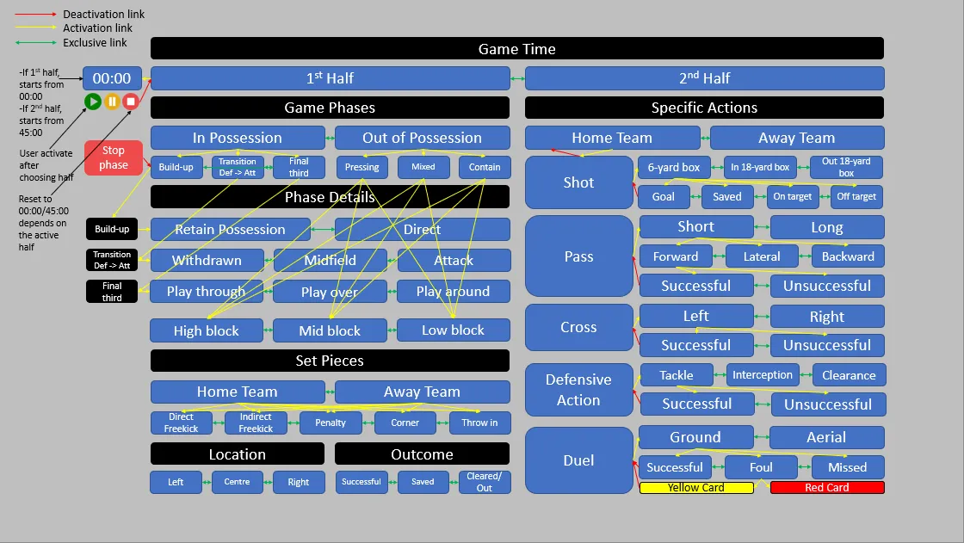
8%
2%
42%
4%
42%

