Slide 1
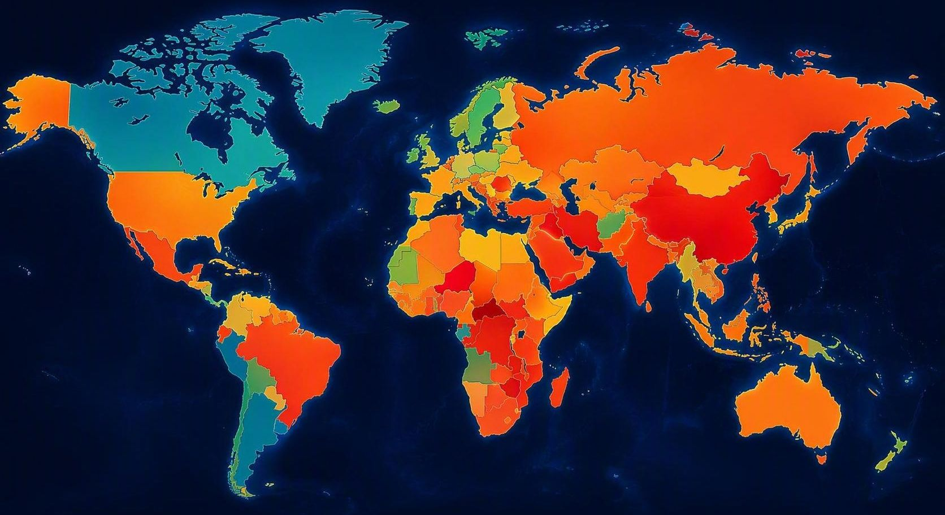
AN INTERACTIVE COVID-19 DECISION SUPPORT APPLICATION Integrating Machine Learning, Clustering, and Explainable AI
Daryl Morris
Springboard Data Science Career Track
Capstone Three
July 2026
Notes:
Good morning. My name is Daryl Morris, and today I'll be presenting my Springboard Data Science Capstone Three project.
In Capstone Two, I developed a Random Forest machine learning model that predicts country-level COVID-19 mortality using demographic, healthcare, economic, vaccination, and public policy variables.
For Capstone Three, I extended that work into an interactive decision-support application. Rather than simply producing predictions, the application allows users to explore countries, compare clusters of similar nations, understand why the model makes its predictions using Explainable AI, and test "what-if" scenarios by modifying model inputs in real time.
The goal was to create a practical analytical tool that combines predictive modeling, country clustering, and explainable AI into a single interactive dashboard.

Slide 2
Project Evolution
Capstone Two
Capstone Three
Predictive Machine Learning Model
Interactive Decision-Support Application
Random Forest regression model
Country-level COVID-19 mortality prediction
Static analysis and feature importance
Machine learning performance evaluation
Evolved Into
Interactive Streamlit dashboard
K-Means country clustering
Scenario-based prediction
SHAP explainability
Real-time prediction explanation
Project Goal
Transform predictive machine learning into an interactive, explainable decision-support application.
Notes:
"Capstone Two focused on developing and evaluating a Random Forest model capable of predicting country-level COVID-19 mortality. While the model performed well, it remained a traditional machine learning analysis. Capstone Three extends that work by transforming the model into an interactive decision-support application. Users can now explore country clusters, evaluate hypothetical scenarios, and understand predictions through explainable AI—all within a single interface.”

Slide 3
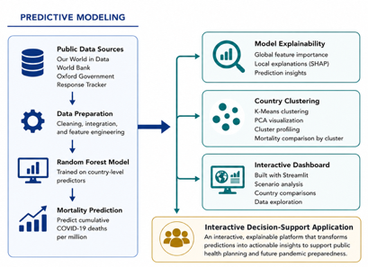
System Architecture
Integrates machine learning prediction, country clustering, and SHAP explainability into a unified interactive application.
Notes:
This diagram summarizes the overall architecture of the application.
The project begins by integrating publicly available data from Our World in Data, the World Bank, and the Oxford COVID-19 Government Response Tracker. These data are cleaned, merged, and prepared for analysis.
The Random Forest model predicts cumulative COVID-19 deaths per million using demographic, healthcare, economic, vaccination, and policy variables.
Capstone Three extends that predictive model in three important ways.
First, K-Means clustering groups countries with similar underlying characteristics, allowing countries to be compared with appropriate peers.
Second, SHAP provides explainable AI by identifying which variables drive both the overall model behavior and individual country predictions.
Finally, these components are integrated into a Streamlit dashboard that allows users to interactively explore the data, visualize global patterns, and generate new predictions under user-defined scenarios.
Together, these components transform a predictive model into an interactive decision-support application.

Slide 4
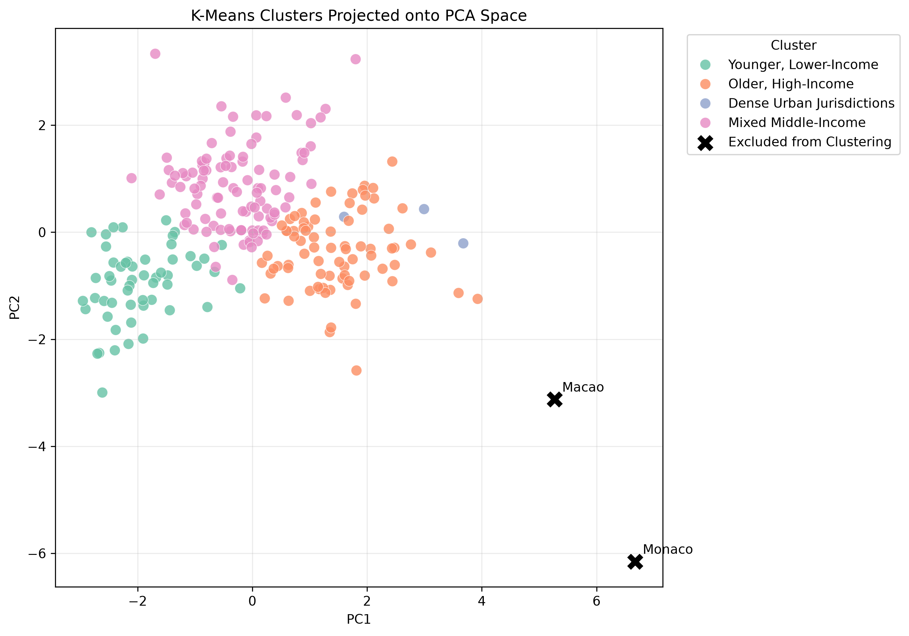
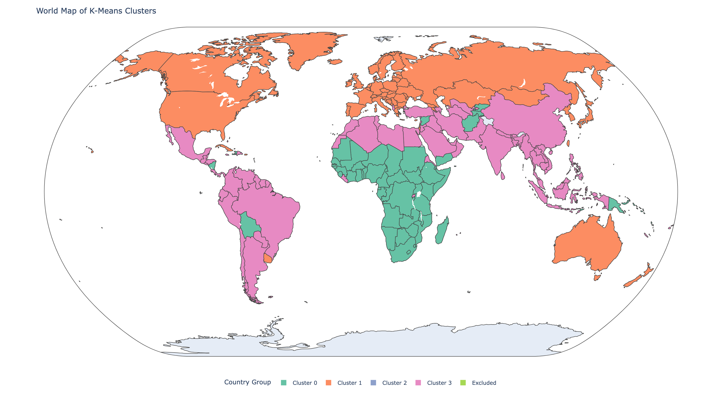
Country Exploration Through Clustering
K-Means Cluster Visualization (PCA Projection)
Interactive Country Cluster Map
Key Insight
Countries are grouped according to demographic, healthcare, economic, and public health characteristics. COVID-19 mortality was intentionally excluded from the clustering process.
Notes:
One major enhancement in Capstone Three is the addition of country clustering.
Rather than comparing every country directly, I used K-Means clustering to group countries with similar demographic, healthcare, economic, vaccination, and policy characteristics.
Importantly, COVID-19 mortality was intentionally excluded from the clustering algorithm. This ensures that the clusters are based only on underlying characteristics rather than outcomes.
The figure on the left shows the clusters projected into two principal components using PCA for visualization, while the map on the right illustrates how those clusters are distributed geographically.
These clusters provide meaningful peer groups that make comparisons more informative throughout the dashboard. Users can explore mortality patterns within clusters instead of relying solely on geographic location or income classification.

Slide 5
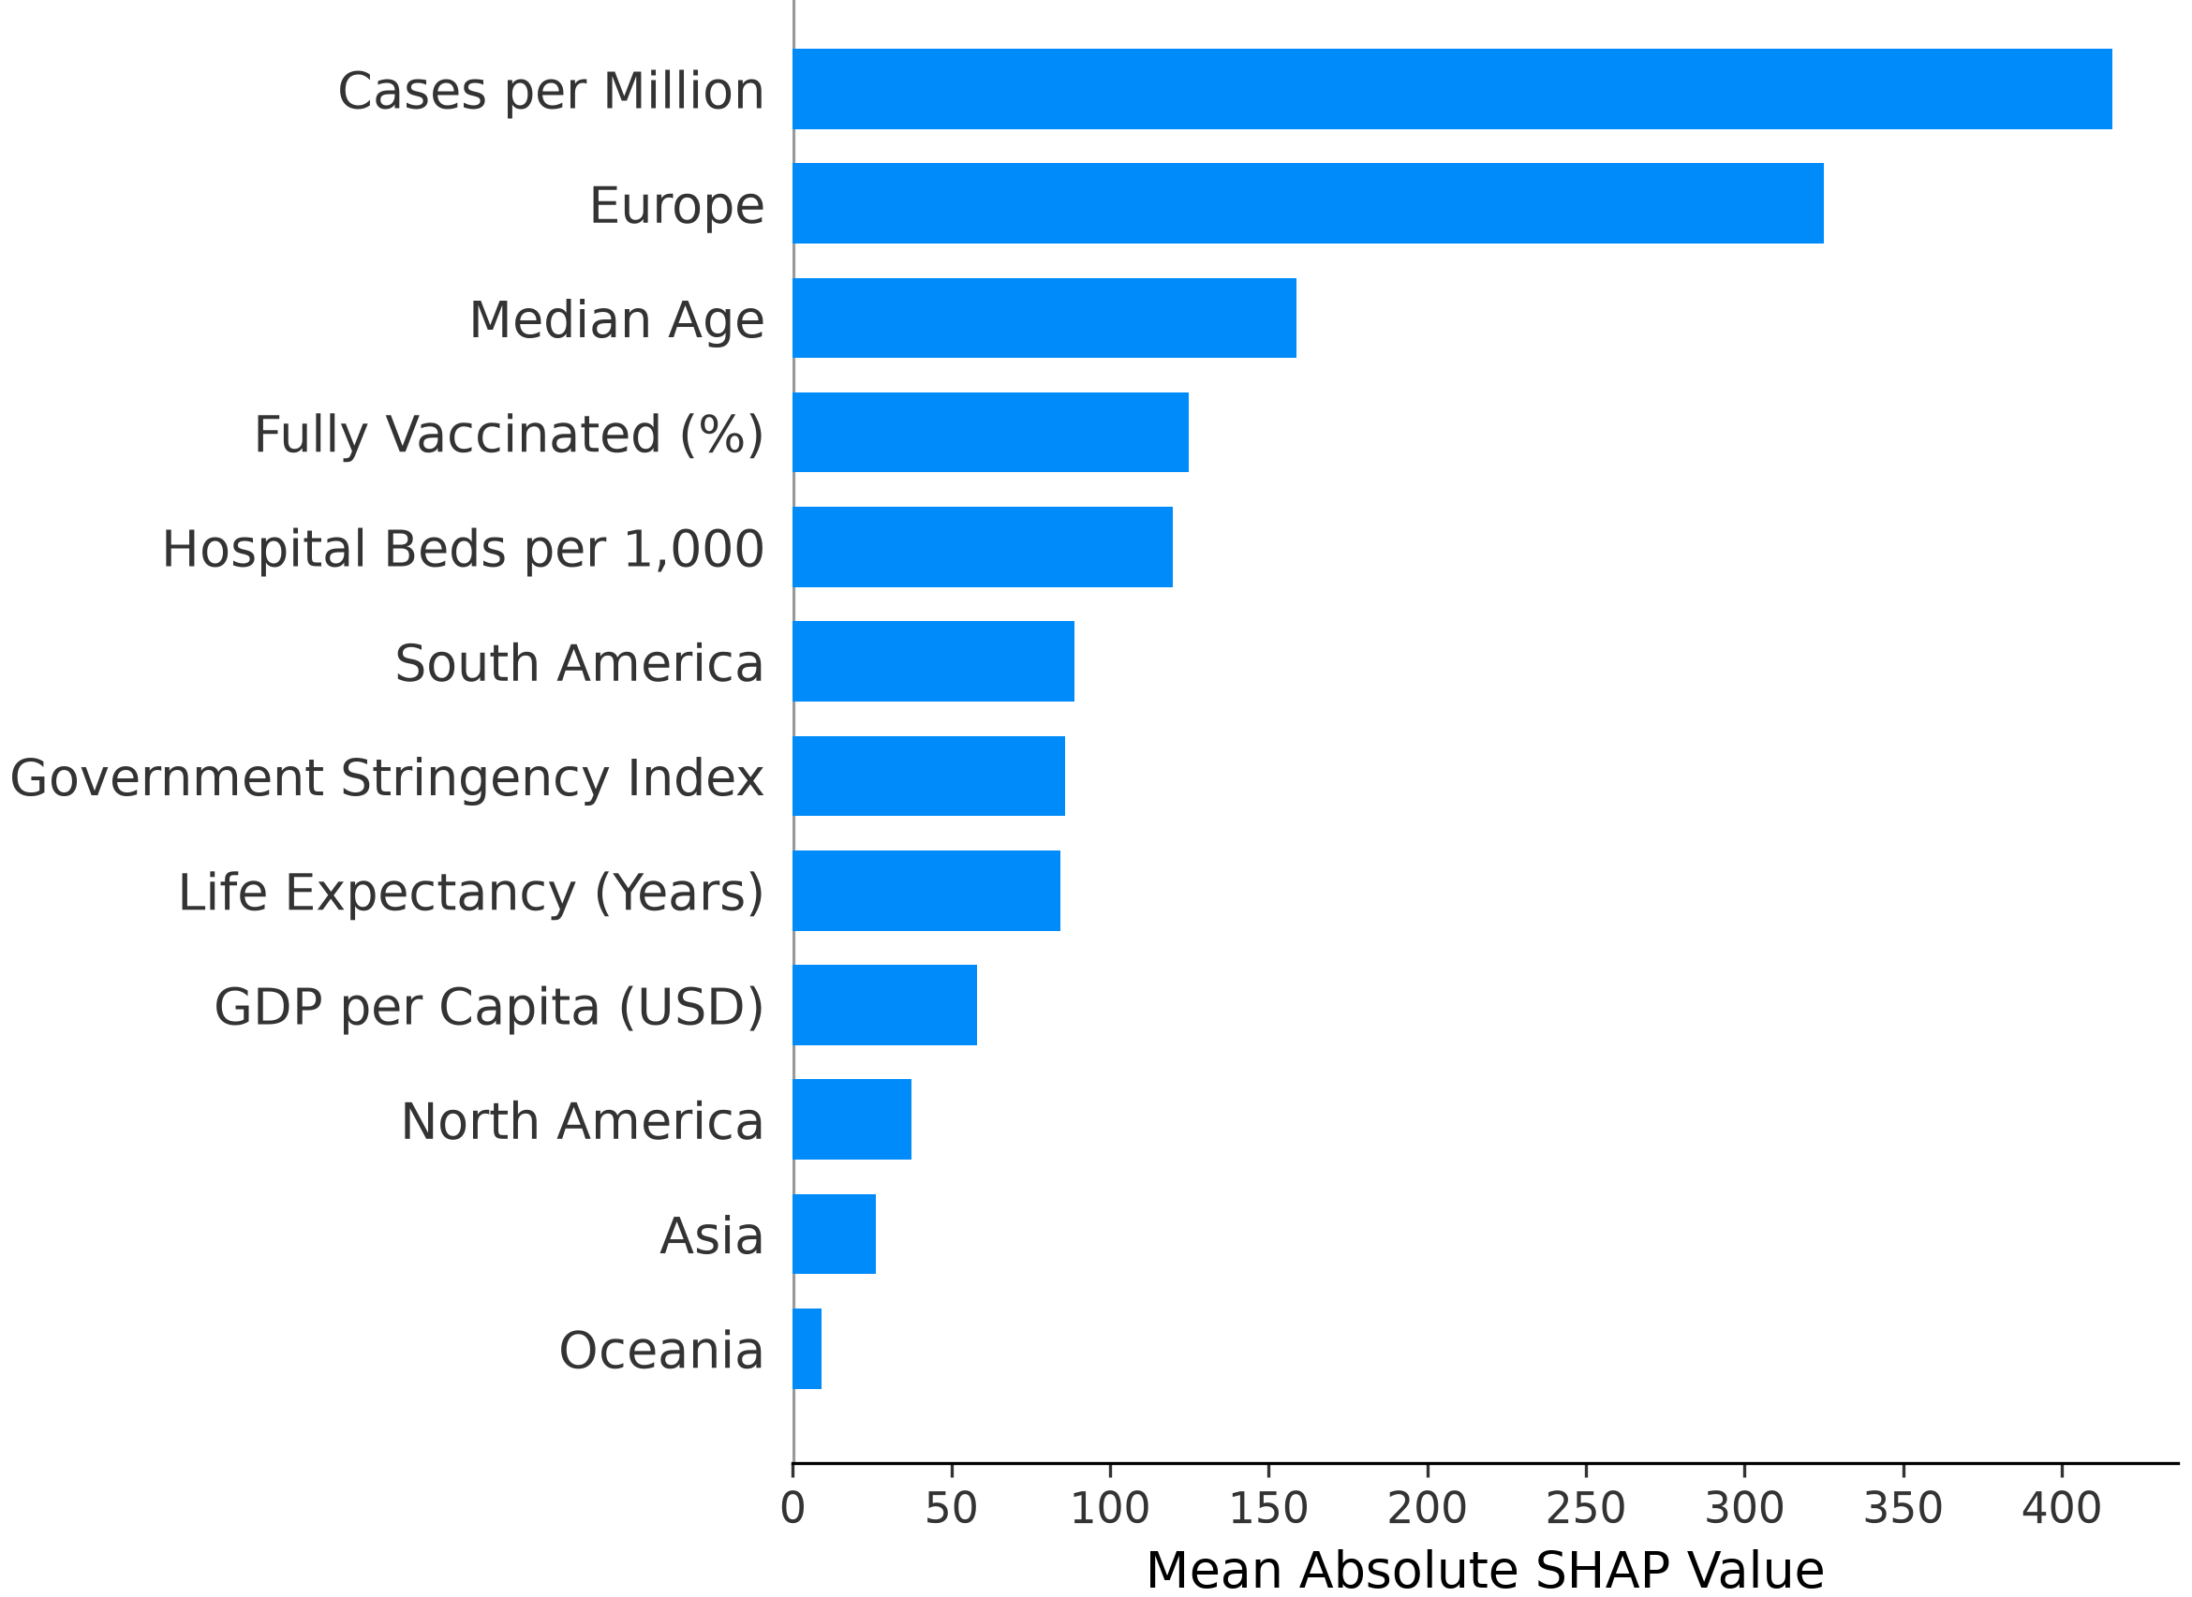
Explainable AI Using SHAP
What SHAP Explains
Explains individual predictions
Quantifies feature contributions
Identifies the most influential predictors
Opens the Random Forest “black box”
Key Insight
Cases per Million and geographic region are the model's strongest predictors of COVID-19 mortality. SHAP provides transparent explanations of how these and other variables influence model predictions.
Notes:
"One challenge with ensemble models like Random Forests is that they often behave as black boxes—they can make accurate predictions without explaining why. To address this, I incorporated SHAP, an Explainable AI framework that quantifies how much each feature contributes to the model's predictions. This chart shows the average importance of each predictor across all countries. Cases per million and geographic region are the strongest contributors, followed by median age, vaccination, and healthcare-related variables. More importantly, SHAP doesn't just explain the model globally—it also explains individual country predictions, which becomes a key feature of the interactive dashboard."

Slide 6
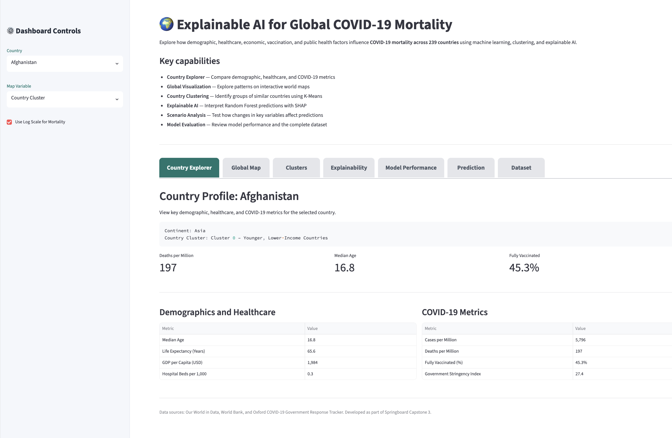
Interactive Dashboard
Dashboard Modules
Country Explorer
Global Map
Country Clusters
SHAP Explainability
Model Performance
Scenario Prediction
Dataset Browser
Key Insight
The dashboard integrates multiple analytical tools into a single interface, allowing users to move seamlessly between exploration, prediction, clustering, and explainable AI.
Notes:
"The final step of the project was integrating everything into a single interactive Streamlit dashboard.
Rather than presenting separate analyses, the dashboard brings together all of the project's components into one interface.
Users can explore individual country profiles, visualize global patterns on an interactive map, compare countries using K-Means clustering, examine model performance, view SHAP explanations, and generate new mortality predictions under hypothetical scenarios.
The goal was to create a practical decision-support tool where users can move seamlessly between exploration, prediction, and interpretation instead of viewing each analysis independently."

Slide 7
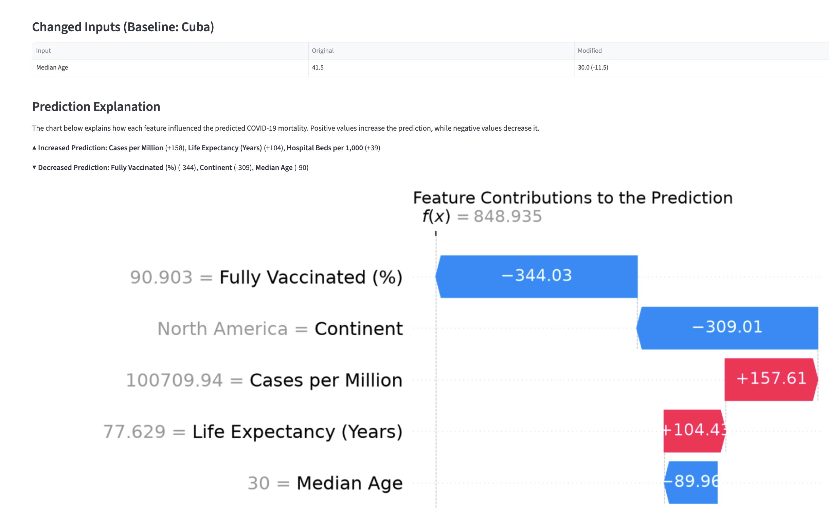
Interactive Scenario Analysis
What Users Can Do
Select any country
Modify demographic, healthcare, economic, or policy variables
Generate a new mortality prediction instantly
Understand direct effects and model interactions
Explain every prediction using SHAP
Key Insight
Users can test hypothetical scenarios and immediately understand not only how the prediction changes, but which variables are responsible for that change.
Notes:
"One of the most useful features of the dashboard is the interactive scenario analysis.
Users begin by selecting any country as a baseline and can then modify demographic, healthcare, vaccination, economic, or policy variables.
The Random Forest model immediately generates a new mortality prediction, while SHAP explains exactly which variables increased or decreased that prediction and by how much.
This transforms the model from a black box into an interactive decision-support system, allowing users to explore 'what-if' scenarios while understanding the reasoning behind each prediction."

Slide 8
Project DELIVERABLES
Data Engineering
Integrated public datasets
Engineered country-level features
Machine Learning
Random Forest mortality prediction
K-Means country clustering
Explainable AI
Global and local SHAP explanations
Feature interaction analysis
Interactive Dashboard
Streamlit application
Seven integrated analytical modules
Public Data
Feature Engineering
Machine Learning
Explainable AI
Interactive Dashboard
Decision Support
Key Insight
This project extends beyond predictive modeling by combining data engineering, machine learning, clustering, explainable AI, and interactive visualization into a unified decision-support system for public health analysis.
Notes:
"This project extends beyond building a predictive model.
It integrates the complete data science workflow—from data engineering and feature engineering through machine learning, explainable AI, and deployment in an interactive application.
Public datasets were combined into a unified analytical dataset, a Random Forest prediction model and K-Means clustering model were developed, SHAP was applied to provide transparent explanations, and these capabilities were integrated into a Streamlit dashboard.
The result is a unified decision-support system that combines prediction, interpretation, visualization, and exploration within a single application."

Slide 9
THANK YOU
RESOURCES
Questions?
GitHub Repository
https://github.com/darylm910/COVID_Decision_Support_System
Explore the code, launch the dashboard, or continue the conversation.
Live Dashboard
https://coviddecisionsupportsystem-bwdacuubwqgfphchtpbb8p.streamlit.app
Technologies
Python • Pandas • Scikit-learn SHAP • Streamlit • Plotly
Springboard Data Science Career Track
Capstone 3
Notes:
"To conclude, this project demonstrates that combining machine learning with explainable AI can produce not only accurate predictions, but also transparent and interpretable insights. By integrating data engineering, clustering, predictive modeling, SHAP explainability, and an interactive Streamlit dashboard, the result is a practical decision-support tool for exploring complex public health outcomes. Thank you, and I'd be happy to answer any questions."

