Slide 1
Digital Design Group Project
VHDL Hexadecimal Peak Detector
Group 17
Alexander Hamilton
Daryl White
Sylvia Betrosian
Adreas Michaelides

Slide 2
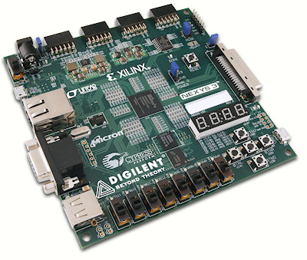
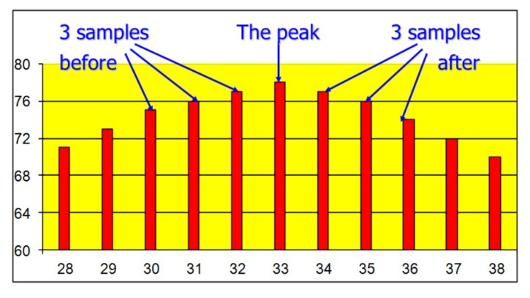
Specifications
Perform peak detection on a 8-bit hexadecimal data stream
Implement in VHDL on a Spartan-6 FPGA
Interaction over UART via simple commands

Slide 3
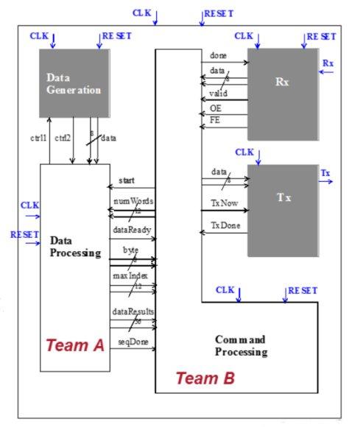
Group Composition
Team A – Data Processor
Alexander Hamilton
Daryl White
Team B – Command Processor
Sylvia Betrosian
Adreas Michaelides

Slide 4
Command Processor

Slide 5
Data Processor
Introduction
The Data Processor is responsible for requesting the required number of bytes from the Data Generator and performing peak detection on this stream of byes.
Once this is done it passes the peak byte and various index values to the Command Processor.

Slide 6
Data Processor
ASM and FSM Design

Slide 7
Data Processor
Architecture and Signals

Slide 8
Data Processor
Processes

Slide 9
Data Processor
Test Bench

Slide 10
Synthesis

Slide 11
Conclusion

