Slide 1
The Peak Detector
By Alexander Hamilton, Daryl White, Sylvia Betrosian, and Adreas Michaelides

Slide 2
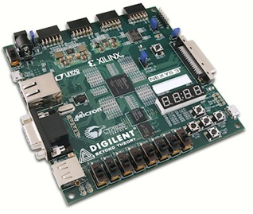
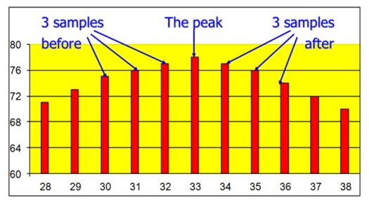
Specifications
Perform peak detection from a stream of 8-bit hexadecimal bytes
Implemented in VHDL on to a Spartan-6 FPGA board
Interaction over UART using simple commands

Slide 3
The Data Processor
Alexander & Daryl
The Data Processor is responsible for requesting the required number of bytes from the Data Generator and performing peak detection on this stream of bytes.
Once this is done it passes the peak byte, along with the 3 bytes before and after, and various index values to the Command Processor.

Slide 4
The Data Processor
Processes
State machines
numWord_BCD conversion
Handshaking protocol
Handling of incoming data bytes
Finding and sending bytes and indexes

Slide 5
The Data Processor
Handshaking Protocol
Switching between states alters ctrlOut value
Counter keeps track of how many transitions have been made
Stops transitioning when the counter reaches the value of numWords

Slide 6
The Data Processor
Handling of data from the generator
Storing the data in an array that can fit 1000 bytes
Registering the ctrlIn signal and XORing with the incoming signal
A counter tracking the index and allocation of bytes
Sending the individual bytes to the command processor

Slide 7
The Data Processor
Peak Detection and sending dataResults
Incoming bytes are compared to a saved peak value
Conversion of the peak index into the BCD format using counters
Allocation of bytes into dataResults array.

Slide 8
The Data Processor
Challenges and Problems
Timing – errors with counters
Synthesis – latches and separation of logic types
Other commitments – deadlines from other labs

Slide 9
Command Processor
DONE
The task of the command Processor is to recognizing various commands and executing them accordingly
These commands:
ANNN or aNNN
L or l
P or p
Push Button Reset BTN
It contains a hexadecimal to ASCII converter to the transmitter and an ASCII to BCD converter and vice versa.
DATA
Rx
valid
oe
fe
start
Numwords
data
Tx
dataReady
txNow
byte
txDone
maxIndex
dataResults
seqDone
Command Processor

Slide 10
Block Diagram in Command Processor
Rx
Model repeated
Data from Rx
Numwords_bcs signal
NumWords
Tx
Data Processor
Byte to ASCII converter
Txdata signal
Data received

Slide 11
Functionality of Command Processor
Data received from Rx
Storing data in numWords signal
Conversion of data from byte signal to ASCII
Tx signal sends converted byte to Tx
Repeat the process

Slide 12
State Diagram Of Command Processor
Other data
S0
rxData=A or a
S1
rxData= 1-9
S2
rxData= 1-9
S3
Other data
rxData=A or a
P or p
L or l
S5
dataReady=1
seqDone=1
S4
rxData= 1-9
Other data
Other data

Slide 13
Process
Process (clk):
When ACSII integer N (n1_enable=1 ), then it is being stored in the signal n1_byte. Once the third number has been found, it is sent to the Data processor where they are all stored in signal numWords_bcd.
Process (clk):
If the reset is enabled (reset=1) then the system transitions to the initial state S0
Process (clk, rxnow)
When we receive a signal from Rx ( rxnow=1) then rxdone is 1 so that the system stores what is sent and its ready to receive the next one.
Process (clk, txdone)
When we send a signal to Tx, (txdone=1) then txnow goes from ‘0’ to ’1’ so we can send the next one.
Process (clk)
When the third integer is received, it makes start=‘1’, so that the bytes are sent to the data processor to be processed.

