Slide 1


Trip Advisor Hotel Reviews
Daryna Ronska

Slide 2
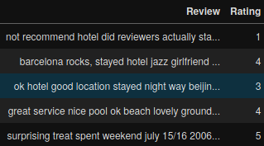
Data
https://www.kaggle.com/andrewmvd/trip-advisor-hotel-reviews
Hotels play a crucial role in traveling and with the increased access to information new pathways of selecting the best ones emerged.
This dataset, consists of 20k reviews crawled from Tripadvisor.

Slide 3
Task
Predict the rating of each review.

Slide 4
Exploration

Slide 5
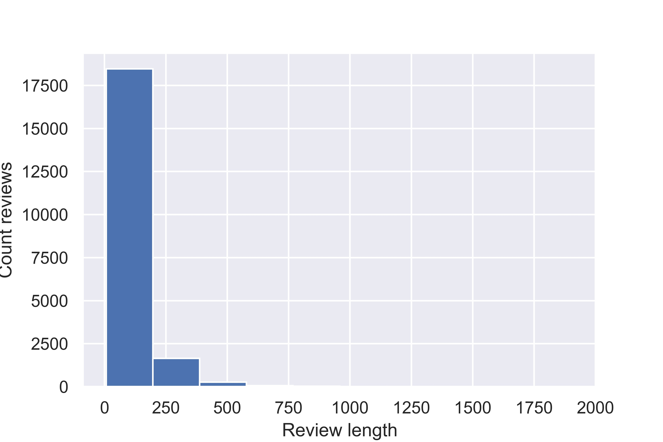
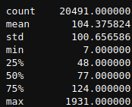

Slide 6
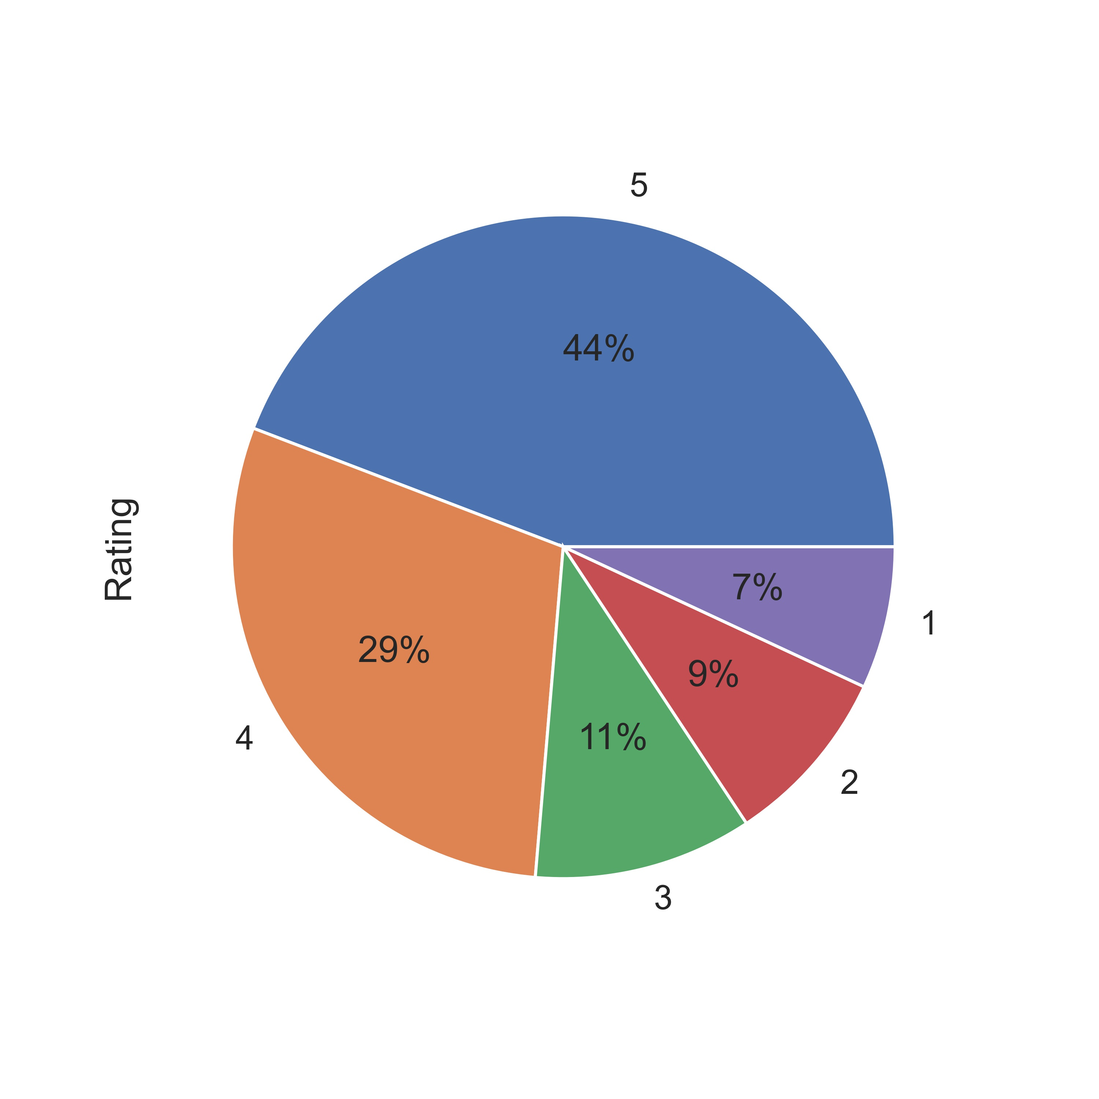

Slide 7
Validation
Split data:
Train – 80%
Validation – 10%
Test – 10%

Slide 8
Tokenization
StaticTokenizerEncoder from torchnlp package is used.
Vocabulary size - 67354.
Padded to 2000.

Slide 9
Regression or Classification?

Slide 10
Metrics
Loss function – MSE.
Score metric – Quadratic Weighted Kappa.

Slide 11
Quadratic Weighted Kappa (QWK)
Quadratic weighted kappa measures the agreement between two ratings.
This metric typically varies from 0 (random agreement between raters) to 1 (complete agreement between raters). If there is less agreement between the raters than expected by chance, the metric may go below 0. The quadratic weighted kappa is calculated between the scores which are expected/known and the predicted scores.
P. S. Quadratic Kappa Metric is same to cohen kappa score in sci-kit learn (sklearn.metrics.cohen_kappa_score) when weights are set to 'quadratic'.

Slide 12
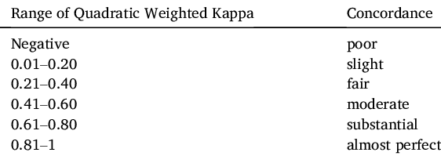
Interpretation of QWK
Source: https://www.researchgate.net/figure/Interpretation-of-quadratic-weighted-kappa_tbl1_336574571

Slide 13
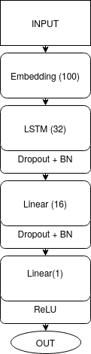
Rating Regression Model

Slide 14
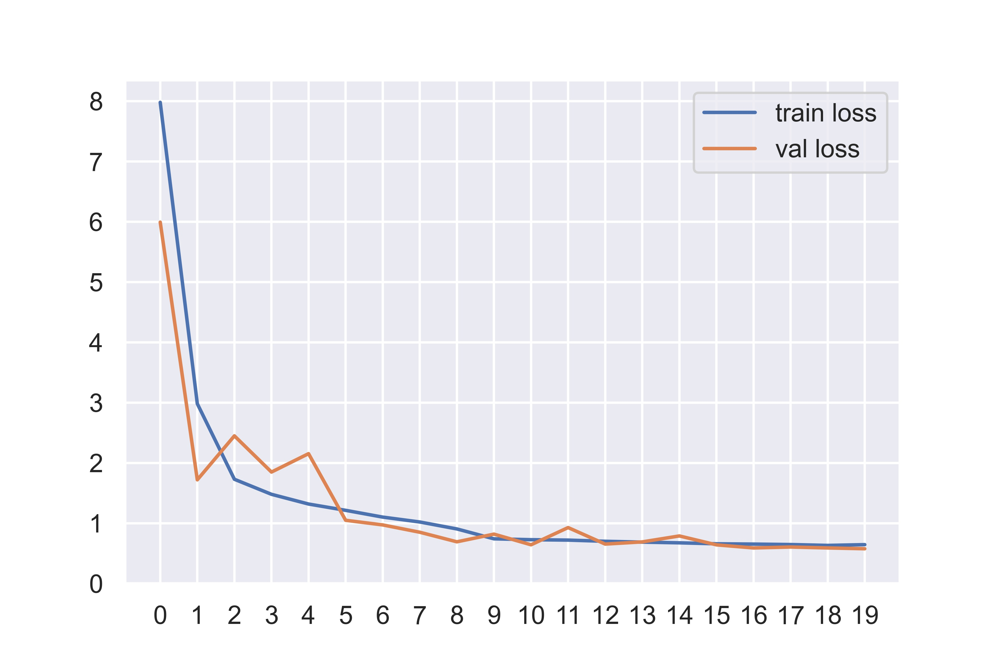
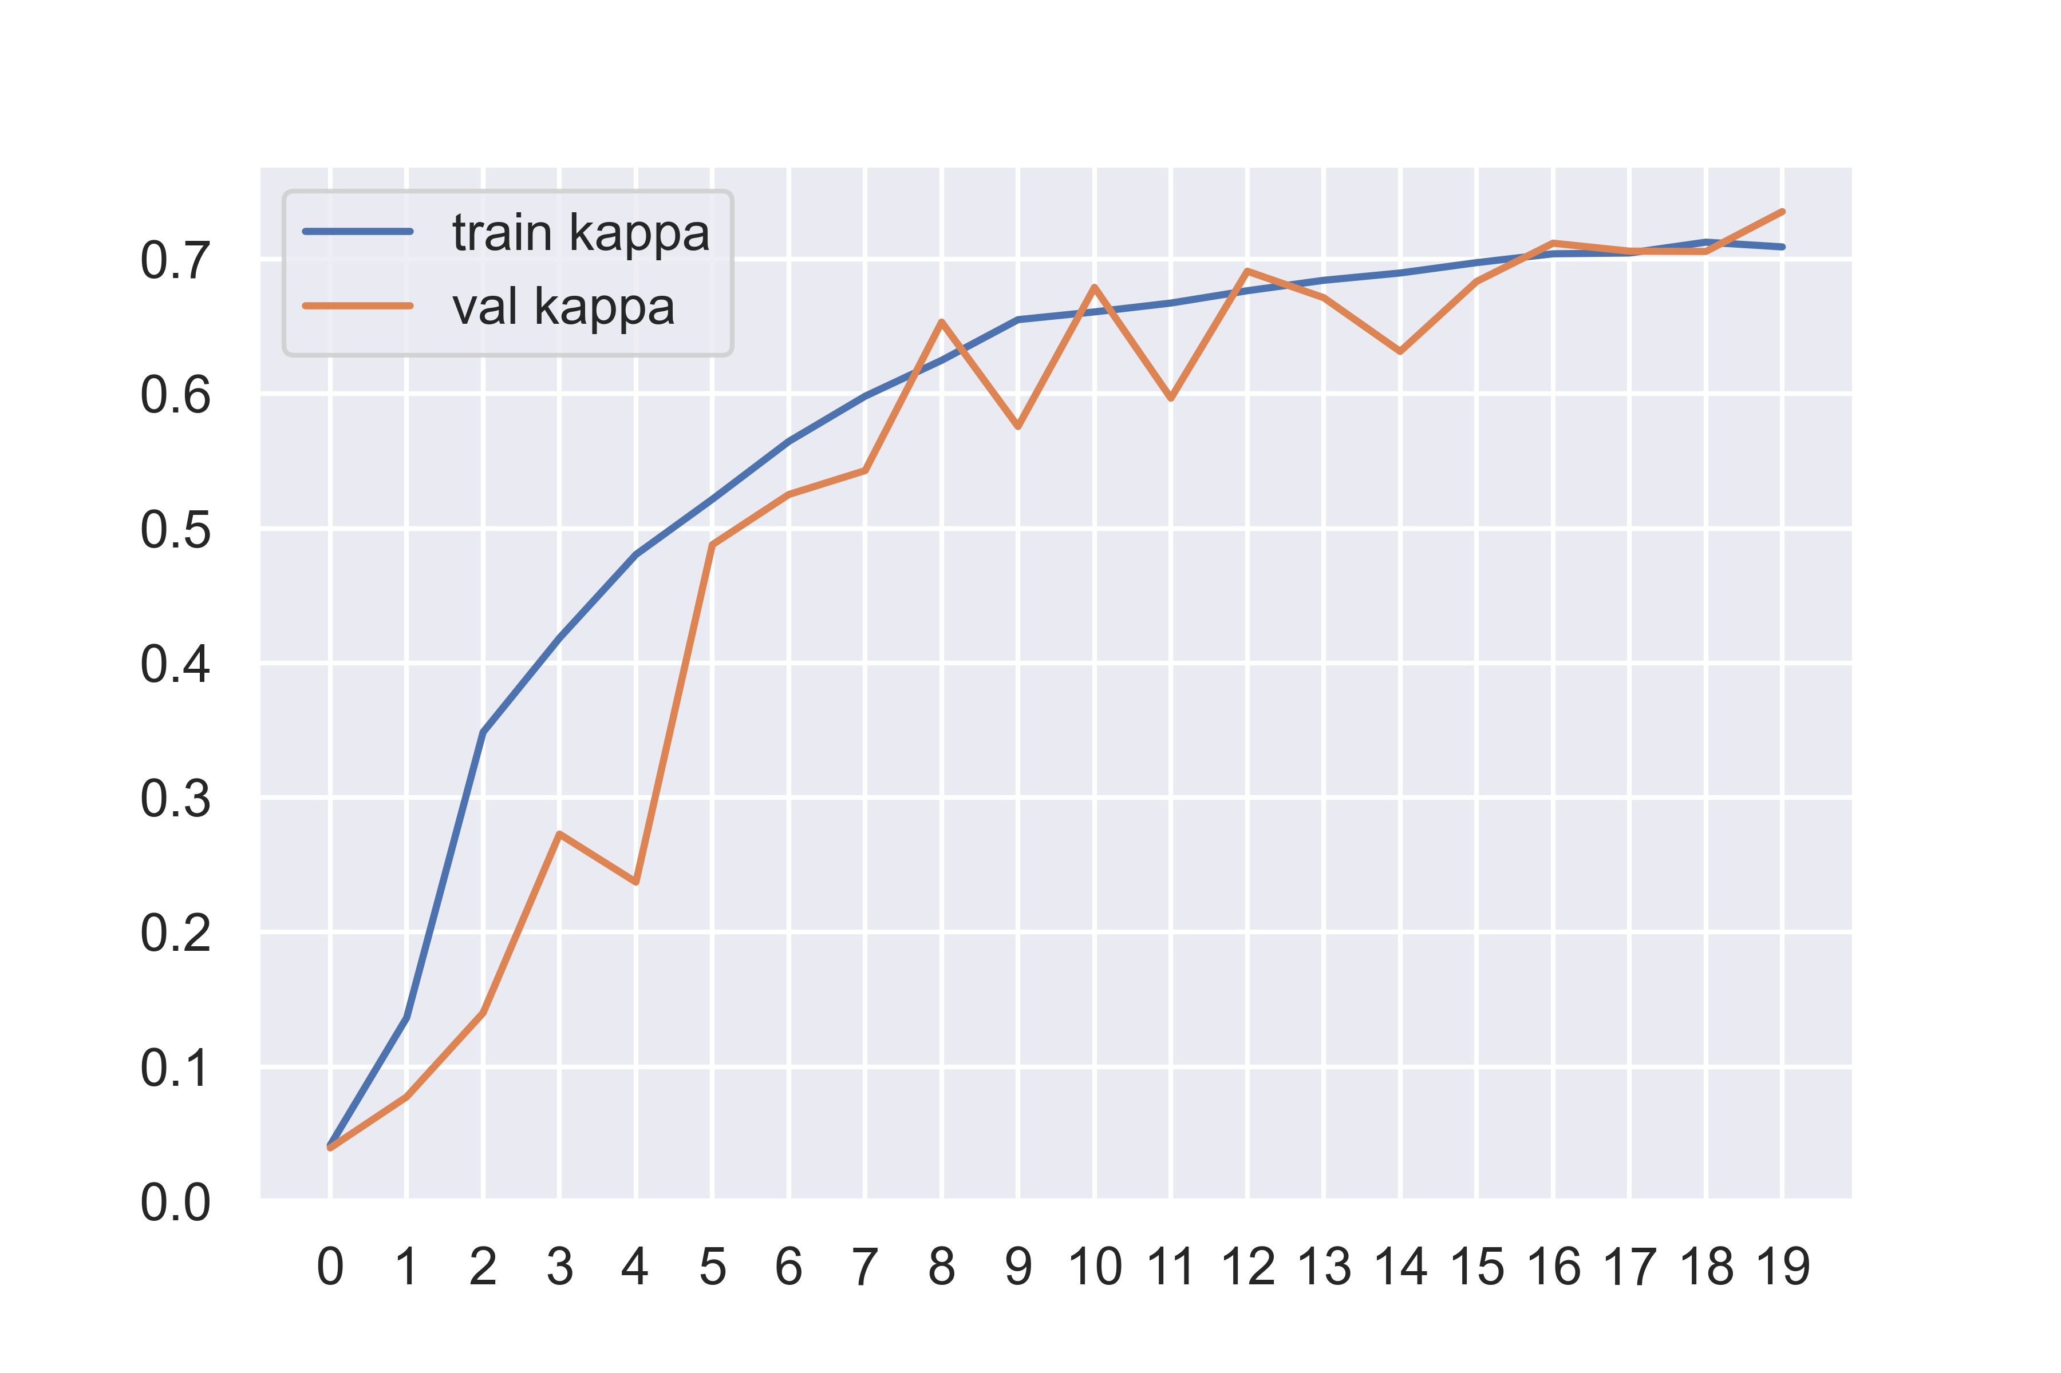
Performance

Slide 15
Round predictions
Default thresholds (simple round): [1.5, 2.5, 3.5, 4.5]
Using scipy.optimize.minimize to find best thresholds (based on quadratic weighted kappa)
Thresholds after optimization: [1.615, 2.850, 3.417, 4.172]

Slide 16
Model Evaluation

Slide 17

Quadratic Weighted Kappa Score
 | QWK Score
 | Simple Rounder | Optimized Rounder
Train | 0.794 | 0.834
Validation | 0.736 | 0.785
Test | 0.748 | 0.786

Slide 18
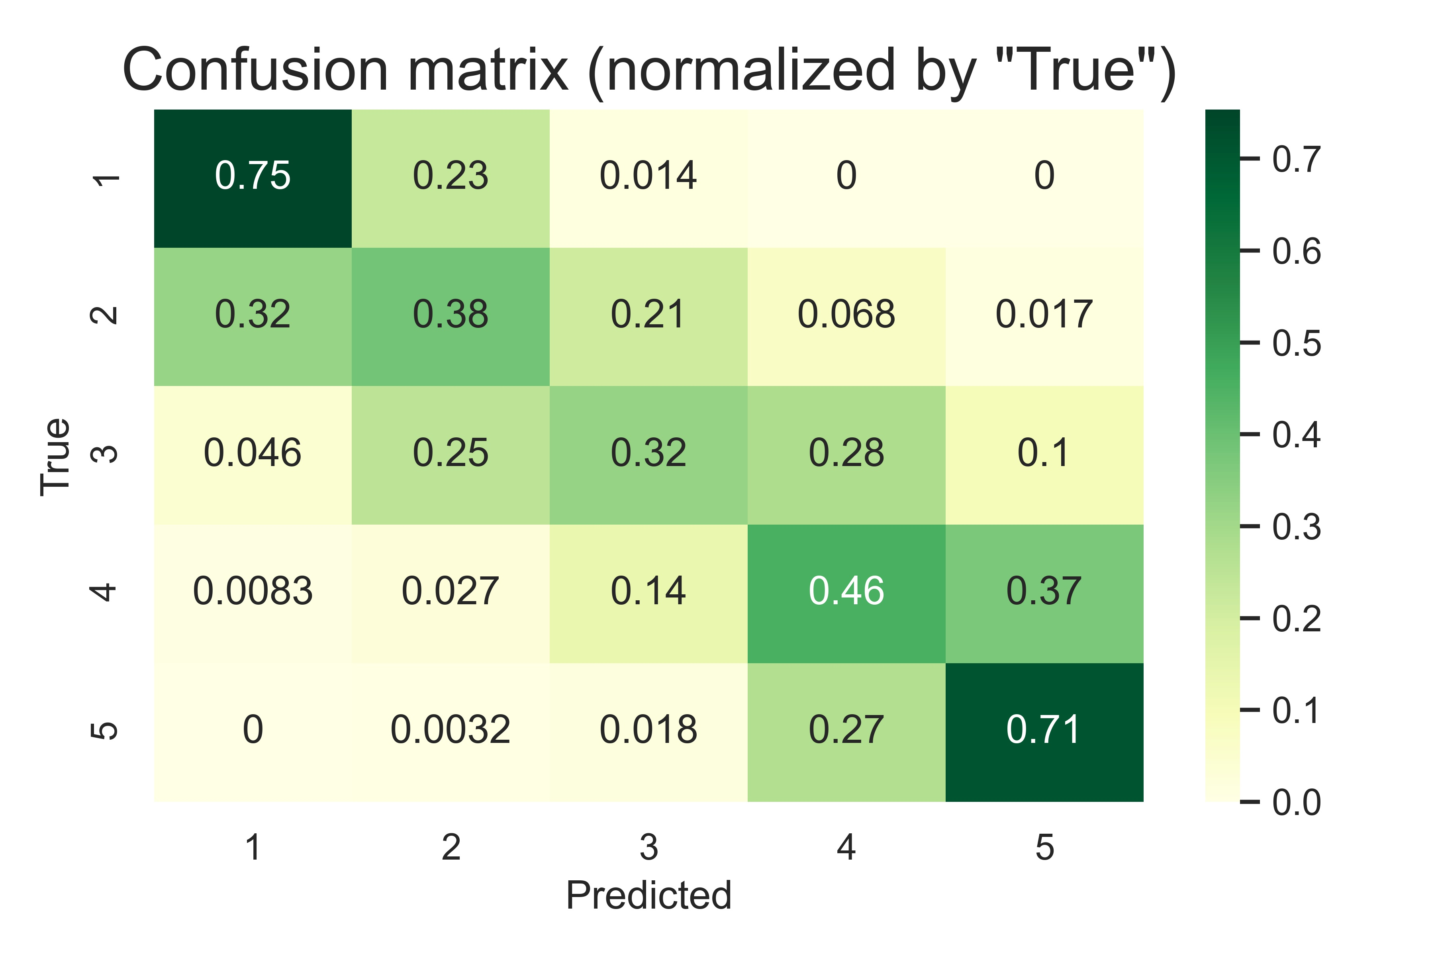

Slide 19
Thanks!

