Slide 1
Spooky Author Identification
https://www.kaggle.com/c/spooky-author-identification
Daryna Ronska

Slide 2
Data Description
The competition dataset contains text from works of fiction written by spooky authors of the public domain: Edgar Allan Poe, HP Lovecraft and Mary Shelley.
The data was prepared by chunking larger texts into sentences using CoreNLP's MaxEnt sentence tokenizer
Train set: 19 579 samples

Slide 3
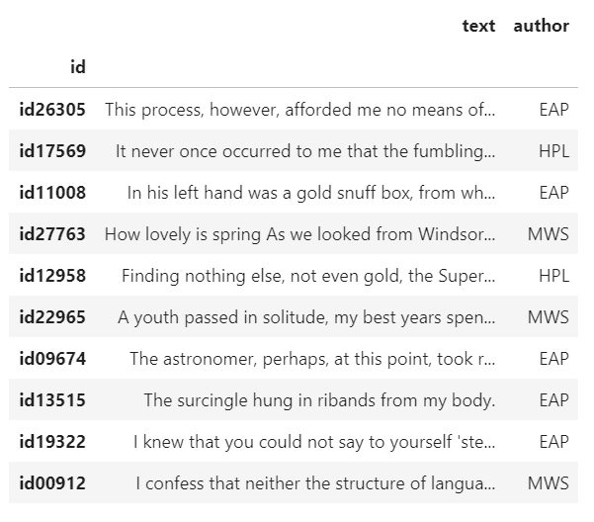
Data fields:
id - a unique identifier for each sentence
text - some text written by one of the authors
author - the author of the sentence (EAP: Edgar Allan Poe, HPL: HP Lovecraft; MWS: Mary Wollstonecraft Shelley)

Slide 4
Task
Identify the author of the sentences.

Slide 5
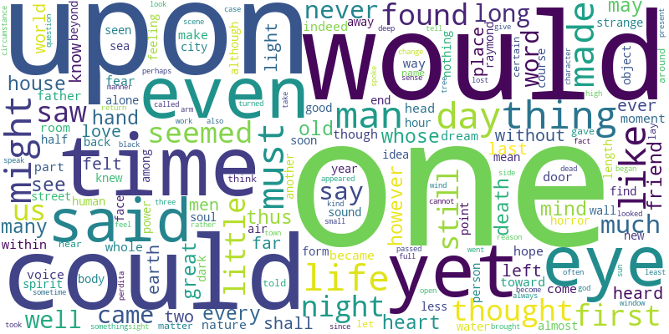

Slide 6
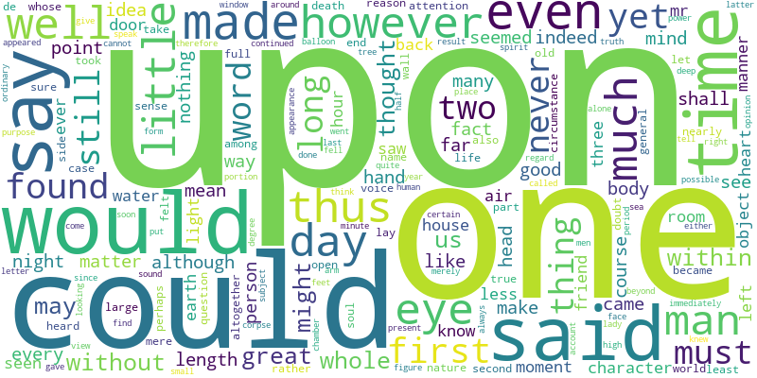
Edgar Allan Poe

Slide 7
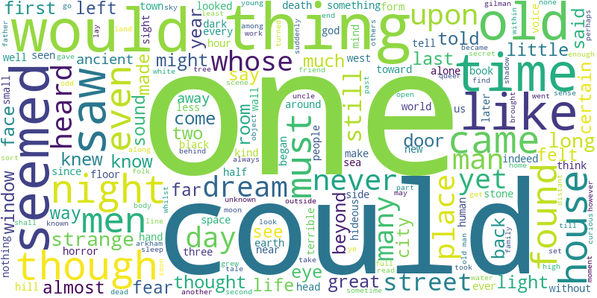
HP Lovecraft

Slide 8
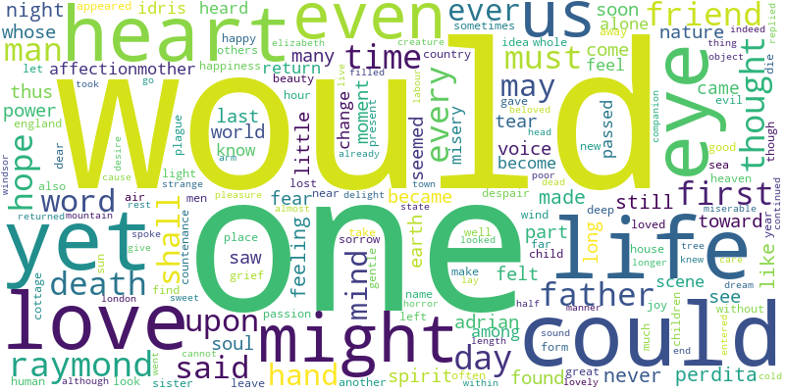
Mary Shelley

Slide 9
Feature Engineering
'n_chars’,
'n_words’,
'n_punctuation’,
'n_noun’,
'n_adj’,
'n_verb',
'n_stopwords’,
'n_unique’,
'fract_noun’,
'fract_adj’,
'fract_verb',
'fract_stopwords’,
'fract_unique’,
'fract_punctuation'

Slide 10
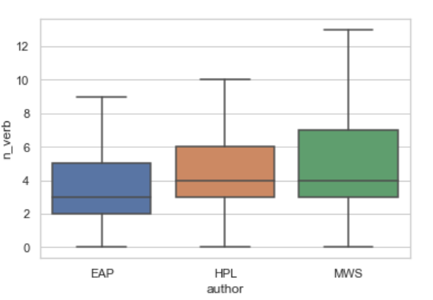
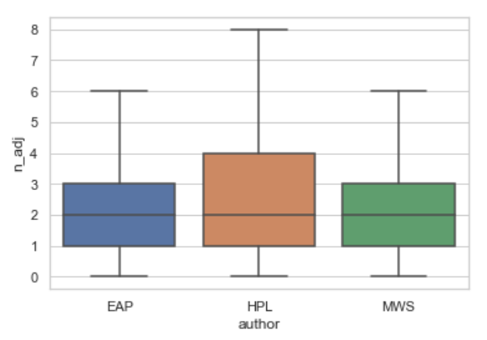

Slide 11
Text Processing
Lowercase
Remove punctuation marks
Remove stopwords
Stemming
TF-IDF

Slide 12
Models
Naive Bayes
Random Forest
SVM
Voting Classifier

Slide 13
Accuracy
MultinomialNB 0.820
RandomForestClassifier 0.649
SVC 0.760
VotingClassifier 0.801
* train/test split – 80/20

Slide 14
Thank you for your attention!

