Slide 1
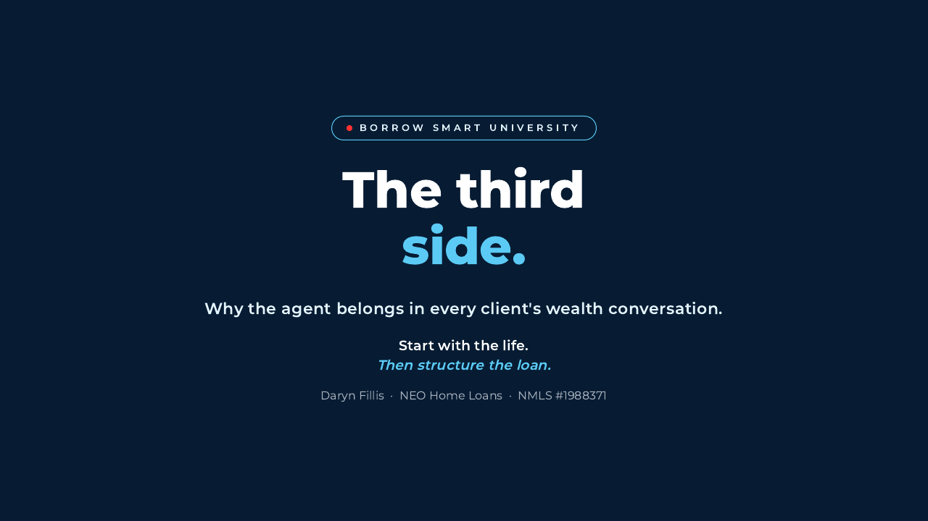
Notes:
[STTS Step 1: Title. Keep it brief. The promise is about the agent, not the book.]
"The third side is real estate. That means you already have a seat in the wealth conversation."
"Today I want to show you how important your role really is, and how to use it without stepping outside your lane."

Slide 2
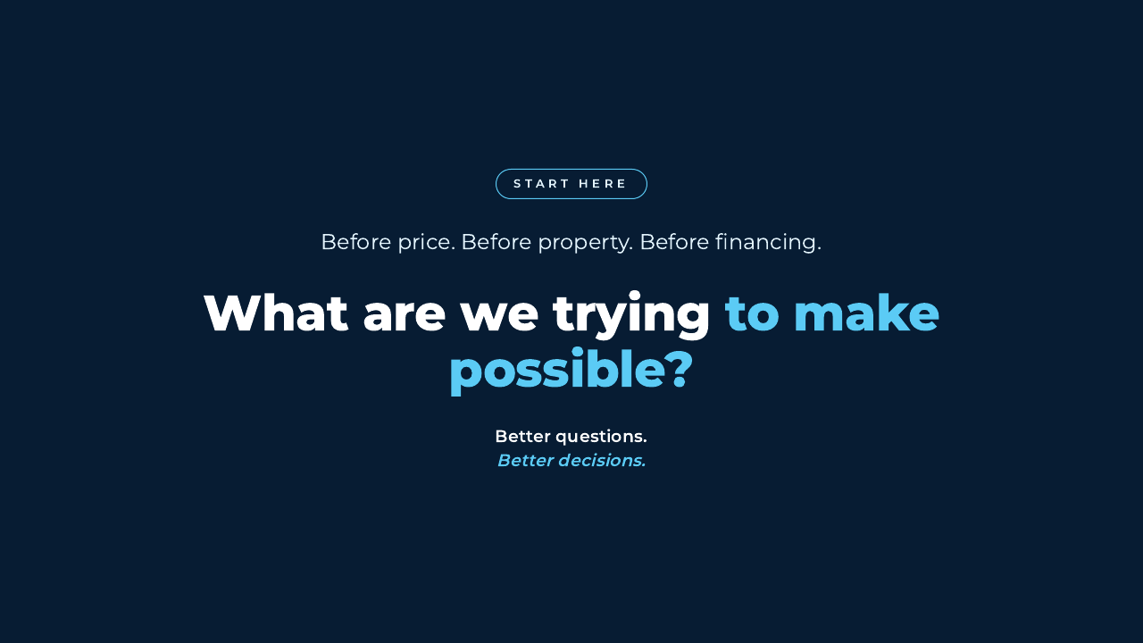
Notes:
[STTS Step 1: Bold opening. Let the question finish typing. Pause.]
"Before we talk about price, property, or financing, what are we trying to make possible?"
Ask the room for one life event that recently caused a client to move.

Slide 3
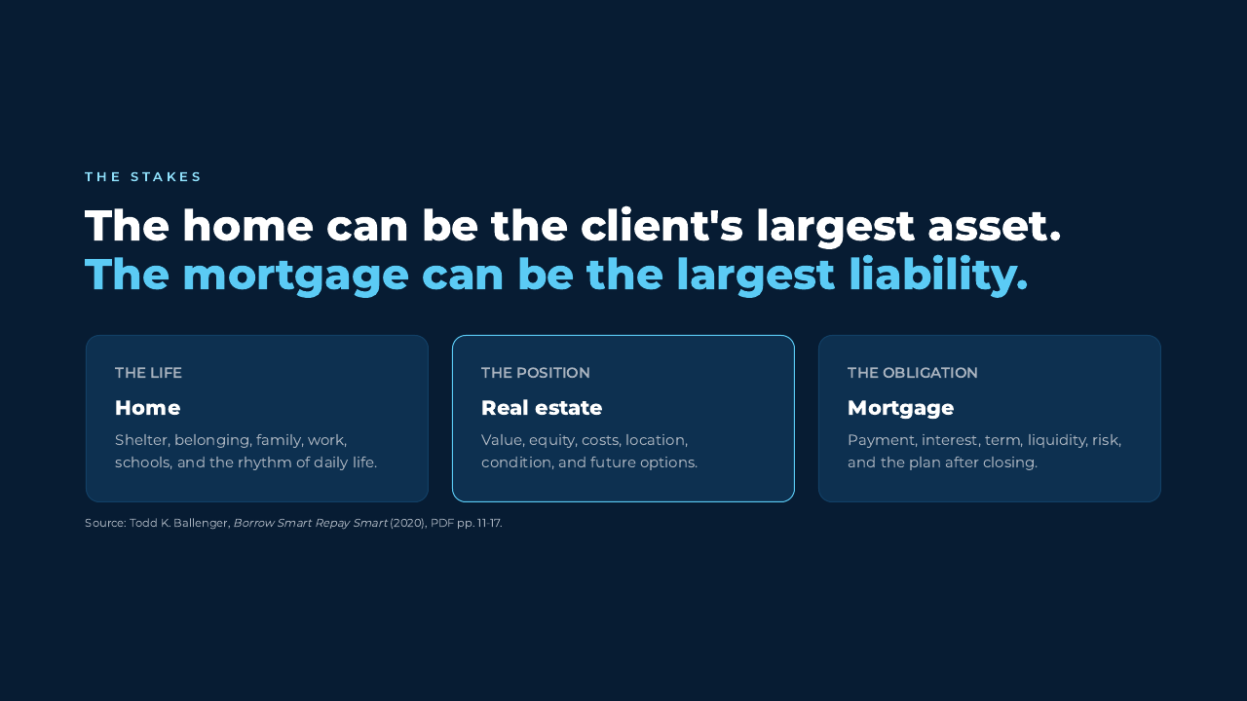
Notes:
[STTS Step 1 continued: The stakes. Reveal Home, Real Estate, and Mortgage.]
"For many households, the home and mortgage are the biggest financial positions they manage, but the decision is still deeply personal."
"That is why the transaction cannot be separated from the life around it."
[Sources] Todd K. Ballenger, Borrow Smart Repay Smart, 2020 edition, PDF pp. 11-17.

Slide 4
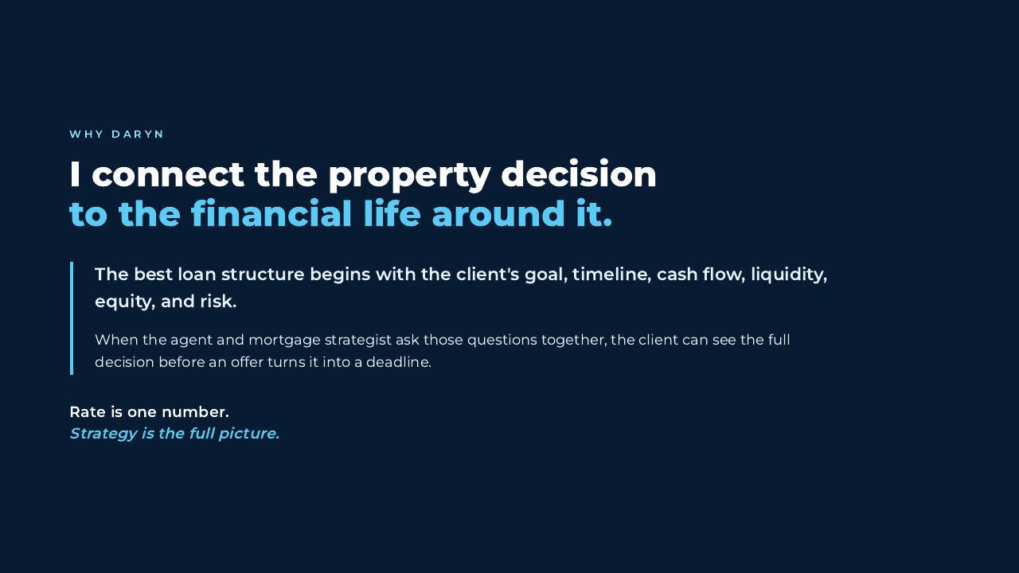
Notes:
[STTS Step 2: Credibility. Relevant proof only.]
"My job is to connect the property decision to the goal, timeline, cash flow, liquidity, equity, and risk before recommending a structure."
"When the agent and mortgage strategist ask better questions together, the client can decide before an offer creates urgency."

Slide 5
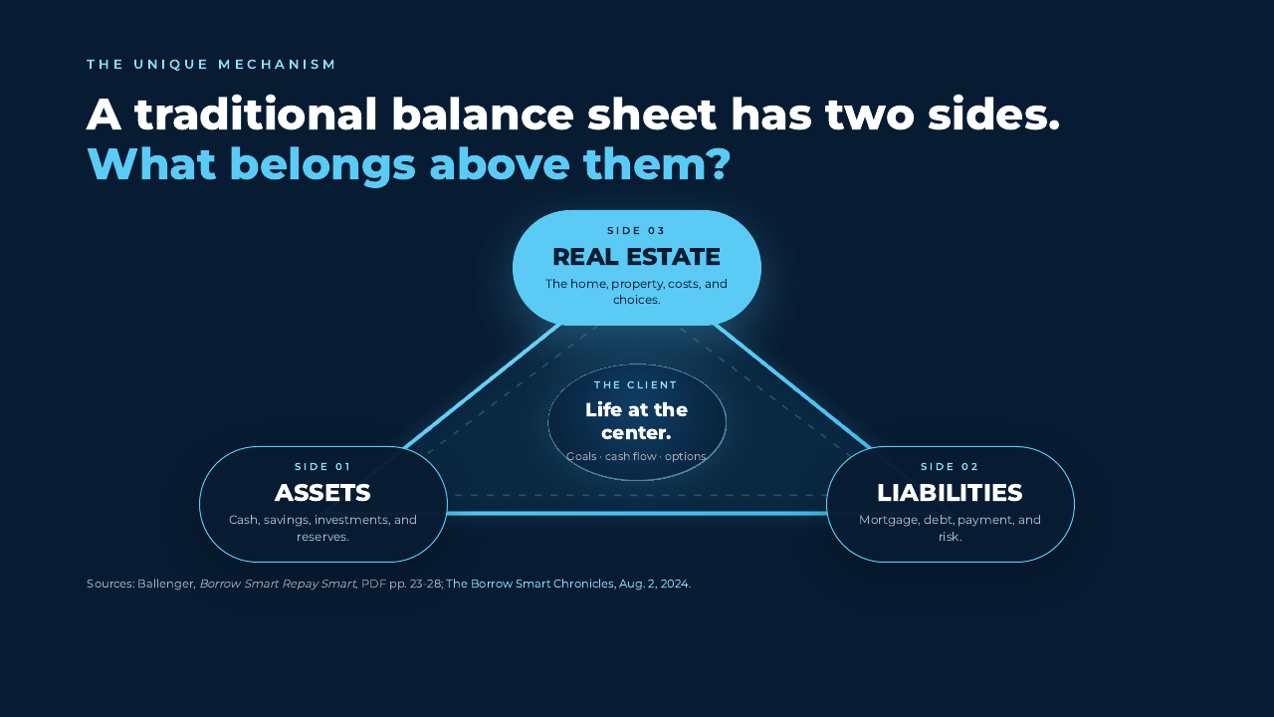
Notes:
[STTS Steps 3 and 4: Roadmap plus unique mechanism. Reveal Assets, then Liabilities. Pause and ask what belongs above them. Reveal Side 03 and the triangle together. Reveal the client at the center last.]
"The classic balance sheet gives us assets on one side and liabilities on the other."
[Pause before the third click.]
"Borrow Smart adds the third side: real estate. This is where you work every day."
"The client and the life they are building stay at the center of all three."
Do not call real estate guaranteed wealth. Emphasize position, choices, costs, and risk.
[Sources] Todd K. Ballenger, Borrow Smart Repay Smart, 2020 edition, PDF pp. 23-28. Todd Ballenger, The Borrow Smart Chronicles, Rentals and Wealth Gaps, Aug. 2, 2024.

Slide 6
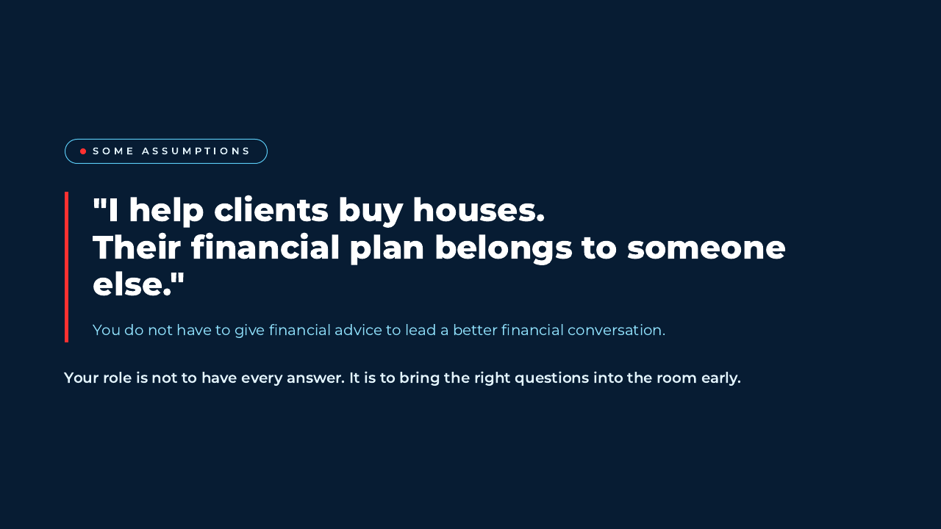
Notes:
[STTS Step 5: Break false belief 1. Validate the boundary first.]
"You are right not to give investment, tax, legal, insurance, or mortgage advice outside your expertise."
"But staying in your lane does not mean shrinking the conversation. It means asking the questions that bring the right experts into it."

Slide 7
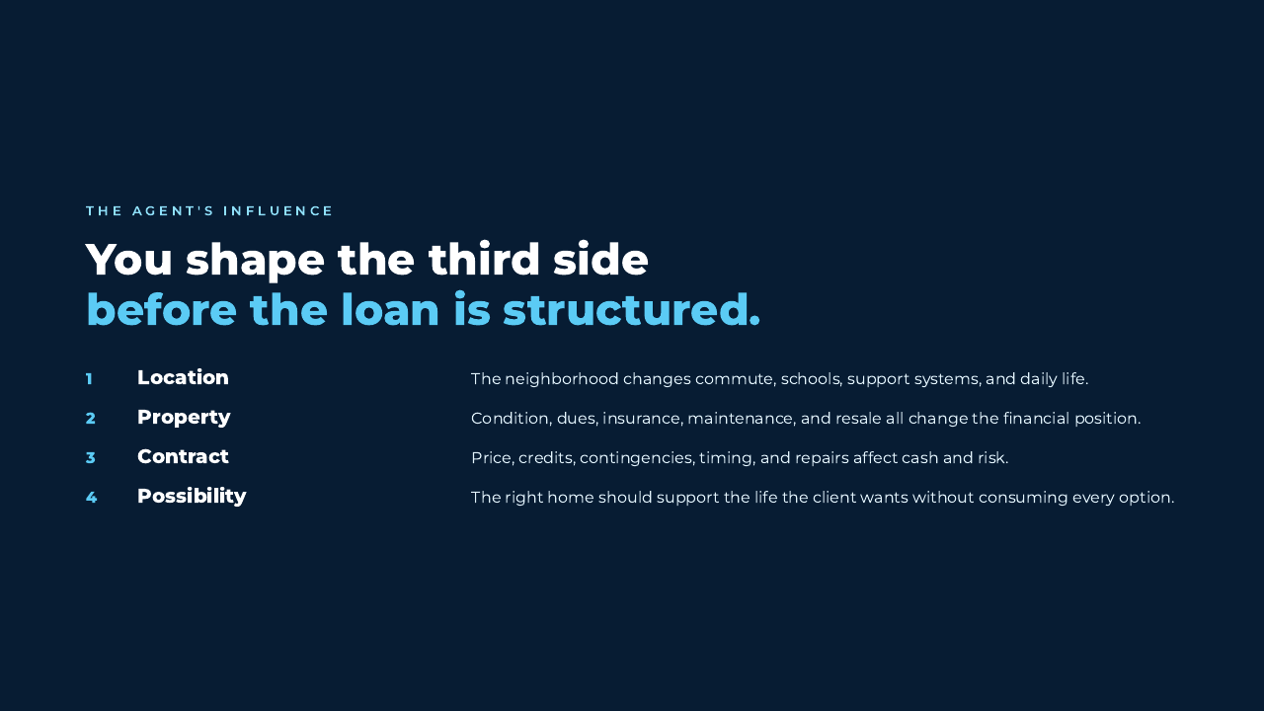
Notes:
[Reveal one influence point at a time.]
Connect Location, Property, Contract, and Possibility to one real buyer you have helped.
"The agent shapes the third side before the lender ever finalizes the liability."

Slide 8
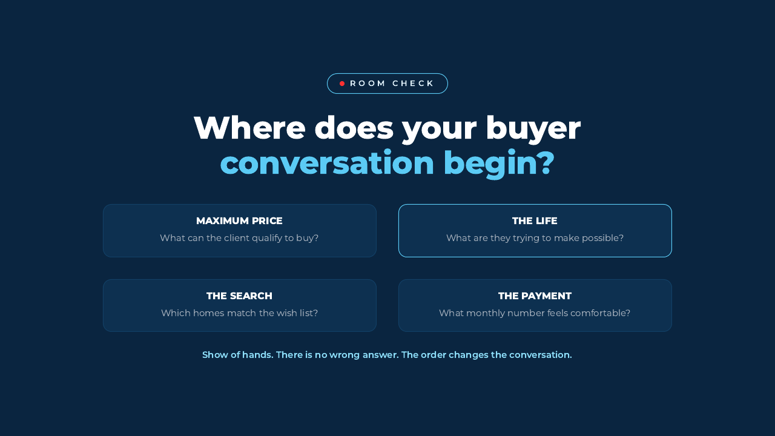
Notes:
[Audience engagement. Ask for a real show of hands before revealing all four choices.]
Follow with: "The point is not that one starting place is always wrong. The order changes what the client notices and what they may miss."
"Life first does not ignore qualification. It gives qualification a purpose."

Slide 9
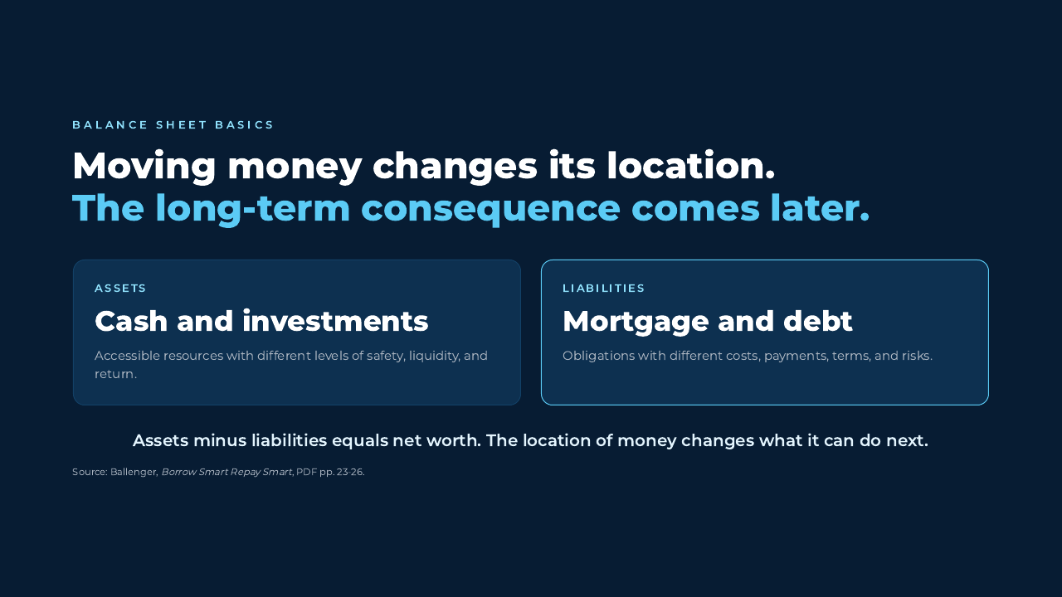
Notes:
[STTS Step 6: Teach the foundation. Keep the accounting simple.]
"Moving cash from checking to an investment or using it to reduce debt can be neutral in the moment. The location changes what the money can do later."
"Where you place your money matters."
[Sources] Todd K. Ballenger, Borrow Smart Repay Smart, 2020 edition, PDF pp. 23-26.

Slide 10
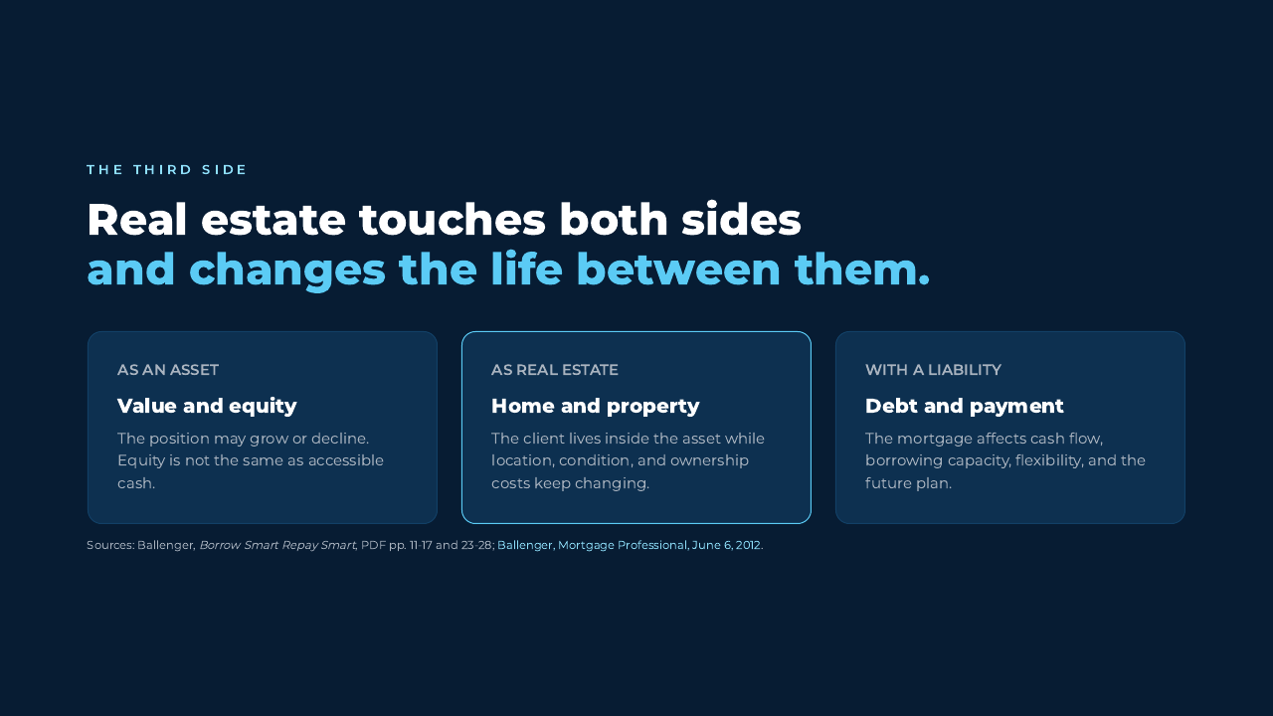
Notes:
[STTS Step 6: Teach the third side. Reveal asset, real estate, liability.]
"Real estate is unusual because the client lives inside the asset while the property carries costs and often a mortgage."
"The third side connects the life, the asset, and the liability."
[Sources] Todd K. Ballenger, Borrow Smart Repay Smart, 2020 edition, PDF pp. 11-17 and 23-28. Todd K. Ballenger, The Key to Success in a Compliant World, Mortgage Professional, June 6, 2012.

Slide 11
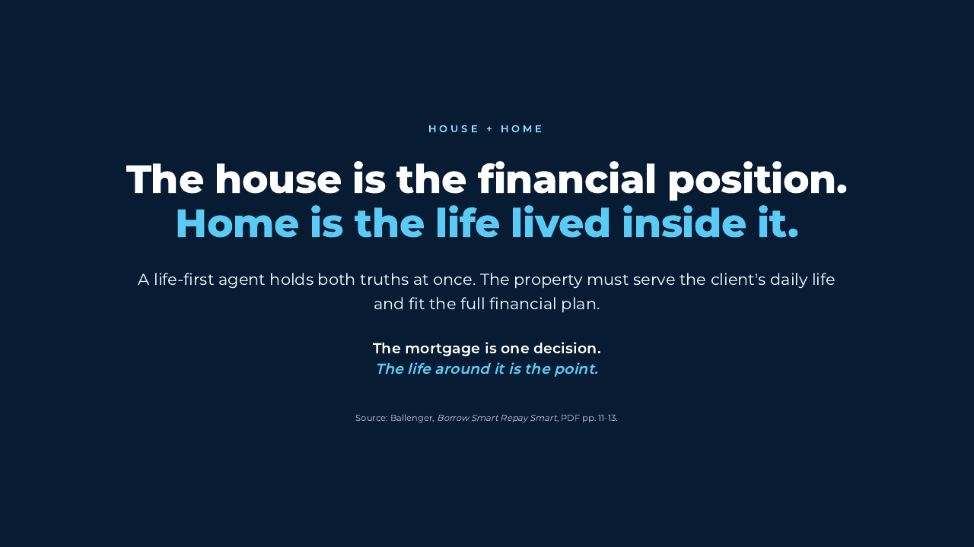
Notes:
[Slow down. This is the life-first bridge.]
"The house is the structure and the financial position. Home is the life lived inside it."
Ask: "What changes when we treat those as related, but not identical?"
[Sources] Todd K. Ballenger, Borrow Smart Repay Smart, 2020 edition, PDF pp. 11-13.

Slide 12
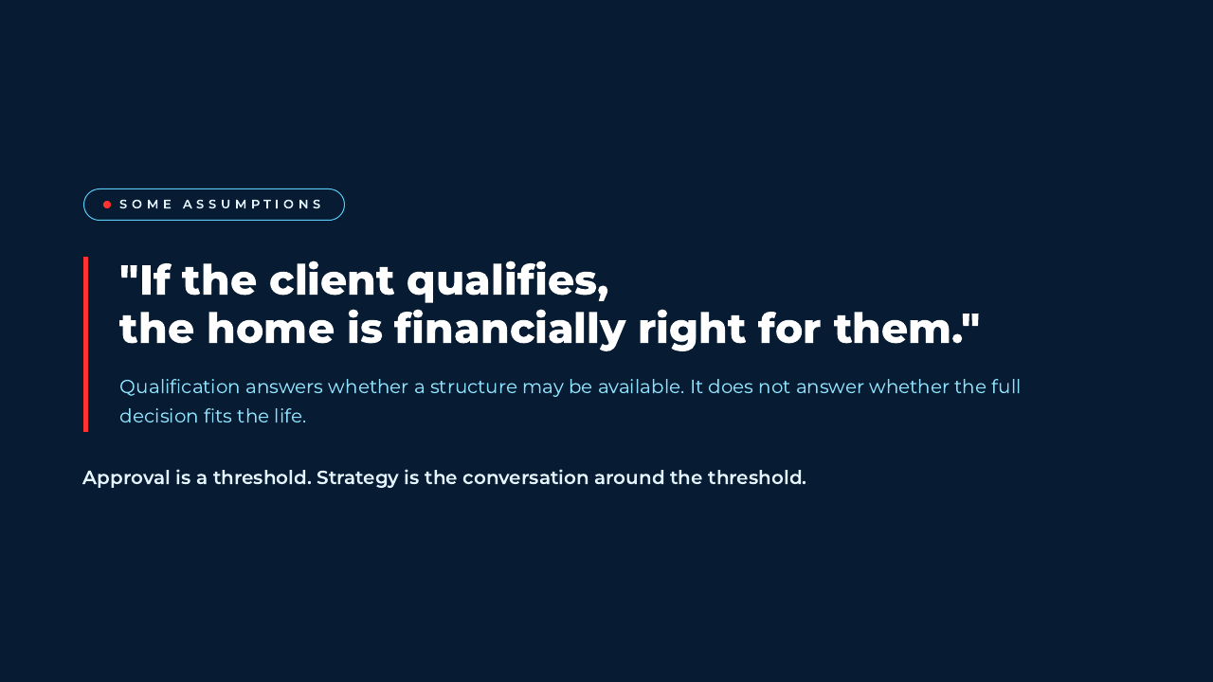
Notes:
[STTS Step 5: Break false belief 2.]
"Qualification is important. It tells us what may be available under a set of guidelines."
"It does not decide what leaves room for the rest of the client's life."
Avoid using suitability as a legal claim. Keep the language to fit, tradeoffs, and client choice.

Slide 13
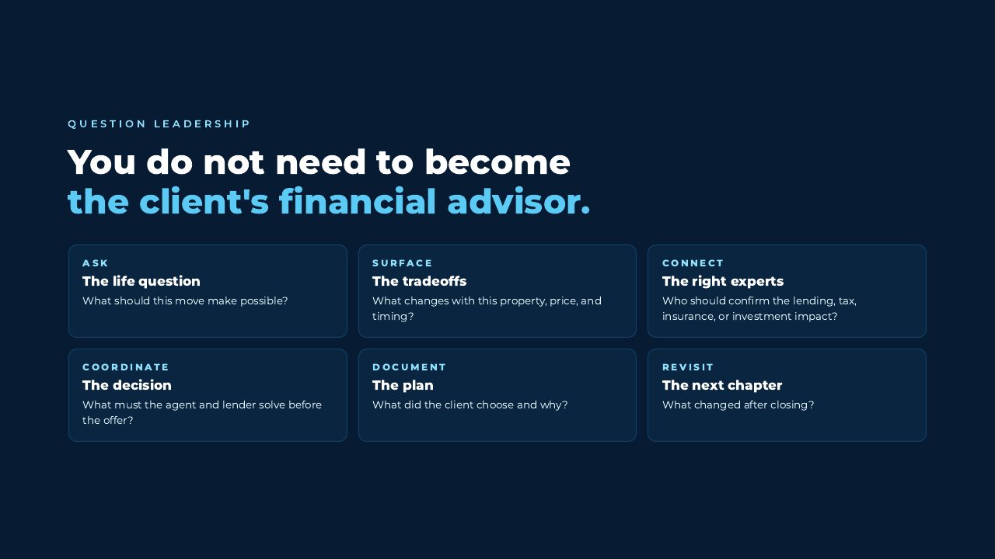
Notes:
[Reframe the agent as a question leader, not a substitute advisor.]
Reveal Ask, Surface, Connect, Coordinate, Document, and Revisit.
"Your value is not knowing every answer. It is knowing when the client needs a bigger question and who should answer it."

Slide 14
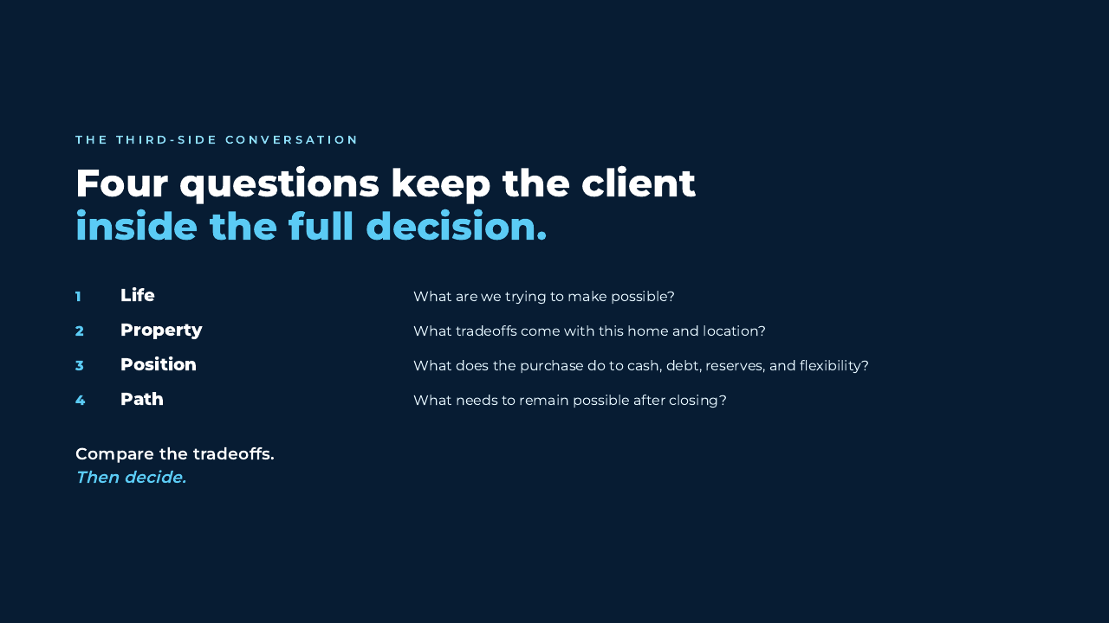
Notes:
[STTS Step 6: Teach the usable framework. Reveal the four questions.]
"Life tells us the destination. Property tells us the tradeoffs. Position tells us what changes financially. Path tells us what must remain possible."
Ask the room to repeat the four words: Life. Property. Position. Path.
[Sources] The Third-Side Conversation is Daryn Fillis's life-first synthesis of the Borrow Smart balance-sheet and seven-step teachings.

Slide 15
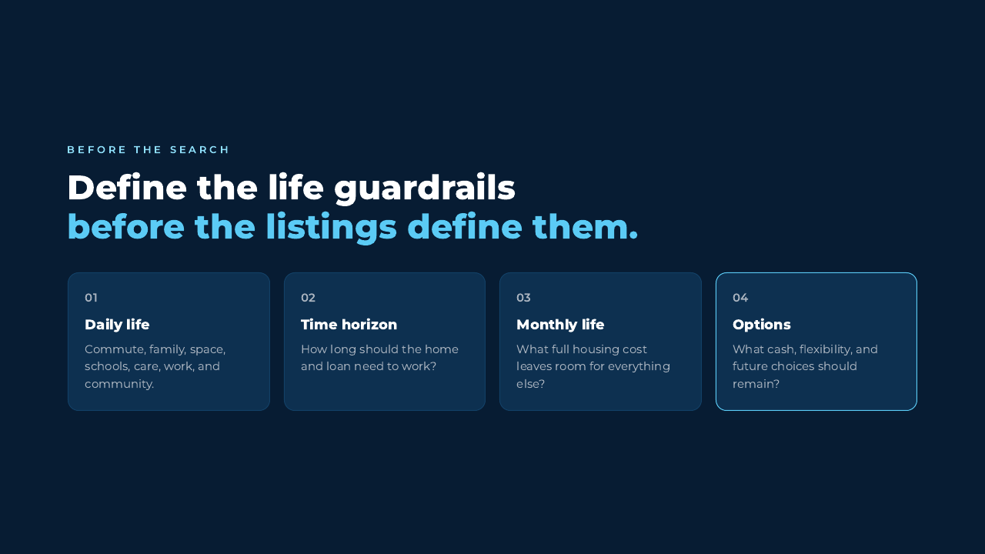
Notes:
[Apply the framework before search.]
"Guardrails are not limitations. They protect the client from letting a beautiful listing rewrite the plan."
Ask agents which guardrail is usually missing from their first buyer meeting.

Slide 16
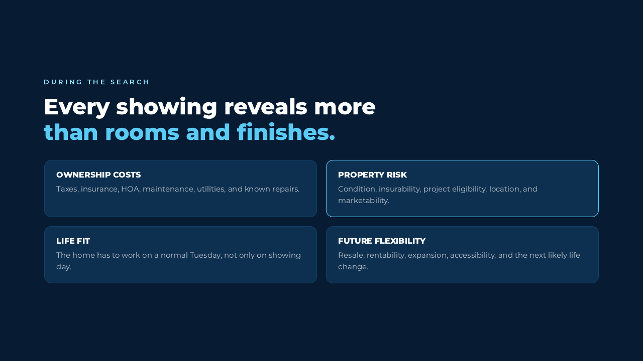
Notes:
[Apply the framework during search. Reveal each category.]
"A showing is also due diligence on the third side."
Use a local example such as HOA dues, insurance, condition, commute, or project eligibility. Do not promise marketability or appreciation.

Slide 17
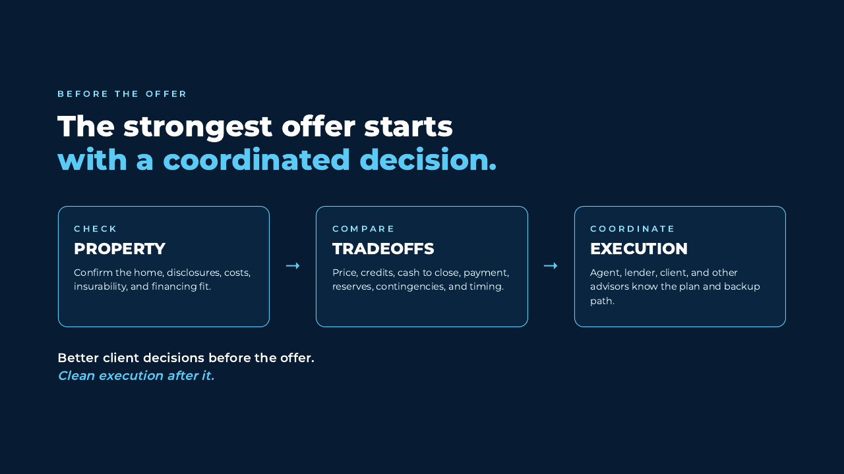
Notes:
[Apply the framework before offer.]
"The strongest offer starts before it is written."
"Check the property, compare the tradeoffs, and coordinate the execution while the client still has room to think."
Invite one agent to name a recent issue that better coordination could have surfaced sooner.

Slide 18
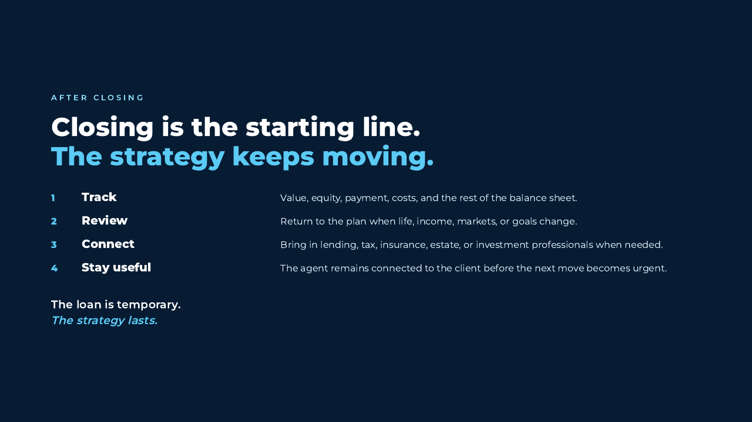
Notes:
[Show the relationship after closing.]
"Closing is the starting line. The client is now living with the payment, the property, and the plan."
"The loan is temporary. The strategy lasts."
[Sources] Todd K. Ballenger, Borrow Smart Repay Smart, 2020 edition, Management and Discipline, PDF pp. 180-205.

Slide 19
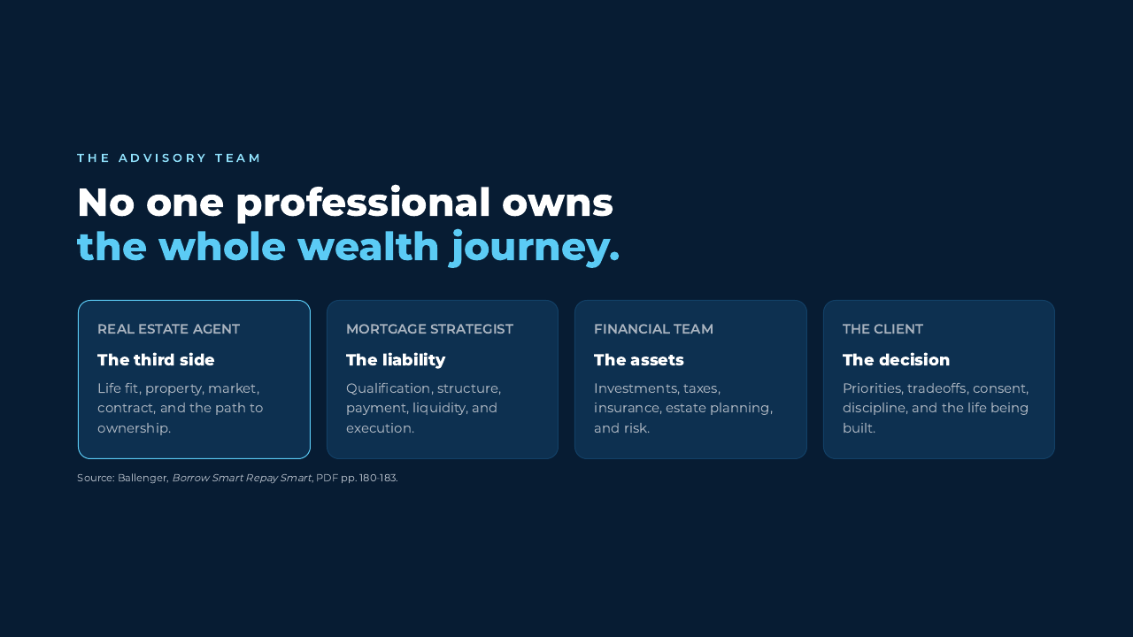
Notes:
[Position the team without blurring professional boundaries.]
"The agent owns the market and property conversation. The mortgage strategist owns the lending analysis. Other qualified professionals confirm tax, insurance, estate, and investment questions. The client owns the decision."
"No one professional owns the whole wealth journey. The value is in the connection."
[Sources] Todd K. Ballenger, Borrow Smart Repay Smart, 2020 edition, PDF pp. 180-183.

Slide 20
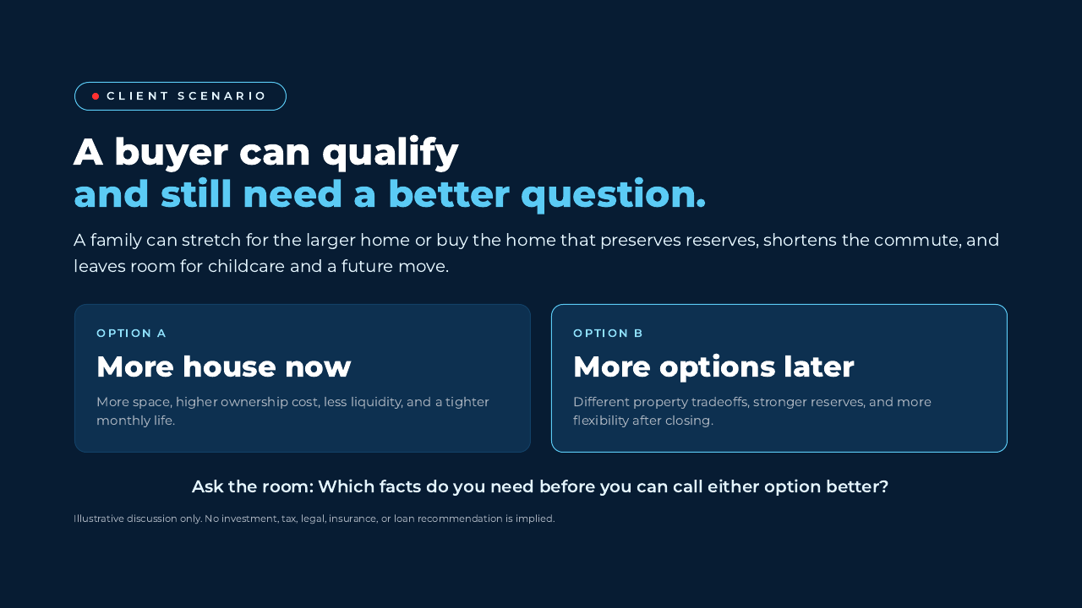
Notes:
[STTS Step 7: Scenario. This is illustrative. Do not invent numbers.]
Read both options without endorsing either one.
Ask the room: "What do we still need to know?" Listen for time horizon, monthly comfort, reserves, childcare, commute, risk, property condition, and future plans.
"The better option is the one that fits the client after the missing facts are visible."

Slide 21
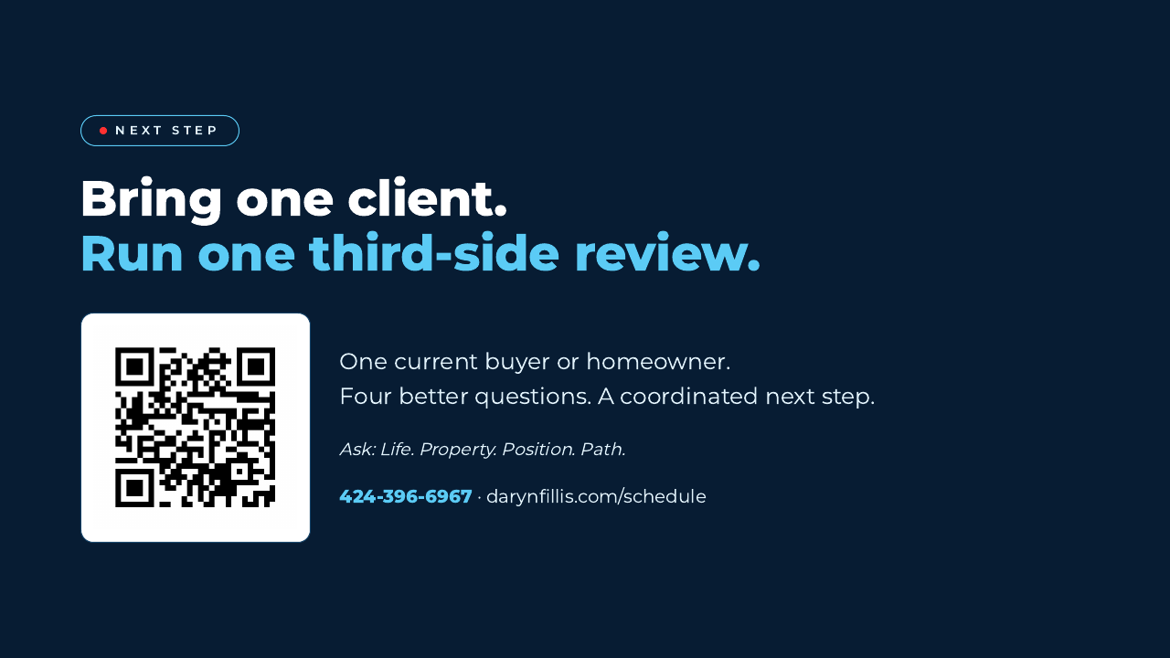
Notes:
[STTS Steps 8 and 9: Interest check plus concrete offer.]
Ask: "Would a 15-minute third-side review make one current client clearer?" Wait for hands or chat responses.
Invite them to bring one current buyer or homeowner. Then scan the code.
"Life. Property. Position. Path. Four questions before the next structure or offer."

Slide 22
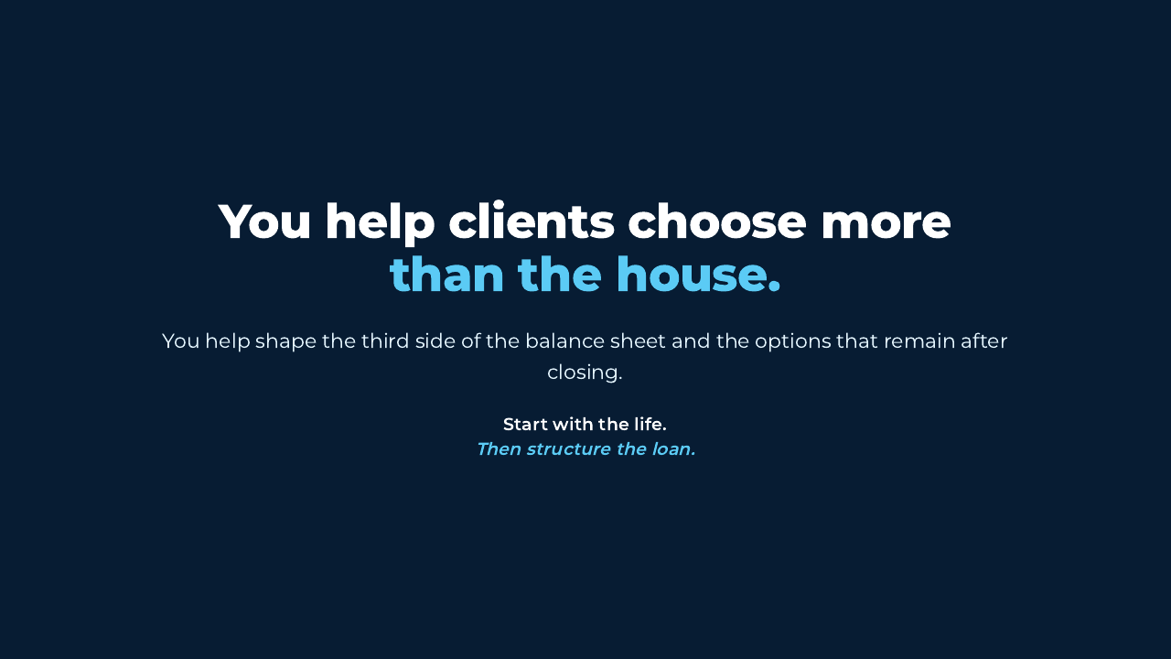
Notes:
[STTS Step 10: Emotional close. Warm, direct, unhurried.]
"You help clients choose more than the house."
"You help shape the third side of the balance sheet and the options that remain after closing."
"Start with the life. Then structure the loan."

Slide 23
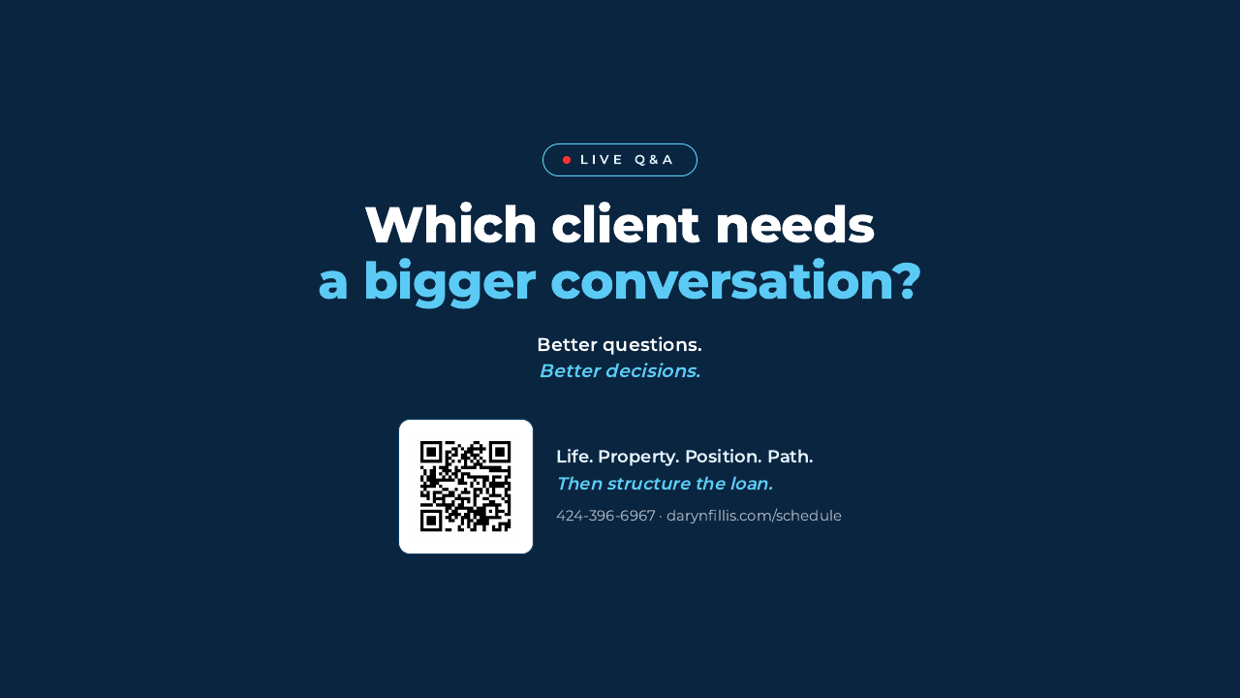
Notes:
[STTS Step 11: Q&A. Keep the third-side question visible.]
Invite questions about one real buyer or homeowner, not broad market predictions.
Useful prompts: life change, property tradeoff, cash and reserves, liabilities, timing, and the post-closing path.
Close each answer by identifying the next better question and the right professional to answer it.

