Slide 1
ImageLab Assessment 2
Short and Long
Polling Comparison
Daryn Forman
Short polling
Long polling
Same image-processing application.
Two ways for the browser to observe progress.
Daryn Forman | ImageLab Assessment 2 | Introduction
01
Notes:
I’m Daryn Forman. My project compares short polling and long polling in ImageLab. Both modes watch the same background image-processing jobs. I wanted to find out how many requests each mode sends, how quickly the browser notices completion, and which job versions it receives.
The teacher has replaced the original narrated video with this classroom presentation. I am using the same assessment requirements for the implementation and experiment. The results here come from the 30 recorded runs on 25 October 2026, not made-up examples.
I’ll start with how the application works, then show the code, the experiment and the trade-offs.
Evidence and preparation: Teacher brief and Version 2 requirements; revised three-page report; runs.csv.

Slide 2
The worker processes. The browser observes.
Assessment 2 adds version-based long polling beside the existing short-polling mode.
POST
GET
Browser
Go API
read / write
PostgreSQL
Upload + observe
Accept + return state
Authoritative job record
claim +
progress
Stopping observation
does not cancel
the worker’s job.
Local files
store
One worker
Original + outputs
Create the variants
Three real outputs: thumbnail, preview and display.
Daryn Forman | ImageLab Assessment 2 | Application overview
02
Notes:
The browser uploads the image with POST /v1/images. A 202 response means the upload has been accepted and a durable job exists; it does not mean the variants are ready. The single worker claims jobs, reads the stored original, creates each variant and records progress in PostgreSQL. The API returns the job’s current state to the browser.
The key distinction is that processing and observation are separate. Changing polling mode or stopping a browser request does not cancel the worker. The worker uses the application’s worker context, rather than the individual observation request’s context.
The three variants keep the original transformation settings: a 150 by 150 crop, preview within 800 by 600, and display within 1200 by 900 with aspect ratio preserved for the latter two. Completed snapshots expose the complete set, not partial results as completed work. Next I’ll compare the two observation loops.
Evidence and preparation: cmd/api/images.go; cmd/api/worker.go; internal/data/jobs.go; Version 2 requirements.

Slide 3
Same snapshots, different request timing
Short polling
Long polling
GET the current snapshot
Wait 1 second after the response
Send the next GET
GET with the last version
Wait for change or a 20 s deadline
Immediately send the next GET
Version: an increasing number for a changed job representation.
Snapshot: the current state, not a history of every update.
A normal 204 means no change before the holding deadline.
Daryn Forman | ImageLab Assessment 2 | Observation model
03
Notes:
Short polling asks for the current state and then waits one second after the response and rendering before asking again. It is not exactly one second from one request start to the next, because response time is added. The client does not overlap requests.
Long polling begins with the same prompt snapshot, then sends after equal to its last version and wait=20. If the job is already newer, it returns immediately. If it is unchanged and active, the server holds the request until a notification, cancellation or deadline. A normal 204 means there was still no newer snapshot at the final deadline check. It is not an error. The browser immediately renews after either an active 200 or a 204.
A version is not a percentage. It changes whenever observable job information changes. A snapshot can jump over versions because it represents current state, not a replay. The two cards are an explanation of the code’s behaviour, not a fabricated measurement trace. Now I’ll show how state and version are saved together.
Evidence and preparation: web/assets/app.js pollJob(); cmd/api/jobs.go showJobHandler()/observationQuery(); Version 2 terms.

Slide 4
Save truthful progress, then notify
PostgreSQL stores the authoritative state and version together.
UPDATE jobs
SET
variants_completed=
variants_completed+1,
stage=$2,
version=version+1
WHERE id=$1 AND status='processing'
AND variants_completed<3
RETURNING version,variants_completed
if err = tx.Commit(); err != nil {
return err
}
j.Stage = v.Name + "_ready"
j.Status = "processing"
m.committed(j)
… committed() helper …
if m.Changes != nil {
m.Changes.Notify(j.PublicID)
}
internal/data/jobs.go · Milestone() SQL
internal/data/jobs.go · selected locations; gap marked
Actual variant file + metadata → progress/version commit → broadcast
Daryn Forman | ImageLab Assessment 2 | Server implementation
04
Notes:
The SQL on the left is the actual Milestone update, wrapped onto shorter lines for this slide. It increments variants_completed and version in the same transaction that stores the variant metadata. The worker calls Milestone only after the variant file has been written. That keeps real progress tied to actual work.
On the right, tx.Commit must succeed before m.committed is called. I have combined two clearly separated locations from internal/data/jobs.go: the milestone’s successful commit path and the notification lines inside committed. The helper logs the committed version and then broadcasts to observers. It does not send a success message to the browser directly.
A failure to commit returns an error instead of announcing a change that does not exist. The version identifies a consistent saved representation; PostgreSQL remains authoritative. Simulated steps use a separate field and never increase the real variant count. I’ll now show why observers subscribe before checking that saved record.
Evidence and preparation: internal/data/jobs.go Milestone() and committed(); cmd/api/worker.go transformation/milestone ordering. Only whitespace wrapping and marked omissions in excerpts.

Slide 5
Subscribe before checking the database
The signal tells the handler to reread the job. It does not prove success.
changed, release :=
app.models.Jobs.Changes.Subscribe(id)
defer release()
returnAfter := time.NewTimer(wait)
defer returnAfter.Stop()
for {
job, err := get()
if !app.jobReadOK(w, r, err) {
return
}
Read now
Newer or terminal → 200
Otherwise wait
Notification → reread
Deadline
Reread; 204 if unchanged
cmd/api/jobs.go · start of long-poll branch (excerpt)
Register first. Buffered signals bridge the gap between checking and waiting.
Daryn Forman | ImageLab Assessment 2 | Waiting and notification
05
Notes:
This excerpt is the beginning of the actual long-poll branch. Subscribe registers a separate buffered signal for this observer under a mutex before get reads PostgreSQL. If a change is committed before the read, the read can discover it. If it happens after the read but before waiting, the signal stays buffered, so the observer does not miss the change in that gap.
Further down this same handler, a newer version or any valid terminal snapshot returns 200 immediately. Otherwise select waits for the signal, request cancellation or the holding timer. A signal loops back to get. At the deadline the handler does one final authoritative read before deciding whether to return a newer 200 or normal 204. Subscription and timer cleanup are deferred.
JobChanges.Notify broadcasts to every registered observer, rather than having all observers compete for one receive. A signal means check PostgreSQL; it never proves that processing succeeded. The browser must inspect the returned state. The endpoint also rejects future or malformed versions and invalid wait values. Those contracts are in the source; these experiment runs do not independently exercise every error branch.
Evidence and preparation: cmd/api/jobs.go lines 31–65; internal/data/job_changes.go Subscribe()/Notify(); code inspection, not a new runtime test.

Slide 6
The browser renews, stops and retries safely
First: prompt snapshot and baseline. Then: one observation request at a time.
if(response.status===204){
if(!isLong)
throw new Error(
'Unexpected no-content snapshot');
entry.outcome='no_change_204';
schedule();
return;
}
if(job.status==='completed'||
job.status==='failed'){
stopObservation();
pollingIndicator.textContent=
'Status checking stopped';
}else{
schedule();
}
web/assets/app.js · pollJob() / 204 branch
web/assets/app.js · pollJob() / terminal branch
Active 200: render, save version,
then immediately long poll again.
Cancel old session; ignore late replies.
Try again observes the same job.
Stopping observation does not stop the worker.
Daryn Forman | ImageLab Assessment 2 | Browser lifecycle
06
Notes:
Every observation session starts with a prompt GET, including retry or a mode change. The first received version is the baseline. A valid active 200 updates activeJob and renders it before schedule runs. The schedule function uses zero delay for long polling and 1,000 milliseconds for short polling. The client timeout is 30 seconds.
The left excerpt is the real 204 branch. It does not parse JSON or advance the version. It records normal no-change and immediately schedules the next long poll. The right excerpt stops for completed or failed. Both blocks are only whitespace wrapped from the source.
stopObservation aborts the request and clears its timer. The observation session identity is checked again after fetch and after JSON parsing so a reply from an old loop cannot overwrite the current job. Genuine retrieval errors preserve the last known state and show Try again. Its click handler calls startObservation for the existing activeJob; it does not POST another image.
This slide explains the implementation. The 30-run series covers successful completion and A-long-1 shows normal 204 renewal. Separate saved demonstrations on slides 12–14 now cover mode switching with worker continuation, same-job retry after a real status-connection error in short polling, and failed-job stopping in both modes. Backend cancellation cleanup and other acceptance checks are outside those captures.
Evidence and preparation: web/assets/app.js stopObservation(), startObservation(), pollJob(), mode/retry event handlers; A-long-1-client.json.

Slide 7
Predictions first. Then 30 controlled runs.
5 conditions × 2 modes × 3 repetitions
Condition
My request-count prediction
A
30 s quiet delay + real work
Long fewer: avoid repeated checking.
B
Real transformations only
Short fewer: stop when complete.
C1
10 s sim; 2 s updates
Long fewer: wait for updates.
C2
10 s sim; 200 ms updates
Short fewer: checks span several changes.
C3
C2 + 200 ms latency setting
Delays rise; counts roughly like C2.
Same image/settings • one observer • alternating order • queue checked empty
Foreground sampled; SQL check output unsaved. C3 timing increase: 174–285 ms.
Daryn Forman | ImageLab Assessment 2 | Experimental method
07
Notes:
I saved each prediction before starting that condition. For A I expected short polling to make more requests because long polling avoids unnecessary checks. For B I chose short polling because the client stops when it finds completion. For C1 I chose long polling because it waits. For C2 I chose short polling because frequent changes can be reflected in one later response. My saved clarification is that this is still one latest snapshot, not a list of events. For C3 I expected both detection delays to rise because responses arrive later, with request counts roughly like C2. These are forecasts, not rewritten conclusions.
The recorder used the actual Firefox UI and the same beach image hash and transformation settings. It checked that there were no queued or processing jobs before each upload, but did not retain separate SQL output. There was one controlled observer. Each condition alternated order short/long, long/short, short/long. Visibility samples were foreground; there was no continuous visibility log.
The window starts at the first job GET and ends at terminal JSON receipt. GET counts include that first snapshot, not upload POSTs or health probes. Detection delay is browser Date.now receipt minus the matching server post-commit millisecond timestamp, joined by job ID and version on the same computer. This is an estimate, not screen-paint time.
Only C3 used Firefox Network Monitor with latency=200 ms and upload/download limits of 1,000,000,000 bytes/s. Five prompt health-GET probes before and after throttling per run measured median increases of 174–285 ms, not exactly 200 ms. C1–C3 simulated steps finish before real transformations; actual commits are logged separately from truthful variant counts. All 30 runs finished with three recorded real variants.
Evidence and preparation: prediction.json, B/C1/C2/C3-prediction.json; configuration and prompt-get files; record.py; runs.csv; revised report.

Slide 8
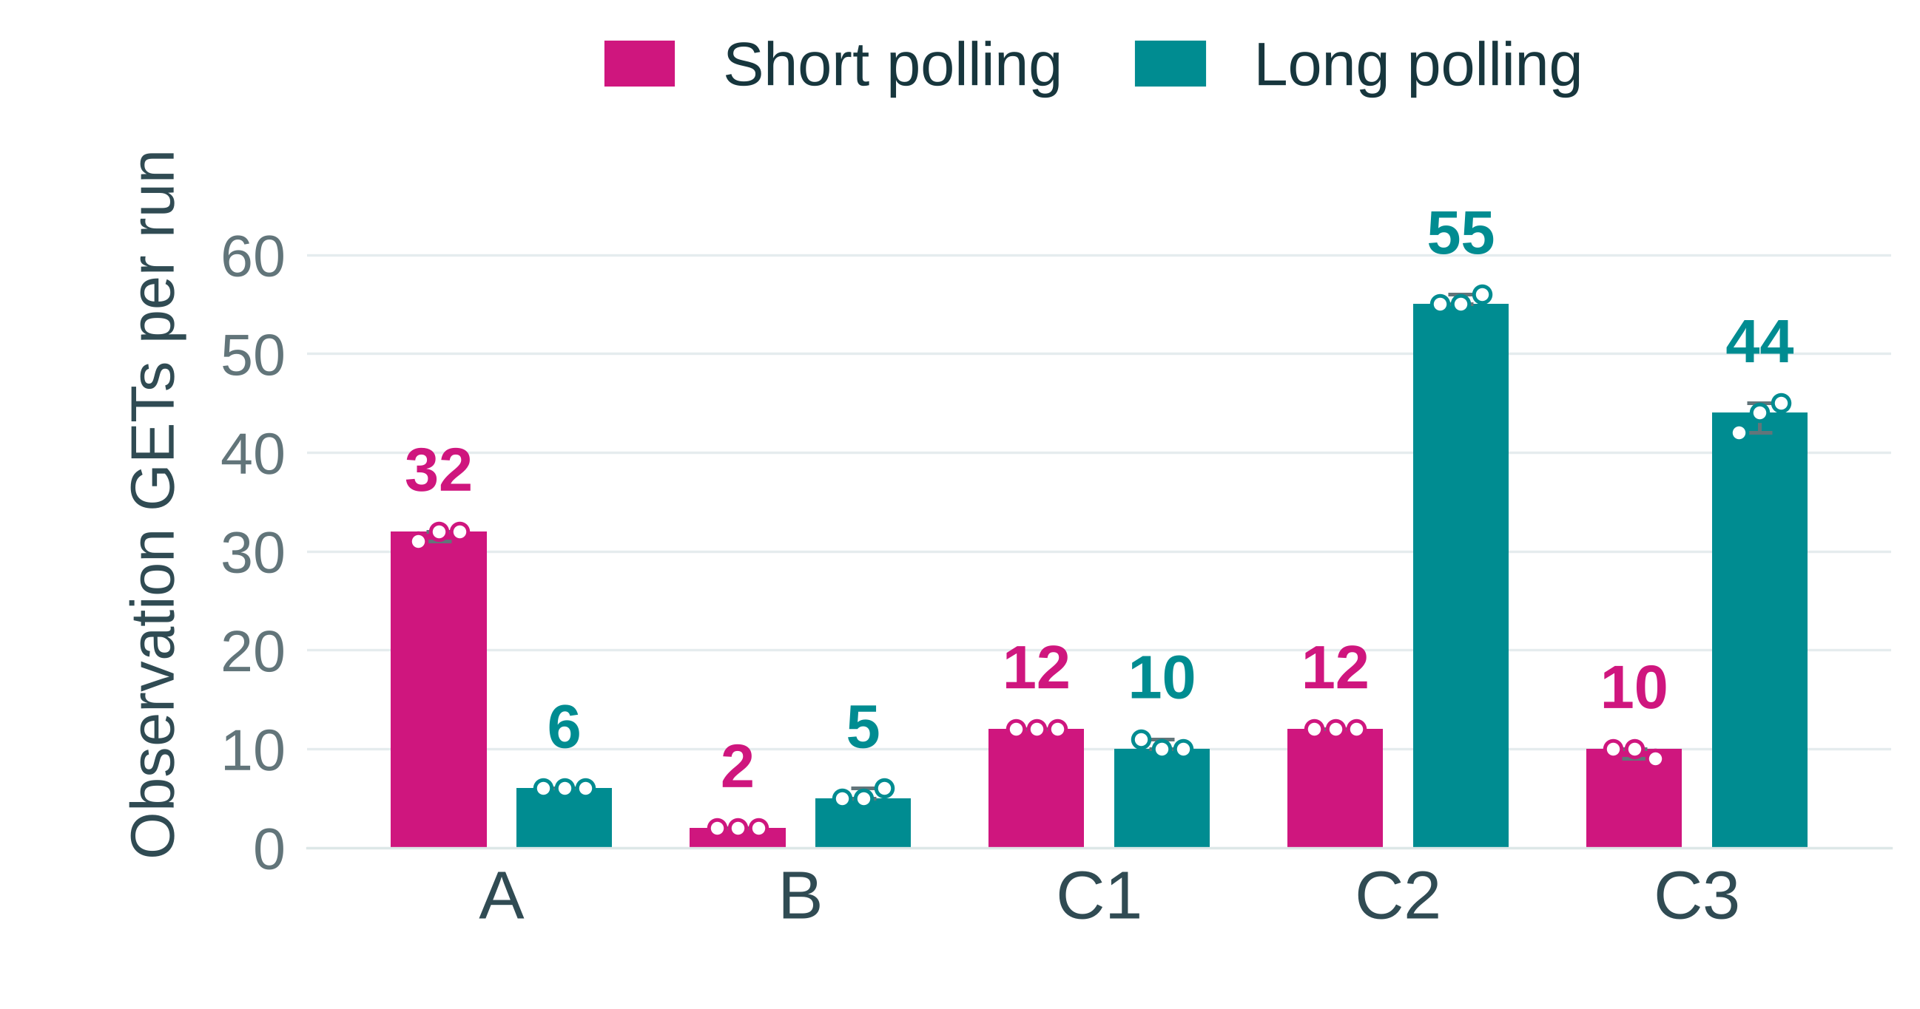
Request counts depend on update frequency
Count = all observation GET starts, including the first snapshot.
Forecasts supported
A and C1: long fewer.
B and C2: short fewer.
Fast updates
C2 long median: 55.
Active responses start
another request.
Bars/labels: median • Dots: 3 individual runs • Lines: minimum–maximum
Daryn Forman | ImageLab Assessment 2 | Measured results
08
Notes:
This chart uses the actual 30 rows in runs.csv. Fuchsia is always short polling and teal is always long polling. The bar and number show the median of three runs, the dots are individual runs and the range line runs from the minimum to maximum. The plotted values have not been changed.
Median short versus long counts are A 32 versus 6, B 2 versus 5, C1 12 versus 10, C2 12 versus 55, and C3 10 versus 44. That supports my request predictions for A, B, C1 and C2. It does not validate the explanation that stopping is unique to short polling; both modes stop at completion. In A, 86 of the 95 short-poll GETs across three runs returned unchanged state.
During frequent updates, long polling tends to return on each new saved state and then immediately starts another request. Short polling lets several changes happen before its next check. C3 counts were lower than C2, contrary to my roughly unchanged count forecast. Longer response cycles can include several intervening commits.
The version logs make that visible: new distinct versions after baseline had medians of 11 short and 54 long in C2, then 9 short and 43 long in C3. Missing committed versions had medians of 44 short and 1 long in C2, then 46 short and 12 long in C3. Baseline was 1 in C2; C3 short baselines were 2, 1 and 2, while C3 long baselines were 1. The report and raw summaries retain every version and gap. Next I’ll separate request count from how quickly completion was learned.
Evidence and preparation: runs.csv requests_started; C2/C3 *-client.json, *-server.log, *-summary.json; original chart data, reformatted for projection.

Slide 9
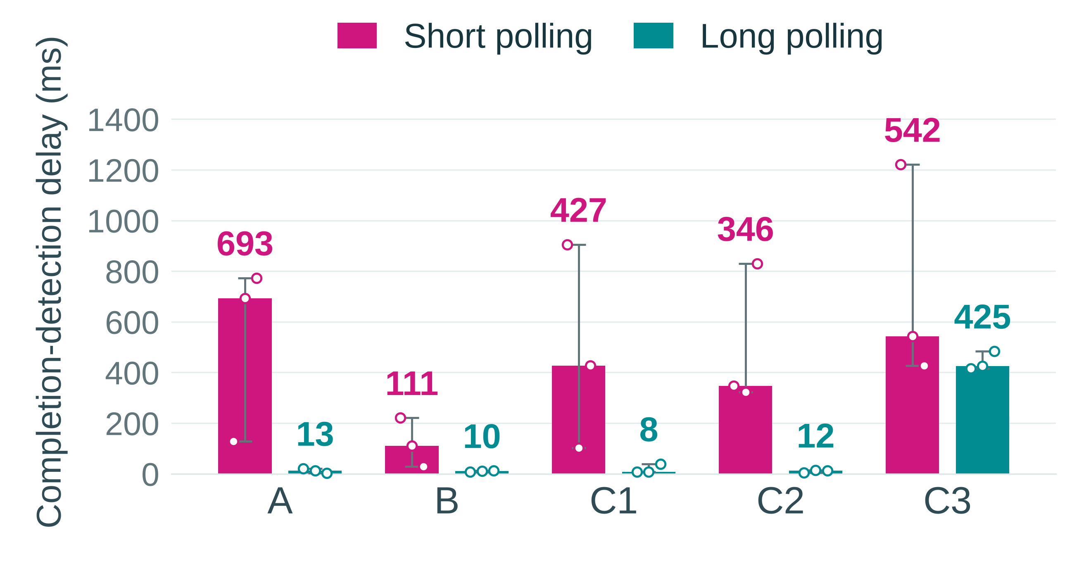
Long polling usually learned completion sooner
Delay = browser receipt − server terminal-commit log, in milliseconds.
B: real processing
Short: 111 ms
Long: 10 ms
Keep the exception
C3 repetition 3:
short 426 ms,
long 484 ms.
Bars/labels: median • Dots: 3 runs • Lines: min–max
C3: delays ↑, GETs ↓
Daryn Forman | ImageLab Assessment 2 | Measured results
09
Notes:
During ordinary processing in B, median completion-detection delay was 111 ms for short polling and 10 ms for long polling. Across A, B, C1, C2 and C3, short medians were 693, 111, 427, 346 and 542 ms; long medians were 13, 10, 8, 12 and 425 ms. Long polling had a lower median in every condition, but that is not the same as always winning each paired run.
C3 repetition 3 is the exception I kept: short polling detected completion in 426 ms and long polling in 484 ms. With three repetitions, individual timing and scheduling can matter; I cannot use the medians as a universal promise.
My C3 delay prediction was supported at the median level: relative to C2, delays rose from 346 to 542 ms for short and from 12 to 425 ms for long. My count prediction was not: counts fell from 12 to 10 and 55 to 44. The timing probes found median increases of 174–285 ms under the configured 200 ms throttling, so I do not describe it as exactly 200 ms on every request.
These values use same-computer wall clocks. Date.now was taken after terminal JSON was read; the server timestamp was immediately after the terminal commit. Logging, JSON parsing and scheduling introduce uncertainty. These are not transformation speeds. That distinction is important for the next slide.
Evidence and preparation: runs.csv detection_ms; post-commit server logs matched to terminal client receipt; C3 prompt-get files; revised report.

Slide 10
What these results do, and do not, establish
1
Detection is not processing
The worker’s work is separate from browser receipt.
2
HTTP counts are not total server cost
C1 median SQL reads: short 13; long 20.
3
A version gap is not a lost final result
C2 → C3 long medians: 54 → 43 new; 1 → 12 missed.
4
Every event needs stronger guarantees
Keep durable event history and support replay.
5
One continuing response could carry more
Frame updates for incremental reading. Not implemented.
Daryn Forman | ImageLab Assessment 2 | Interpretation
10
Notes:
First, quicker detection does not show faster image processing. B’s processing-duration medians were 217.594 ms for the short runs and 451.356 ms for the long runs, and neither small group establishes a causal processing benefit. Artificial waits dominate the delayed conditions.
Second, fewer HTTP requests can hide database work. In C1 the long mode used fewer GETs but more observation reads, 20 median versus 13. This implementation waits on notifications, not periodic SQL polling. It reads on entry, wake-up and the final deadline check, with extra completed-result metadata reads. Worker queries are not part of these counters. A new HTTP request also does not necessarily mean a new TCP connection.
Third, the version comparison is based on each run’s first observed baseline. The numbers shown are medians of new versions and counts of missing committed versions, not sizes of version jumps. C2 long observed a median 54 new versions, range 54–55, missing 1, range 0–1. C3 long observed 43, range 41–44, missing 12, range 11–14. All reached terminal version 56 with the final results. A-long-1 also skipped version 5 and still received completed version 6.
If every event had to be kept, the latest snapshot and a notification signal would not be enough. We would need durable event history and a way to request missing events again. A different design could keep one response open and send separately framed updates so the browser reads each part as it arrives. It would still need disconnect and recovery rules. I have not implemented that continuing-response design.
Evidence and preparation: C1 SQL counters; C2/C3 client/server version logs and summaries; A-long-1 trace; Version 2 snapshot definition. Continuing response is a proposal only.

Slide 11
Choose for the workload, not a universal winner
What limits the conclusion
My recommendation
3 repeats, 1 image, 1 computer
Approximate latency and timestamps
Sampled visibility; unsaved queue output
No CPU, memory or scaling benchmark
Long polling for prompt feedback
and quiet or occasional changes.
Short polling when ~1 s checks are
acceptable during frequent changes.
Measured: GETs, detection delay, versions and observation SQL reads.
Not established: lower total resource cost or better performance at scale.
Daryn Forman | ImageLab Assessment 2 | Limitations and recommendation
11
Notes:
There are only three repetitions per mode and condition. This is a classroom comparison with one image, one observer and one computer, not a general performance study. I did not measure CPU, memory, total network bytes or many concurrent observers.
The browser and server use the same computer clock, but millisecond resolution, logging after commit and scheduling still add uncertainty. C3 timing was approximate, and only C3 opened Firefox Network Monitor, which may itself add overhead. The foreground check was sampled rather than continuous. The recorder enforced an empty queue before upload, but did not save the separate SQL check output. Successful measured runs are not proof that every failure and lifecycle acceptance branch works.
My recommendation follows what I measured. Long polling is useful when quick feedback matters and the job changes only occasionally, particularly A and C1. Short polling remains reasonable when about one-second checking is acceptable and many frequent updates would otherwise generate requests. B also showed that a very short job may complete between short polls. I would not claim one mode is always more efficient.
The separate report, 30-row CSV and supporting logs preserve the detailed numbers so this presentation can be checked.
Evidence and preparation: Revised report limitations and recommendation; raw runs/configuration/probe evidence; no new benchmarks performed.

Slide 12
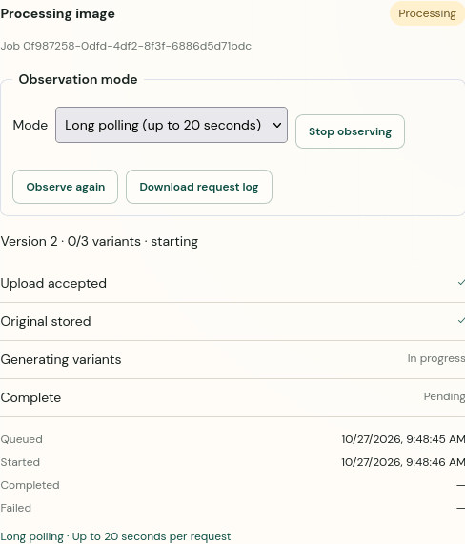
Demonstration: switch modes, keep the job
Real browser capture: long → short → long, while processing continues.
Same job throughout
Job 0f987258…
Same ID across both switches.
One upload, three real variants
Network log: 1 POST.
Same job completes with 3 variants.
Old observation cancelled
Cancelled request recorded.
No later GETs in the stop check.
Animated screenshots: play in Slide Show. Starts after upload; raw frames, timestamps and logs are saved.
Daryn Forman | ImageLab Assessment 2 | Saved application evidence
12
Notes:
This is now saved runtime evidence, separate from my 30 experiment runs. The animation begins after the upload, with long polling selected. Only the idle pre-upload frames were trimmed from the saved screenshot sequence. While the worker is still processing, the automation changes to short polling and then back to long polling through the page’s real mode control.
The job ID remains 0f987258-0dfd-4df2-8f3f-6886d5d71bdc. The client log records the old long poll as cancelled. The network log contains exactly one upload POST for this demonstration. The same job then reaches completed version 6 with all three variants. The observation log has 12 requests at completion and still 12 after a 6,520 ms stop check.
I can explain the animation without claiming that cancelling observation cancels work. It cancels the browser loop; the worker continues. The temporary local forwarder can retain its upstream request until the server responds, so this demonstration does not prove backend cancellation-resource cleanup. It proves the browser switch, same-job continuation and completion.
These are time-sampled native Firefox screenshots, not full-frame-rate video. The GIF keeps their capture timing and is embedded in the deck. In PowerPoint I use Slide Show to play it; the still frames and logs remain available separately.
Evidence and preparation: ready-to-show/01-mode-switch: actions.json, client-log.json, network-log.json, server-job.log, terminal/polling-still-stopped states and verification.json.

Slide 13
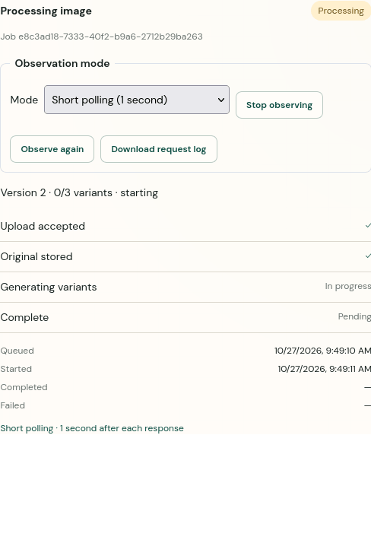
Demonstration: error, Try again, same job
A real failed status fetch pauses observation; Try again resumes it.
Last known state preserved
Error panel appears.
Job stays processing at version 2.
Try again: no new upload
Same job e8c3ad18…
Network log: exactly 1 POST.
Same job completes
Error clears; observation resumes.
Retry checked in short polling.
Controlled fault: local forwarder closes a status connection. Successful responses come from the real application.
Daryn Forman | ImageLab Assessment 2 | Saved application evidence
13
Notes:
I deliberately caused a genuine transport failure for a status GET. A temporary local forwarding helper closed the connection instead of returning a response. It did not invent job JSON, replace fetch, stop the worker or change application source.
The real browser showed Unable to check status and Try again. It retained the same processing snapshot at version 2 and paused checking. The automation removed the fault and clicked the actual Try again button. The error cleared, observation resumed, and job e8c3ad18-7333-40f2-b9a6-2712b29ba263 completed normally.
The network log proves there was only one POST /v1/images across this demonstration. Requests after Try again target the same job URL. The browser had 15 observation requests at completion and still 15 after a 6,487 ms stop check. Those request counts are evidence for this lifecycle check, not extra rows in the experiment CSV.
This retry demonstration used short polling. I should not describe it as a separate runtime retry check of both modes. The full-page error screenshot and native job-panel capture show the button clearly. The animation is time sampled, with only idle pre-upload frames trimmed, and plays in Slide Show. Next I show a worker failure, which is different from an observation connection error.
Evidence and preparation: ready-to-show/02-error-and-retry: error and retry screenshots/states, actions.json, client-log.json, network-log.json, server-job.log and verification.json.

Slide 14
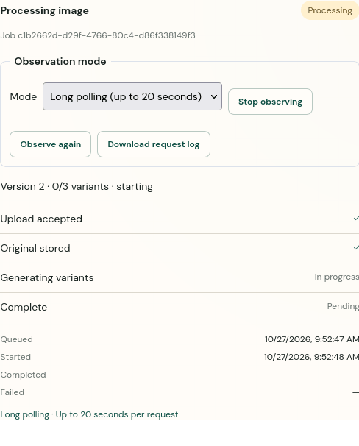
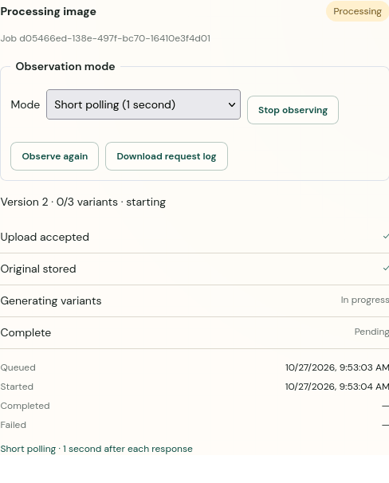
Demonstration: failed jobs stop polling
The real worker records failed; the browser shows the error and stops.
Long polling
Short polling
Safe error shown
No completed
variant results
No further GETs
for over 6 seconds
in either mode
Fault setup: temporarily move only each new demo upload copy; restore it after the worker records failure.
Daryn Forman | ImageLab Assessment 2 | Saved application evidence
14
Notes:
A connection error does not mean that image processing failed. This is a separate check where the worker itself genuinely fails.
Each demonstration began with a real valid upload and an eight-second configured worker delay. The automation temporarily renamed only that new uploaded demonstration copy in temporary storage. When the worker tried to open it, the file was missing. The unmodified worker recorded failed, a failure timestamp and the safe error message. The copy was restored afterwards; my original beach image and existing uploads were not removed.
The long-polling job is c1b2662d-d29f-4766-80c4-d86f338149f3. It reached failed version 3, displayed the safe error and Status checking stopped. Its request count stayed at 3 across a 6,345 ms stop check. The short-polling job is d05466ed-138e-497f-bc70-16410e3f4d01. Its count stayed at 10 across a 6,439 ms stop check. Both had one upload POST, zero completed variants, no completed_at timestamp and no pending browser request at the end.
Those observations now support failed-job browser stopping in both modes. They do not establish every acceptance check or every possible failure. The animations are actual time-sampled job-panel screenshots, with only idle pre-upload frames trimmed; their configuration and raw logs are saved. These fault demonstrations are outside the 30 measured runs.
Evidence and preparation: ready-to-show/03-failure-long and 04-failure-short: terminal-failed/polling-still-stopped screenshots and states, client/network/server logs, configuration and verification.

Slide 15
Less checking is only one part of the decision
Long polling reduced quiet-job traffic
and usually delivered completion sooner.
Frequent updates and latency changed the trade-off.
The final state mattered more than receiving every snapshot.
Questions?
Saved demonstrations cover mode switching, retry and failed-job stop.
Keep the app or separate traces ready for other checks, including two observers.
Daryn Forman | ImageLab Assessment 2 | Conclusion and questions
15
Notes:
My conclusion is that long polling was useful, but it did not make image transformations faster. It reduced repeated checking during quiet work and had a lower median completion-detection delay in these conditions. Frequent updates could create more requests, and added latency meant more intermediate versions were skipped. The final complete snapshot was still received.
The 30-row CSV and client/server logs support the experiment results. The separate demonstrations now add observed evidence of switching modes while the same job completes, Try again after a real status-connection error without another upload, and failed-job browser stopping in both modes. No source code or experiment measurements were changed to produce those captures.
I should distinguish that evidence from checks not established by these demonstrations. The retry capture used short polling. The local forwarder means the mode-switch recording does not establish backend cancellation-resource cleanup. Other original acceptance checks, such as two simultaneous observers and rejection of invalid observation parameters, still need their own saved or live evidence. A-long-1 is saved evidence of a held request, normal 204 renewal and terminal stop.
These slides follow the teacher’s updated classroom-PPT instruction rather than the original video format. Source, migration, meaningful commits, setup/experiment documentation and the Assessment 1 baseline reference remain separate submission items; this presentation does not certify all are complete. No presentation time limit has been assumed.
Questions about the implementation, measurements or demonstrations?
Evidence: revised report, runs.csv, original experiment logs, and assessment2-feature-evidence/ready-to-show verified demonstrations.

