Slide 1
ImageLab Assessment 2
Short and Long
Polling Comparison
Daryn Forman
Short polling
Long polling
Daryn Forman | ImageLab Assessment 2 | Introduction
01
Notes:
I’m Daryn Forman. My project compares short polling and long polling in ImageLab. Both modes watch the same background image-processing jobs. I wanted to find out how many requests each mode sends, how quickly the browser notices completion, and which job versions it receives.
The teacher has replaced the original narrated video with this classroom presentation. I am using the same assessment requirements for the implementation and experiment. The results here come from the 30 recorded runs on 25 October 2026, not made-up examples.
I’ll start with how the application works, then show the code, the experiment and the trade-offs.
Evidence and preparation: Teacher brief and Version 2 requirements; revised three-page report; runs.csv.

Slide 2
How the application works
POST
GET
Browser
Go API
read / write
PostgreSQL
Uploads + checks job progress
Accepts + gives status
Saves job progress
claim +
progress
Local files
store
Background worker
Original + results
Creates 3 image sizes
02
Notes:
The browser uploads the image with POST /v1/images. A 202 response means the upload has been accepted and a durable job exists; it does not mean the variants are ready. The single worker claims jobs, reads the stored original, creates each variant and records progress in PostgreSQL. The API returns the job’s current state to the browser.
The key distinction is that processing and observation are separate. Changing polling mode or stopping a browser request does not cancel the worker. The worker uses the application’s worker context, rather than the individual observation request’s context.
The three variants keep the original transformation settings: a 150 by 150 crop, preview within 800 by 600, and display within 1200 by 900 with aspect ratio preserved for the latter two. Completed snapshots expose the complete set, not partial results as completed work. Next I’ll compare the two observation loops.
Evidence and preparation: cmd/api/images.go; cmd/api/worker.go; internal/data/jobs.go; Version 2 requirements.

Slide 3
How the two methods check progress
Short polling
Long polling
Ask for the current progress.
Receive a response.
Wait 1 second, then ask again.
Ask, reply, wait one second, repeat.
Ask using the last version.
Wait for change, or up to 20 seconds.
Receive a reply, then ask again.
Ask, Wait, Reply, Repeat
Version: increases whenever the saved job information changes.
204 response: no change before the waiting time ended.
03
Notes:
Short polling asks for the current state and then waits one second after the response and rendering before asking again. It is not exactly one second from one request start to the next, because response time is added. The client does not overlap requests.
Long polling begins with the same prompt snapshot, then sends after equal to its last version and wait=20. If the job is already newer, it returns immediately. If it is unchanged and active, the server holds the request until a notification, cancellation or deadline. A normal 204 means there was still no newer snapshot at the final deadline check. It is not an error. The browser immediately renews after either an active 200 or a 204.
A version is not a percentage. It changes whenever observable job information changes. A snapshot can jump over versions because it represents current state, not a replay. The two cards are an explanation of the code’s behaviour, not a fabricated measurement trace. Now I’ll show how state and version are saved together.
Evidence and preparation: web/assets/app.js pollJob(); cmd/api/jobs.go showJobHandler()/observationQuery(); Version 2 terms.

Slide 4
Save progress, then send a notification
UPDATE jobs
SET
variants_completed=
variants_completed+1,
stage=$2,
version=version+1
WHERE id=$1 AND status='processing'
AND variants_completed<3
RETURNING version,variants_completed
if err = tx.Commit(); err != nil {
return err
}
j.Stage = v.Name + "_ready"
j.Status = "processing"
m.committed(j)
… committed() helper …
if m.Changes != nil {
m.Changes.Notify(j.PublicID)
}
Save progress and increase the version together. [jobs.go]
Send a notification only after the save succeeds. [jobs.go]
Create the image file first. Then save progress and notify observers.
04
Notes:
The SQL on the left is the actual Milestone update, wrapped onto shorter lines for this slide. It increments variants_completed and version in the same transaction that stores the variant metadata. The worker calls Milestone only after the variant file has been written. That keeps real progress tied to actual work.
On the right, tx.Commit must succeed before m.committed is called. I have combined two clearly separated locations from internal/data/jobs.go: the milestone’s successful commit path and the notification lines inside committed. The helper logs the committed version and then broadcasts to observers. It does not send a success message to the browser directly.
A failure to commit returns an error instead of announcing a change that does not exist. The version identifies a consistent saved representation; PostgreSQL remains authoritative. Simulated steps use a separate field and never increase the real variant count. I’ll now show why observers subscribe before checking that saved record.
Evidence and preparation: internal/data/jobs.go Milestone() and committed(); cmd/api/worker.go transformation/milestone ordering. Only whitespace wrapping and marked omissions in excerpts.

Slide 5
When the browser continues or stops
if(response.status===204){
if(!isLong)
throw new Error(
'Unexpected no-content snapshot');
entry.outcome='no_change_204';
schedule();
return;
}
if(job.status==='completed'||
job.status==='failed'){
stopObservation();
pollingIndicator.textContent=
'Status checking stopped';
}else{
schedule();
}
204: send another long-poll request. [app.js]
Completed or failed: stop checking. [app.js]
Job still active?
Update the page and check again.
Connection error? Show “Try again.”
Retry checks the same job.
Changing polling methods does not stop the worker.
06
Notes:
Every observation session starts with a prompt GET, including retry or a mode change. The first received version is the baseline. A valid active 200 updates activeJob and renders it before schedule runs. The schedule function uses zero delay for long polling and 1,000 milliseconds for short polling. The client timeout is 30 seconds.
The left excerpt is the real 204 branch. It does not parse JSON or advance the version. It records normal no-change and immediately schedules the next long poll. The right excerpt stops for completed or failed. Both blocks are only whitespace wrapped from the source.
stopObservation aborts the request and clears its timer. The observation session identity is checked again after fetch and after JSON parsing so a reply from an old loop cannot overwrite the current job. Genuine retrieval errors preserve the last known state and show Try again. Its click handler calls startObservation for the existing activeJob; it does not POST another image.
This slide explains the implementation. The 30-run series covers successful completion and A-long-1 shows normal 204 renewal. Separate saved demonstrations on slides 12–14 now cover mode switching with worker continuation, same-job retry after a real status-connection error in short polling, and failed-job stopping in both modes. Backend cancellation cleanup and other acceptance checks are outside those captures.
Evidence and preparation: web/assets/app.js stopObservation(), startObservation(), pollJob(), mode/retry event handlers; A-long-1-client.json.

Slide 6
How I tested both methods
5 conditions × 2 methods × 3 repetitions = 30 runs
Condition
A
30 s quiet delay, then processing
B
Real image processing only
C1
10 s of updates, every 2 s
C2
10 s of updates, every 200 ms
C3
C2 + added delay set to 200 ms
07
Notes:
I saved each prediction before starting that condition. For A I expected short polling to make more requests because long polling avoids unnecessary checks. For B I chose short polling because the client stops when it finds completion. For C1 I chose long polling because it waits. For C2 I chose short polling because frequent changes can be reflected in one later response. My saved clarification is that this is still one latest snapshot, not a list of events. For C3 I expected both detection delays to rise because responses arrive later, with request counts roughly like C2. These are forecasts, not rewritten conclusions.
The recorder used the actual Firefox UI and the same beach image hash and transformation settings. It checked that there were no queued or processing jobs before each upload, but did not retain separate SQL output. There was one controlled observer. Each condition alternated order short/long, long/short, short/long. Visibility samples were foreground; there was no continuous visibility log.
The window starts at the first job GET and ends at terminal JSON receipt. GET counts include that first snapshot, not upload POSTs or health probes. Detection delay is browser Date.now receipt minus the matching server post-commit millisecond timestamp, joined by job ID and version on the same computer. This is an estimate, not screen-paint time.
Only C3 used Firefox Network Monitor with latency=200 ms and upload/download limits of 1,000,000,000 bytes/s. Five prompt health-GET probes before and after throttling per run measured median increases of 174–285 ms, not exactly 200 ms. C1–C3 simulated steps finish before real transformations; actual commits are logged separately from truthful variant counts. All 30 runs finished with three recorded real variants.
Evidence and preparation: prediction.json, B/C1/C2/C3-prediction.json; configuration and prompt-get files; record.py; runs.csv; revised report.

Slide 7
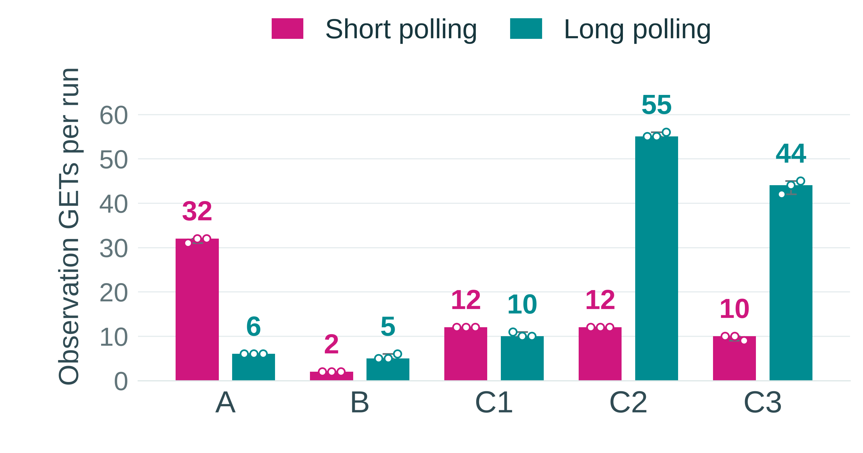
Which method sent fewer requests?
Request count: how many status checks the browser started.
A — Quiet delay
Short repeats checks.
Long waits for changes.
B — Quick processing
Short needs few checks.
Long reacts to progress updates
C1 — Occasional updates
Long waits for updates,
avoiding repeated checks.
C2 — Frequent updates
Long reacts and asks again often.
Short checks less often.
C3 — Added network delay
The browser could not ask again as quickly. That reduced the number of requests.
30-second
quiet delay
Real processing
only
Updates every
2 seconds
Updates every
200 ms
C2 + network
delay
Daryn Forman | ImageLab Assessment 2 | Measured results
08
Notes:
This chart uses the actual 30 rows in runs.csv. Fuchsia is always short polling and teal is always long polling. The bar and number show the median of three runs, the dots are individual runs and the range line runs from the minimum to maximum. The plotted values have not been changed.
Median short versus long counts are A 32 versus 6, B 2 versus 5, C1 12 versus 10, C2 12 versus 55, and C3 10 versus 44. That supports my request predictions for A, B, C1 and C2. It does not validate the explanation that stopping is unique to short polling; both modes stop at completion. In A, 86 of the 95 short-poll GETs across three runs returned unchanged state.
During frequent updates, long polling tends to return on each new saved state and then immediately starts another request. Short polling lets several changes happen before its next check. C3 counts were lower than C2, contrary to my roughly unchanged count forecast. Longer response cycles can include several intervening commits.
The version logs make that visible: new distinct versions after baseline had medians of 11 short and 54 long in C2, then 9 short and 43 long in C3. Missing committed versions had medians of 44 short and 1 long in C2, then 46 short and 12 long in C3. Baseline was 1 in C2; C3 short baselines were 2, 1 and 2, while C3 long baselines were 1. The report and raw summaries retain every version and gap. Next I’ll separate request count from how quickly completion was learned.
Evidence and preparation: runs.csv requests_started; C2/C3 *-client.json, *-server.log, *-summary.json; original chart data, reformatted for projection.

Slide 8
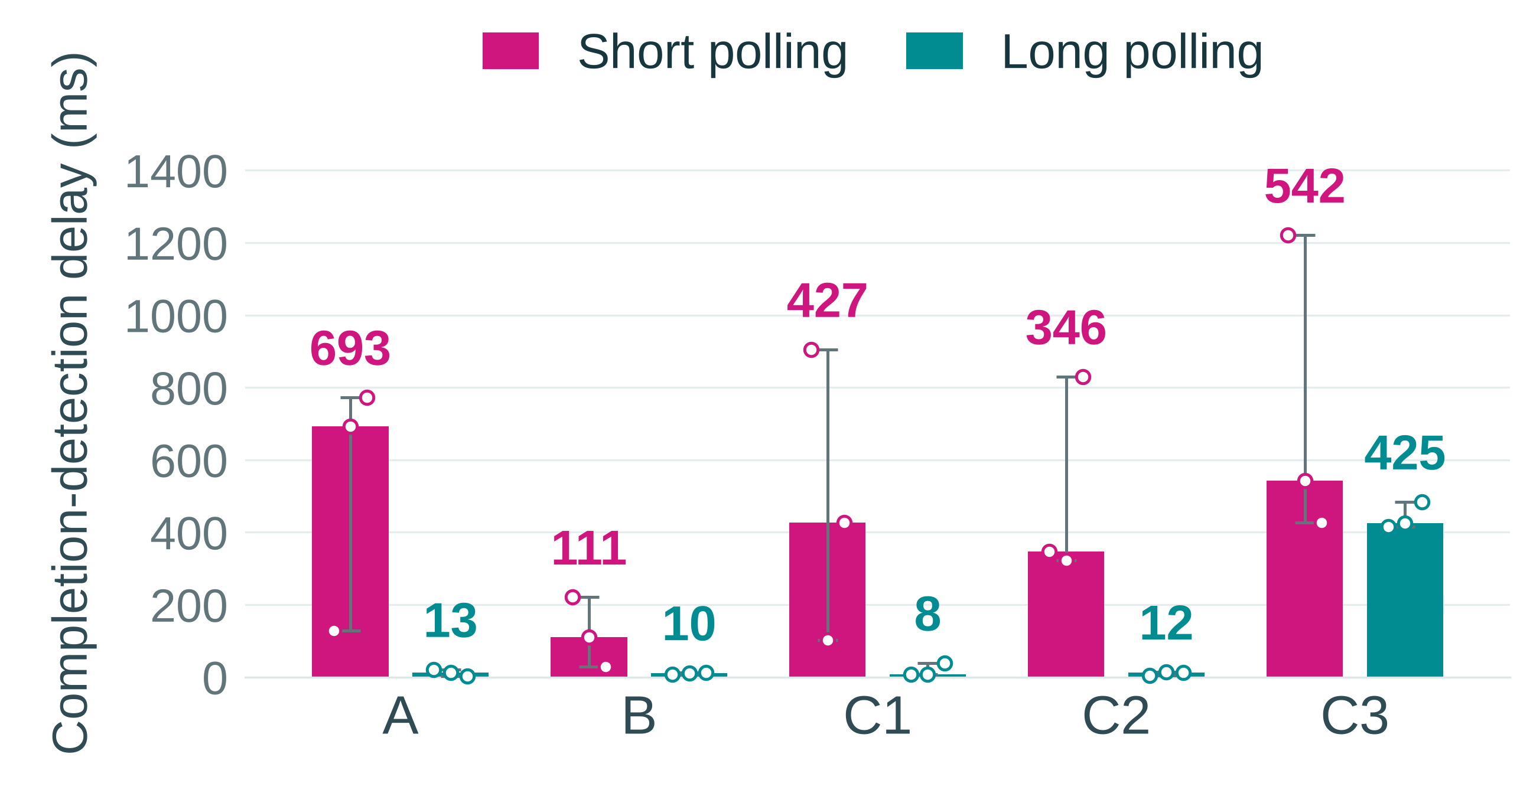
Which method noticed completion sooner?
Why long was usually quicker
A waiting long poll can return
when the job finishes.
Short may be waiting for its next checks.
.
30-second
quiet delay
Real processing
only
Updates every
2 seconds
Updates every
200 ms
C2 + network
delay
.
Daryn Forman | ImageLab Assessment 2 | Measured results
09
Notes:
During ordinary processing in B, median completion-detection delay was 111 ms for short polling and 10 ms for long polling. Across A, B, C1, C2 and C3, short medians were 693, 111, 427, 346 and 542 ms; long medians were 13, 10, 8, 12 and 425 ms. Long polling had a lower median in every condition, but that is not the same as always winning each paired run.
C3 repetition 3 is the exception I kept: short polling detected completion in 426 ms and long polling in 484 ms. With three repetitions, individual timing and scheduling can matter; I cannot use the medians as a universal promise.
My C3 delay prediction was supported at the median level: relative to C2, delays rose from 346 to 542 ms for short and from 12 to 425 ms for long. My count prediction was not: counts fell from 12 to 10 and 55 to 44. The timing probes found median increases of 174–285 ms under the configured 200 ms throttling, so I do not describe it as exactly 200 ms on every request.
These values use same-computer wall clocks. Date.now was taken after terminal JSON was read; the server timestamp was immediately after the terminal commit. Logging, JSON parsing and scheduling introduce uncertainty. These are not transformation speeds. That distinction is important for the next slide.
Evidence and preparation: runs.csv detection_ms; post-commit server logs matched to terminal client receipt; C3 prompt-get files; revised report.

Slide 9
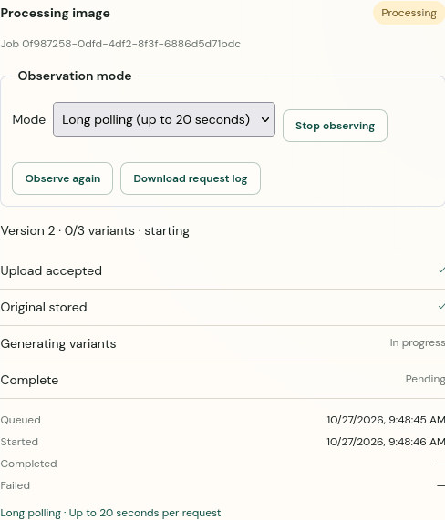
Switching methods keeps the same job
I switched from long to short polling, then back. The worker continued.
.
12
Notes:
This is now saved runtime evidence, separate from my 30 experiment runs. The animation begins after the upload, with long polling selected. Only the idle pre-upload frames were trimmed from the saved screenshot sequence. While the worker is still processing, the automation changes to short polling and then back to long polling through the page’s real mode control.
The job ID remains 0f987258-0dfd-4df2-8f3f-6886d5d71bdc. The client log records the old long poll as cancelled. The network log contains exactly one upload POST for this demonstration. The same job then reaches completed version 6 with all three variants. The observation log has 12 requests at completion and still 12 after a 6,520 ms stop check.
I can explain the animation without claiming that cancelling observation cancels work. It cancels the browser loop; the worker continues. The temporary local forwarder can retain its upstream request until the server responds, so this demonstration does not prove backend cancellation-resource cleanup. It proves the browser switch, same-job continuation and completion.
These are time-sampled native Firefox screenshots, not full-frame-rate video. The GIF keeps their capture timing and is embedded in the deck. In PowerPoint I use Slide Show to play it; the still frames and logs remain available separately.
Evidence and preparation: ready-to-show/01-mode-switch: actions.json, client-log.json, network-log.json, server-job.log, terminal/polling-still-stopped states and verification.json.

Slide 10
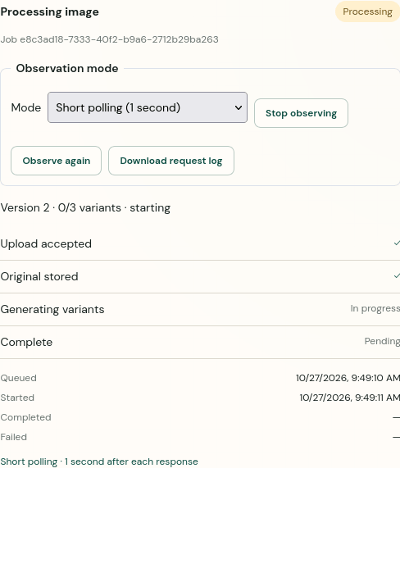
Try again checks the same job
A connection error interrupted status checking. The worker could continue.
13
Notes:
I deliberately caused a genuine transport failure for a status GET. A temporary local forwarding helper closed the connection instead of returning a response. It did not invent job JSON, replace fetch, stop the worker or change application source.
The real browser showed Unable to check status and Try again. It retained the same processing snapshot at version 2 and paused checking. The automation removed the fault and clicked the actual Try again button. The error cleared, observation resumed, and job e8c3ad18-7333-40f2-b9a6-2712b29ba263 completed normally.
The network log proves there was only one POST /v1/images across this demonstration. Requests after Try again target the same job URL. The browser had 15 observation requests at completion and still 15 after a 6,487 ms stop check. Those request counts are evidence for this lifecycle check, not extra rows in the experiment CSV.
This retry demonstration used short polling. I should not describe it as a separate runtime retry check of both modes. The full-page error screenshot and native job-panel capture show the button clearly. The animation is time sampled, with only idle pre-upload frames trimmed, and plays in Slide Show. Next I show a worker failure, which is different from an observation connection error.
Evidence and preparation: ready-to-show/02-error-and-retry: error and retry screenshots/states, actions.json, client-log.json, network-log.json, server-job.log and verification.json.

Slide 11
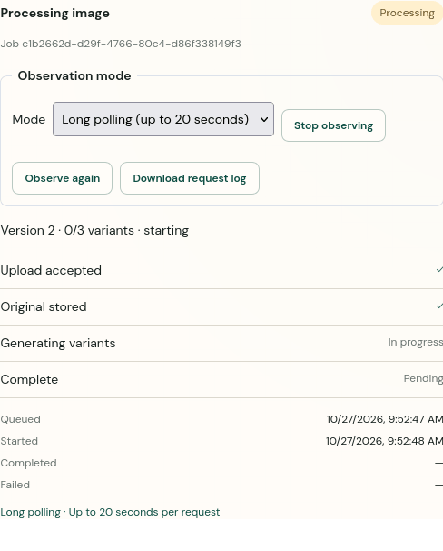
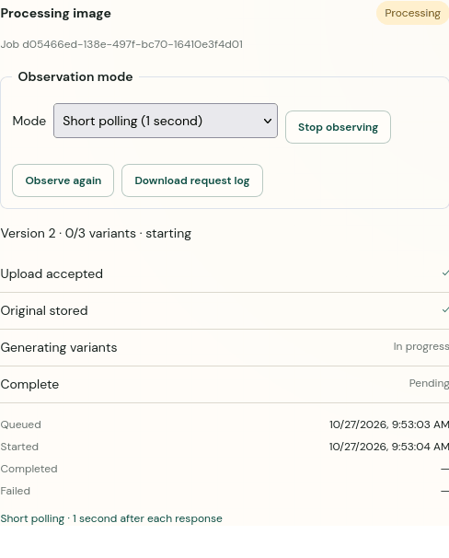
A failed job stops checking
The worker failed. The browser showed the error and stopped checking.
Long polling
Short polling
.
14
Notes:
A connection error does not mean that image processing failed. This is a separate check where the worker itself genuinely fails.
Each demonstration began with a real valid upload and an eight-second configured worker delay. The automation temporarily renamed only that new uploaded demonstration copy in temporary storage. When the worker tried to open it, the file was missing. The unmodified worker recorded failed, a failure timestamp and the safe error message. The copy was restored afterwards; my original beach image and existing uploads were not removed.
The long-polling job is c1b2662d-d29f-4766-80c4-d86f338149f3. It reached failed version 3, displayed the safe error and Status checking stopped. Its request count stayed at 3 across a 6,345 ms stop check. The short-polling job is d05466ed-138e-497f-bc70-16410e3f4d01. Its count stayed at 10 across a 6,439 ms stop check. Both had one upload POST, zero completed variants, no completed_at timestamp and no pending browser request at the end.
Those observations now support failed-job browser stopping in both modes. They do not establish every acceptance check or every possible failure. The animations are actual time-sampled job-panel screenshots, with only idle pre-upload frames trimmed; their configuration and raw logs are saved. These fault demonstrations are outside the 30 measured runs.
Evidence and preparation: ready-to-show/03-failure-long and 04-failure-short: terminal-failed/polling-still-stopped screenshots and states, client/network/server logs, configuration and verification.

