Slide 1
ImageLab Assessment 2
Short and Long
Polling Comparison
Daryn Forman
Short polling
Long polling
Same image-processing application.
Two ways for the browser to observe progress.
Daryn Forman | ImageLab Assessment 2 | Introduction
01
Notes:
I’m Daryn Forman. My project compares short polling and long polling in ImageLab. Both modes watch the same background image-processing jobs. I wanted to find out how many requests each mode sends, how quickly the browser notices completion, and which job versions it receives.
The teacher has replaced the original narrated video with this classroom presentation. I am using the same assessment requirements for the implementation and experiment. The results here come from the 30 recorded runs on 25 October 2026, not made-up examples.
I’ll start with how the application works, then show the code, the experiment and the trade-offs.
Evidence and preparation: Teacher brief and Version 2 requirements; revised three-page report; runs.csv.

Slide 2
The worker processes. The browser observes.
Assessment 2 adds version-based long polling beside the existing short-polling mode.
POST
GET
Browser
Go API
read / write
PostgreSQL
Upload + observe
Accept + return state
Authoritative job record
claim +
progress
Stopping observation
does not cancel
the worker’s job.
Local files
store
One worker
Original + outputs
Create the variants
Three real outputs: thumbnail, preview and display.
Daryn Forman | ImageLab Assessment 2 | Application overview
02
Notes:
The browser uploads the image with POST /v1/images. A 202 response means the upload has been accepted and a durable job exists; it does not mean the variants are ready. The single worker claims jobs, reads the stored original, creates each variant and records progress in PostgreSQL. The API returns the job’s current state to the browser.
The key distinction is that processing and observation are separate. Changing polling mode or stopping a browser request does not cancel the worker. The worker uses the application’s worker context, rather than the individual observation request’s context.
The three variants keep the original transformation settings: a 150 by 150 crop, preview within 800 by 600, and display within 1200 by 900 with aspect ratio preserved for the latter two. Completed snapshots expose the complete set, not partial results as completed work. Next I’ll compare the two observation loops.
Evidence and preparation: cmd/api/images.go; cmd/api/worker.go; internal/data/jobs.go; Version 2 requirements.

Slide 3
Same snapshots, different request timing
Short polling
Long polling
GET the current snapshot
Wait 1 second after the response
Send the next GET
GET with the last version
Wait for change or a 20 s deadline
Immediately send the next GET
Version: an increasing number for a changed job representation.
Snapshot: the current state, not a history of every update.
A normal 204 means no change before the holding deadline.
Daryn Forman | ImageLab Assessment 2 | Observation model
03
Notes:
Short polling asks for the current state and then waits one second after the response and rendering before asking again. It is not exactly one second from one request start to the next, because response time is added. The client does not overlap requests.
Long polling begins with the same prompt snapshot, then sends after equal to its last version and wait=20. If the job is already newer, it returns immediately. If it is unchanged and active, the server holds the request until a notification, cancellation or deadline. A normal 204 means there was still no newer snapshot at the final deadline check. It is not an error. The browser immediately renews after either an active 200 or a 204.
A version is not a percentage. It changes whenever observable job information changes. A snapshot can jump over versions because it represents current state, not a replay. The two cards are an explanation of the code’s behaviour, not a fabricated measurement trace. Now I’ll show how state and version are saved together.
Evidence and preparation: web/assets/app.js pollJob(); cmd/api/jobs.go showJobHandler()/observationQuery(); Version 2 terms.

Slide 4
Save truthful progress, then notify
PostgreSQL stores the authoritative state and version together.
UPDATE jobs
SET
variants_completed=
variants_completed+1,
stage=$2,
version=version+1
WHERE id=$1 AND status='processing'
AND variants_completed<3
RETURNING version,variants_completed
if err = tx.Commit(); err != nil {
return err
}
j.Stage = v.Name + "_ready"
j.Status = "processing"
m.committed(j)
… committed() helper …
if m.Changes != nil {
m.Changes.Notify(j.PublicID)
}
internal/data/jobs.go · Milestone() SQL
internal/data/jobs.go · selected locations; gap marked
Actual variant file + metadata → progress/version commit → broadcast
Daryn Forman | ImageLab Assessment 2 | Server implementation
04
Notes:
The SQL on the left is the actual Milestone update, wrapped onto shorter lines for this slide. It increments variants_completed and version in the same transaction that stores the variant metadata. The worker calls Milestone only after the variant file has been written. That keeps real progress tied to actual work.
On the right, tx.Commit must succeed before m.committed is called. I have combined two clearly separated locations from internal/data/jobs.go: the milestone’s successful commit path and the notification lines inside committed. The helper logs the committed version and then broadcasts to observers. It does not send a success message to the browser directly.
A failure to commit returns an error instead of announcing a change that does not exist. The version identifies a consistent saved representation; PostgreSQL remains authoritative. Simulated steps use a separate field and never increase the real variant count. I’ll now show why observers subscribe before checking that saved record.
Evidence and preparation: internal/data/jobs.go Milestone() and committed(); cmd/api/worker.go transformation/milestone ordering. Only whitespace wrapping and marked omissions in excerpts.

Slide 5
Subscribe before checking the database
The signal tells the handler to reread the job. It does not prove success.
changed, release :=
app.models.Jobs.Changes.Subscribe(id)
defer release()
returnAfter := time.NewTimer(wait)
defer returnAfter.Stop()
for {
job, err := get()
if !app.jobReadOK(w, r, err) {
return
}
Read now
Newer or terminal → 200
Otherwise wait
Notification → reread
Deadline
Reread; 204 if unchanged
cmd/api/jobs.go · start of long-poll branch (excerpt)
Register first. Buffered signals bridge the gap between checking and waiting.
Daryn Forman | ImageLab Assessment 2 | Waiting and notification
05
Notes:
This excerpt is the beginning of the actual long-poll branch. Subscribe registers a separate buffered signal for this observer under a mutex before get reads PostgreSQL. If a change is committed before the read, the read can discover it. If it happens after the read but before waiting, the signal stays buffered, so the observer does not miss the change in that gap.
Further down this same handler, a newer version or any valid terminal snapshot returns 200 immediately. Otherwise select waits for the signal, request cancellation or the holding timer. A signal loops back to get. At the deadline the handler does one final authoritative read before deciding whether to return a newer 200 or normal 204. Subscription and timer cleanup are deferred.
JobChanges.Notify broadcasts to every registered observer, rather than having all observers compete for one receive. A signal means check PostgreSQL; it never proves that processing succeeded. The browser must inspect the returned state. The endpoint also rejects future or malformed versions and invalid wait values. Those contracts are in the source; these experiment runs do not independently exercise every error branch.
Evidence and preparation: cmd/api/jobs.go lines 31–65; internal/data/job_changes.go Subscribe()/Notify(); code inspection, not a new runtime test.

Slide 6
The browser renews, stops and retries safely
First: prompt snapshot and baseline. Then: one observation request at a time.
if(response.status===204){
if(!isLong)
throw new Error(
'Unexpected no-content snapshot');
entry.outcome='no_change_204';
schedule();
return;
}
if(job.status==='completed'||
job.status==='failed'){
stopObservation();
pollingIndicator.textContent=
'Status checking stopped';
}else{
schedule();
}
web/assets/app.js · pollJob() / 204 branch
web/assets/app.js · pollJob() / terminal branch
Active 200: render, save version,
then immediately long poll again.
Cancel old session; ignore late replies.
Try again observes the same job.
Stopping observation does not stop the worker.
Daryn Forman | ImageLab Assessment 2 | Browser lifecycle
06
Notes:
Every observation session starts with a prompt GET, including retry or a mode change. The first received version is the baseline. A valid active 200 updates activeJob and renders it before schedule runs. The schedule function uses zero delay for long polling and 1,000 milliseconds for short polling. The client timeout is 30 seconds.
The left excerpt is the real 204 branch. It does not parse JSON or advance the version. It records normal no-change and immediately schedules the next long poll. The right excerpt stops for completed or failed. Both blocks are only whitespace wrapped from the source.
stopObservation aborts the request and clears its timer. The observation session identity is checked again after fetch and after JSON parsing so a reply from an old loop cannot overwrite the current job. Genuine retrieval errors preserve the last known state and show Try again. Its click handler calls startObservation for the existing activeJob; it does not POST another image.
This slide explains implemented code. The measured series covers successful completion, and A-long-1 demonstrates normal 204 renewal. It does not establish that every cancellation, retry or failed-job browser path was runtime-tested. Those need live or separately saved evidence.
Evidence and preparation: web/assets/app.js stopObservation(), startObservation(), pollJob(), mode/retry event handlers; A-long-1-client.json.

Slide 7
Predictions first. Then 30 controlled runs.
5 conditions × 2 modes × 3 repetitions
Condition
My request-count prediction
A
30 s quiet delay + real work
Long fewer: avoid repeated checking.
B
Real transformations only
Short fewer: stop when complete.
C1
10 s sim; 2 s updates
Long fewer: wait for updates.
C2
10 s sim; 200 ms updates
Short fewer: checks span several changes.
C3
C2 + 200 ms latency setting
Delays rise; counts roughly like C2.
Same image/settings • one observer • alternating order • queue checked empty
Foreground sampled; SQL check output unsaved. C3 timing increase: 174–285 ms.
Daryn Forman | ImageLab Assessment 2 | Experimental method
07
Notes:
I saved each prediction before starting that condition. For A I expected short polling to make more requests because long polling avoids unnecessary checks. For B I chose short polling because the client stops when it finds completion. For C1 I chose long polling because it waits. For C2 I chose short polling because frequent changes can be reflected in one later response. My saved clarification is that this is still one latest snapshot, not a list of events. For C3 I expected both detection delays to rise because responses arrive later, with request counts roughly like C2. These are forecasts, not rewritten conclusions.
The recorder used the actual Firefox UI and the same beach image hash and transformation settings. It checked that there were no queued or processing jobs before each upload, but did not retain separate SQL output. There was one controlled observer. Each condition alternated order short/long, long/short, short/long. Visibility samples were foreground; there was no continuous visibility log.
The window starts at the first job GET and ends at terminal JSON receipt. GET counts include that first snapshot, not upload POSTs or health probes. Detection delay is browser Date.now receipt minus the matching server post-commit millisecond timestamp, joined by job ID and version on the same computer. This is an estimate, not screen-paint time.
Only C3 used Firefox Network Monitor with latency=200 ms and upload/download limits of 1,000,000,000 bytes/s. Five prompt health-GET probes before and after throttling per run measured median increases of 174–285 ms, not exactly 200 ms. C1–C3 simulated steps finish before real transformations; actual commits are logged separately from truthful variant counts. All 30 runs finished with three recorded real variants.
Evidence and preparation: prediction.json, B/C1/C2/C3-prediction.json; configuration and prompt-get files; record.py; runs.csv; revised report.

Slide 8
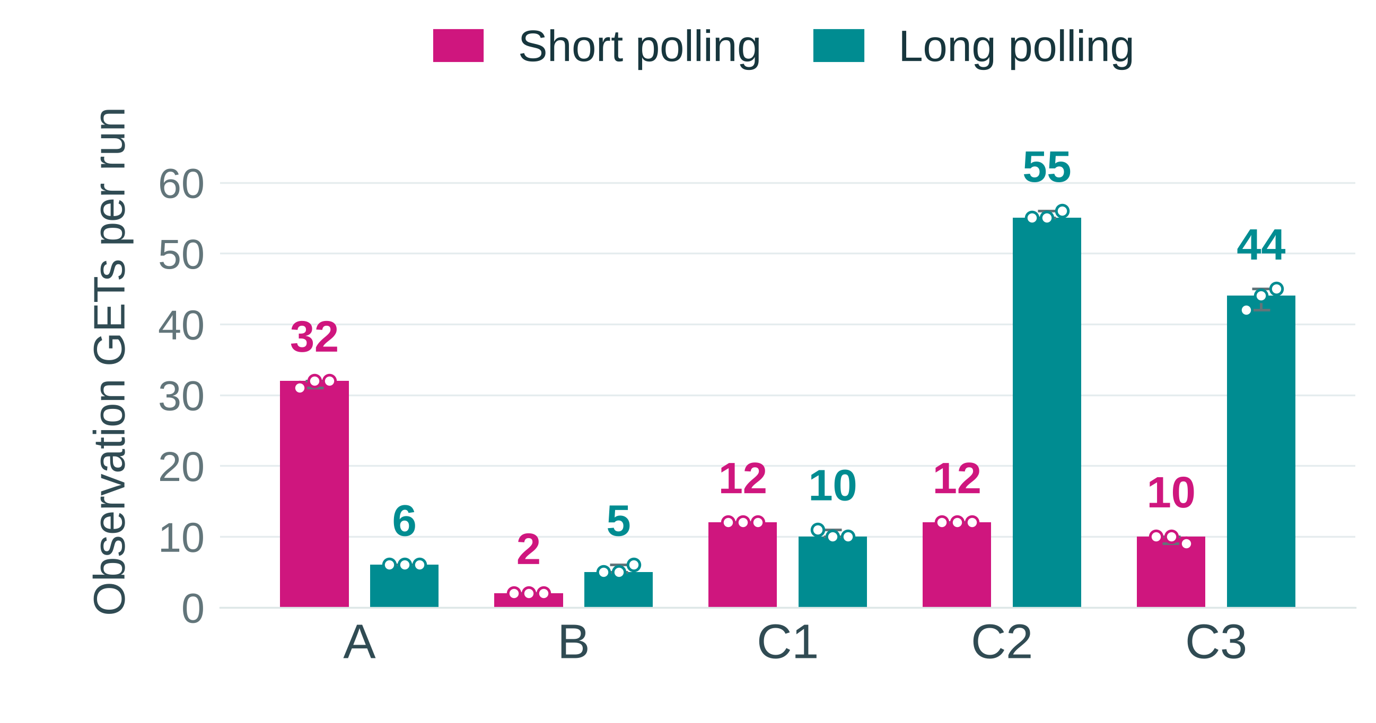
Request counts depend on update frequency
Count = all observation GET starts, including the first snapshot.
Forecasts supported
A and C1: long fewer.
B and C2: short fewer.
Fast updates
C2 long median: 55.
Active responses start
another request.
Bars/labels: median • Dots: 3 individual runs • Lines: minimum–maximum
Daryn Forman | ImageLab Assessment 2 | Measured results
08
Notes:
This chart uses the actual 30 rows in runs.csv. Fuchsia is always short polling and teal is always long polling. The bar and number show the median of three runs, the dots are individual runs and the range line runs from the minimum to maximum. The plotted values have not been changed.
Median short versus long counts are A 32 versus 6, B 2 versus 5, C1 12 versus 10, C2 12 versus 55, and C3 10 versus 44. That supports my request predictions for A, B, C1 and C2. It does not validate the explanation that stopping is unique to short polling; both modes stop at completion. In A, 86 of the 95 short-poll GETs across three runs returned unchanged state.
During frequent updates, long polling tends to return on each new saved state and then immediately starts another request. Short polling lets several changes happen before its next check. C3 counts were lower than C2, contrary to my roughly unchanged count forecast. Longer response cycles can include several intervening commits.
The version logs make that visible: new distinct versions after baseline had medians of 11 short and 54 long in C2, then 9 short and 43 long in C3. Missing committed versions had medians of 44 short and 1 long in C2, then 46 short and 12 long in C3. Baseline was 1 in C2; C3 short baselines were 2, 1 and 2, while C3 long baselines were 1. The report and raw summaries retain every version and gap. Next I’ll separate request count from how quickly completion was learned.
Evidence and preparation: runs.csv requests_started; C2/C3 *-client.json, *-server.log, *-summary.json; original chart data, reformatted for projection.

Slide 9
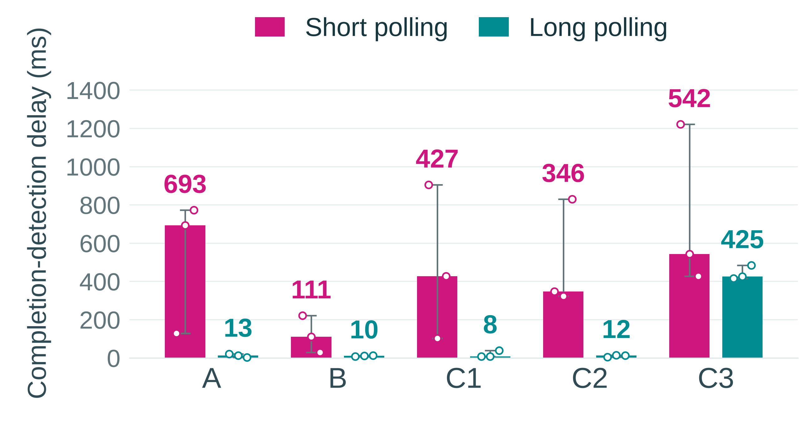
Long polling usually learned completion sooner
Delay = browser receipt − server terminal-commit log, in milliseconds.
B: real processing
Short: 111 ms
Long: 10 ms
Keep the exception
C3 repetition 3:
short 426 ms,
long 484 ms.
Bars/labels: median • Dots: 3 runs • Lines: min–max
C3: delays ↑, GETs ↓
Daryn Forman | ImageLab Assessment 2 | Measured results
09
Notes:
During ordinary processing in B, median completion-detection delay was 111 ms for short polling and 10 ms for long polling. Across A, B, C1, C2 and C3, short medians were 693, 111, 427, 346 and 542 ms; long medians were 13, 10, 8, 12 and 425 ms. Long polling had a lower median in every condition, but that is not the same as always winning each paired run.
C3 repetition 3 is the exception I kept: short polling detected completion in 426 ms and long polling in 484 ms. With three repetitions, individual timing and scheduling can matter; I cannot use the medians as a universal promise.
My C3 delay prediction was supported at the median level: relative to C2, delays rose from 346 to 542 ms for short and from 12 to 425 ms for long. My count prediction was not: counts fell from 12 to 10 and 55 to 44. The timing probes found median increases of 174–285 ms under the configured 200 ms throttling, so I do not describe it as exactly 200 ms on every request.
These values use same-computer wall clocks. Date.now was taken after terminal JSON was read; the server timestamp was immediately after the terminal commit. Logging, JSON parsing and scheduling introduce uncertainty. These are not transformation speeds. That distinction is important for the next slide.
Evidence and preparation: runs.csv detection_ms; post-commit server logs matched to terminal client receipt; C3 prompt-get files; revised report.

Slide 10
What these results do, and do not, establish
1
Detection is not processing
The worker’s work is separate from browser receipt.
2
HTTP counts are not total server cost
C1 median SQL reads: short 13; long 20.
3
A version gap is not a lost final result
C2 → C3 long medians: 54 → 43 new; 1 → 12 missed.
4
Every event needs stronger guarantees
Keep durable event history and support replay.
5
One continuing response could carry more
Frame updates for incremental reading. Not implemented.
Daryn Forman | ImageLab Assessment 2 | Interpretation
10
Notes:
First, quicker detection does not show faster image processing. B’s processing-duration medians were 217.594 ms for the short runs and 451.356 ms for the long runs, and neither small group establishes a causal processing benefit. Artificial waits dominate the delayed conditions.
Second, fewer HTTP requests can hide database work. In C1 the long mode used fewer GETs but more observation reads, 20 median versus 13. This implementation waits on notifications, not periodic SQL polling. It reads on entry, wake-up and the final deadline check, with extra completed-result metadata reads. Worker queries are not part of these counters. A new HTTP request also does not necessarily mean a new TCP connection.
Third, the version comparison is based on each run’s first observed baseline. The numbers shown are medians of new versions and counts of missing committed versions, not sizes of version jumps. C2 long observed a median 54 new versions, range 54–55, missing 1, range 0–1. C3 long observed 43, range 41–44, missing 12, range 11–14. All reached terminal version 56 with the final results. A-long-1 also skipped version 5 and still received completed version 6.
If every event had to be kept, the latest snapshot and a notification signal would not be enough. We would need durable event history and a way to request missing events again. A different design could keep one response open and send separately framed updates so the browser reads each part as it arrives. It would still need disconnect and recovery rules. I have not implemented that continuing-response design.
Evidence and preparation: C1 SQL counters; C2/C3 client/server version logs and summaries; A-long-1 trace; Version 2 snapshot definition. Continuing response is a proposal only.

Slide 11
Choose for the workload, not a universal winner
What limits the conclusion
My recommendation
3 repeats, 1 image, 1 computer
Approximate latency and timestamps
Sampled visibility; unsaved queue output
No CPU, memory or scaling benchmark
Long polling for prompt feedback
and quiet or occasional changes.
Short polling when ~1 s checks are
acceptable during frequent changes.
Measured: GETs, detection delay, versions and observation SQL reads.
Not established: lower total resource cost or better performance at scale.
Daryn Forman | ImageLab Assessment 2 | Limitations and recommendation
11
Notes:
There are only three repetitions per mode and condition. This is a classroom comparison with one image, one observer and one computer, not a general performance study. I did not measure CPU, memory, total network bytes or many concurrent observers.
The browser and server use the same computer clock, but millisecond resolution, logging after commit and scheduling still add uncertainty. C3 timing was approximate, and only C3 opened Firefox Network Monitor, which may itself add overhead. The foreground check was sampled rather than continuous. The recorder enforced an empty queue before upload, but did not save the separate SQL check output. Successful measured runs are not proof that every failure and lifecycle acceptance branch works.
My recommendation follows what I measured. Long polling is useful when quick feedback matters and the job changes only occasionally, particularly A and C1. Short polling remains reasonable when about one-second checking is acceptable and many frequent updates would otherwise generate requests. B also showed that a very short job may complete between short polls. I would not claim one mode is always more efficient.
The separate report, 30-row CSV and supporting logs preserve the detailed numbers so this presentation can be checked.
Evidence and preparation: Revised report limitations and recommendation; raw runs/configuration/probe evidence; no new benchmarks performed.

Slide 12
Less checking is only one part of the decision
Long polling reduced quiet-job traffic
and usually delivered completion sooner.
Frequent updates and latency changed the trade-off.
The final state mattered more than receiving every snapshot.
Questions?
Keep live evidence available: held request, 204 renewal, cancel/retry,
failed-job stop and two observers. Slides do not prove those checks.
Daryn Forman | ImageLab Assessment 2 | Conclusion and questions
12
Notes:
My conclusion is that long polling was useful, but not because it made image transformations faster. It reduced repeated checking during quiet work and had a lower median completion-detection delay in these conditions. Frequent updates could make it send many more requests, and added latency meant more intermediate versions were skipped. The final complete snapshot was still received.
I can explain each measurement from the CSV and the matching client/server logs. I have kept unexpected findings instead of removing them to make the comparison look cleaner. Are there any questions about the implementation, measurements or recommendation?
For classroom preparation, these slides replace the narrated-video format according to the teacher’s updated instruction. They do not substitute for demonstrating or retaining evidence of the original behaviour checks. Keep the application and saved traces available for: immediate older-version response; a waiting request released by a change; a change between requests; normal 204 renewal; terminal stop for completed and failed; cancellation/mode switch with worker continuation; retry of the same job without another POST; truthful real/simulated progress; and two observers outside the single-observer experiment. A-long-1 is saved evidence of 204 renewal and successful terminal stop. The 30-run series does not establish failed-job browser stop; that path still needs live or separately saved browser evidence. Do not present code inspection as a passed runtime check.
The original brief also requires source, migration, meaningful commits, setup/experiment documentation and the Assessment 1 baseline reference. Those are separate submission evidence; this slide deck does not certify that every item is complete. No presentation time limit has been assumed.
Evidence and preparation: Teacher brief/Version 2 acceptance checks; user instruction replacing video with classroom PPT; saved A-long-1 trace; source-code inspection.

