Slide 1


Slide 2
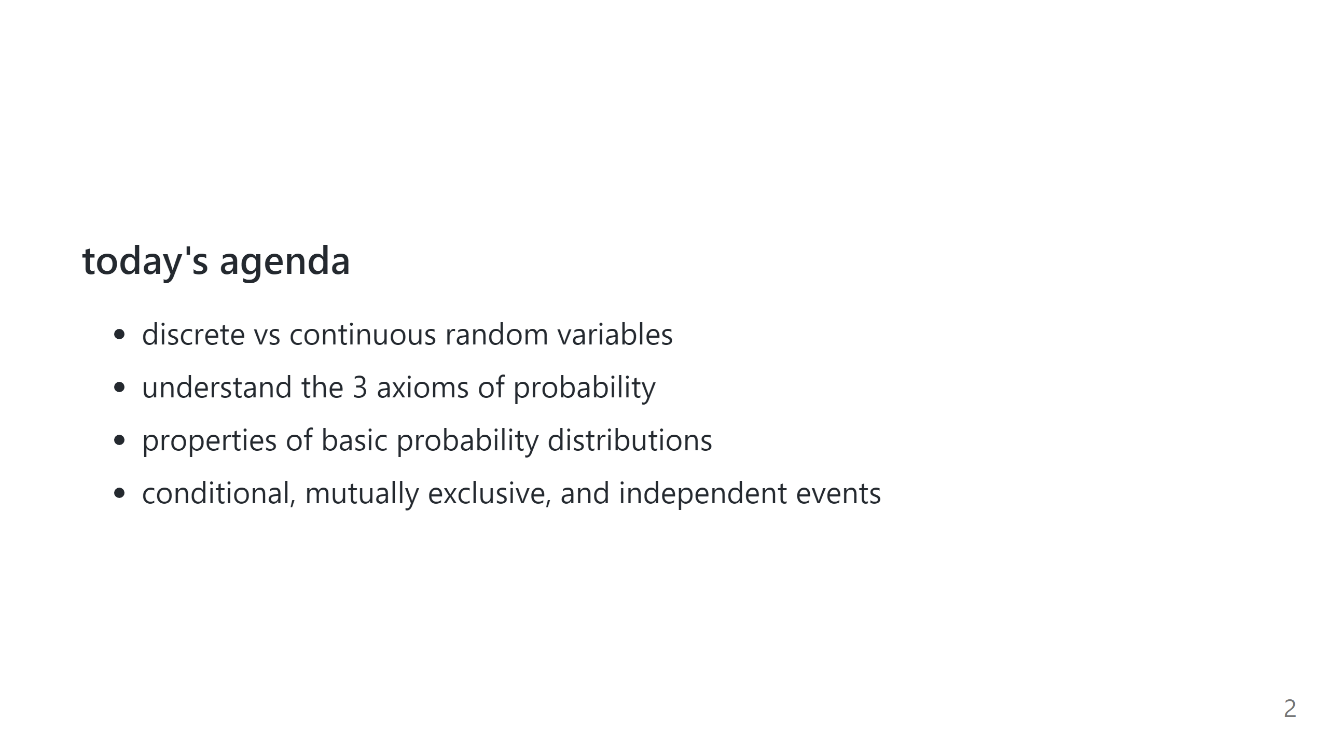

Slide 3
Introduction to Counting & Probability
Why counting?
Counting is fundamental to probability theory.
Probability is the extent or likelihood of an event or set of events.
Depends heavily on the ability to COUNT up potential outcomes.

Slide 4
Counting
Counting is one of the biggest areas of mathematics, called “Combinatorics”.
Example:
Subway has 4 different breads, 5 different meats, and 4 different toppings. How many sandwich combinations are there?
How many different 4-beer tasters can I have in a bar with 10 beers on tap?
Solve the above with the “Multiplication Principle”.
Subway:
Beer Tasters:
4
5
4
*
*
=80 Sandwiches
# of Breads
# of Meats
# of Toppings
10
9
8
7
*
*
*
=5,040 Beer Tasters
# Beer Choices
# Beer Choices
# Beer Choices
# Beer Choices

Slide 5
Multiplication Principle
If there are A ways of doing task-a, B ways of doing task-b, then there are A*B ways of completing both tasks.
Example:
If I have 5 books, how many ways can I ORDER them on the bookshelf
5
4
3
2
1
*
*
*
*
=120 Book Orderings
# Book Choices
# Book Choices
# Book Choices
# Book Choices
# Book Choices

Slide 6
Factorials
Factorials
Count # of ways to order N things = N!
Factorials get VERY VERY large quickly.
21! Is larger than the biggest long-int in 64 bit.
21! = 5.1E19
Biggest long int (64bit) = 9.2E18
Fun fact, every 52 card shuffle is highly likely to be the only time that shuffle has ever occurred.

Slide 7

Counting Subgroups
Revisit: 10 beers on tap, need a sample of 4 different beers.
Let’s assume order matters.
E.g. Amber-Stout-Porter-Red is different than Red-Porter-Stout-Amber
Use “Permutations” or “Pick”:
$$10∗9∗8∗7=\frac{10!}{6!}=\frac{10!}{\left(10−4\right)!}=10P4=P(10,4)$$

Slide 8
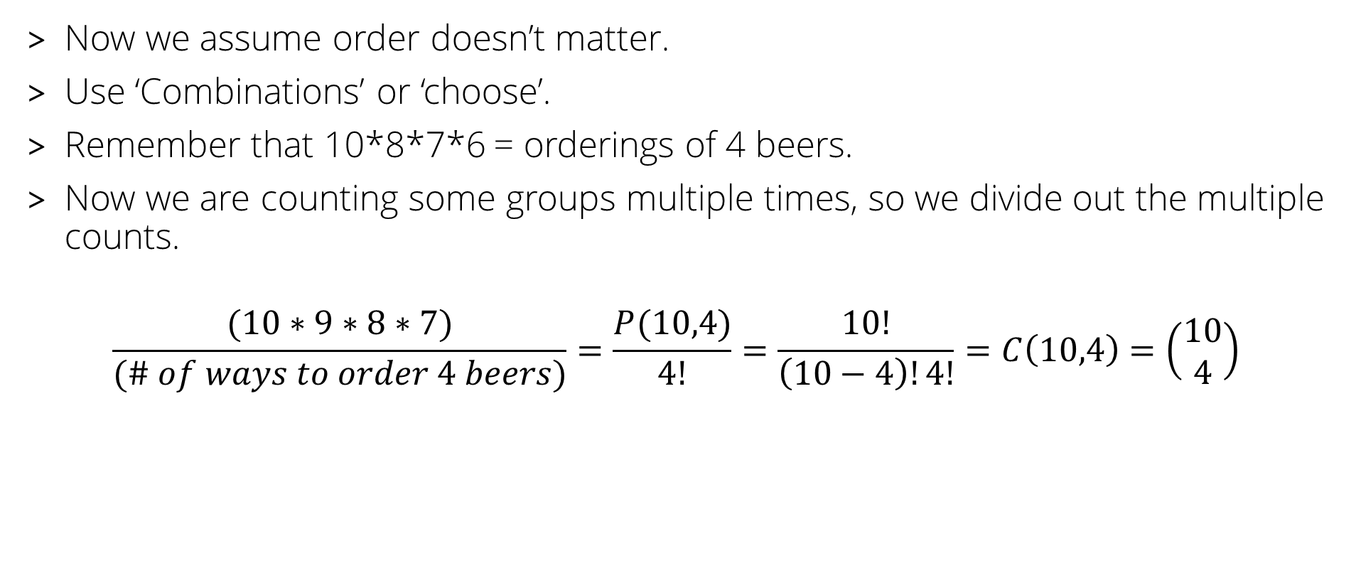
Counting Subgroups
Now we assume order doesn’t matter.
Use ‘Combinations’ or ‘choose’.
Remember that 10*8*7*6 = orderings of 4 beers.
Now we are counting some groups multiple times, so we divide out the multiple counts.
$$\frac{(10∗9∗8∗7)}{(\# of ways to order 4 beers)}=\frac{P(10,4)}{4!}=\frac{10!}{\left(10−4\right)!4!}=C\left(10,4\right)=\left(\begin{matrix}10 \\ 4\end{matrix}\right)$$

Slide 9
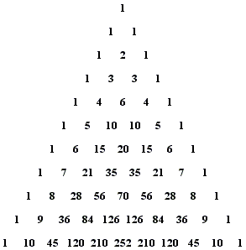


More About Combinations
Combinations appear on Pascal’s Triangle!
C(N,x) appears on the Nth row, x-th number over (starting counting at 0).
$$\left(\begin{matrix}10 \\ 4\end{matrix}\right)$$

Slide 10
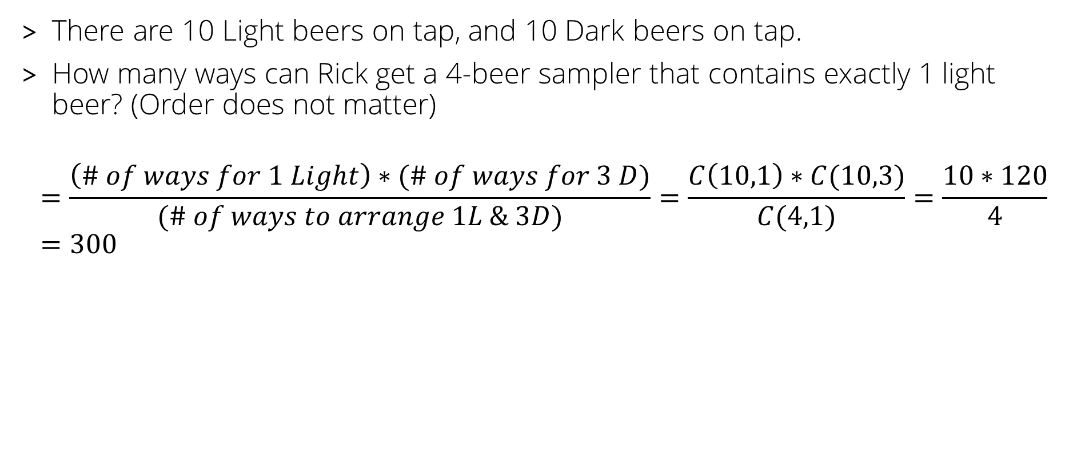
Counting Examples
There are 10 Light beers on tap, and 10 Dark beers on tap.
How many ways can Rick get a 4-beer sampler that contains exactly 1 light beer? (Order does not matter)
$$=\frac{\left(\# of ways for 1 Light\right)∗(\# of ways for 3 D)}{(\# of ways to arrange 1L \& 3D)}=\frac{C\left(10,1\right)∗C(10,3)}{C(4,1)}=\frac{10∗120}{4}=300$$

Slide 11

Counting Examples
6:5 Blackjack is dealt with a 6 shoe deck (52*6=312 cards)
How many ways can someone get dealt two rank 10 cards?
$$\left(\begin{matrix}6decks ∗4ranks ∗4suits \\ 2\end{matrix}\right)=\left(\begin{matrix}96 \\ 2\end{matrix}\right)=4,560$$

Slide 12
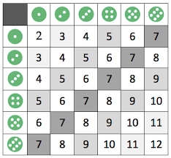
DICE!
How many ways can two dice be rolled to get a sum of 10?

Slide 13
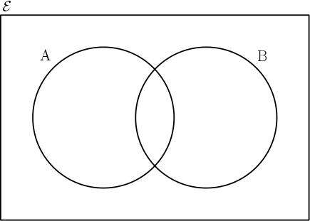
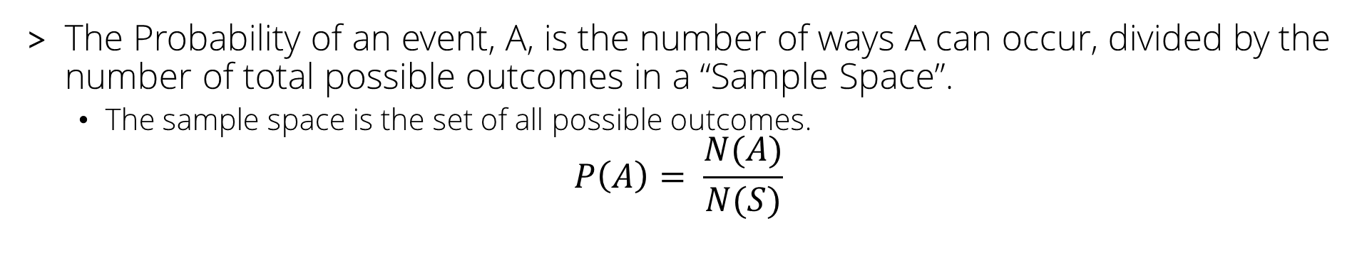
Probability
The Probability of an event, A, is the number of ways A can occur, divided by the number of total possible outcomes in a “Sample Space”.
The sample space is the set of all possible outcomes.
$$P\left(A\right)= \frac{N(A)}{N(S)}$$
S
In this example, if ‘ ‘ is an event, then:
P(A) = 6/10=3/5
P(B) = 3/10
P(S) = 10/10 = 1.0

Slide 14

Probability
S
If ‘ ’ is an event, then
Intersection:
$P\left(A∩B\right)=\frac{2}{10}=\frac{1}{5}$
Union:
$P\left(A∪B\right)=\frac{7}{10}$
Negation:
$P\left({\left(A∪B\right)}^{′}\right)=\frac{3}{10}$
$P\left(A^{′}∩B^{′}\right)=\frac{3}{10}$

Slide 15


Axioms of Probability
Probability is bounded between 0 and 1.
Probability of the Sample Space is equal to 1.
The probability of finite mutually exclusive events is the sum of their probabilities.
$$0≤P(A)≤1$$
Note: “percent” literally means per one hundred.
$$P\left(S\right)= 1$$
$P\left(A∪B\right)=P\left(A\right)+P(B)$ if A and B are Mutually Exclusive

Slide 16
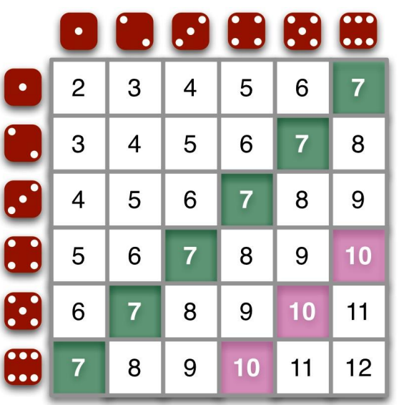
Quick Review – Probabilities
What is the probability of rolling a 10?
What is the probability of rolling an even #?
What is the probability of doubles?

Slide 17
“At Least” or “At Most” Probabilities
When dealing with problems that are “At Least” or “At Most”, we can think of what else can happen and do 1 minus that.
Ex:
What is the probability that the sum is at least 3?
1-P(sum = 2) = 1-(1/36) = 35/36.
If it is always 40% chance of rain each day, what is the probability that it rains on at most 6 days this week?
1-P(rains all week) =1- (0.4)^7

Slide 18
Why is this false?
$$P\left(A∪B\right)=P\left(A\right)+P(B)$$
S
A
B

Slide 19

Mutually Exclusive Events
In all cases, the probability of the union of A and B takes the form:
If A and B are mutually exclusive then means that:
$$P\left(A∪B\right)=P\left(A\right)+P\left(B\right)−P(A∩B)$$
S
A
B
S
$$P\left(A∩B\right)=0$$
$$P\left(A∪B\right)=P\left(A\right)+P\left(B\right)$$
A
B

Slide 20
Conditional Probability
The Probability of A given B is written:
And is equal to:
$$P\left(A|B\right)$$
$P\left(A|B\right)=\frac{P(A∩B)}{P(B)}$, compare to: $P\left(E\right)=\frac{P(E)}{P(S)}$
S
A
B

Slide 21
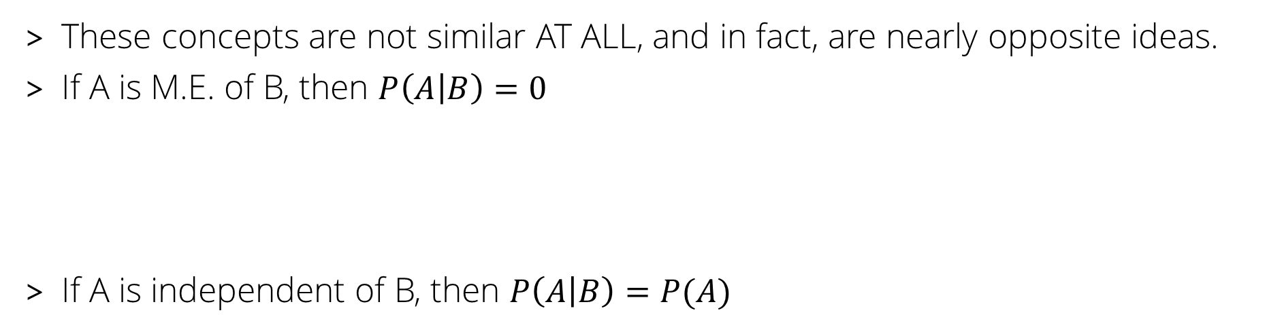
Independence VS Mutually Exclusive
These concepts are not similar AT ALL, and in fact, are nearly opposite ideas.
If A is M.E. of B, then $P\left(A | B\right)=0$
If A is independent of B, then $P\left(A | B\right)=P(A)$
The event, B, has a HUGE effect on the occurrence of event A.
Example: The probability the sidewalk is wet given it is raining is very high, but the probability that it is raining given the sidewalk is wet could be quite low, if I run my sprinklers often.

Slide 22
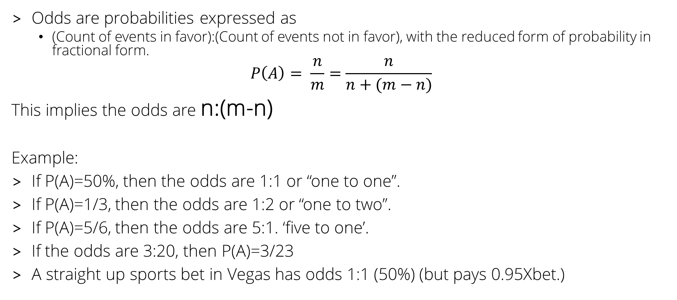
ODDS
Odds are probabilities expressed as
(Count of events in favor):(Count of events not in favor), with the reduced form of probability in fractional form.
$$P\left(A\right)= \frac{n}{m}=\frac{n}{n+(m−n)}$$
This implies the odds are n:(m-n)
Example:
If P(A)=50%, then the odds are 1:1 or “one to one”.
If P(A)=1/3, then the odds are 1:2 or “one to two”.
If P(A)=5/6, then the odds are 5:1. ‘five to one’.
If the odds are 3:20, then P(A)=3/23
A straight up sports bet in Vegas has odds 1:1 (50%) (but pays 0.95Xbet.)

Slide 23







Independent Events
Event A is independent of event B if and ONLY if:
A being independent of B does NOT imply B is independent of A
$$P\left(A|B\right)=P(A)$$
$$P\left(A|B\right)=P(A)$$
$$P\left(B|A\right)=P(B)$$
$$P\left(A|B\right)=P\left(A\right)=\frac{P(A∩B)}{P(B)}$$
$$P\left(A\right)P\left(B\right)=P(A∩B)$$
Used in a sentence: The event that my boss takes a vacation has an impact on when I take vacation. But when I take vacation has no impact on when my boss takes a vacation.

Slide 24
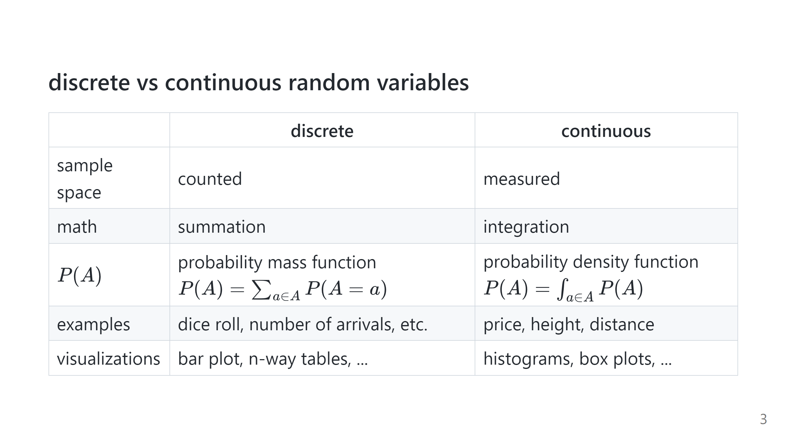

Slide 25
Consider the probabilities of all potential sums of the two die:
P(2)=1/36
P(3)=2/36
P(4)=3/36
P(5)=4/36
P(6)=5/36
P(7)=6/36
P(8)=5/36
P(9)=4/36
P(10)=3/36
P(11)=2/36
P(12)=1/36
If we consider all the event possibilities together, this is called a “Probability Distribution”.

Slide 26
Discrete Distributions
Properties of Discrete Distributions:
Sum of all events MUST be equal to 1.
Probability of event, E, is equal to the value of the distribution at that point.
No negative values or values greater than 1.

Slide 27
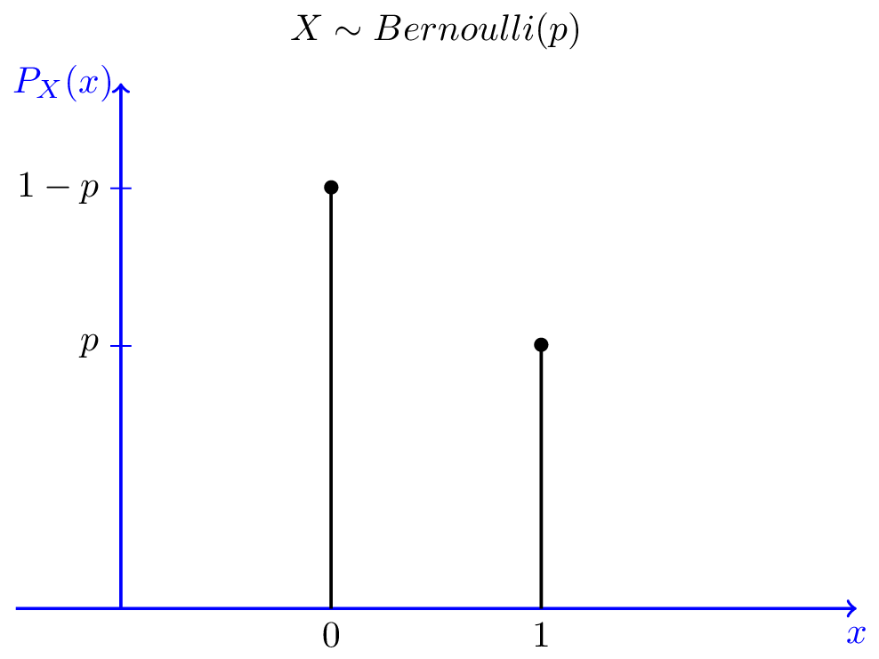

Discrete Distribution: Bernoulli Distribution (1 coin flip)
Bernoulli (1 event, example: 1 coin flip)
$$P\left(x\right)=\left\{\begin{matrix}p if x=1 \\ \left(1−p\right)if x=0\end{matrix}\right.$$
$$P\left(x\right)=p^{x}{(1−p)}^{(1−x)} for x∈\{0,1\}$$
Mean = p
Variance = p(1-p)

Slide 28
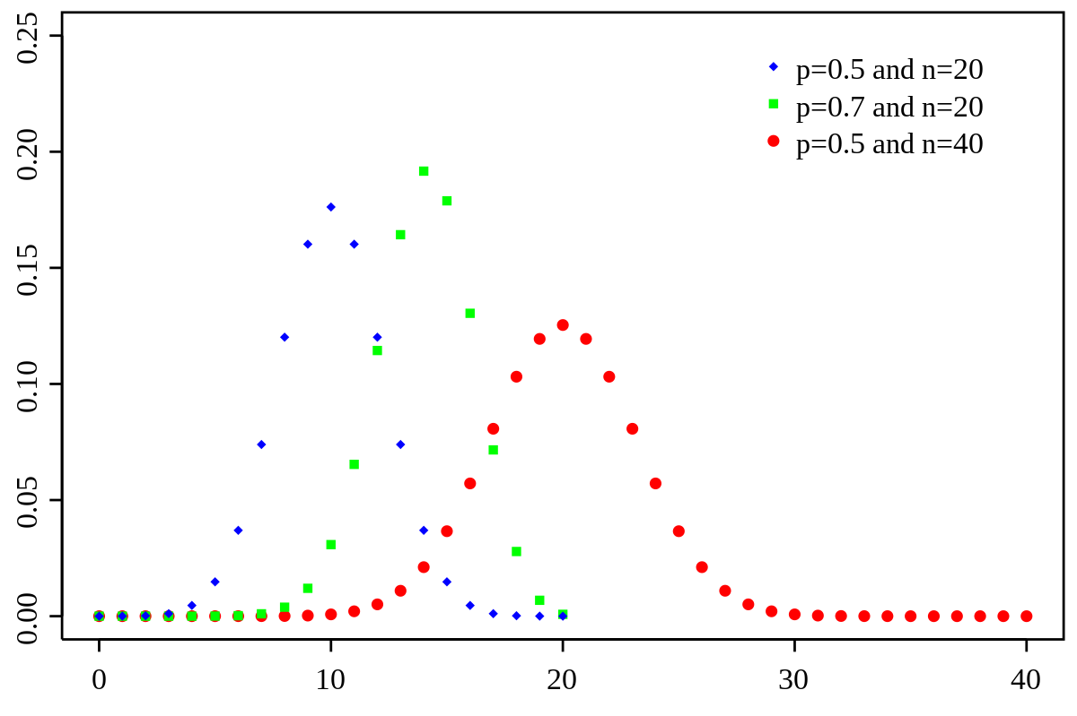

Discrete Distribution: Binomial Distribution (Multiple Coin Flips)
Multiple independent events = Product of Bernoilli probabilities.
$$P\left(x|N,p\right)=\left(\begin{matrix}N \\ x\end{matrix}\right)p^{x}{(1−p)}^{(N−x)}$$
Mean = np
Variance = np(1-p)
Note: for larger n, we approximate this by a normal distribution.

Slide 29
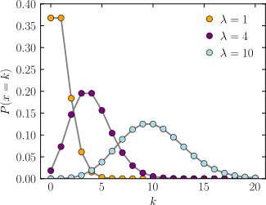

Discrete Distribution: Poisson Distribution (Counting)
Count number of events in a time span.
$$P\left(x|λ\right)=\frac{λ^{x}}{x!}e^{−λ}$$
Mean = $λ$
Variance = $λ$
Interpretation: The rate of occurrence of an event is equal to lambda in a finite period of time
Can also approximate by a normal at large lambda.

Slide 30
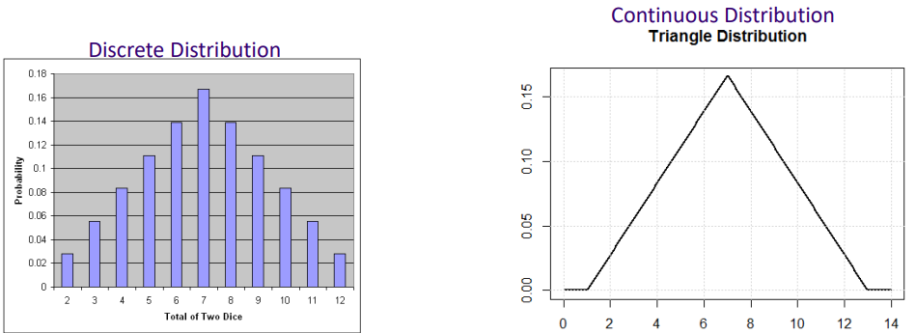
Continuous Distributions
Properties of Continuous Distributions:
AREA under the curve MUST be equal to 1.
Probability of event, E, is equal to the AREA under the curve between two points.
No negative values or values greater than 1.
Probability of a single, exact value is 0.

Slide 31
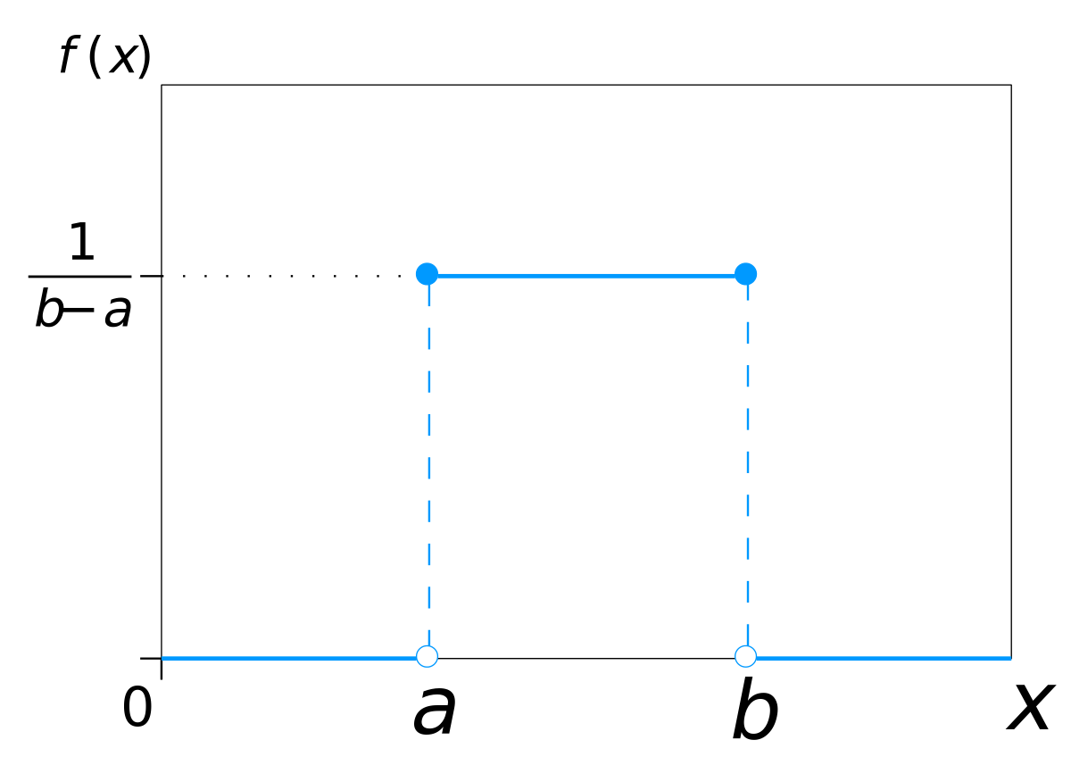

Continuous Distribution: Uniform Distribution (Equal Probability)
Most commonly used in machine learning. (not most commonly occurring in data)
Uninteresting distribution, all events are equal.
Flat & Bounded.
$$f\left(x\right)=\left\{\begin{matrix}\frac{1}{(b−a)} if a≤x≤b \\ 0 x<a or x>b \end{matrix}\right.$$
Mean = $\frac{(a+b)}{2}$
Variance = $(\frac{1}{12}){(b−a)}^{2}$
Very useful when we need to put in information about a data point or parameter, but we don’t know much about it.

Slide 32
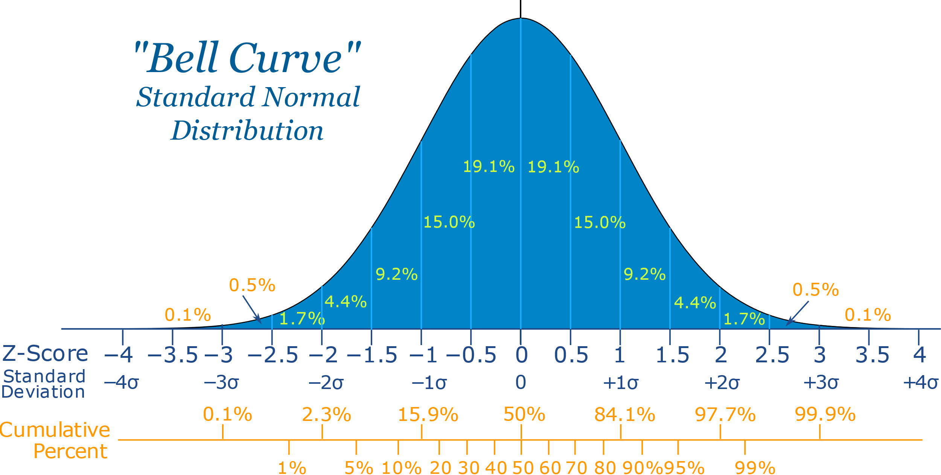

Continuous Distribution: Normal Distribution (Gaussian/Bell Curve)
Most common & naturally occurring in data/nature.
Defined by a mean and variance only.
$$f\left(x\right)=\frac{1}{\sqrt{2πσ^{2}}}e^{\frac{−{(x−μ)}^{2}}{2σ^{2}}}$$
Has very nice properties.
Testing data for normality is VERY important.

Slide 33
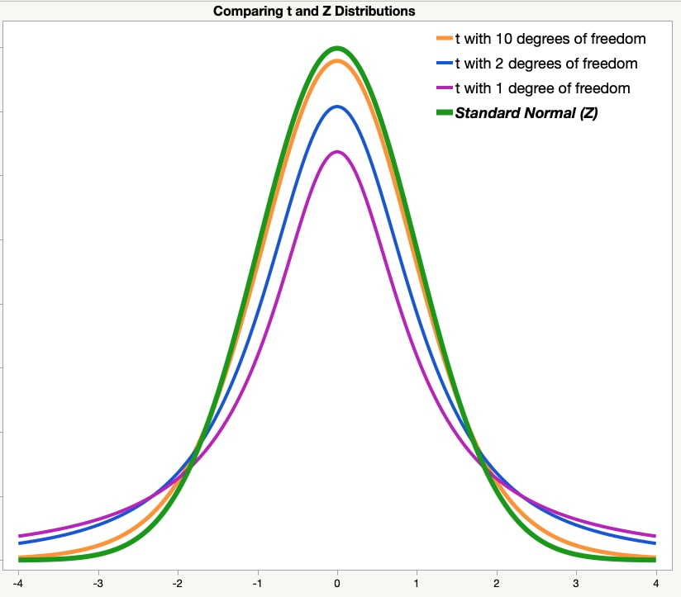
Continuous Distribution: Student’s T Distribution
Important for investigating / testing smaller data sample sizes.
Used specifically for:
Testing of a mean-value when st.dev. is unknown.
Testing difference between two distribution means.
Looks very similar to the Normal distribution, but has longer tails.

Slide 34
Distribution Transformations
The purpose of transforming a variable is to make it easier to distinguish between values (graphically, statistically, ML models…)
Most commonly, we are looking to transform it to a normal distribution.
Useful transformations are generally MONOTONIC
Functions used are never changing directions.
Common Transformations to consider:
Log based
Log(x), log(x+1), log(x-min(x)+1)
N-th root based (of positive #s)
X^(1/n)
Any combination you can think of- but keep it monotonic.
How to determine? We will cover normality tests in a later class.

Slide 35


Slide 36
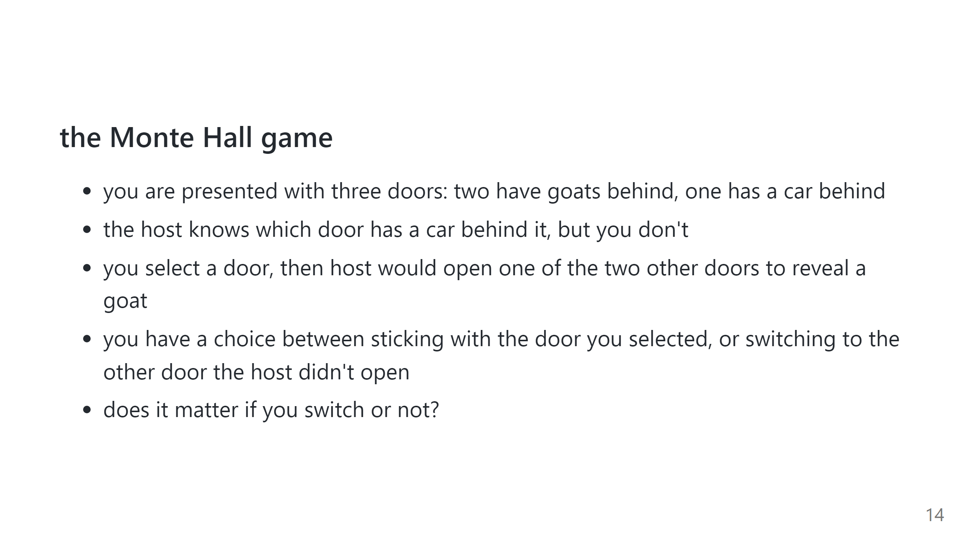

Slide 37
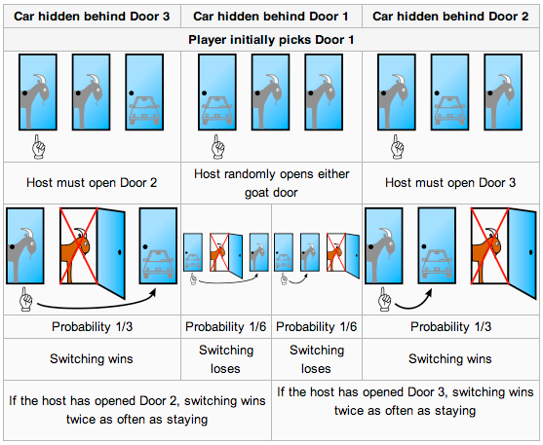
Monty Hall Problem
Start with 3 doors. One prize behind unknown door. Pick a door.
Host reveals a separate door with no prize.
Then contestant can switch. Should they?
Let’s consider this situation first

Slide 38
Monty Hall Problem
Start with 3 doors. One prize behind unknown door. Pick a door.
Host reveals a separate door with no prize.
Then contestant can switch. Should they?

Slide 39
Monty Hall Problem
Start with 3 doors. One prize behind unknown door. Pick a door.
Host reveals a separate door with no prize.
Then contestant can switch. Should they?

Slide 40
Monty Hall Problem
Start with 3 doors. One prize behind unknown door. Pick a door.
Host reveals a separate door with no prize.
Then contestant can switch. Should they?

Slide 41
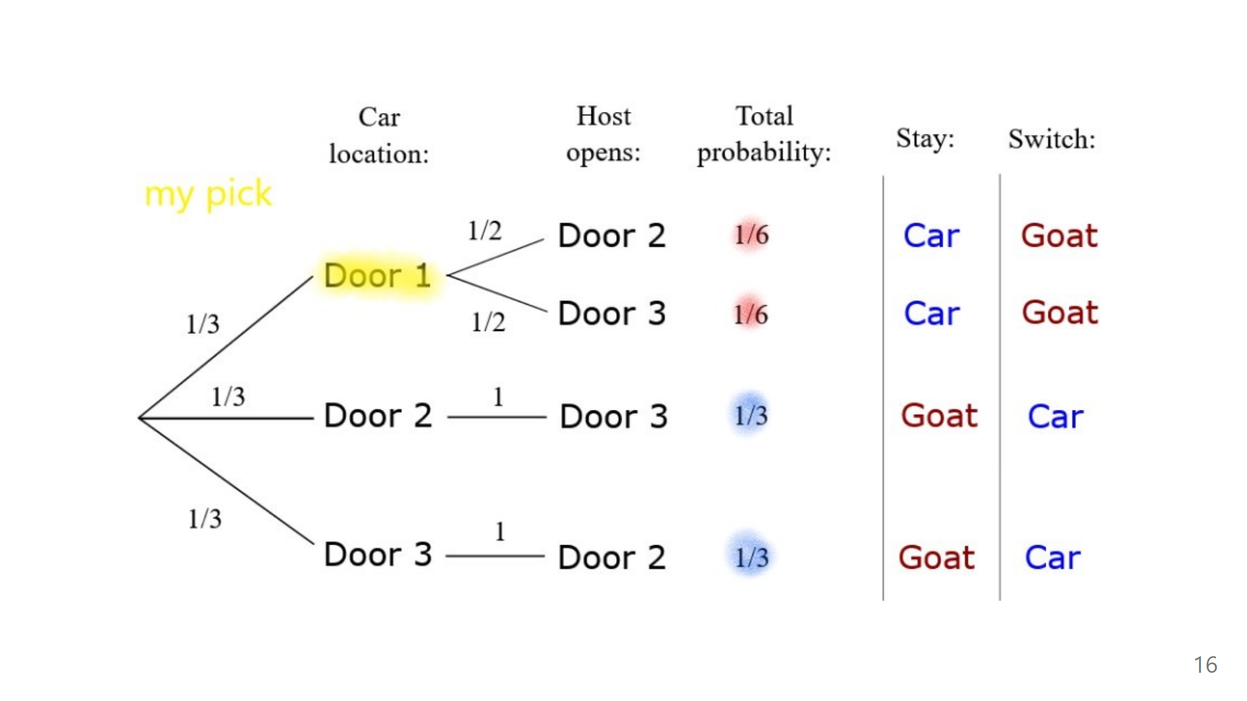

Slide 42
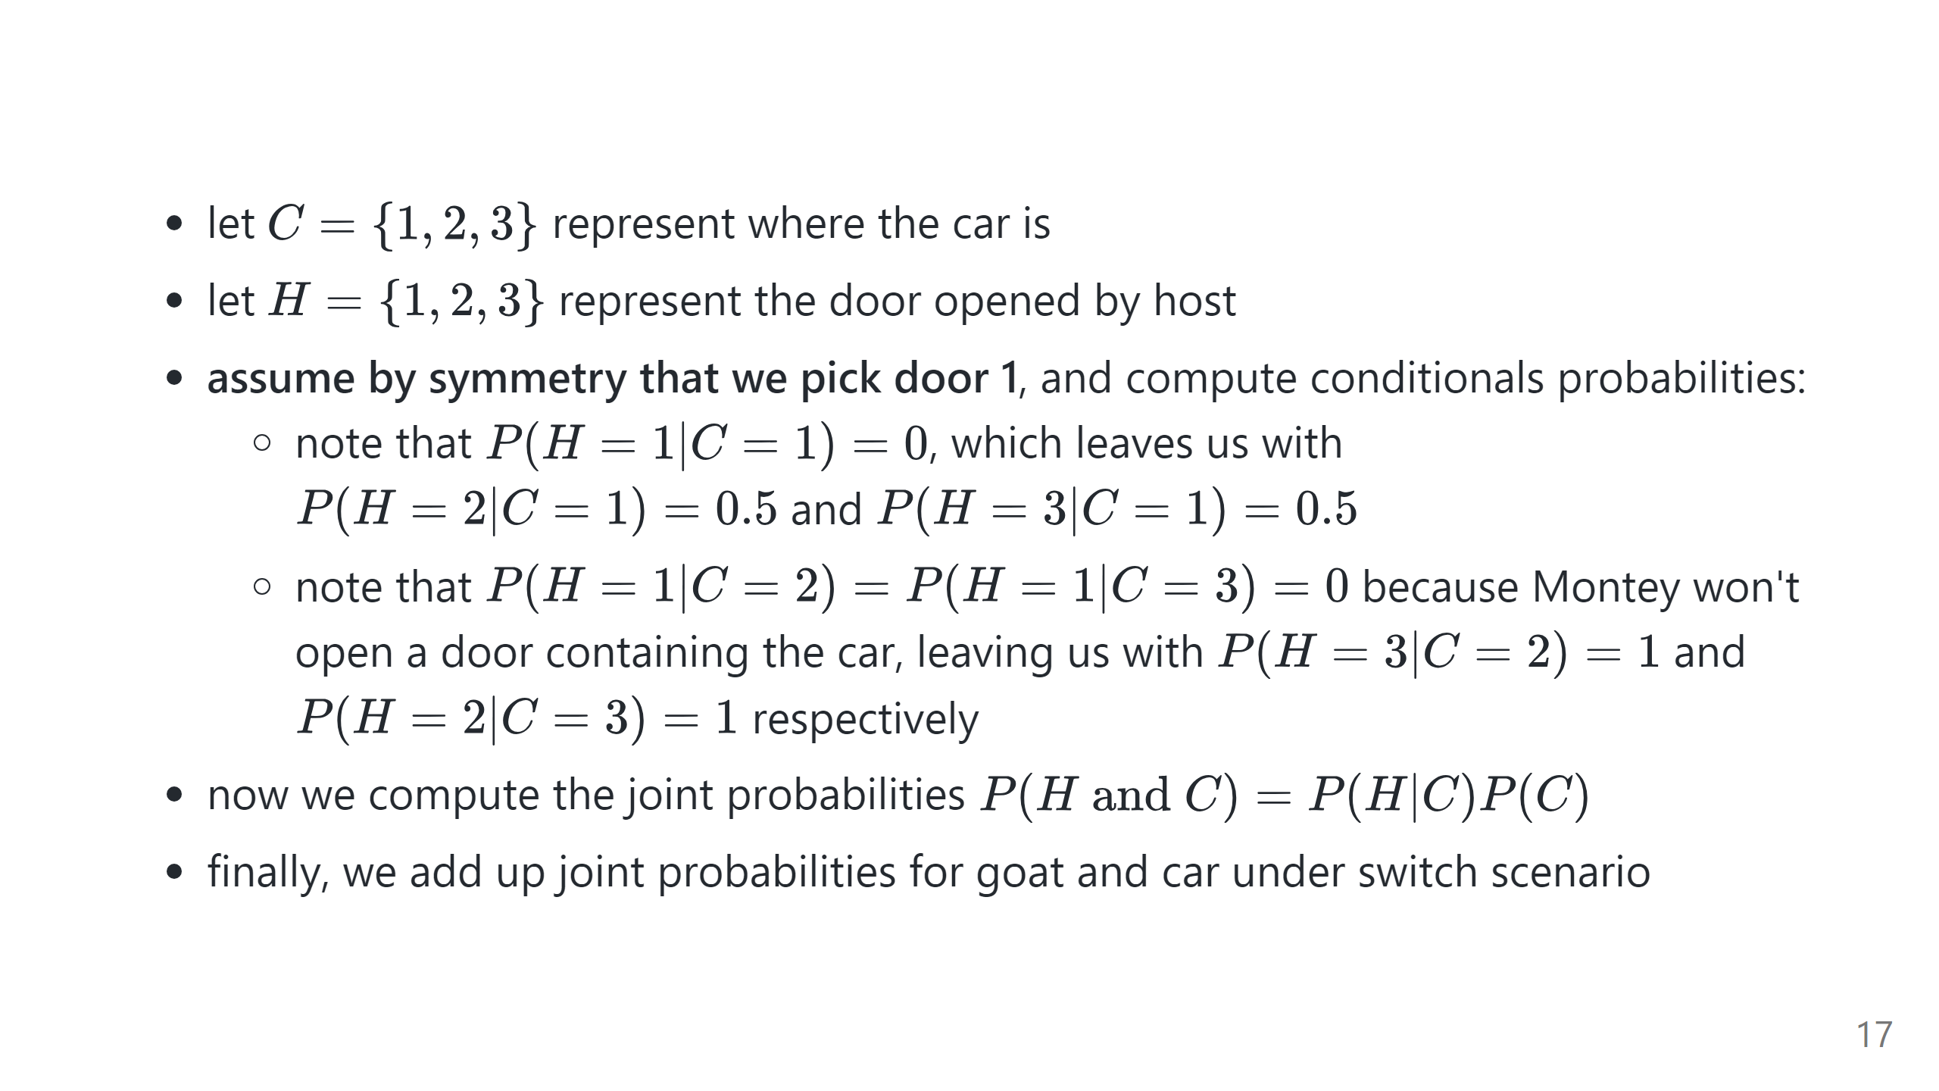

Slide 43
Dealing with Missing Data (Intro)
Reasons for missing data
Recording failure (mechanical/software failures)
Reporting failure (human decisions)
Translation failure (data parsing / data transferring errors)
Many shapes and types of missing data:
Block missing – Physical shapes of data missing
Examples: Time series- collection was down for some time.
Regular missing
Rule based missing: Temperature gauge doesn’t work below freezing.
Random missing
Probability of missing data point equal across all data points.
Sparsity
Very low observations. Hard to observe data (endangered species, rare events)
NOTE: Outliers may be treated as missing data. Depending on reasons.

Slide 44
Dealing with Missing Data
Type | Benefits | Disadvantages | Notes
Drop Missing | Speed | Data Loss
Mean/Median/Mode Fill | No Data Loss | Variation Reduction
X ~ F(independents) | More accurate No Data Loss | Slower | Needs most columns to be filled out Harder on truly independent data
KNN | More accurate No Data Loss | Slower Dependent on a Distance Function
X~F(y,independents) | Very Accurate No Data Loss | Slower Need Y | Can ONLY do this on a TRAINING dataset.

Slide 45
Dealing with Missing Data in the Real World: Using Outside or New Data Sources as Supplements
Don’t forget to explore outside or new data sources to help with missing data.
With the advent of free public data and bigger data sources, this is gaining popularity as a tool for imputation.
This includes using unstructured text as a major source of data.
Will eventually include asking Large-Language-Models to generate missing data.
Ex
Caesar’s uses public reviews on websites to mine for customer sentiment about hotel rooms.
Zillow uses text descriptions of properties to fill in missing data about homes (# BDs, # BTHMs, sq footage, etc)
Subject to human stupidity.:
Yelp Rating for Circus-Circus: 2/5
Text Description: “My son and I stayed here. The service and room was great, but it turns out my son is deathly afraid of clowns.

Slide 46
Breakout Discussion
Below are some example situations for missing data.
How would / could we address these? (Both statistically AND business wise)
Situations
An intern at your company accidentally deleted 10 rows in a large user-events table.
A set of door-to-door poll workers in a county were all sick over the same time period. (They are interviewing residents about news topic sentiments).
A malicious SQL injection attack dropped data from user-sign in logging records. Only from users who have a email that starts with the letter ‘A’ or ‘a’.
The IoT coffee maker company you work for has a defect in the devices – it disconnects from wifi when boiling water is spilled in a certain spot.
A rental car company cannot collect GPS car locations during severe weather.

Slide 47


