Slide 1

Training Courses

Slide 2

Git@Work!
Daryoosh Hoora

Slide 3
دوره آموزش کاربردی Git
●
REC
کد دوره: DTS.DEV.GIT.WRK.01
نگارش: 1.0
مدرس: داریوش هورا
تاریخ: تابستان 1405

Slide 4
انتشار این محتوای آموزشی با ذکر منبع بلامانع می باشد
@datisONE

Slide 5


Slide 6

Notes:
برنامه نویسی اتفرادی
مدیریت ورژن های مشتریها
Change tracking and revert problems
Notebook crash down
برنامه نویسی تیمی
همکاری مشترک

Slide 7
سخن بزرگان
To git, or not to git, that is the question. 
William Shakespeare

Slide 8
That question is: Do you love, or hate the Git?

Slide 9

2025 Stack Overflow Developer Survey
https://survey.stackoverflow.co/2025

Slide 10
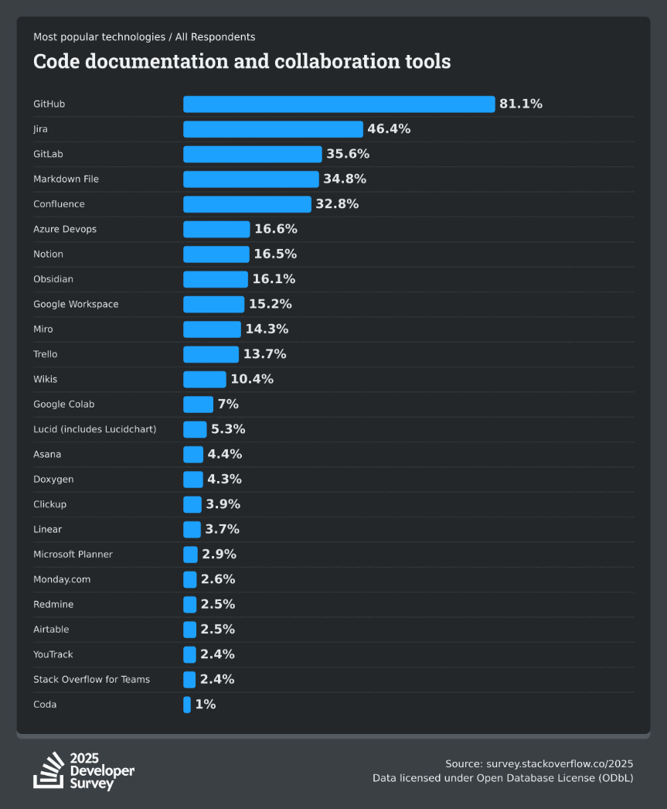
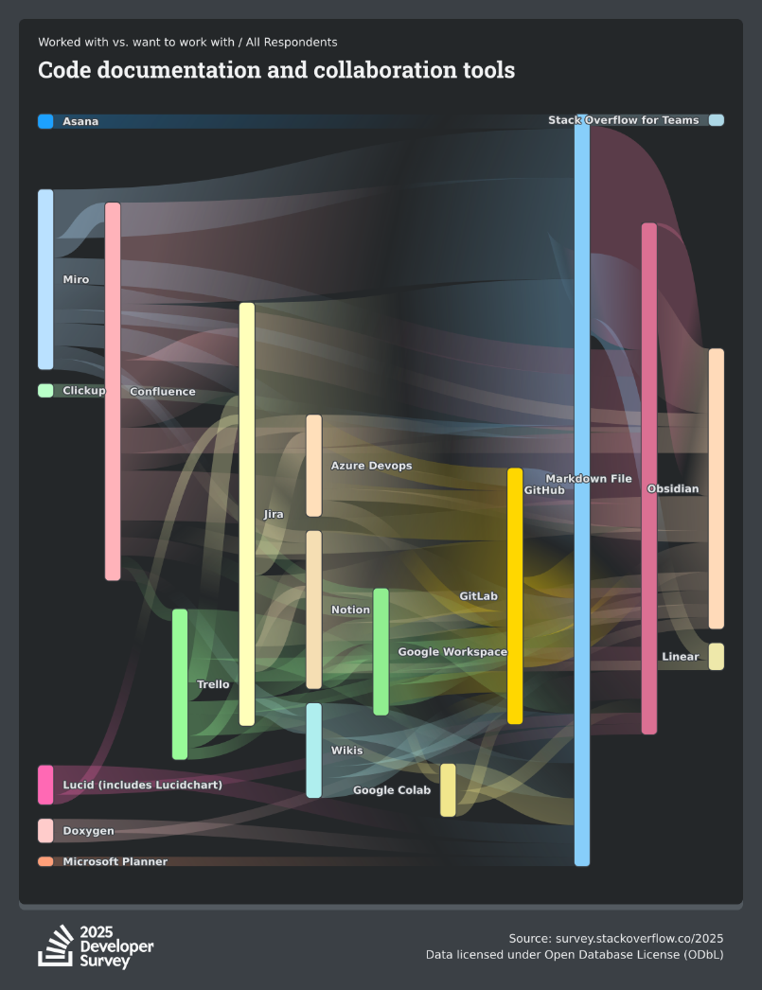
They loves Git!

Slide 11
چرا Git؟
Easy to use, Git is simple!
Free and open-source.
Cross platform, running on Windows, macOS and of curse Linux, where Git was borne.
Lightening and lightweight, so it’s high performance.
Integrated with all most development tools (IDEs).
Widely utilized in most DevOps frameworks.
Classy! Everyone wants you to know about that.

Slide 12
چرا Git؟
Distributed, so it’s reliable. (important!)
Reliable because it’s distributed. (very important!)

Slide 13
Everything is Everywhere
Source lives
on remote
server
Source lives
on client
Source lives
on server
Source lives
on remote
client
Source lives
on client
Source lives
on client

Slide 14
Practice Time

Slide 15
مخاطبان دوره
Project’s team members
Artifact creators
Everyone who create, update and manage files

Slide 16
دوره های تکمیلی
همنیاز دوره
پیشنیاز دوره
null
null

Slide 17
منابع
Git
  https://git-scm.com/
Pro Git Book, Apress pub.
  https://git-scm.com/book/en/v2
W3Schools
  https://www.w3schools.com/git/default.asp

Slide 18





توضیحات
تمامی اسکرین شات های این آموزش از محیط ویندوز 11 تهیه شده، در سایر نگارشهای ویندوز و سیستمهای عامل لینوکس و مک ممکن است تفاوت ظاهری وجود داشته باشد.
در تاریخ انتشار این آموزش، نگارش مورد استفاده گیت 2.x می باشد.
برای اجرای دستورات این آموزش لازم است اتصال به اینترنت برقرار باشد.
وضوح و بلندی صدای ویدیو!
daryoosh@hoora.info
@datis.one
@datisone

Slide 19

https://github.com/daryoosh-hoora
Repositories: Git-at-Work

Slide 20
عناوین دوره
Session 1 - Git Internal
  Concepts
  Definitions
  Skeleton
  Installation
Session 2 – Git External
  Configuration
  Basics
  Working scenarios

Slide 21
Training Courses

Slide 22
Git@Work!
Daryoosh Hoora

Slide 23
فصل اول
انتشار این محتوای آموزشی با ذکر منبع بلامانع می باشد

Slide 24
Previously on Git!
Why Git?
Who are audiences?
What are references?

Slide 25
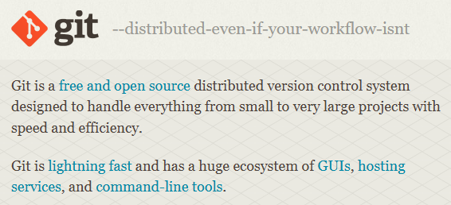
What is Git?
  https://git-scm.com/

Slide 26

What is NOT?
Git is NOT a file storage system
Git is NOT GitHub
Git is NOT GitLab

Slide 27
History
Linux (OS)
Community (People)
BitKeeper (VCS)
Linus Torvalds (Person)
2005 (Birthdate)

Slide 28
What is VCS
Version control is a system that records changes to a file or set of files over time so that you can recall specific versions later.
  Any type of files
  Revert back to previous state
  Compare changes over time
  Who makes changes and when
  etc.

Slide 29
V 1.1
V 1.2
V 1.3
Branching
Release 3
Merging
V 2.0
Master
V 1.0
V 3.2
V 4.0
Release 1
Branching
V 2.1
V 2.2
Release 2

Slide 30
Types of VCS
Stupid version control approach
  Copy files into another folder!
  Time-stamped folder for clever people.
➖ Confusing about folders
➖ No change tracking
➖ Client crash down

Slide 31
Types of VCS
Local Version Control Systems
  A simple database lives on client
➕ Changes tracking
➖ Teamwork impossible
➖ Client crash down

Slide 32
Types of VCS
Centralized Version Control Systems (CVCSs)
  A shared database on server
  You may know SVN
➕ Teamwork collaboration is possible
➕ Administrative controls
➖ Server crash down

Slide 33
Types of VCS
Distributed Version Control Systems (DVCSs)
  --everything-is-local
  Clients do not check out the latest changes, the fully mirror the database, including it's all history
➕ Collaborate with different group of people in different workflows within same project
➕ Server failover by restoring database from each clients
➕ Avoid network latency overhead
➕ It is hard to do something that is not undoable or losing data
So, this is Git

Slide 34
Who needs Git?
A lonely alone programmer, someone who developing solo.
Software development teams to collaborate on codebase.
Non-programmers, to work on their documents.
Git is not suitable for archiving images, movies and any other large files.

Slide 35
Ecosystem
GUIs: https://git-scm.com/downloads/guis
Hosting services: https://git-scm.com/tools/hosting
CLI tools: https://git-scm.com/tools/command-line
Integration extensions

Slide 36
Workout
Create your own GitHub account
Create your first repository

Slide 37
CLI vs. GUI
CLI is native
CLI is generic
CLI is only place to run all commands
CLI is foundation of GUIs
So, CLI is professional's recommendation

Slide 38
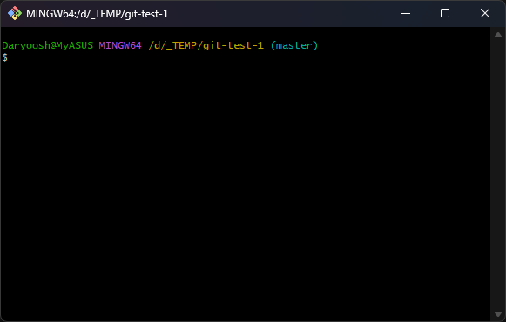
CLI – Git Bash

Slide 39
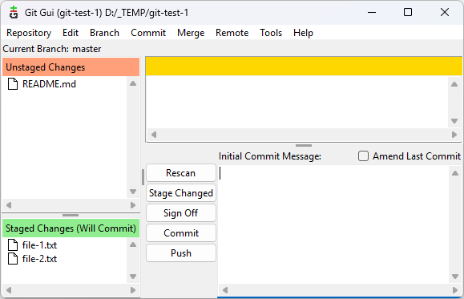
GUI – Git GUI

Slide 40
Glossary
Working tree/directory
Staging area (index)
Repository
  Local repo (.git directory)
    For individual/solo working
    Disconnected from server
  Remote repo
    For teamwork collaboration
    Safety backup

Slide 41
The four states
 | File state | Location
1 | Untracked | Project folder
2 | Modified | Working tree
3 | Staged | Staging area
4 | Committed | Local repository

Slide 42
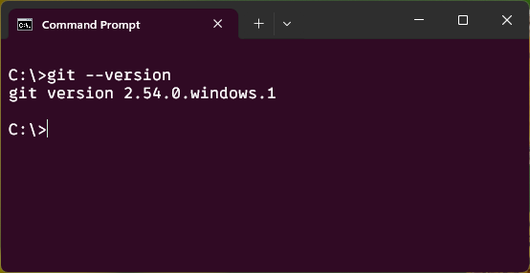
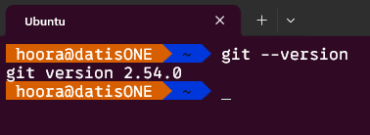
Git Installation
Checking if Git is installed or not
git --version
git -v

Slide 43
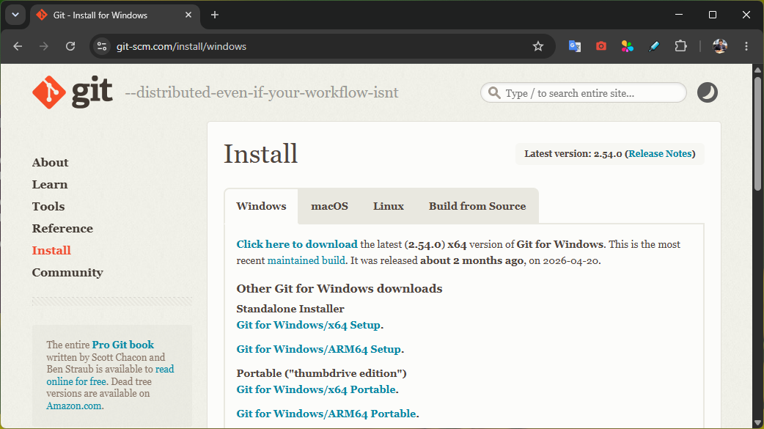
Git Installation
Visit the https://git-scm.com/install/
Download the latest version and Install or update to new version.

Slide 44
Git Installation
Let’s try

Slide 45
Git Installation
On windows:
Install any other GUI clients (GitHub Desktop, SourceTree, Git Tortoise, …)
Integration with your IDE
winget install --id Git.Git -e --source winget
git update-git-for-windows

Slide 46
Training Courses

Slide 47
Git@Work!
Daryoosh Hoora

Slide 48
فصل دوم
انتشار این محتوای آموزشی با ذکر منبع بلامانع می باشد

Slide 49
Previously on Git!
What is Git or is not?
Who needs Git and why?
What means of Git concepts?
How to setting Git up?

Slide 50
Configurations
git config
  git config --list
Config files
  [path]/etc/gitconfig (System-level configurations)
    git config --system <config-item>
  ~/.gitconfig or ~/.config/git/config (User-level configurations)
    git config --global <config-item>
  .git/config (project-level configurations)
    git config --local <config-item>
    or, git config <config-item>
  git config --list --show-origin
Local

Global

system

Slide 51
Configurations
Initialize configurations
  Introduce yourself
    git config --global user.name "User Name"
    git config --global user.email user@email.com
  Tricks:
  Linux
    git config --global user.name $USERNAME
  Windows
    git config --global user.name $($env:USERNAME)
    git config --global user.email $($env:USERNAME)@$($env:USERDOMAIN).com

Slide 52
Configurations
Optional configurations
  Choose your editor
    https://git-scm.com/book/en/v2/Appendix-C:-Git-Commands-Setup-and-Config#ch_core_editor
  main or master
    git config --system init.defaultBranch main
  CRLF or LF
    git config --system core.autocrlf [true | false | input]
  In Behsazan
    git config --system http.sslVerify false
For more: https://git-scm.com/docs/git-config

Slide 53
Getting started
Create a local repository
  cd <project-folder>
  git init
Linking the local repository to a remote repository
  git remote add origin <url>
  git remote -v
  git push --set-upstream origin main
Clone a remote repository
  git clone <url>

Slide 54
Basics
status
add
commit
diff
rm
mv
reset
restore
push
pull
fetch

Slide 55
.gitignore
# ignore all .a files
*.a
# but do track lib.a, even though you're ignoring .a files above
!lib.a
# only ignore the TODO file in the current directory, not subdir/TODO
/TODO
# ignore all files in any directory named build
build/
# ignore doc/notes.txt, but not doc/server/arch.txt
doc/*.txt
# ignore all .pdf files in the doc/ directory and any of its subdirectories
doc/**/*.pdf

Slide 56


Edited File
New File
Project Folder/.git
Project Folder
Project Folder
Project Folder
Project Folder
$ git init
$ git add
$ git rm
🙂
$ git commit
$ git restore
$ git merge
Working Tree
Staging Area
Local Repository

Slide 57

Remote Repository
Project Folder
Project Folder
Project Folder
$ git push
$ git pull
$ git fetch
$ git clone
Working Tree
Staging Area
Local Repository

Slide 58
Test scenario
Create an empty GitHub repository
  Scenario 1:
    Linking project folder to remote repository without set default branch.
  Scenario 2:
    Linking project folder to remote repository with set default branch.
  Scenario 3:
    Linking project folder to remote repository with rename default branch.
Create a GitHub repository with README file
  Scenario 4:
    Linking project folder to remote repository with set default branch.

Slide 59
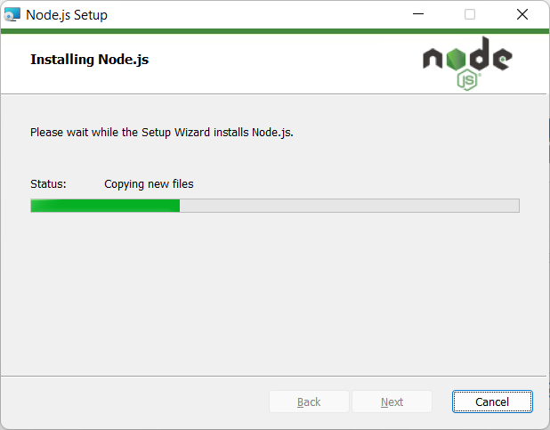
Node.js-Setup (Continue)

Slide 60
Ok, Ready to start…

Slide 61
Learning Courses

Slide 62
Git@Work!
Daryoosh Hoora

Slide 63
جلسه سوم
انتشار این محتوای آموزشی با ذکر منبع بلامانع می باشد

Slide 64
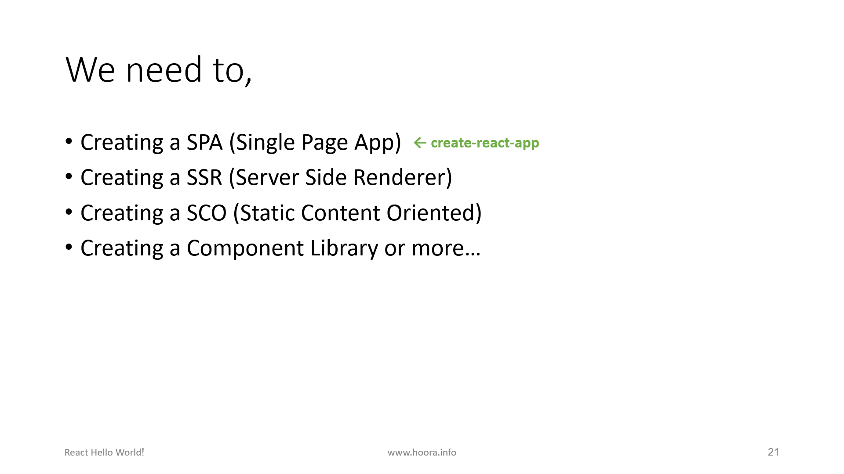
Previously on React!
Why Node.js?
How to installing Node.js?
How to setting up Npm?
← create-react-app

Slide 65
Tips and Tricks
Using the following command to checking version
  create-react-app --version
Using the following command to uninstall
  npm uninstall --location=global create-react-app
Reinstall for update

Slide 66
Tips and Tricks
It’s prefer to open windows terminal (Cmd / PowerShell) as Administrator
Try to use PowerShell instate of Cmd

Slide 67
Learning Courses

Slide 68
Git@Work!
Daryoosh Hoora

Slide 69
جلسه چهارم
انتشار این محتوای آموزشی با ذکر منبع بلامانع می باشد

Slide 70
Previously on React!
What is create-react-app?
How to create React app?
How to start React app?

Slide 71






Slide 72
Magic of WinGet!
Create an auto installer batch file!
  winget install -i OpenJS.NodeJS.LTS
  npm install -g npm@latest
  npm install -g create-react-app
  winget install -i microsoft.visualstudiocode
https://github.com/daryoosh-hoora
Repositories: Learning_React.js

Slide 73
React Glossary
Component, is a box of UI!
  Types:
    Class Component
    Functional Component
  Lifecycle:
    Mount
    Update
    Unmount
DOM (Document Object Model)
Virtual DOM, is a virtual DOM for speed up
Render, is about drawing web page
JSX, is a combination of HTML into JavaScript
ES6, is ECMAScript
Babel, is a JavaScript compiler (transpiler)
Webpack, is a bundling module
Babel
Browser
JSX
ES6
JS

Slide 74
Go Live!

Slide 75
Training Courses

