Slide 1
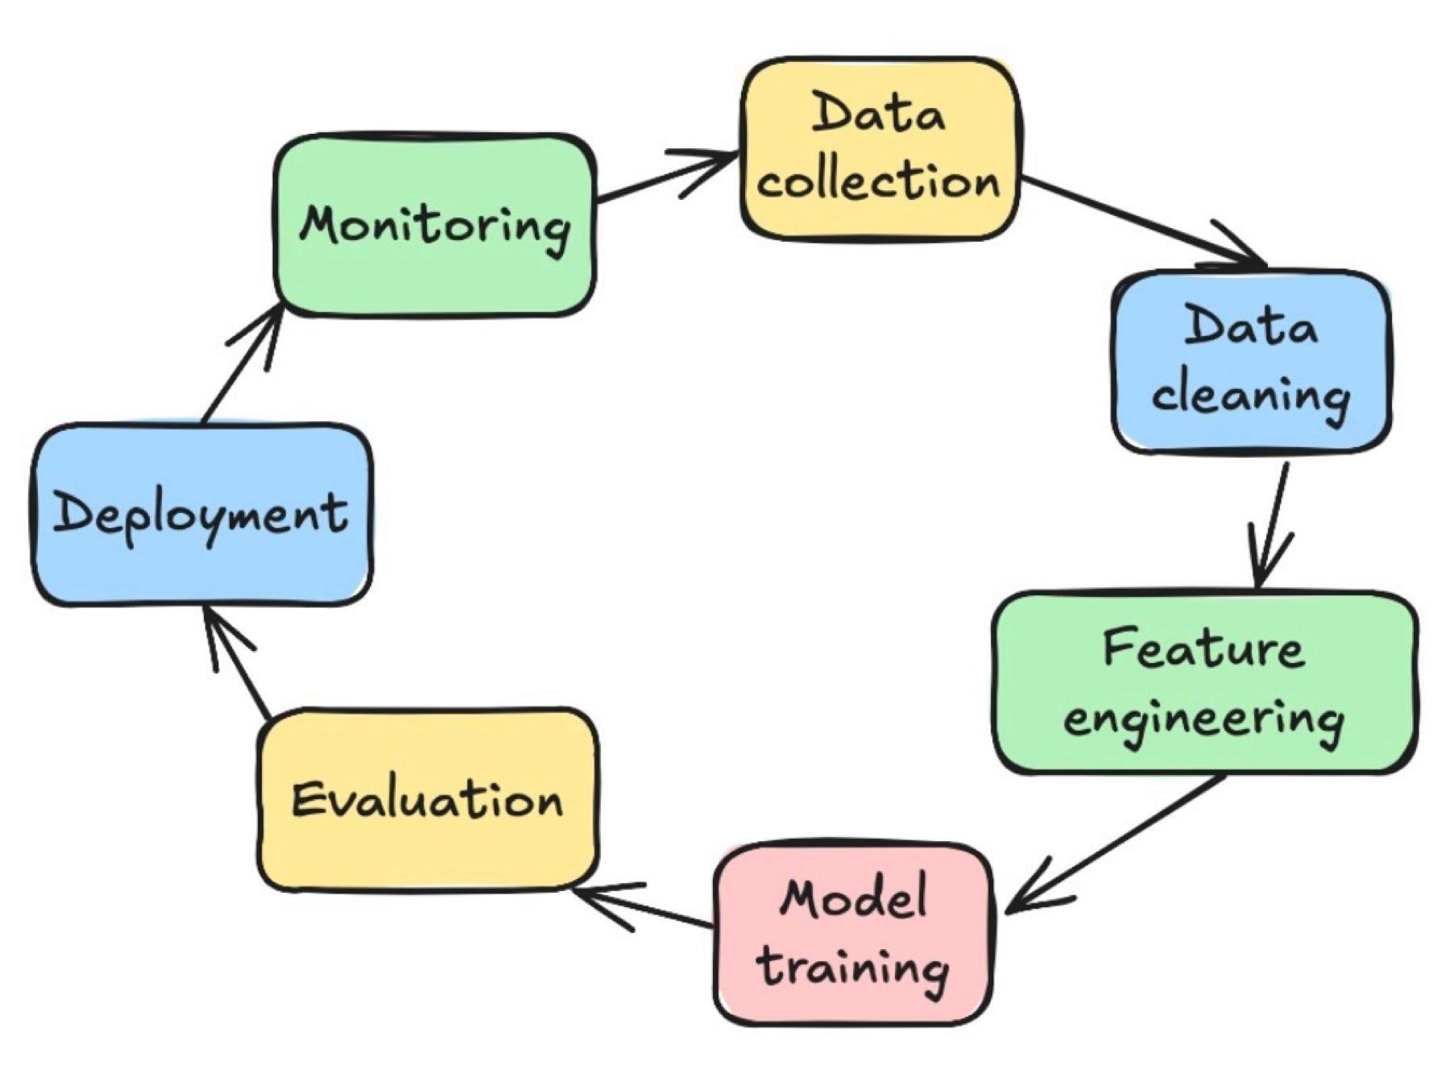
Project overview and objective
Title: Predicting Income Level Using Machine Learning
Goal - Predict whether an individual earns >50K annually using demographic and financial features.
Key Steps :
Data Cleaning & Feature Engineering
Exploratory Analysis
Model Building & Evaluation
Submitted by: Saurav Kumar Das

Slide 2
Data Insights & EDA Learnings
Key Observations:
Data has one unwanted column and weird entries.
Every numerical column has outliers present in them.
Higher education levels strongly correlate with higher income.
Marital and relationship status show strong economic influence.
Capital gain/loss has noticeable outliers but high predictive power.
Hours per week and age moderately impacts income probability.
Title: Understanding the Data & Early Insights

Slide 3
Modeling Strategy & Results
Title: Choosing the Right Model
Tree-based models chosen due to non-linear relationships and robustness to scaling.
As this is an income data which contains many natural outliers, these models can handle them without the need for removing.
Best Model Performance:
Title: Key Takeaways & Future Direction
Insights:
Data preprocessing quality heavily determines model success.
After doing feature importance - Relationship, Marital status, Capital gain and Number of years in education came out as top features contributing to the income level of individuals.
Challenges:
Handling missing data and outliers.
Selecting and balancing model accuracy along with interpretability.
Model | Accuracy | F1-Score | ROC_AUC
XGBoost | 87.5% | 0.72 | 0.80

