Slide 1
MARK YOUR CUSTOMERS
Team Members:
Partho Sarthi Das
Jithesh Yemi Reddy
Vaishnavi Seenuvasan
Sai Ram Prasanna Vulisetti
Vamshidhar Rao Billakanti

Slide 2

Introduction
The dataset that we adopted has record of customer activity in a real business situation.
As a group of business analysts, our role is to analyse and return valuable insights for the ecommerce website to improve its customer experience.

Slide 3
Data Mining objective
We aim to create a prediction model which could identify the users who would complete a successful transaction based on the duration spent on different modules of e-commerce website.
In the project, our team would create various prediction models from the dataset.
We will then make performance evaluations to determine which model would best suit our e-commerce business case.

Slide 4
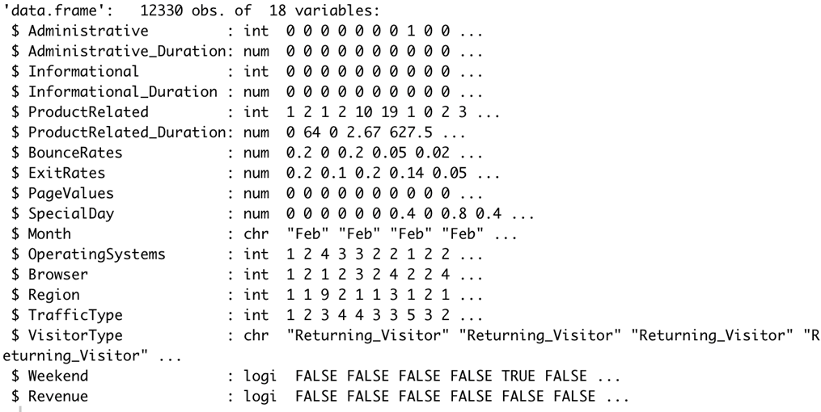
About Dataset
Each record in the dataset is a consolidated session of a unique user in a single record who visited the website during the one-year period.

Slide 5
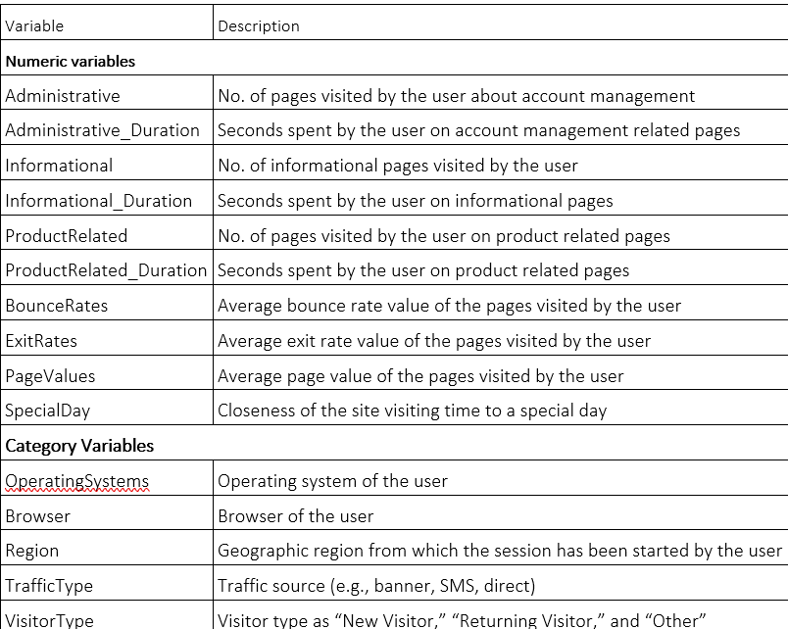
Meta Data

Slide 6
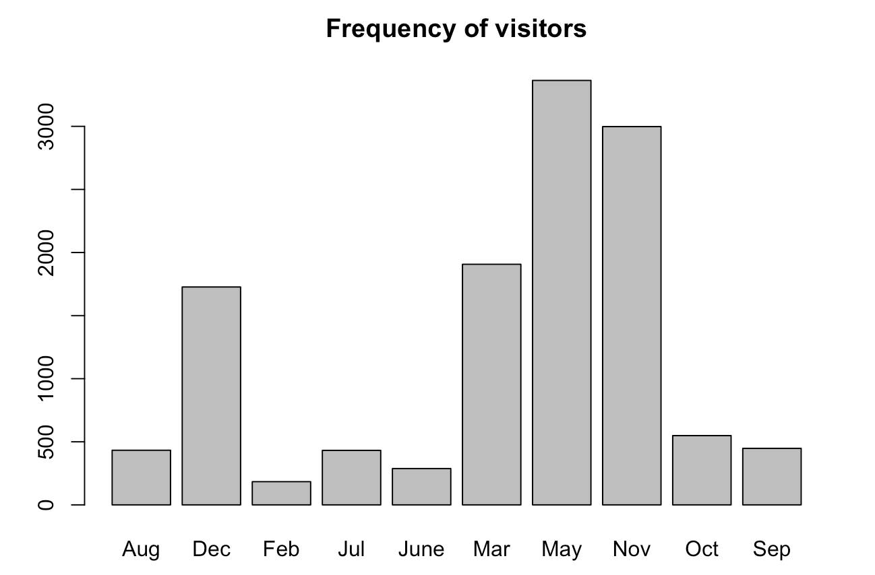
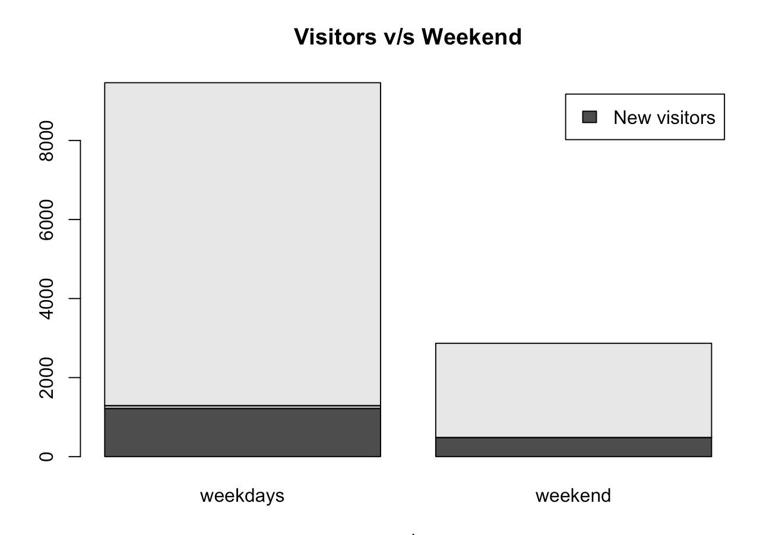
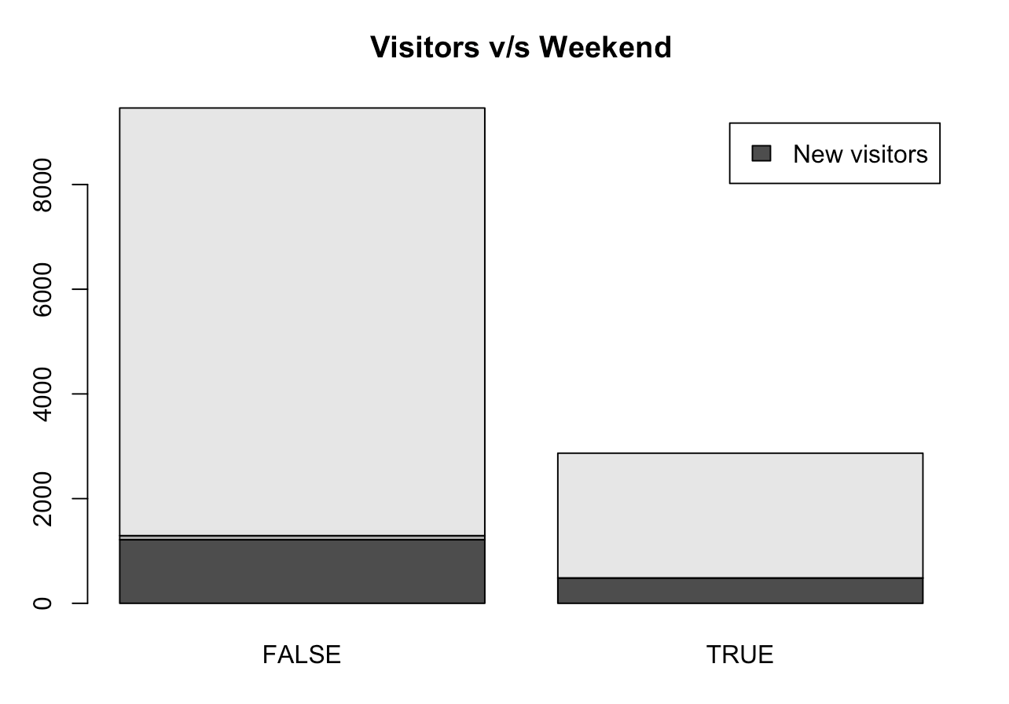
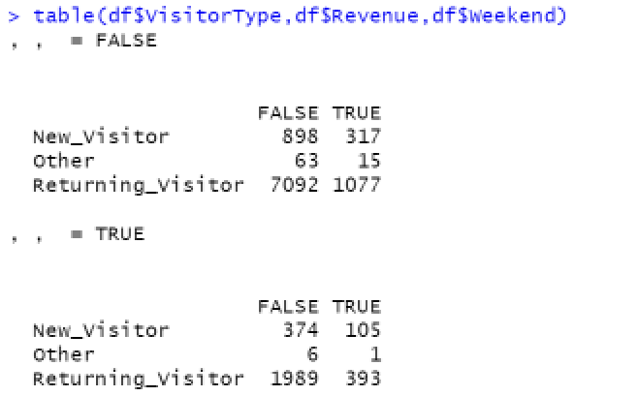
Descriptive statistics

Slide 7
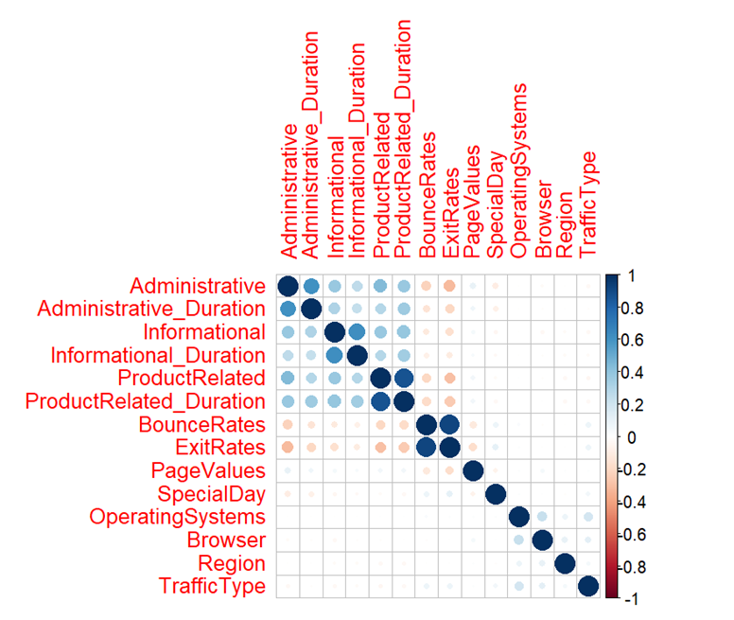
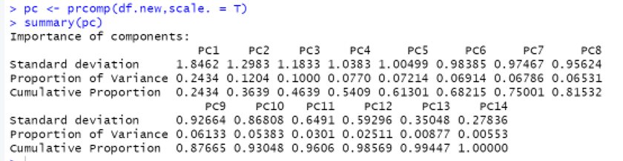
Descriptive statistics
PCA shows that the first 11 variables contain 96% of the information from all the variables of the dataset.
Exit rates and bounce rates are strongly correlated.

Slide 8
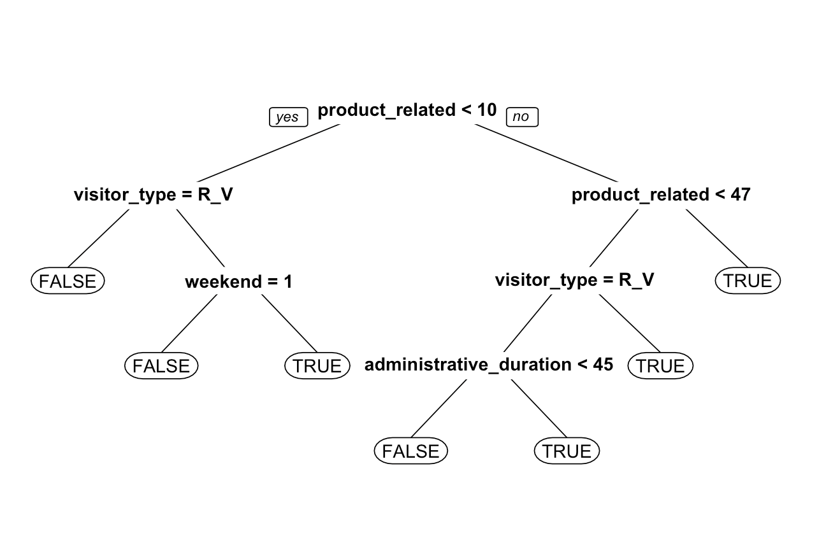
Decision Tree Model

Slide 9
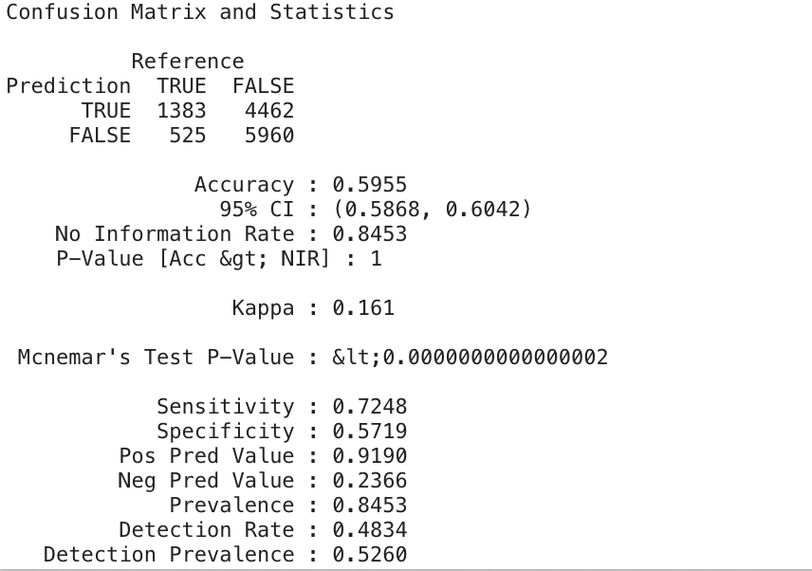
Decision Tree Model
On the balanced dataset:
The accuracy of the training dataset is 72.7%.
The accuracy of the validation dataset is 71.3%.
The area of the ROC curve or can be referred as the AUC value is 77.8%
On the original dataset:
Accuracy of whole dataset is 59.5%
The area of the ROC curve or can be referred as the AUC value is 67.7%

Slide 10
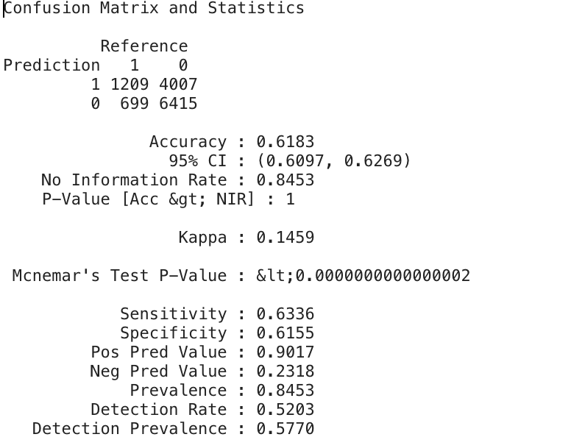
Logistic Regression Model
On balanced dataset:
The accuracy for the training model is 70.4%
The accuracy for validation training dataset is 69.53%.
On original dataset:
The accuracy for the original dataset is 61.8%. The sensitivity of this model is 63.36%
The area of the ROC curve or can be referred as the AUC value is 67.7%

Slide 11
Evaluation of results
Logistic regression model is better in its accuracy than the decision tree model.
The sensitivity of the logistic regression model is only 63.36%. On the other hand, the decision tree model has a sensitivity score of 72.48%.
According to the business model in this scenario the company can make better revenue when opted for decision tree model for marketing purposes.

Slide 12

Business strategies
The company can make signing up process easier than currently
It would be good for the company if it targets its visiting customers especially on weekends by giving them newsletters on emails or attractive discounts.
In case of discounts and clearance offers, the best months would be May and November.
Gain feedbacks from returning customers
A good number of purchases are made about a week in advance of a special day. So, target customers before the special days arrive.

Slide 13
THANK YOU

