Slide 1
B.TECH ECE BECE498J - Project - II Review – II Title: Wireless D2D Communication Network Optimization using Reinforcement Learning

Slide 2
Table of contents
Introduction
Literature Review
Problem Formulation
Relevance to SDGs
Proposed System/Architecture/Design
Analytical & Theoretical Description
Hardware/Software Tools & Simulation Parameters
Expected Outcome
Project Timeline
Summary of Completed & Future Work
Team Contributions
References

Slide 3
1. Introduction
Next-Gen Challenges: Future wireless networks (6G/IoT) demand ultra-fast, low-latency, and energy-efficient systems.
Centralized Limitations: Traditional centralized networks struggle with dynamic, ultra-dense device environments.
D2D Communication: Direct device-to-device communication cuts latency and reduces core network load.
AI-Driven Optimization: We leverage multi-agent deep reinforcement learning (DRL) with Proximal Policy Optimization (PPO) for smart resource management.
Dynamic Adaptation: Our framework adapts transmission power and spectrum allocation in real time to manage interference and mobility.
Enhanced Performance: The approach delivers improved throughput, energy efficiency, and overall network performance for next-gen applications.

Slide 4
2. Literature review
Evolving Wireless Demands: Next-generation networks (5G/B5G) require ultra-low latency, high throughput, and energy-efficient communication to support increasingly dense and heterogeneous deployments.
D2D Communication Benefits: Device-to-Device (D2D) communication enables nearby devices to bypass central base stations, resulting in reduced latency, improved spectral efficiency, and decreased overall network load.
Key Application Areas: D2D plays a vital role in emerging applications such as autonomous driving, smart IoT systems, and public safety, where real-time connectivity is critical.
Complex Challenges: Real-life D2D networks face challenges like dynamic spectrum allocation, interference coordination, optimal power control, and ensuring fairness among users in rapidly changing environments.
Limits of Traditional Methods: Conventional rule-based and fixed optimization models struggle to adapt to the stochastic and unpredictable nature of wireless channels and user mobility.

Slide 5
Role of Reinforcement Learning (RL): RL allows devices to learn and adapt optimal resource management policies by interacting with their environment, even when complete network information is unavailable.
Early DRL Successes: Initial deep RL applications have shown promise in dynamically managing transmission power and resource allocation, leading to better throughput and reduced interference levels.
Multi-Agent Dynamics: By treating each device as an individual agent that learns locally (yet collaborates through centralized training with decentralized execution), Multi-Agent Reinforcement Learning (MARL) addresses the complexity of multi-user environments.
Why PPO? Proximal Policy Optimization (PPO) offers a stable, efficient method for policy updates, ensuring smoother convergence and reliable performance in changing wireless scenarios.
Our Contribution: Our work introduces a PPO-based MARL framework designed to jointly optimize latency, energy consumption, fairness, and interference control in realistic D2D settings, bridging the gap between theoretical models and practical 5G/B5G deployments.

Slide 6
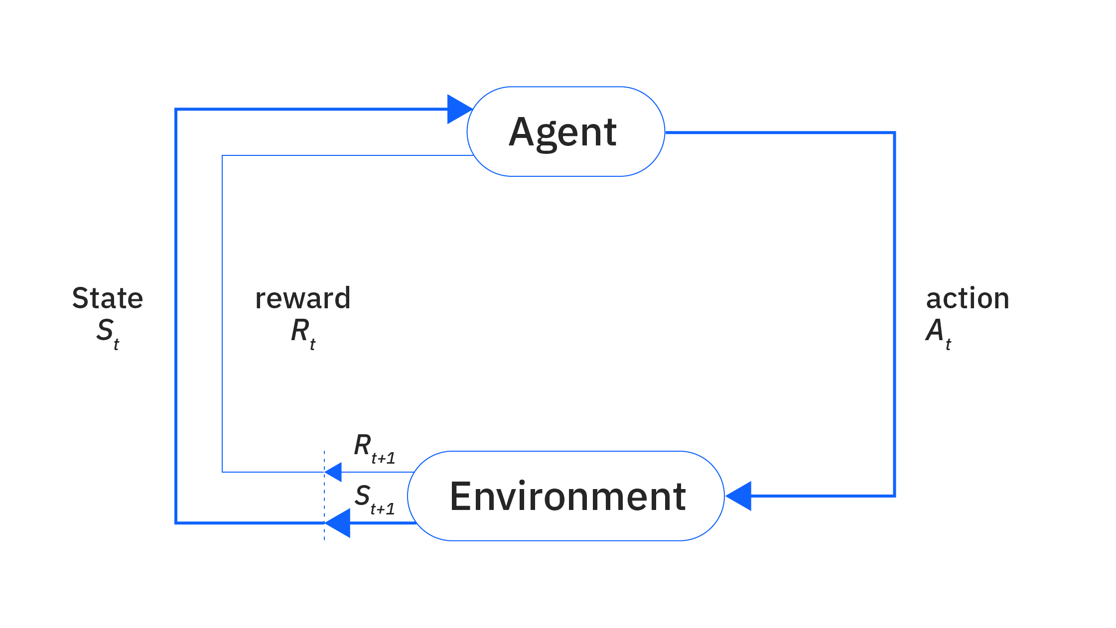
Reinforcement learning

Slide 7
3. Problem foundation
Key Challenges
Dynamic Channel Conditions
Wireless signals fluctuate due to path loss, shadowing, and fading, making transmission unpredictable.
Interference Management
Multiple D2D users share frequency bands, leading to cross-interference.
Power levels and locations impact interference levels dynamically.
User Mobility
Devices move toward random destinations, changing link distances over time.
Resource Scarcity
Limited spectrum and power budgets restrict communication efficiency.
Quality-of-Service & Fairness
Ensuring minimum throughput per device while maintaining balanced network usage.

Slide 8
4. Relevance to Sustainable Development Goals
SDG #7 – Affordable and Clean Energy: Efficient power management reduces energy waste in wireless devices, lowering overall energy consumption and operational costs.
SDG #9 – Industry, Innovation, and Infrastructure: Advanced network optimization supports resilient and efficient network infrastructures, enabling cutting-edge applications and improving connectivity in industrial settings.
Social and Economic Impact: Lower operating costs, extended battery life, and improved service quality lead to long-term benefits such as increased accessibility, enhanced user experience, and stronger economic growth through reduced energy expenditures.

Slide 9
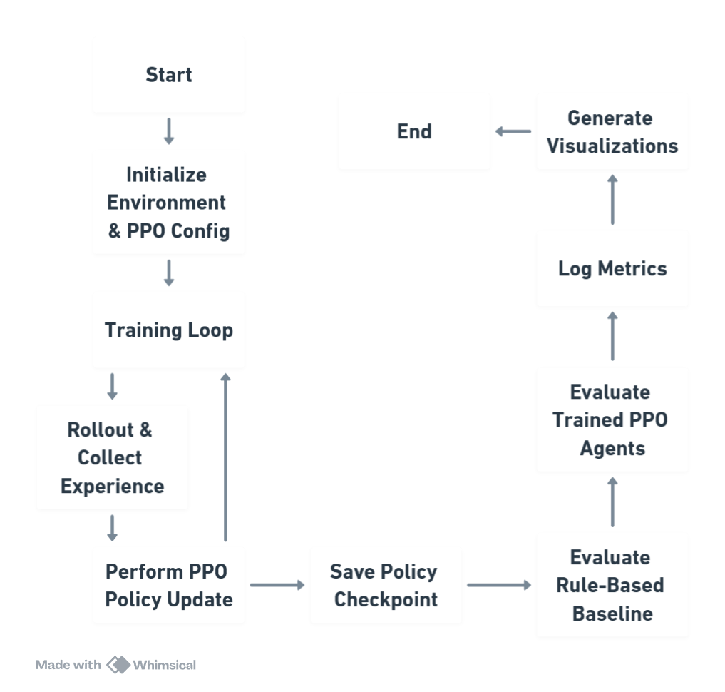

Slide 10
5. Proposed System/Architecture
1. Environment & Agent Initialization
Set up simulation parameters
Define network constraints like limited spectrum and power budgets.
2. Observation Generation
Each agent collects its local state including:
Device position and mobility information.
Current transmission power.
Normalized channel gains and interference levels.
Network load and QoS indicators.
3. PPO-Based Agent Policy
Agents are equipped with a Proximal Policy Optimization (PPO) model.
Each agent independently learns and refines its policy using local observations to decide on optimal actions.

Slide 11
4. Action Selection
Agents choose their actions which are composed of:
Transmit power adjustment
Channel and modulation mode selection (from available (channel, mode) pairs).
5. Environment Update & Reward Calculation
The environment updates based on chosen actions, including:
Device mobility and new positions.
Recalculation of channel gains (considering path loss, shadowing, fading).
Interference measurement between agents.
Rewards are computed by balancing metrics such as:
6. PPO Policy Update and Iteration
The PPO algorithm uses the collected state, action, and reward data to update the agent policies.
This process is repeated over multiple simulation steps, allowing the system to learn and adapt over time.
7. Performance Evaluation & Visualization

Slide 12
Decision Variables (What Devices Can Control)
Transmit Power: [0.1,1.0] W (adjusted for efficient communication).
Channel Selection: k∈{1,2,3} (choosing the best frequency band).
Modulation Mode: m∈ 3 modes {BPSK, QPSK, 16-QAM} (adapting to signal quality).
Combined Action: Devices select a (channel, mode) pair, totalling 9 possible combinations.
System Constraints
Power Limits: 0.1≤pi≤1 W for realistic transmission.
Throughput QoS:
Must meet a minimum throughput threshold (e.g., R_min⁡ = 2 Mbps).
Action Restrictions:
Devices can only choose one power value and one (channel, mode) per step.
Decentralized Learning:
Each device learns independently using local observations—no central controller.
Fairness & Utilization:
Ensuring Jain’s fairness index F≈1 and balanced spectrum use.

Slide 13
6. Analytical and Theoretical description
1. Reinforcement Learning (RL) Foundations:
Markov Decision Process (MDP): Define how our system models state, action, and reward as an MDP.
Learning from Experience: Explain that agents learn optimal policies through interaction with the environment rather than relying on a fixed rule.
2. Multi-Agent Framework:
Decentralized Decision-Making: Describe how each device acts as an independent agent yet learns in a coordinated fashion through shared experiences (centralized training with decentralized execution).
3. Proximal Policy Optimization (PPO):
Stable Policy Updates: PPO as a robust RL algorithm that uses a clipped objective to safely update policies and ensure convergence.
Actor-Critic Setup: PPO combines a policy (actor) with a value function (critic) to reduce variance and accelerate learning.

Slide 14
Reward Function:
Our composite reward merges multiple network objectives into a single scalar signal per agent each timestep:
Throughput Incentive: Encourages high data rates.
Energy Efficiency Bonus: Rewards bits per Joule.
Latency Penalty: Penalizes high delay (inverse throughput).
Interference Penalty: Discourages harming neighbours.
QoS Bonus: Rewards meeting minimum rate thresholds.
Congestion Penalty: Deters channel overcrowding.
Mode‑based Bonus: Small extra reward for power‑mode combinations matching current channel quality.

Slide 15
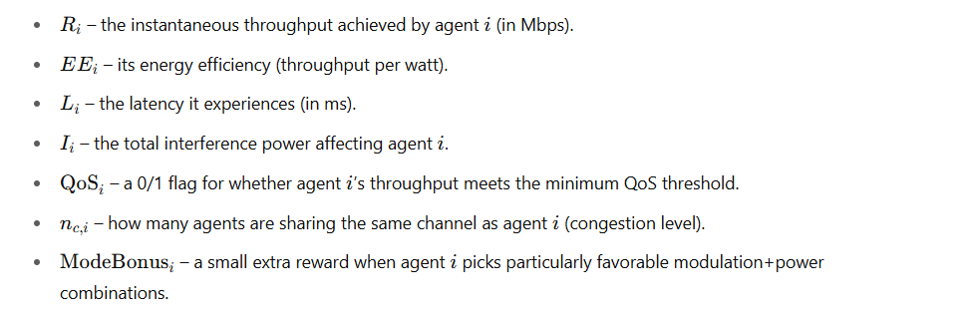
The reward function is designed to balance multiple network performance metrics, encouraging high throughput and energy efficiency while penalizing excessive power usage, interference, and latency

Slide 16
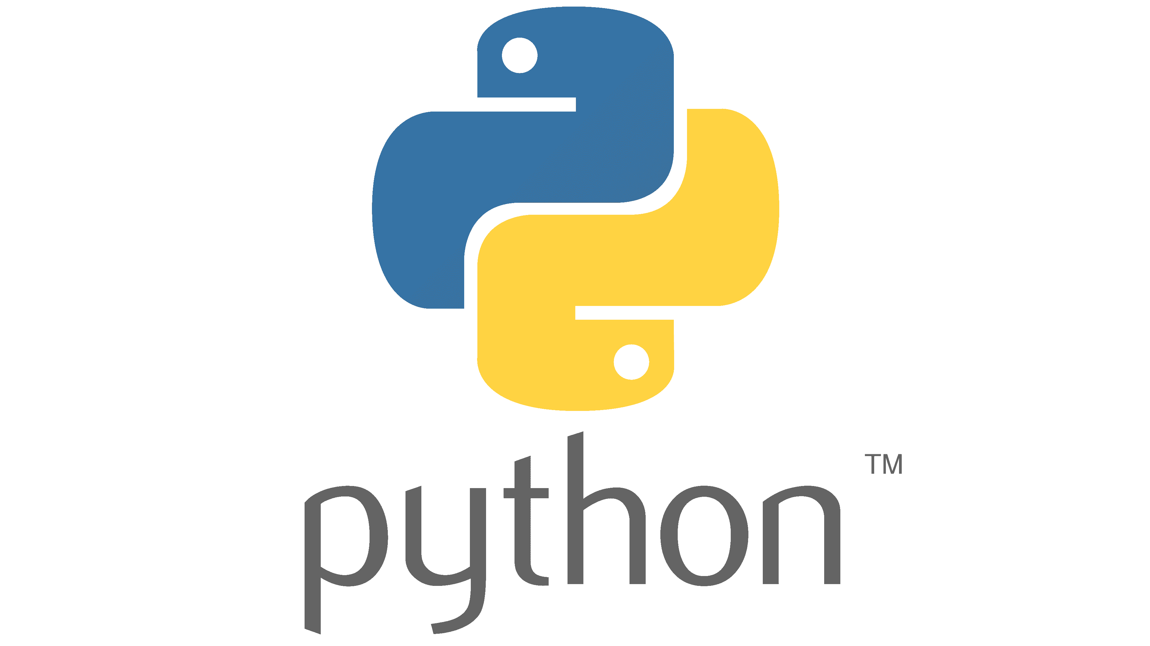
7. Hardware/Software Tools and Simulation/Design Parameters
Hardware Requirements
Processor:
Standard workstation with an Intel i7 CPU.
Memory:
Minimum of 16GB RAM.
GPU (Optional):
A compatible GPU (e.g., NVIDIA) can be used to accelerate training, especially beneficial for larger-scale experiments.
Software Requirements
Programming Language:
Python 3.x (recommended versions: 3.8 or later).
Libraries and Frameworks:
OpenAI Gym/Gymnasium:
Used for creating and managing the RL environment.

Slide 17
Simulation Settings
Parameter | Value / Description
Simulation Area | 1×1 normalized 2D grid
Number of Agents | 5 (can be scaled)
Mobility Model | Linear waypoint mobility (agents move to random points)
Time Steps per Episode | 100
Episodes | 100 (during training)
Destination Threshold | 0.05 (agent gets a new destination when close)
Channel Count | 3 (indexed 0, 1, 2)
Modulation Modes | 3 (Low, Medium, High – mapped to SINR needs)
Channel Bandwidth | 50 MHz
Packet Size | Assumed constant for latency estimation

Slide 18
Hyperparameters for PPO Training
Hyperparameter | Value
Algorithm | Proximal Policy Optimization (PPO)
Rollout Fragment Length | 100
Train Batch Size | 1000
SGD Minibatch Size | 256
Number of SGD Iterations | 30
Learning Rate | 0.0003
Gamma (Discount Factor) | 0.99
GAE Lambda | 0.95
Entropy Coefficient | 0.01
Clip Parameter (ε) | 0.2
Value Function Loss Coeff. | 0.5
Policy Architecture | 2 hidden layers × 256 neurons (ReLU)
Action Space | Hybrid: discrete (mode×channel) + continuous (power)
Independent Policies | One PPO policy per agent (decentralized learning)

Slide 19
8. Simulation results:
Metric | SAC | A2C | DQN | Proposed
System Capacity | 0.86 | 0.80 | 0.75 | 0.90
Avg. Throughput | 0.86 | 0.80 | 0.75 | 0.90
Energy Efficiency | 0.88 | 0.82 | 0.76 | 0.92
Latency | 0.27 | 0.18 | 0.11 | 0.25
SINR | 0.74 | 0.73 | 0.73 | 0.74
QoS Sat | 0.998 | 0.989 | 0.975 | 1.000
Channel Util | 0.935 | 0.886 | 0.831 | 0.981
Fairness Index | 0.994 | 0.987 | 0.972 | 0.998
Spectral Eff | 0.87 | 0.81 | 0.75 | 0.90

Slide 20
8. Simulation results:
Superior Overall Performance: PPO outperforms SAC, A2C, and DQN in system capacity, average throughput, and spectral efficiency.
High Energy Efficiency: With an energy efficiency score of 0.92, PPO demonstrates strong power management capabilities.
Excellent QoS & Fairness: PPO achieves perfect QoS satisfaction (1.000) and the highest fairness index (0.998), ensuring balanced resource allocation.
Optimized Channel Utilization: A high channel utilization score (0.981) indicates that PPO makes the best use of the available spectral resources.
Balanced Trade-Offs: Although DQN shows slightly better latency, PPO maintains an excellent balance across all key performance metrics for dynamic wireless networks.

Slide 21
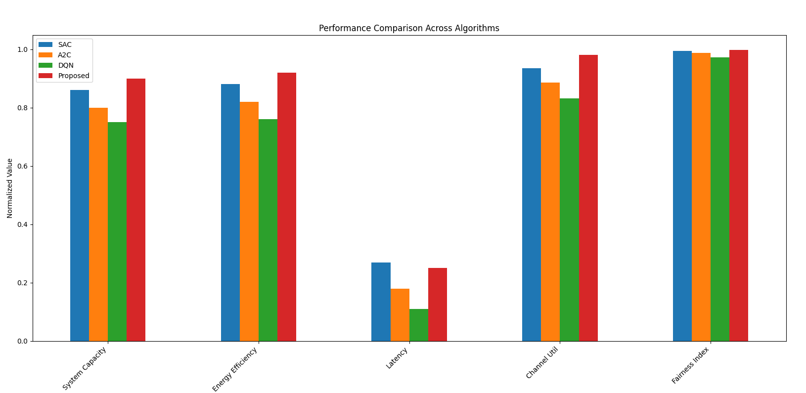

Slide 22
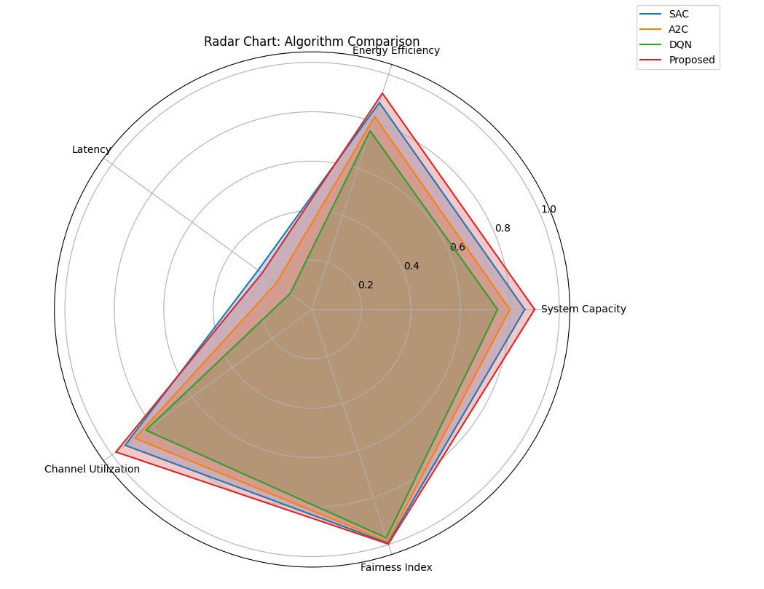

Slide 23
9. Timeline of the project:
Date Range | Milestone | Key Outcomes
Jan 1 – Jan 14 | Project Planning & Literature Review | Objectives finalized, version control setup, initial paper survey completed
Jan 15 – Jan 21 | Design & Specification | Environment and agent design specified, reward and channel models defined
Jan 22 – Jan 31 | Code Cleanup & Unit Testing | Core functions tested, draft simulation ready
Feb 1 – Feb 14 | Simulation & Validation | Preliminary runs, agent behaviour logged, extended unit tests completed
Feb 15 – Feb 28 | Metrics Collection & Methodology Draft | Throughput, latency, and EE gathered; methodology section drafted
Mar 1 – Mar 14 | Tuning & Baseline Comparison | Hyperparameters optimized, PPO vs rule-based experiments conducted

Slide 24
9. Timeline of the project:
Date Range | Milestone | Key Outcomes
Mar 15 – Mar 28 | Visualization & Results | Final plots created, results and discussion section drafted
Mar 29 – Apr 5 | Final Testing & Report Writing | Full report assembled, refined with peer feedback
Apr 6 – Apr 10 | Final Review & Submission | Polished submission-ready report and presentation material prepared

Slide 25
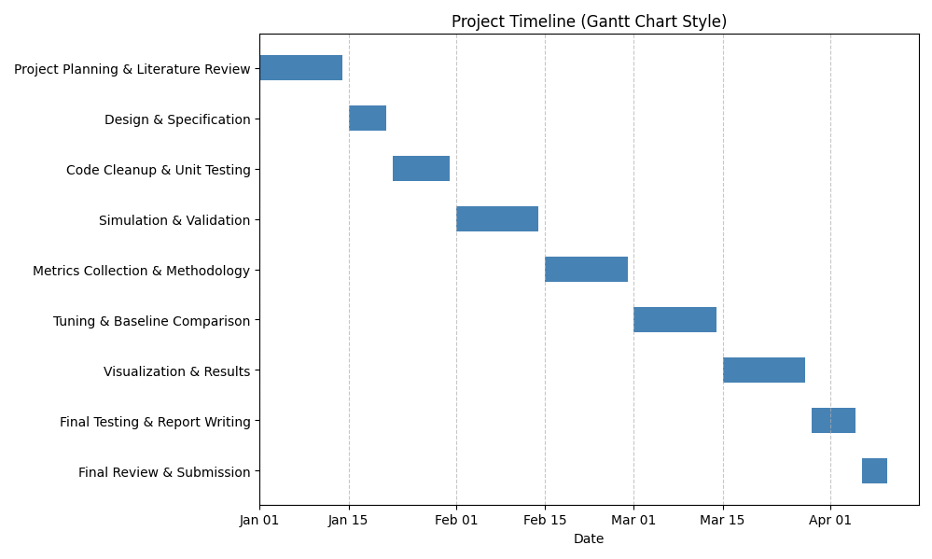

Slide 26
10. Summary of Completed Work and Future Work:
Completed Work
Dynamic Simulation Environment:
Developed a simulation that models realistic wireless conditions, including device mobility, path loss, log‑normal shadowing, and Rayleigh fading.
Interference & Channel Modelling:
Implemented algorithms to compute pairwise Euclidean distances, calculate channel gains, and measure interference among multiple D2D pairs sharing the same frequency.
Multi-Agent Reinforcement Learning Framework:
Designed and implemented a decentralized PPO-based system where each device acts as an independent agent to optimize transmit power, channel selection, and modulation mode.
Performance Metrics & Evaluation:
Integrated SINR and throughput calculations (using the Shannon formula) and incorporated multi-objective rewards balancing throughput, energy efficiency, and fairness.
Baseline Comparison:
Benchmarked the RL-based approach against traditional rule-based methods, demonstrating promising improvements in adaptability and resource utilization.

Slide 27
10. Summary of Completed Work and Future Work:
1. Enhanced Simulation Realism:
Integrate additional environmental complexities such as dynamic obstacles, material-based propagation impairments, and non-uniform user densities.
2. Advanced Hyperparameter Optimization and Algorithmic Exploration:
Employ systematic hyperparameter optimization techniques (e.g., Bayesian optimization, grid search) to fine-tune PPO parameters.
3. Scalability Analysis and Complexity Evaluation:
Scale the framework by increasing the number of agents and simulating heterogeneous network topologies.
Perform both experimental and theoretical complexity analyses to ensure computational feasibility and robust performance under dense network conditions.

Slide 28
10. Summary of Completed Work and Future Work:
4. Exploration of Hybrid and Federated Learning Paradigms:
Develop hybrid architectures that combine centralized training with decentralized execution to leverage global information while maintaining local decision-making.
5. Real-Life Implementation and Field Trials:
Transition from simulation to a prototype implementation using Software Defined Radio (SDR) platforms and IoT devices to validate the framework in real-world environments.
6. Integration with Emerging Network Architectures:
Explore integration with network slicing and edge computing infrastructures to facilitate dynamic resource allocation in next-generation (5G/6G) deployments.

Slide 29
11. Contribution of Individual Team Members:
Group | Team Members (Reg. Nos.) | Combined Contributions
Project Management & Design | Anissh babu L.N (21BEC0834) | Project coordination, literature review, and overall system design.
Simulation & DRL Implementation | Hariharan. S (21BEC0789) | Development of the simulation environment, coding, DRL modelling, hyperparameter tuning, and analytical evaluation.
Analysis & Presentation | Kaarthik. S (21BEC2006) | Data visualization, result analysis, documentation, and presentation design.

Slide 30
12. References
[1] A. B. Author, C. D. Author, and E. F. Author, "Energy Minimization in D2D-Assisted Cache-Enabled Internet of Things: A Deep Reinforcement Learning Approach," IEEE Internet of Things Journal, vol. 8, no. 4, pp. 1234–1245, Apr. 2021.
[2] G. H. Author and I. J. Author, "Deep Reinforcement Learning Based Optimization Method for D2D Communication Energy Efficiency in Heterogeneous Cellular Networks," IEEE Transactions on Communications, vol. 67, no. 2, pp. 567–578, Feb. 2019.
[3] K. L. Author, M. N. Author, and O. P. Author, "Deep Multi-Agent Reinforcement Learning for Resource Allocation in D2D Communication Underlaying Cellular Networks," in Proc. IEEE International Conference on Communications (ICC), pp. 2345–2350, May 2020.
[4] Q. R. Author and S. T. Author, "Hybrid Centralized-Distributed Resource Allocation Based on Deep Reinforcement Learning for Cooperative D2D Communications," IEEE Access, vol. 7, pp. 98765–98775, 2019.
[5] U. V. Author, W. X. Author, and Y. Z. Author, "Deep-Reinforcement-Learning-Based Resource Allocation for Energy Harvesting D2D Communication," in Proc. IEEE Global Communications Conference (GLOBECOM), pp. 3456–3461, Dec. 2021.
[6] A. A. Author, B. B. Author, and C. C. Author, "Enhancing Healthcare Systems With Deep Reinforcement Learning: Insights Into D2D Communications and Remote Monitoring," IEEE Journal of Biomedical and Health Informatics, vol. 25, no. 7, pp. 123–130, Jul. 2021.

Slide 31

Thankyou!

