Slide 1
Digital to Analog Converters
Conversores de Sinal -2022/2023
Nuno Paulino – DEEC- FCT/UNL

Slide 2
DAC architectures
Resistive string DACs
Scaled current DACs
  Binary weighted resistor structures
  R-2R ladder structures
Current steering DACs
  Binary weighted current sources
  Unit current sources
  Segmented architectures
Charge distribution DACs
Hybrid structure DACs (between 1 and 4)

Slide 3
Resistive string DACs
b₁ | b₀ | o₀ | o₁ | o₂ | o₃
0 | 0 | 1 | 0 | 0 | 0
0 | 1 | 0 | 1 | 0 | 0
1 | 0 | 0 | 0 | 1 | 0
1 | 1 | 0 | 0 | 0 | 1
Digital
decoder
Analog
multiplexer
Inherently monotonic
The number of resistors grows exponentially with the resolution
Static errors are dependent on the resistive string.
Maximum conversion frequency determined by the time constant: R_{max}.C

Slide 4
Settling error of the DAC
R₂
R₁

Slide 5
Binary weighted resistor DAC
R_{F}=(1/16).Ru R₀=1.Ru R₁=(1/2).Ru R₂=(1/4).Ru R₃=(1/8).Ru (Ru: unit resistor)
The resistors (R_{i}) are obtained by connecting in parallel unit resistors (Ru)
Non-monotonic (can have missing codes)
The resistance values increases exponentially with the resolution
The maximum conversion frequency is dependent of the amplifier.

Slide 6
The problem with binary weighted resistors (weights)
In the transition from code 7 to code 8 a large error can occur:

Slide 7
Unit resistor (unit current) DAC
Digital
decoder
b₁ | b₀ | o₀ | o₁ | o₂
0 | 0 | 0 | 0 | 0
0 | 1 | 1 | 0 | 0
1 | 0 | 1 | 1 | 0
1 | 1 | 1 | 1 | 1
R_{F}=Ru/16 (Ru: unit resistor)
Monotonic (no missing codes)
The number of resistors increases exponentially with the resolution
Requires a digital decoder (can be difficult to build for large resolutions)
The maximum conversion frequency is dependent of the amplifier.

Slide 8
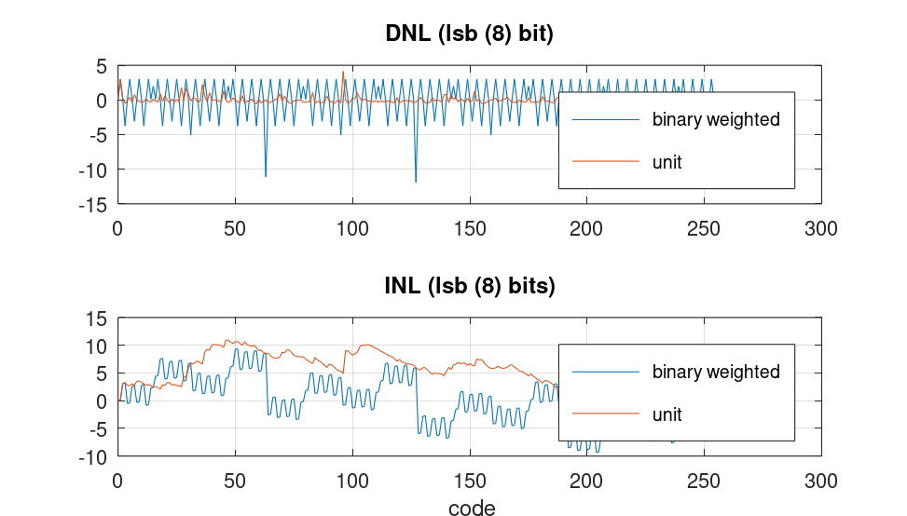
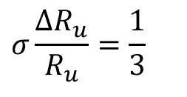
Typical INLs and DNLs for 8 bit DACs, using binary weighted and unit resistors
Absolute error of the unit resistors
$$σ\frac{ΔR_{u}}{R_{u}}=\frac{1}{3}$$
The INL maximum error is similar in both DACs
The DNL is much worse in the case of the binary weighted DAC

Slide 9
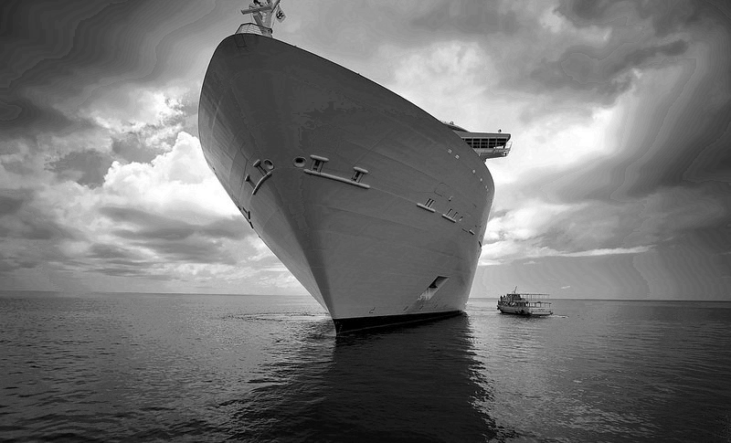
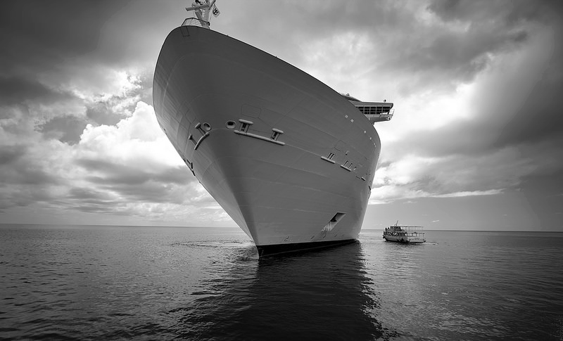
Practical example of application of the 2 DACs
binary weighted resistors DAC
Unit resistors DAC

Slide 10
R-2R ladder DAC
R_{F}=16.Ru R₁=R₂=R₃=R₄=R₈=2.Ru R₅=R₆=R₇=Ru (Ru: unit resistor)
Limited dispersion of component values.
Number of resistors increases linearly with the resolution
The maximum conversion frequency is dependent on the amplifier.

Slide 11
R-2R calculation

Slide 12
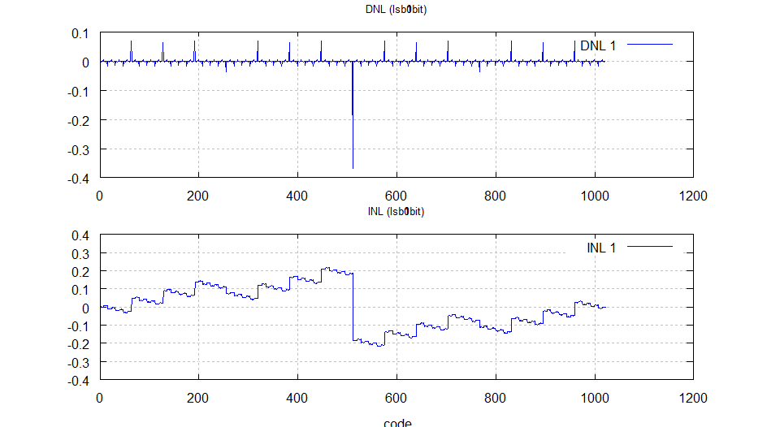
Linearity errors of the R-2R DAC
Absolute error of the unit resistors

Slide 13
Voltage mode R-2R DAC
The reference voltage is positive (single power supply)
Requires an amplifier with a large input impedance (buffer)
The circuit is sensitive to parasitic capacitances (lower speed)
The switches voltage changes with the input digital code.

Slide 14
Current source-based DACs
Eliminates the need of the operational amplifier
The output current is the sum of 2^{n}-1 currents, and it is converted into a voltage trough a resistance (V_{o}=I_{o}.R_{o})
The maximum current value depends on the desired conversion speed of the DAC (τ =R_{o}.C_{o})
The circuit area increases exponentially with the resolution of the DAC.
  Ex. : For 8-bit resolution 255 transistors are necessary.

Slide 15
Binary weighted current source DAC
I_{o}=8I_{u}b₃+4I_{u}b₂+2I_{u}b₁+I_{u}b₀
b₃
b₂
b₁
b₀
The output current is a function of the reference current and the digital code
8 I_{u}
4 I_{u}
2 I_{u}
1 I_{u}
Each current source of weight I_{u} is implemented by one transistor.
For 8-bit resolution 255 transistors are necessary.

Slide 16
Segmented architecture
16+1 T
1/16
I_{o}=8I_{r}b₇+4I_{r}b₆+2I_{r}b₅+I_{r}b₄
I_{o}=8I_{r}b₃+4I_{r}b₂+2I_{r}b₁+I_{r}b₀
b₃
b₂
b₁
b₀
b₇
b₆
b₅
b₄
1 T
8 I_{r}
4 I_{r}
2 I_{r}
1 I_{r}
8 I_{r}
4 I_{r}
2 I_{r}
1 I_{r}
1 T
8 T
8 T
15+15+16+1+1 = 48 transistors

Slide 17





Possible CMOS DAC implementation
$$I_{b0}$$
$$I_{b1}$$
$$I_{b2}$$
$$I_{b3}$$
$$I_{R}=\frac{V_{DD}−V_{R}}{R_{1}}$$
$$V_{DAC}=V_{DD}−I_{R}{∙R}_{2}\left(b_{0}+2b_{1}+4b_{2}+8b_{3}\right)$$

Slide 18
Problem with the switching
The switch is replaced by a differential pair (current steering). Vx voltage can now remain constant.
The differential pair transistors also act as cascode devices increasing the output impedance.
When b₃ is 0, C_{p3} discharges to 0V.
When b₃ changes to 1, C_{p3} must charge from 0V resulting in a glitch and extra delay at the output voltage.

Slide 19
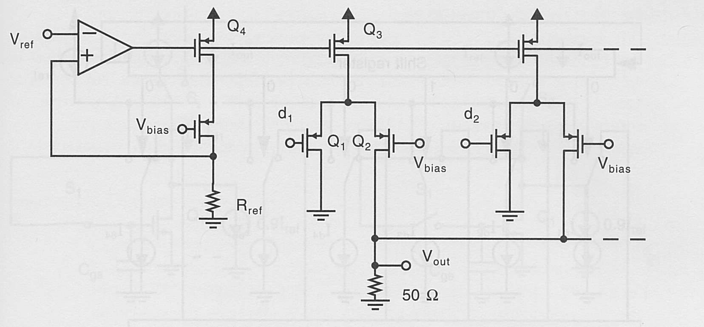
Current steering (switching)
In order to have a constant current in the current source it is necessary to steer the current to another branch instead of simply using a series switch. This arraignment corresponds to using a differential pair as a switch.

Slide 20
Mismatch errors (MOS design)
Due to the random variations of V_{T} and β=μC_{ox}
There is a difference between the drain currents of two equal sized MOS transistors:
Vdd
I_{r}
V_{o}
I_{o}
The variance of the relative error between the
two currents is given by:
M₁
M₂
V_{GS}
M₁=M₂
IEEE JOURNAL OF SOLID-STATE CIRCUITS, VOL. 24, NO. 5, OCTOBER 1989,
Matching Properties of MOS Transistors, MARCEL J. M. PELGROM, C. J. DUINMAIJER,
ANDANTON P. G. WELBERS
The design of the DAC should guaranty that the error is smaller than the maximum error allowed by the DAC resolution

Slide 21
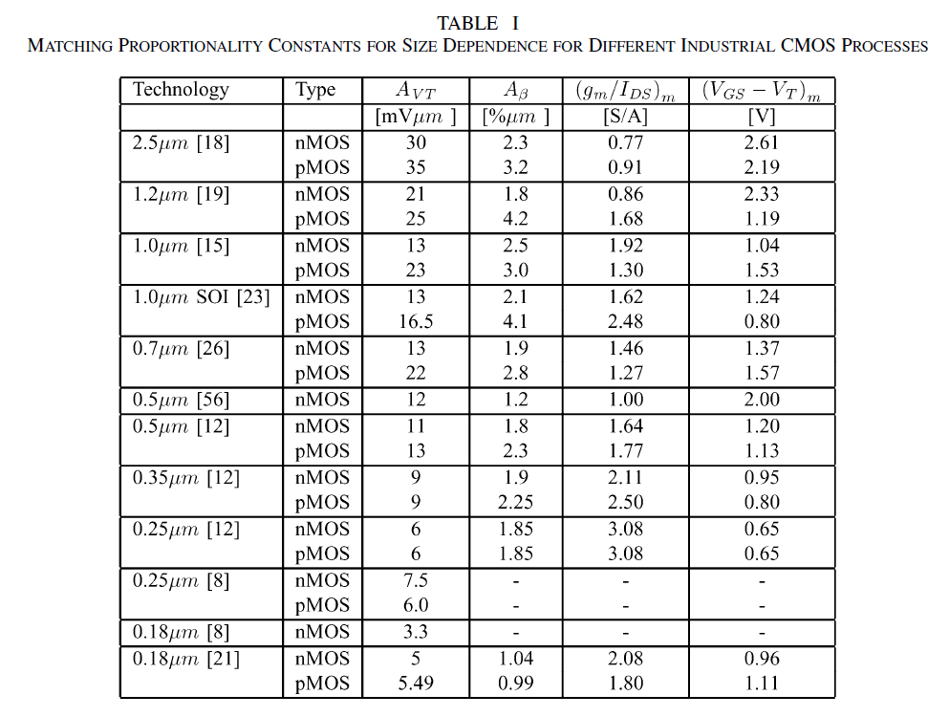
Examples of matching parameters
P. R. Kinget, "Device mismatch and tradeoffs in the design of analog circuits," in IEEE Journal of Solid-State Circuits, vol. 40, no. 6, pp. 1212-1224, June 2005,

Slide 22
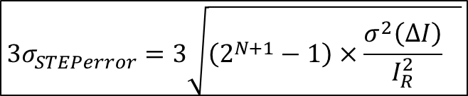



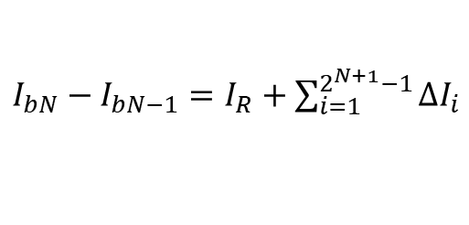

Current source errors
$$I_{bN}$$
The error in the current of bit N (I_{bN}) has a variance that is the sum of the variances of the error current of each unit transistor:
$$σ_{ΔIbN}^{2}=2^{N}×σ_{ΔIR}^{2}$$
The largest error occurs for the code transition from 01…11 (N-1) to 10…00 (N):
$I_{bN}−I_{bN−1}=$ $I_{R}+\sum_{i=1}^{2^{N+1}−1}{∆I_{i}}$
In order to not have missing codes this means:
$${STEP}_{error}\frac{I_{bN}−I_{bN−1}}{I_{R}}−1<1$$
$${3σ}_{STEPerror}^{}<1$$
To guaranty that 99.97% of the cases :
$${3σ}_{STEPerror}^{}=3\sqrt{\left(2^{N+1}−1\right)×{\frac{σ^{2}\left(∆I\right)}{I_{R}^{2}}}_{}^{}}$$

Slide 23
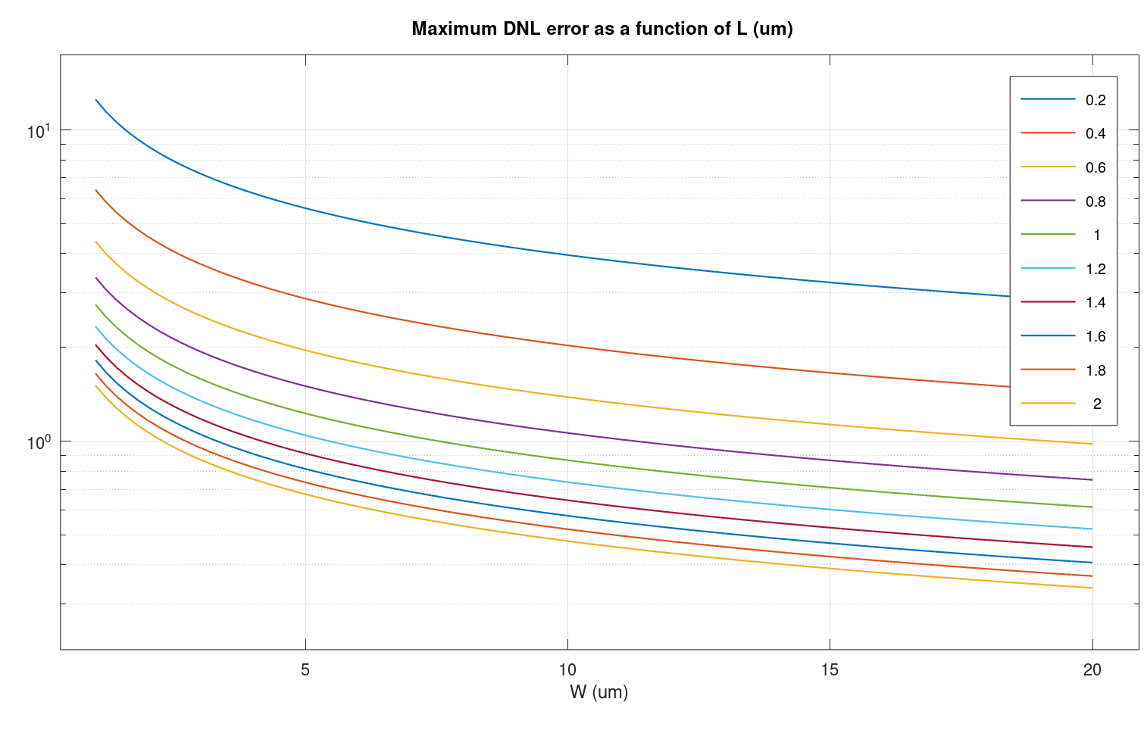
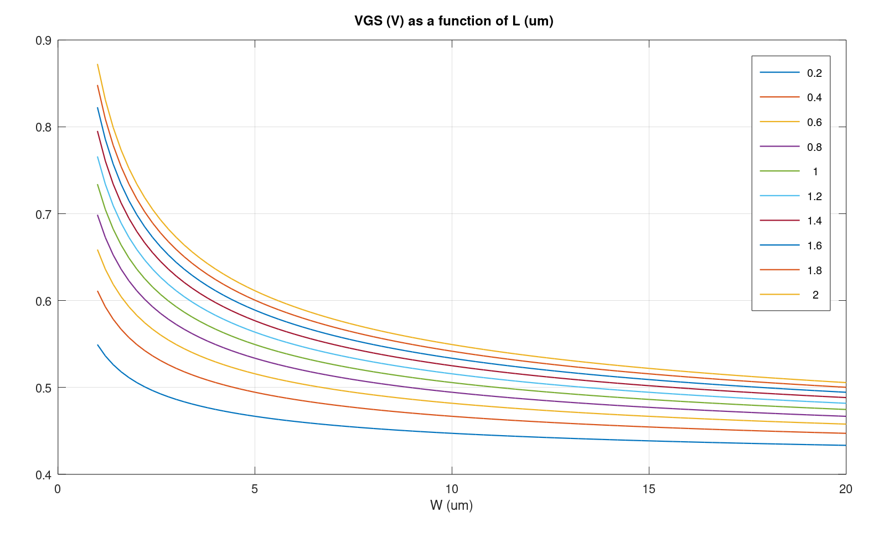
Sizing of MOS current source for 10-bit
3σ value of the maximum DNL error in 10-bit DAC considering MOS transistors with different channel lengths (L) and channel widths (W). Drain current is constant
Valid design space error<1
(Vgs-Vt) voltage in a MOS transistor for different channel lengths (L) and channel widths (W). Drain current is constant
Valid design space: VDsat<0.4V

Slide 24
Unit current source DAC
Using binary weighted current sources results in a non-monotonic characteristic, because for certain code transitions N unit current sources are disconnected and N+1 unit current sources are connected.
In order to solve this problem, it is necessary to connect or disconnect just one-unit current source for every code transition.
The resulting circuit is almost same circuit as a binary weighted DAC, it is only necessary to change the switching scheme and use a digital decoder. The digital decoder is distributed in order to increase the speed of the DAC.

Slide 25
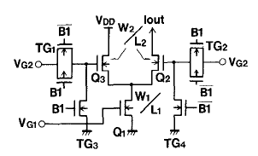
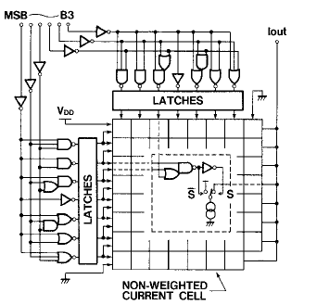
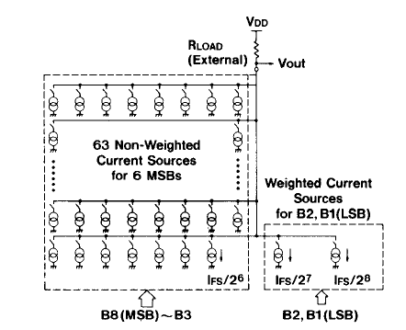
Example of current source based DAC
IEEEJOURNAL OF SOLID-STATECIRCUITS,VOL. SC-21,NO. 6,DECEM8ER 1986, An 80-MHz 8-bit CMOS D/A Converter; TAKAHIRO MIKI, YASUYUKI NAKAMURA, MASAO NAKAYA, SOTOJU ASAI, YOICHI AKASAKA, ANDYASUTAKA HORIBA
Distributed decoder

Slide 26
Example #2: DAC0800: Binary weighted currents generated trough R-2R resistive ladder

Slide 27
Charge redistribution DAC
The component dispersion increases exponentially with the resolution.
The reference voltage value can change with the input code, due to memory effects in the non-ideal reference voltage.

Slide 28
Charge redistribution DAC calculation
During phase 1 the capacitors are charged with the reference voltage multiplied by the digital code
During phase 2 the capacitors are redistribute the charge, causing V_{out} to be set to the correct voltage

Slide 29
Hybrid structure DAC
The component dispersion increases is reduced due to the segmentation.
There is added risk for memory effects.

