Slide 1

Note: The data and information in this document is reflective of a hypothetical situation and client. This document is to be used for KPMG Virtual Internship purposes only.
Sprocket Central Pty Ltd
Data analytics approach
[Division Name] - [Engagement Manager], [Senior Consultant], [Junior Consultant]

Slide 2
Note: The data and information in this document is reflective of a hypothetical situation and client. This document is to be used for KPMG Virtual Internship purposes only.
Agenda
Introduction
Data Exploration
Model Development
Interpretation
Appendix
Area of Growth
Area of Focus
Summary

Slide 3
Note: The data and information in this document is reflective of a hypothetical situation and client. This document is to be used for KPMG Virtual Internship purposes only.
Introduction
Target customers for Annual Revenue Growth.
We will discuss the methodologies being used to target 1000 customers for the company’s benefit based on the datasets provided which includes Transactions, Customers Demography and Customer address. .

Slide 4
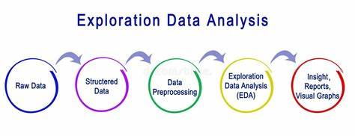
Note: The data and information in this document is reflective of a hypothetical situation and client. This document is to be used for KPMG Virtual Internship purposes only.
Data Exploration
Data preprocessing, Descriptive statistics, Data visualization, Correlation analysis, Exploratory data analysis.
Cleaning the data by handling missing values, removing duplicates, calculating summary statistics, creating charts, graphs, and plots to visualize the data, identify patterns, and uncover insights. Examining the relationships between variables using statistical methods. Conducting in-depth analysis and hypothesis testing to uncover trends, patterns, and relationships within the data.

Slide 5
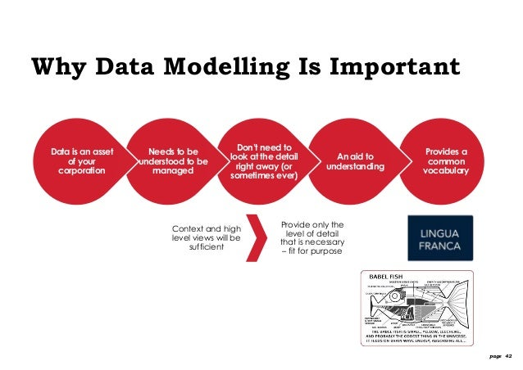
Note: The data and information in this document is reflective of a hypothetical situation and client. This document is to be used for KPMG Virtual Internship purposes only.
Model Development
Feature engineering, Model Selection, Model Training, Model Evaluation, Model Tuning.
Selecting relevant features from the dataset and creating new features that can improve the model's performance. Choosing an appropriate modeling technique, splitting the dataset into training and validation sets and training the model. Assessing the performance of the trained model on the validation set and exploring different algorithms to optimize the model's performance.
Place any supporting images, graphs, data or extra text here.

Slide 6
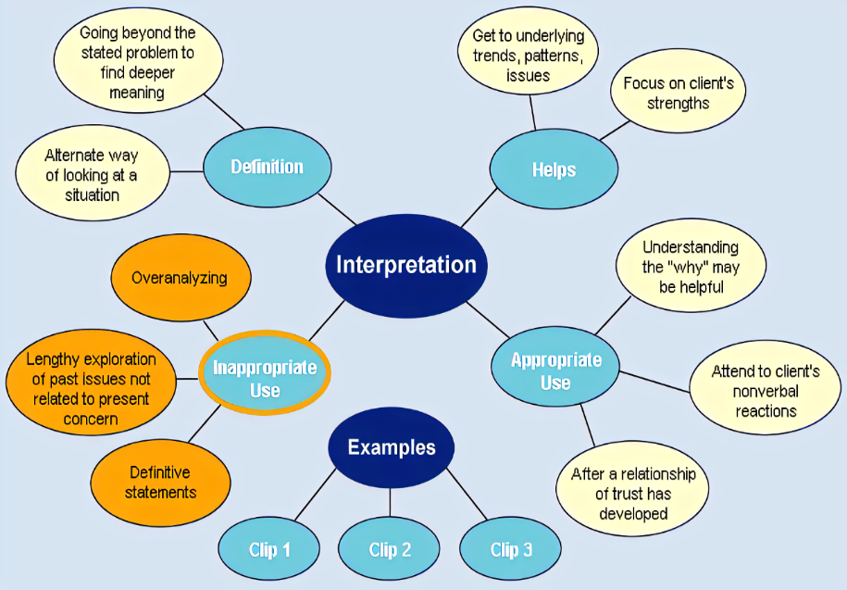
Note: The data and information in this document is reflective of a hypothetical situation and client. This document is to be used for KPMG Virtual Internship purposes only.
Interpretation
Model evaluation, Feature importance analysis, Prediction analysis, Business impact analysis, Communication of findings.
Assessing the model's performance on a test dataset to ensure its generalizability and reliability. Identifying the most influential features in the model and interpreting predictions to gain insights into the underlying factors that contribute to certain outcomes. Presenting the findings and insights to decision-makers in a clear and actionable manner, using visualizations, reports, or presentations.
Place any supporting images, graphs, data or extra text here.

Slide 7
Note: The data and information in this document is reflective of a hypothetical situation and client. This document is to be used for KPMG Virtual Internship purposes only.
Appendix

Slide 8
Note: The data and inforrmation in this document is reflective of a hypothetical situation and client. This document is to be used for KPMG Virtual Internship purposes only.
Appendix
Approach OF GROWTH
METHODS TO IDENTIFY POTENTIAL CUSTOMERS
SHEET NAME | APPROACH | SIGNIFICANCE
Transactions | Analyse the customer_ID, Brand, Month wise profit and Order Status. | To calculate the maximum Profit obtained from these sources.
NewCustomerList | Analyse past_3_years_bike_related_purchase, Age(DOB) and wealth segment. | To identify customers based on their wealth and purchases. This will also make the company aware of the age group of customers making maximum purchase.
CustomerAddress | Analyse the state and customer_ID. | This will let us know from which state company is making maximum profit.

Slide 9
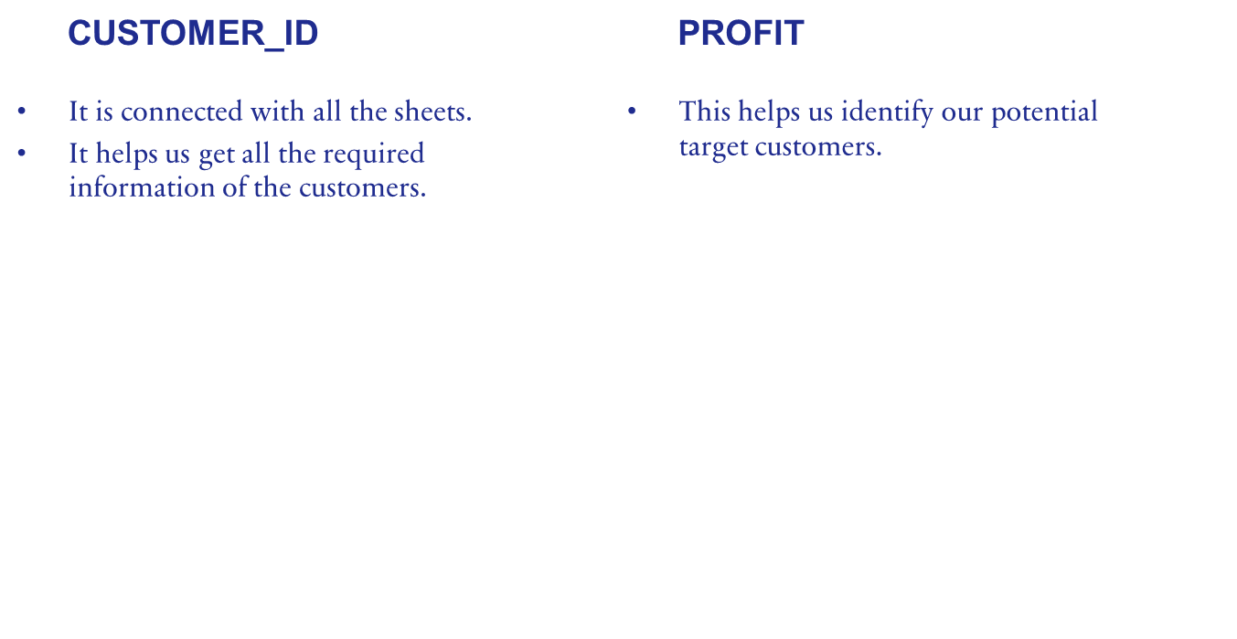
Note: The data and information in this document is reflective of a hypothetical situation and client. This document is to be used for KPMG Virtual Internship purposes only.
AREAS OF FOCUS

Slide 10
Note: The data and information in this document is reflective of a hypothetical situation and client. This document is to be used for KPMG Virtual Internship purposes only.
Note: The data and information in this document is reflective of a hypothetical situation and client. This document is to be used for KPMG Virtual Internship purposes only.
Summary
We will identify the 1000 potential customers based on customer_id’s, which states they belong , which age group they belong mostly, their previous bike purchase, their gender and brand.
Now if we give them offers, they will show interest in buying more items from Sprocket Central Pty Ltd and the company will reach more heights which will lead to annual revenue growth.

