Slide 1
Group 1
Declan Young, Devin Seay, Saif Karim

Slide 2
Dataset: Student Alcohol Consumption
Our chosen dataset examines over 200 students enrolled in a math course at a University in Portugal . Within our dataset is a number of social, gender, and class variables with information that provide insight into the lives of these students. By examining this dataset we can explore the relationship between factors such as alcohol consumption, gender, age, romantic relationships, activites, absences, and even what your environment/family is like in order to gauge how each of these environmental factors can affect performance in school.
Key Variables: Failure, Age, Goout, Romantic, Study Time, Internet, Sex, Higher, G3
Notes:
Saif -Our chosen dataset examines over 200 students enrolled in a math course at a University in Portugal . Within our dataset is a number of social, gender, and class variables with information that provide insight into the lives of these students. By examining this dataset we can explore the relationship between factors such as alcohol consumption, gender, age, romantic relationships, activites, absences, and even what your environment/family is like in order to gauge how each of these environmental factors can affect performance in school.
The key variables within our dataset are- the number of past class failures (failure), the student’s age (age), going out with friends (goout-on a scale of 1-5), in a romantic relationship (romantic), weekly study time (study time), internet access at home (internet), student’s sex (sex), and whether or not they wanted to pursue higher education (higher). While there were 33 variables examined in the study including those calculating the student’s grades throughout the semester, these eight variables were found to have the highest correlation to how well a student performed and are therefore our key variables.

Slide 3
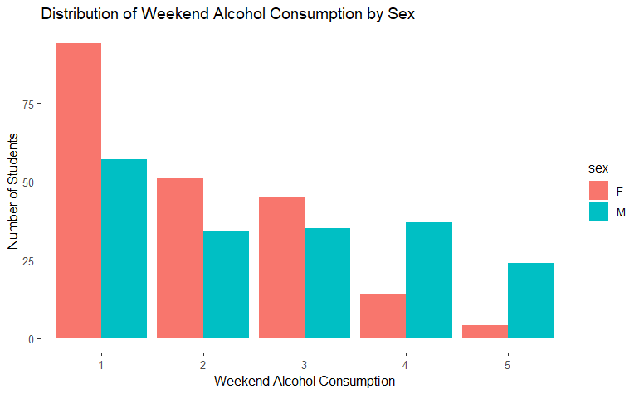
Question 2:
What is the distribution of students' weekend alcohol consumption by sex?
The number of students will taper off as the alcohol consumption level increases at similar proportions for both males and females.

Slide 4
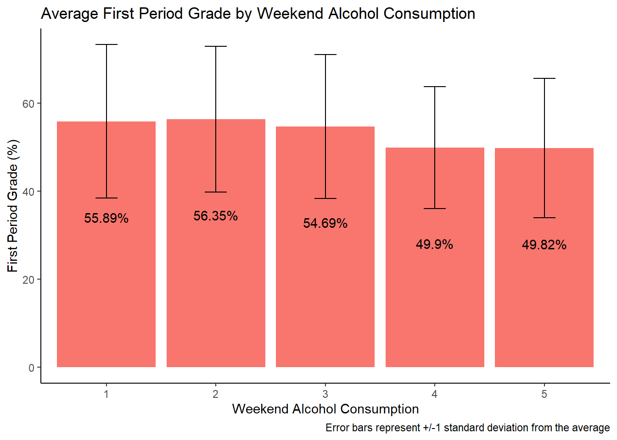
Question 1: Does the level of weekend alcohol consumption in students relate to their first period grades?
Hypothesis: If a student consumes more alcohol then we expect their grade marks to be lower

Slide 5
Questions?

