Slide 1
Random Quote website
Keep calm and Code HTML
- Krish

Slide 2
Task :
Fulfill the below user stories. Use which ever libraries or Api you need. Give it your own personal style
User Story:
i) I can click on a button to get the new Random Quote
3)When ever a button is clicked New Random Quote must display om the website(with out page loading) along with background color and text color need to be changed.

Slide 3
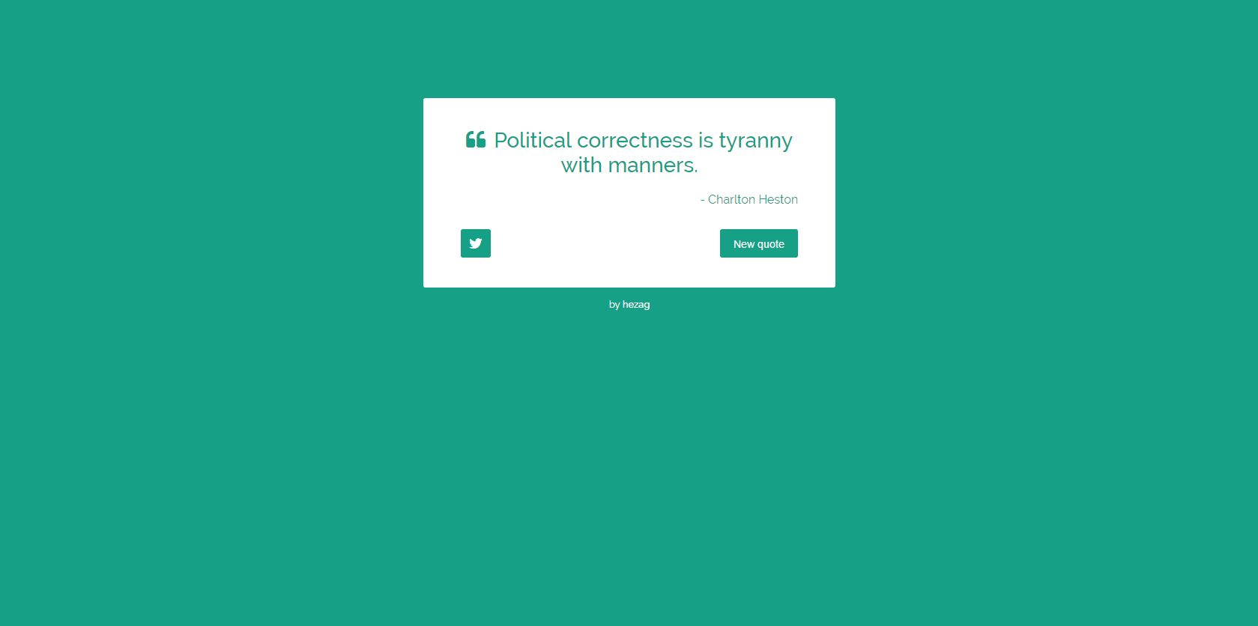
UI DESIGN

Slide 4
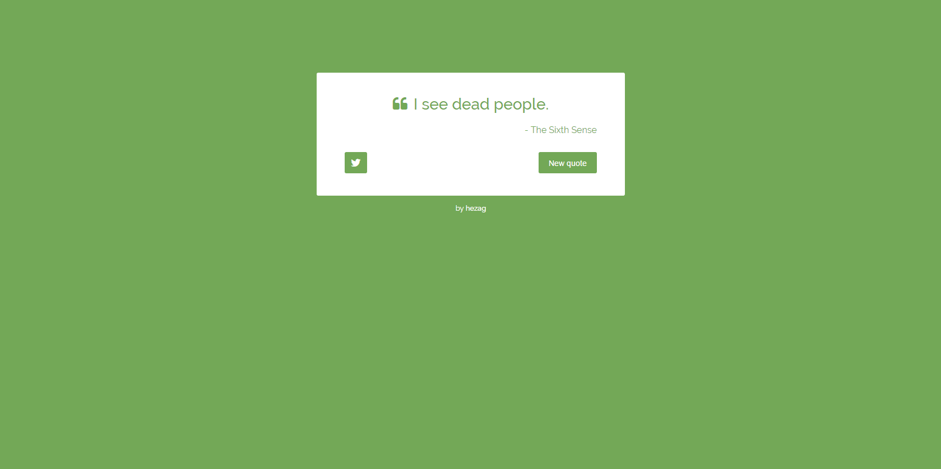
If we click on the New Quote in previous page a new quote must come and color must change

Slide 5
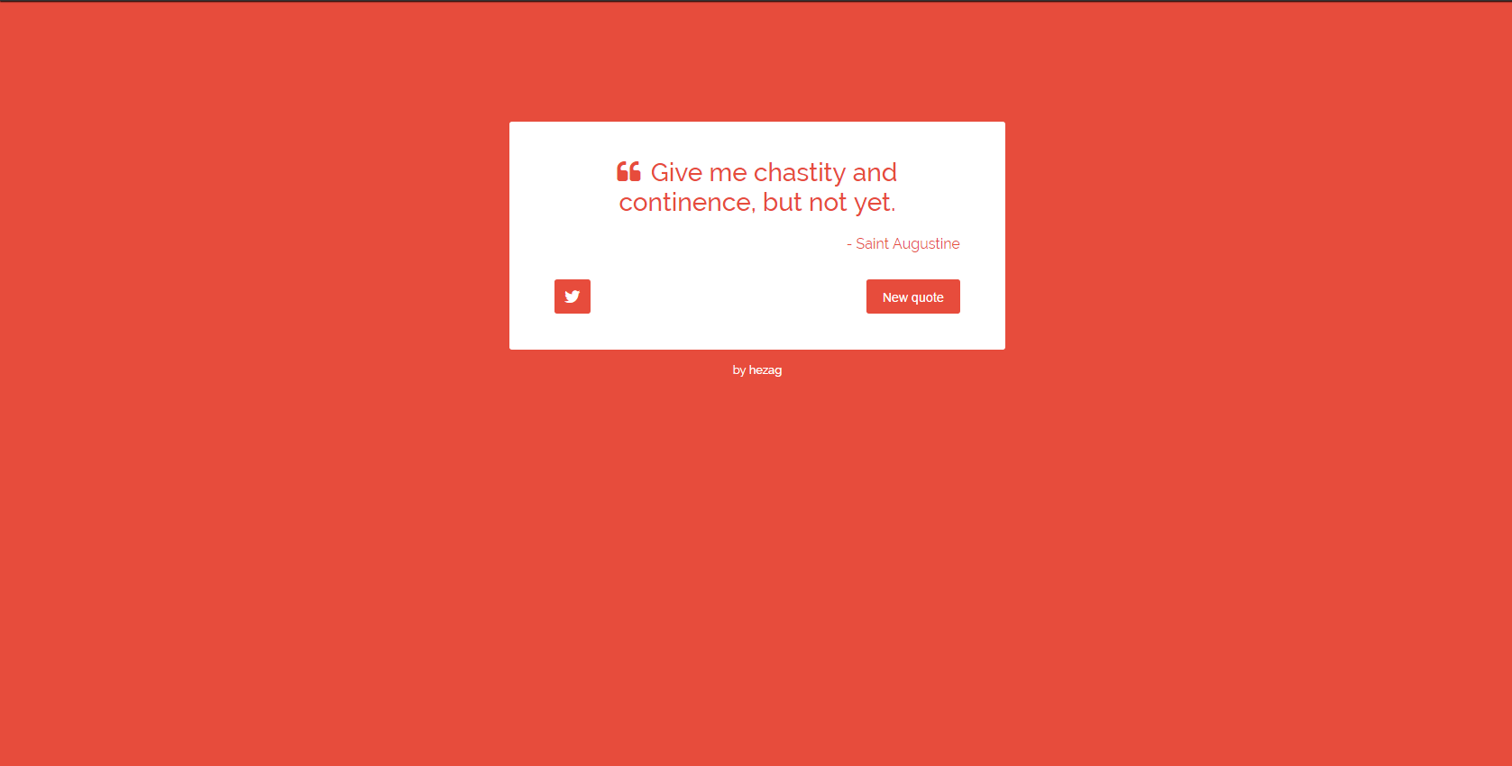
And then Next page

Slide 6
Observe the changes
Observe the changes in Screenshots carefully
The length of the Quote block must be changed based on the Quote size
Page should not reload to get the new Quote

Slide 7
Any Queries ☹
Contact Me if any Queries
Submission Last date : 15-03-2017 11:59 PM

