Slide 1
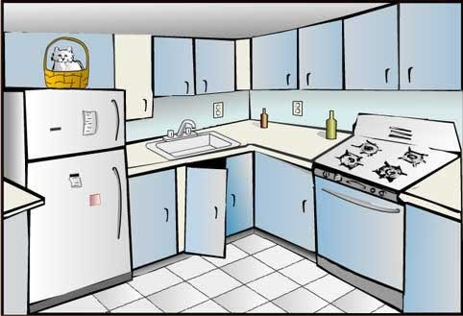
Kitchen
A Basic View of a Kitchen with Stove and other utile inside the kitchen with dynamic updates and instructiveness.

Slide 2
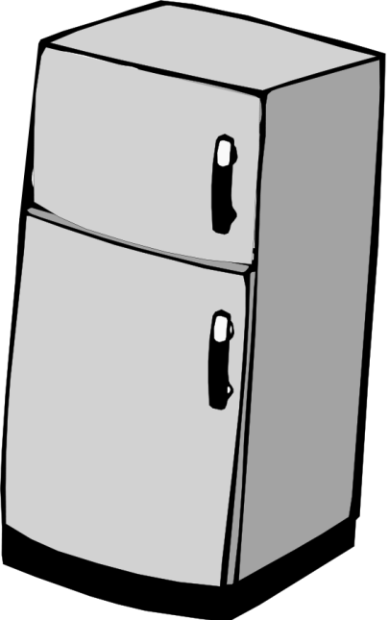
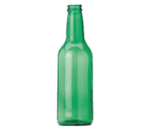


Basic Structure of Kitchen

Slide 3
Functionalities of Kitchen
All the knobs in the kitchen should open the door for 5seconds and should close automatically.
The stove switch on and switch off should lit the flames on and off.
The complete structure should be more 3Dimentional .

