Slide 1
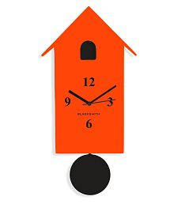
Wall Clock
A sample Wall Clock web page which is going to adjust itself to the current time and has a pendulum.

Slide 2

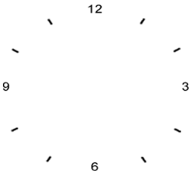
The Basic Structure of Wall Clock

Slide 3
Features of the Wall Clock
Get the dynamic clock timings and pendulum working.
Match the time with current time instance.

