Slide 1

GEOLOGI
AIR TANAH
Penulis: Dasapta Erwin Irawan dan Deny Juanda Puradimaja
Lisensi bebas pakai (CC-BY)

Slide 2
Minggu ke-10
Reference:
Geological structures materials
Weight & Sonderegger, 2007, Manual of Applied Field Hydrogeology, McGraw-Hill online books
Mandel & Shiftan, 1981, Groundwater Resources: Investigation and Development, Academic Press

Slide 3
Materi perkuliahan (format PDF)
sudah dapat di download
di situs KK Geologi Terapan
www.appliedgeology.itb.ac.id
TIPOLOGI
SISTEM AKIFER

Slide 4
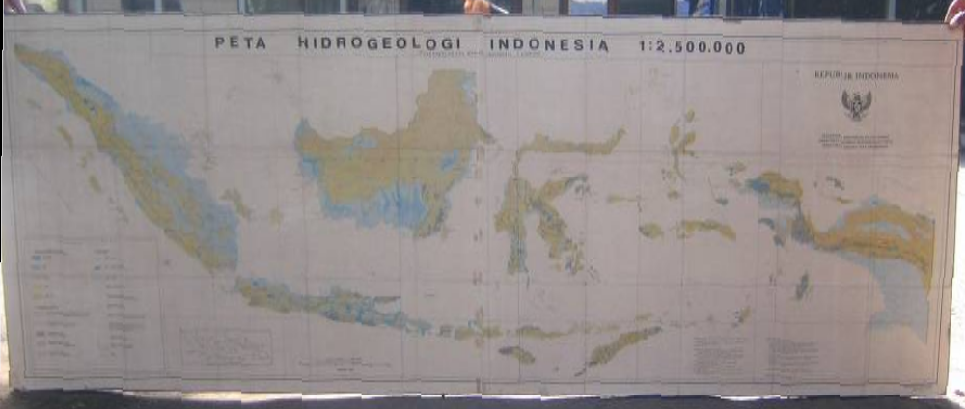
PETA HIDROGEOLOGI INDONESIA SKALA 1 : 2.500.000
Couse note for ITB student. Permission for other uses to Prof. Deny Juanda Puradimaja

Slide 5
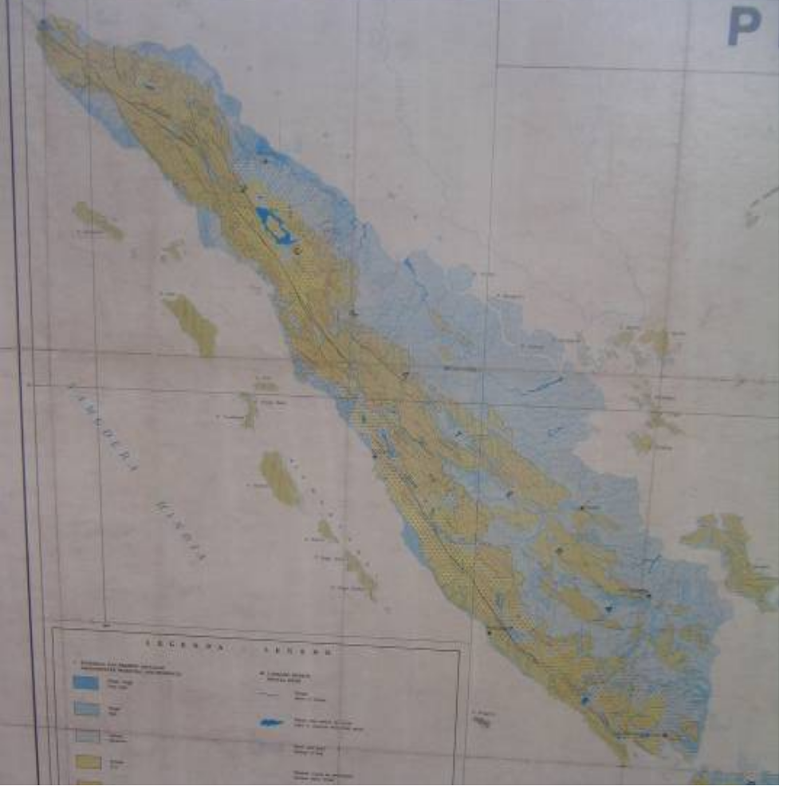
PETA HIDROGEOLOGI
PULAU SUMATERA
Couse note for ITB student. Permission for other uses to Prof. Deny Juanda Puradimaja

Slide 6
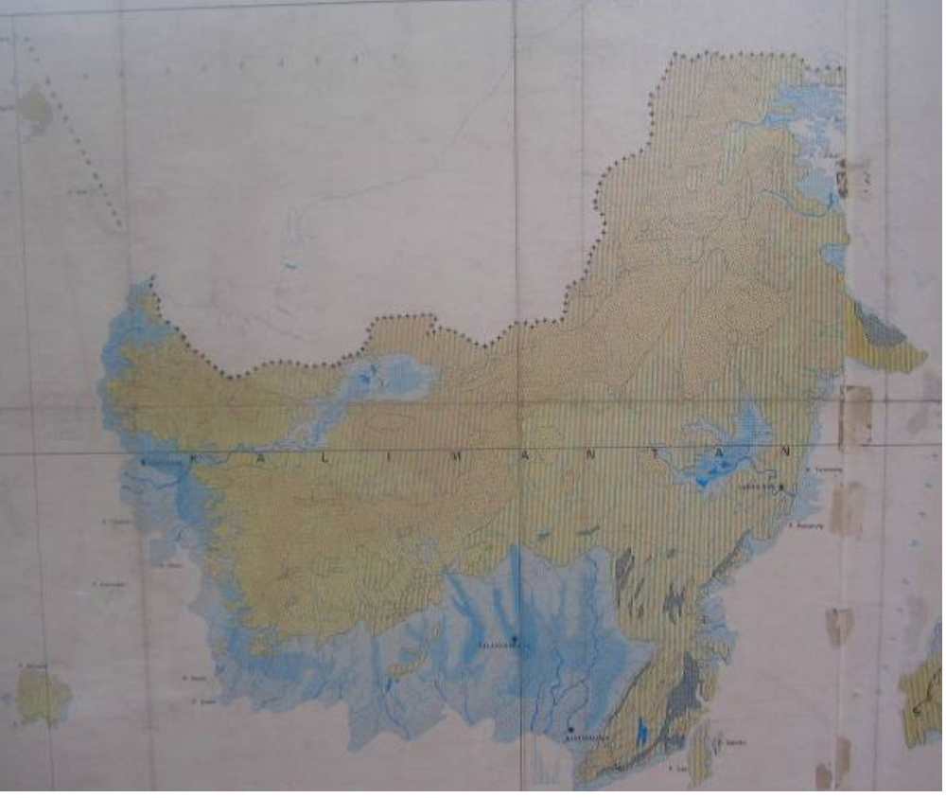
PETA HIDROGEOLOGI
PULAU KALIMANTAN
Couse note for ITB student. Permission for other uses to Prof. Deny Juanda Puradimaja

Slide 7
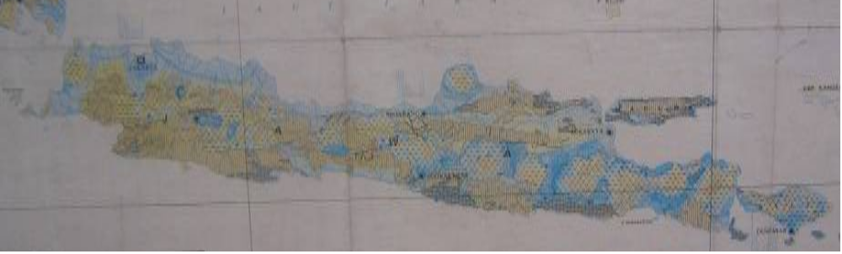
PETA HIDROGEOLOGI
PULAU JAWA
Couse note for ITB student. Permission for other uses to Prof. Deny Juanda Puradimaja

Slide 8
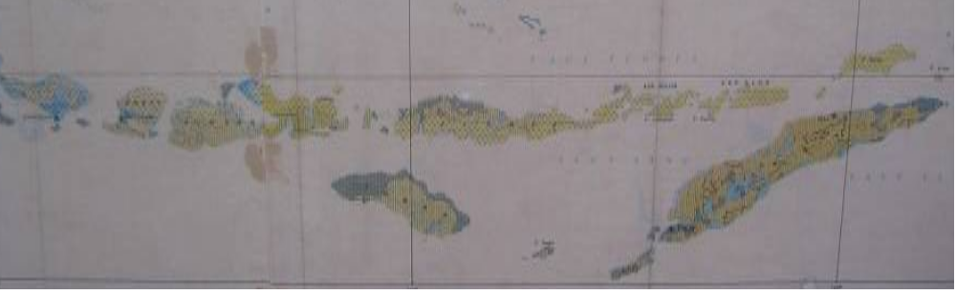
PETA HIDROGEOLOGI
PULAU BALI & NUSA TENGGARA
Couse note for ITB student. Permission for other uses to Prof. Deny Juanda Puradimaja

Slide 9
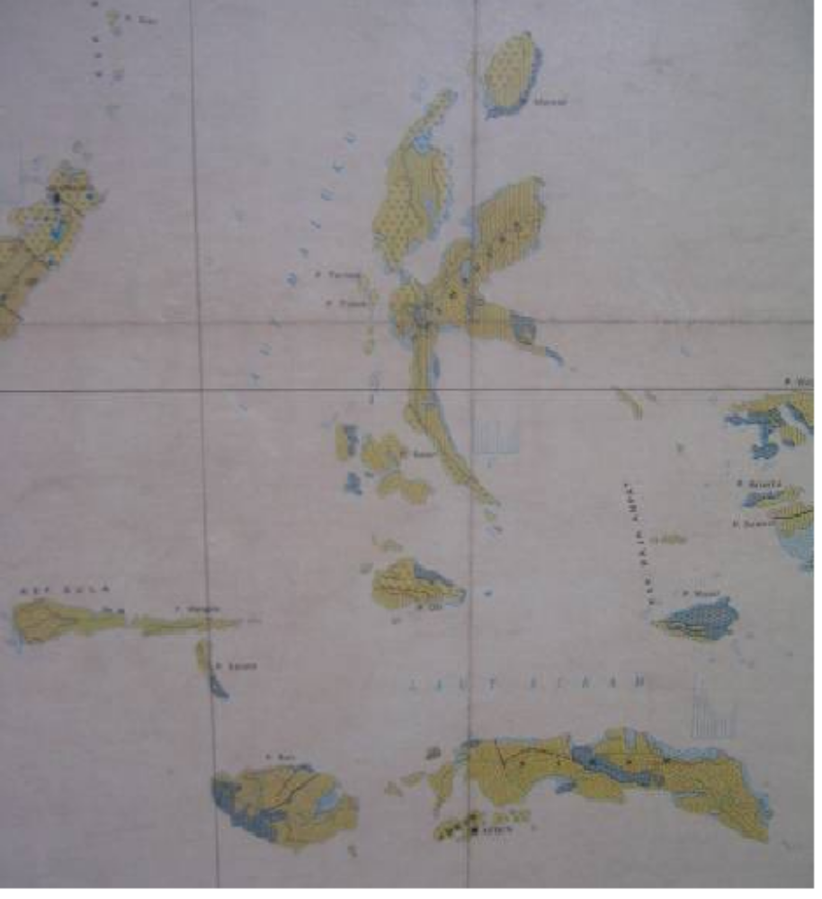
PETA HIDROGEOLOGI
PULAU AMBON
Couse note for ITB student. Permission for other uses to Prof. Deny Juanda Puradimaja

Slide 10
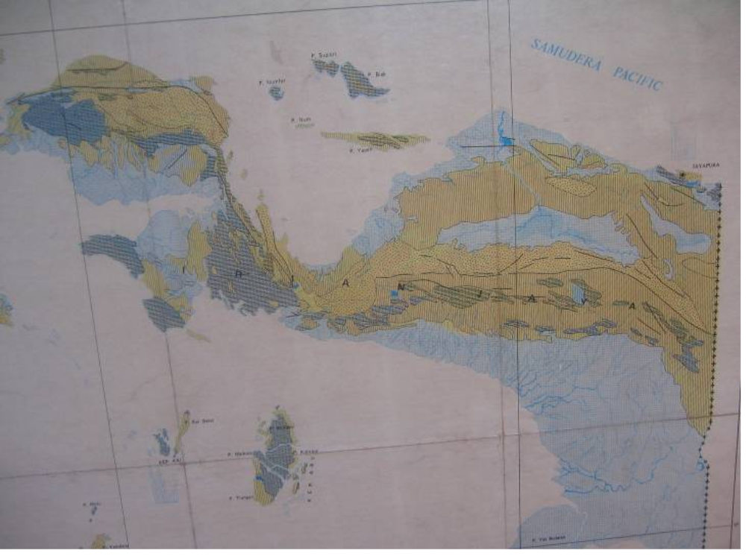
PETA HIDROGEOLOGI
PULAU IRIAN JAYA
Couse note for ITB student. Permission for other uses to Prof. Deny Juanda Puradimaja

Slide 11
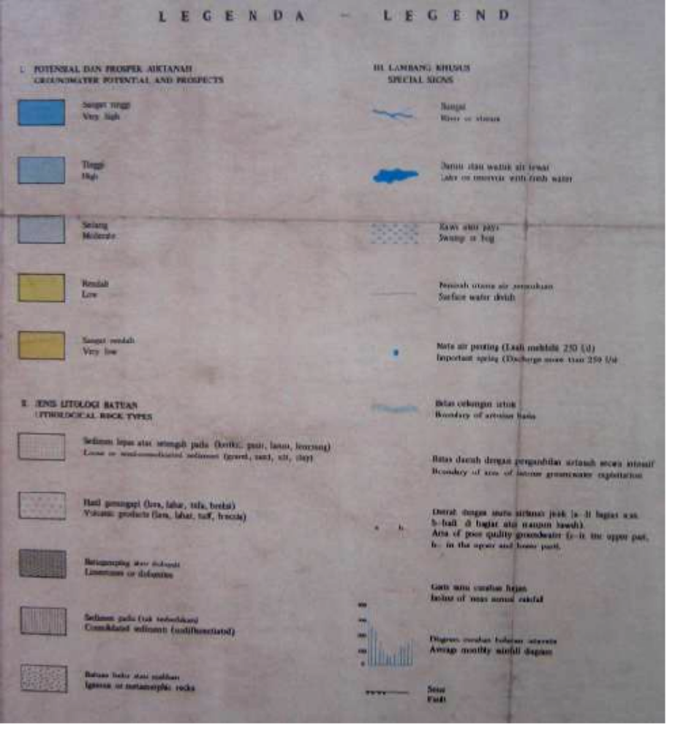
LEGENDA
Couse note for ITB student. Permission for other uses to Prof. Deny Juanda Puradimaja

Slide 12
TERIMAKASIH

