Slide 1

GEOLOGI
AIR TANAH
Penulis: Dasapta Erwin Irawan dan Deny Juanda Puradimaja
Lisensi bebas pakai (CC-BY)

Slide 2
Minggu ke-2
Geologi: Petrologi, Sedimentologi, Struktur
(Geology: Petrology, Sedimentology, Structure)‏
Reference:
Basic geology materials
Weight & Sonderegger, 2007, Manual of Applied Field Hydrogeology, McGraw-Hill online books
Mandel & Shiftan, 1981, Groundwater Resources: Investigation and Development, Academic Press

Slide 3
Buku-buku referensi yang diperlukan (diantaranya)
Thompson and Turk, 2003, Introduction to physical geology.
Mandel and Shiftan, 1981, Groundwater Resources: Development and Management, Academic Press.
Weight and Sonderegger, 2007, Manual of Applied Field Hydrogeology, McGraw-Hill.
Buku-buku yg terkait dengan Physical Geology, Basic Geology, Introduction of Geology, Structural Geology

Slide 4
Tujuan, untuk memahami
Definisi geologi
Definisi hidrogeologi
Peran geologi dalam analisis hidrogeologi

Slide 5
Geologi
Definisi: ilmu yang mempelajari bumi (batuan):
  Asal mula (sejarah)
  Material
  Proses

Slide 6
Hidrogeologi
Definisi: ilmu yang mempelajari air tanah (zona jenuh):
  Padatan
    Akuifer/akuitar/akuiklud/akuifug
    Tertekan/tak tertekan
    Syarat batas
  Fluida
    Asal mula
    Aliran dan proses
    Neraca

Slide 7
Peran geologi
Padatan
  Akuifer/akuitar/akuiklud/akuifug = petrologi
  Tertekan/tak tertekan = sedimentologi/stratigrafi
  Syarat batas = struktur geologi
Fluida
  Asal mula
  Aliran dan proses
  Neraca

Slide 8
Terminologi
Inggris
Hidrogeology
Groundwater geology
Geohydrology
Groundwater hydrology
Subsurface hydrology
Indonesia
Hidrogeologi
Geologi air tanah
Geohidrologi
Hidrologi air tanah
Hidrologi bawah permukaan

Slide 9
Beberapa Definisi
Study of Surface water
Study of Subsurface water
Sumber
Hydrography and hydrometry
Hydrology
De Wiest (1965)‏
Surface hydrology
Geohydrology (subterranean hydrology) =
Meinzer (1939)‏
Hydrogeology = study of the laws of the occurrence and movement of subterranean waters.
Mead (1919) in Davis and De Wiest (1966)‏
Hydrogeology (general terms), Hydrogéologie (Belgia, Perancis)‏
Hidrogeologia (Amerika Latin) = study of groundwater with particular emphasis given to its chemistry, mode of migration, and relation to the geological environment
De Wiest (1965)‏

Slide 10
Weight & Sonderegger, 2007, Manual of Applied Field Hydrogeology, McGraw-Hill online books
Prinsip-prinsip hidrogeologi
  Memberi solusi
  Ketidakpastian tinggi (error level ???)
  Bawah permukaan = kompleks
Notes:
Hydrogeological principles are applied to solve problems that always have a degree of uncertainty. The reason is that one can know exactly what is occurring in the subsurface.
… A hydrogeologist must have a background in all aspects of the hydrologic cycle. They are concerned withy precipitation, evaporation, surface water, and groundwater….
… Hydrogeologists may also have some area of specialization, such as the vadose zone, computer mapping, well hydraulics, public water supply, underground storage tanks, source-water protection areas, and surface-water groundwater interaction….

Slide 11
Weight & Sonderegger, 2007, Manual of Applied Field Hydrogeology, McGraw-Hill online books
Ahli hidrogeologi harus paham
  Geologi
  Siklus hidrologi
    Hujan
    Evaporasi
    Air permukaan
    Air tanah
  Proses-proses dalam air
    Apa saja?
Notes:
Hydrogeological principles are applied to solve problems that always have a degree of uncertainty. The reason is that one can know exactly what is occurring in the subsurface.
… A hydrogeologist must have a background in all aspects of the hydrologic cycle. They are concerned withy precipitation, evaporation, surface water, and groundwater….
… Hydrogeologists may also have some area of specialization, such as the vadose zone, computer mapping, well hydraulics, public water supply, underground storage tanks, source-water protection areas, and surface-water groundwater interaction….

Slide 12
Weight & Sonderegger, 2007, Manual of Applied Field Hydrogeology, McGraw-Hill online books
Spesialisasi
  Penyediaan air
  Pemodelan dan simulasi
  Hidrolika sumur
  Polusi
  Mata air
  Hidrokimia
  Hidroisotop
  Eksplorasi
    Migas
    Geotermal
    CBM
  dll
Notes:
Hydrogeological principles are applied to solve problems that always have a degree of uncertainty. The reason is that one can know exactly what is occurring in the subsurface.
… A hydrogeologist must have a background in all aspects of the hydrologic cycle. They are concerned withy precipitation, evaporation, surface water, and groundwater….
… Hydrogeologists may also have some area of specialization, such as the vadose zone, computer mapping, well hydraulics, public water supply, underground storage tanks, source-water protection areas, and surface-water groundwater interaction….

Slide 13
Berbagai Bidang Kajian Hidrogeologi
Bidang
Contoh Kajian
Penyediaan air bersih
Eksplorasi airtanah untuk penyediaan air bersih
Perencanaan wilayah
Survei potensi airtanah di kawasan binaan
Pencemaran airtanah
Pencemaran limbah industri
Masalah geologi teknik
Tanah longsor dan penurunan permukaan tanah
Eksplorasi hidrokarbon
hidrodinamika airtanah untuk melacak migrasi minyak
Eksplorasi endapan mineral
Alterasi Hidrotermal
Energi panas bumi
Aliran airtanah di kawasan lapangan panas bumi
Intrusi air laut
Survei salinitas dalam airtanah

Slide 14
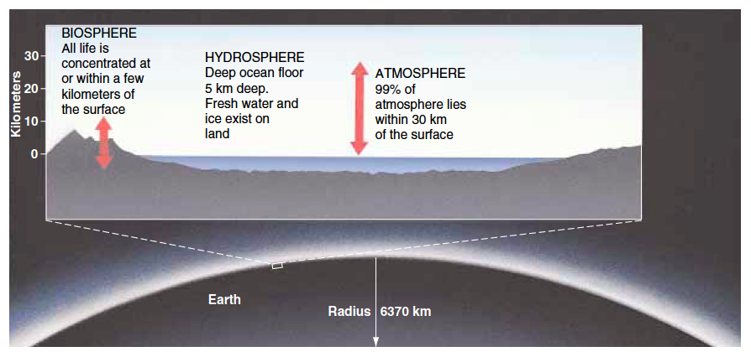
Sistem bumi: obyek
Thompson and Turk (2003)

Slide 15
Sistem bumi: proses
Waktu
  Gradual
    contoh
  Katastrofik
Lokasinya
  Endogen
  Eksogen
Thompson and Turk (2003)

Slide 16
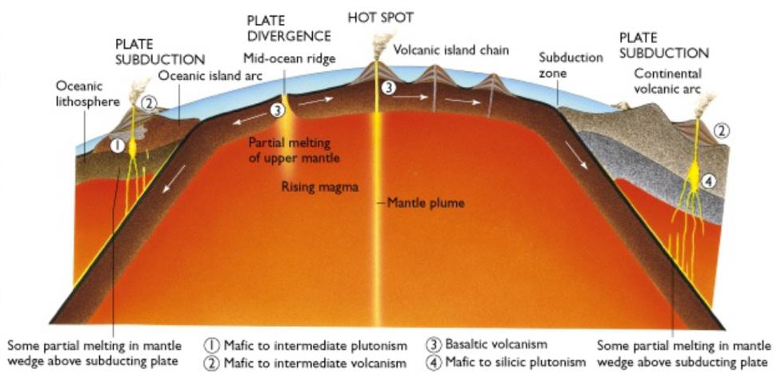

Slide 17
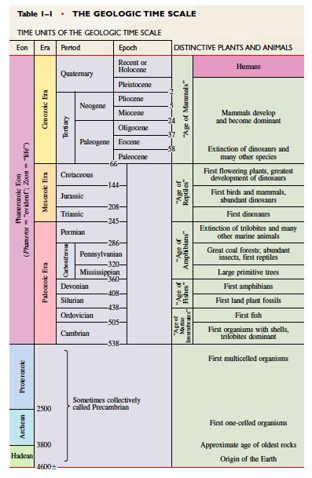
Sistem bumi: waktu
Thompson and Turk (2003)
catatan kuliah (untuk mahasiswa ITB), penggunaan untuk hal lain memerlukan izin dari penulisCouse note for ITB student. Permission for other uses to Prof. Deny Juanda Puradimaja

Slide 18
Prinsip dasar ilmu geologi:
  The present is the key to the past
  Hukum Steno
  Dll (sebutkan bila ada)

Slide 19
Umur geologi:
Biostratigrafi
Litostratigrafi
Kronostratigrafi
Dll (sebutkan bila ada)

Slide 20
Berbagai Bidang Kajian Hidrogeologi
Bidang
Contoh Kajian
Penyediaan air bersih
Eksplorasi airtanah untuk penyediaan air bersih
Perencanaan wilayah
Survei potensi airtanah di kawasan binaan
Pencemaran airtanah
Pencemaran limbah industri
Masalah geologi teknik
Tanah longsor dan penurunan permukaan tanah
Eksplorasi hidrokarbon
hidrodinamika airtanah untuk melacak migrasi minyak
Eksplorasi endapan mineral
Alterasi Hidrotermal
Energi panas bumi
Aliran airtanah di kawasan lapangan panas bumi
Intrusi air laut
Survei salinitas dalam airtanah

Slide 21
Major Rock Types
Igneous: Rocks formed from cooling magma or lava
Sedimentary: Rocks derived from other rock type sediments through the processes of erosion, sedimentation, lithification
Metamorphic: Rocks derived from other rock type through the processes of changing chemistry, mineralogy, and texture.

Slide 22
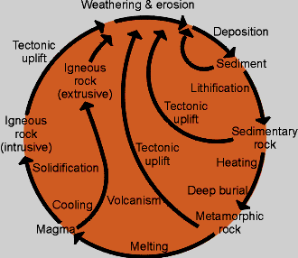
Rock Cycle

Slide 23
What are igneous rocks?
The term “igneous'' comes from the Latin word ignis or “fire''. Igneous rocks are rocks which form from cooling magma or lava.
Magma
Molten or partially molten rock material and dissolved gases.
Magma is molten rock beneath Earth's surface.
Lava
Molten or partially molten rock material and dissolved gases.
Lava is molten rock which has erupted at Earth's surface.

Slide 24
Classifying Igneous Rocks
Two main schemes are used in classifying igneous rocks: texture and chemistry.
Texture is an umbrella term which includes different aspects of how rocks look, such as:
The size of the mineral grains (crystals) which make up the igneous rock in question.
2. Whether or not the rock has holes, or vesicles, in it. A rock with lots of vesicles has a vesicular texture. Vesicles are signs of gas bubbles in the lava as it was erupting and cooling; some vesicular rocks actually float on water.
3. Whether the rock is formed from a coherent mass of mineral grains or from smaller chunks of igneous rock which have been cemented or welded together (a pyroclastic texture).

Slide 25
From their textures, and primarily, rocks can be classified as either intrusive or extrusive:
Intrusive
These rocks are made of big crystals, which indicates slow cooling. Intrusive rocks cool slowly because they solidify inside the Earth.
Extrusive
These rocks are made of small, microscopic, or even no crystals (in the case of obsidian), which indicates rapid cooling. Extrusive rocks cool rapidly because they solidify at Earth's surface.
Igneous rocks are also classified by their chemical compositions. There are four general types:
Felsic
High in silica (65% +). Usually light-colored. Examples: Rhyolite (extrusive) and granite (intrusive)‏
Intermediate
Lower silica content (55-65% or so). Darker than felsic, lighter than mafic.
Examples: Andesite/dacite (extrusive) and diorite/granodiorite (intrusive)‏
Mafic
Low silica content (45-55% or so). Usually dark-colored. Examples: Basalt (extrusive) and gabbro (intrusive)‏
Ultramafic
Extremely low silica content (less than 45%). Usually dark-colored, but high olivine content can lend green colors. Other rare colors can be found.

Slide 26
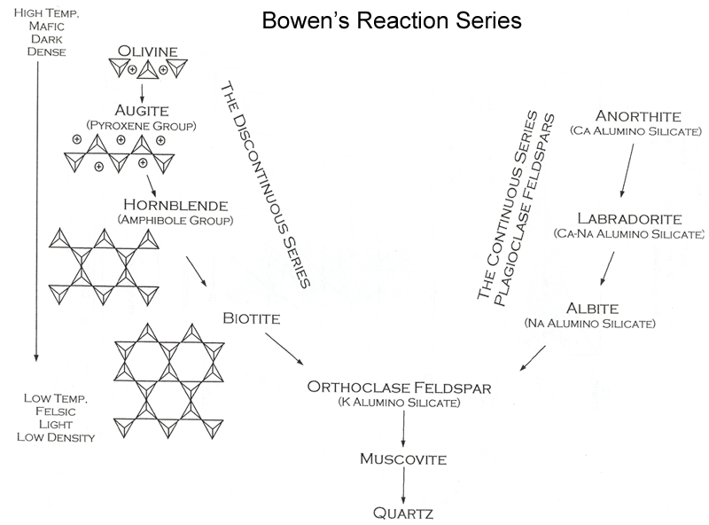

Slide 27
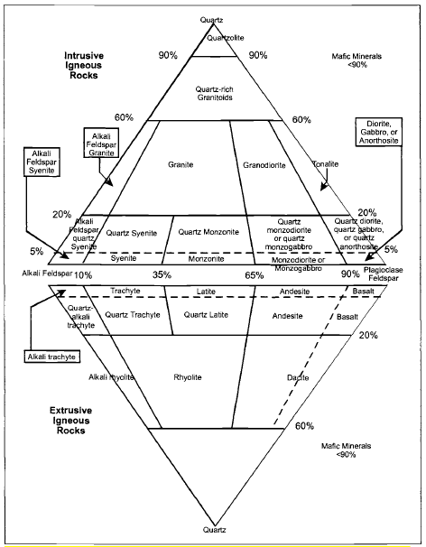
Classification of igneous rocks

Slide 28
Igneous Rock Description
What are the major rock characteristics that can be used to adequately describe a rock?
  Grain Type (i.e., mineral identification)
  Modal Abundance (i.e., volume percentages of the minerals which comprise the rock)
  Grain Size: aphanitic vs phaneritic; pegmatitic, coarse-, medium-, fine-grained, aplitic etc. equigranular vs inequigranular; seriate; porphyritic
  Grain Shape : euhedral ; subhedral; anhedral
  Grain Distribution: preferred alignments, fabrics
  Special features and textures: e.g., granophyric, orbicular etc.

Slide 29
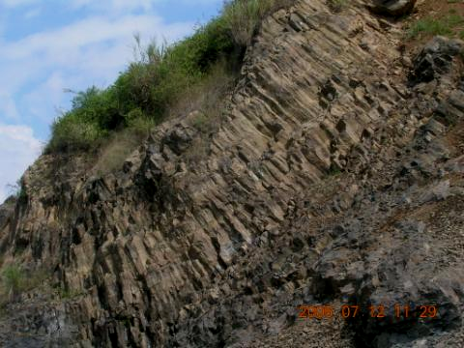
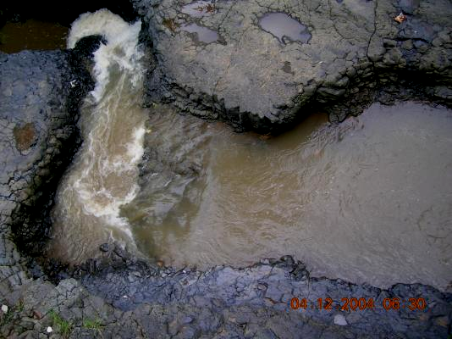
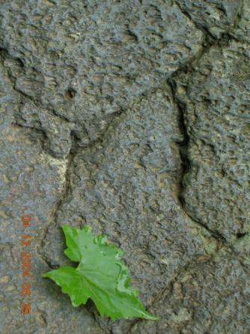
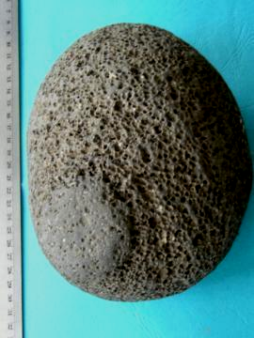
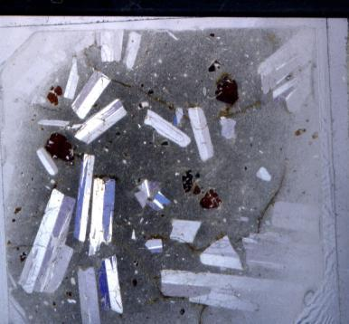
Igneous rocks are rocks which form from cooling magma or lava.
10mm

Slide 30
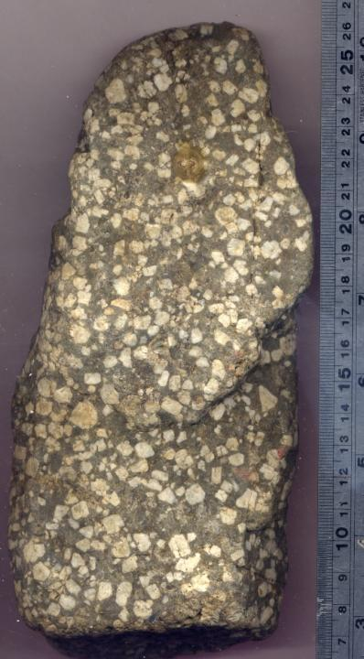
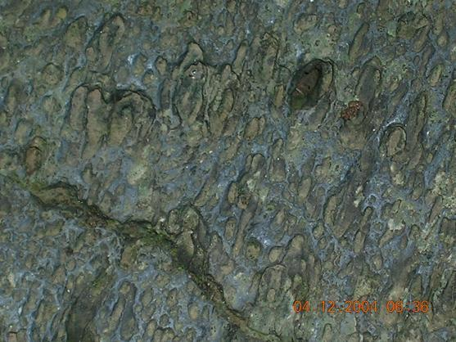
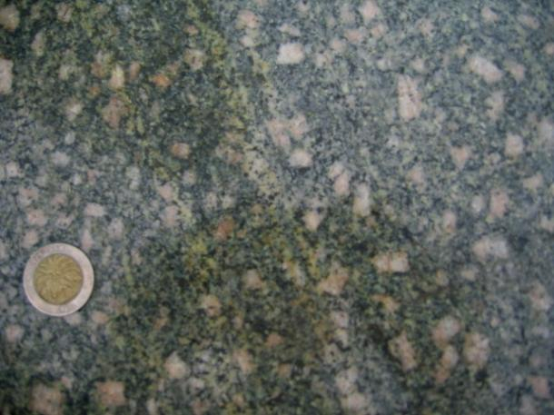
intermediate
mafic
felsic

Slide 31
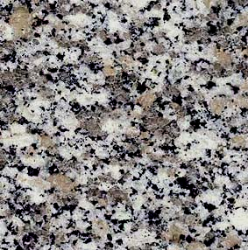
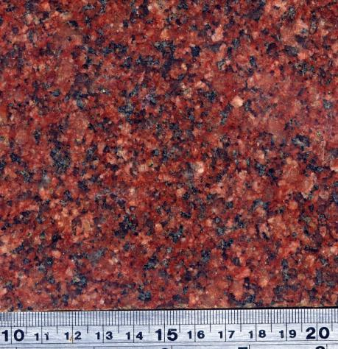
Na plagioclase feldspar (white)
K feldspar (pink, but may be white in other granites)
Quartz (gray)
Small amounts of biotite and/or amphibole (black)
and sometimes muscovite (not shown)

Slide 32
Porosity and permeability in igneous rocks
Soil (Weathered rock) form porous aquifer system.
Fresh rocks form fractured aquifer system:
  Breccia pipes from filling of gas vents
  Pumice layers from vesicular lava
  Surficial cooling cracks on basalt flow
  Columnar joints on lava flow

Slide 33
Infiltration rate of residual soil of volcanis rocks. Case study: Mt. Ciremai (Irawan, et.al, 2006)
Residual soil from lahar shows the largest values of 1.26 – 2.53 cm/min,
Residual soil from pyroclastic breccias 1.5 cm/min, and
Residual soil from lava flow 0.5 – 1.2 cm/min.

Slide 34
Fractures of volcanis rocks. Case study: Mt. Ciremai (Irawan, et.al, 2006)
Fracture zone controls the level of spring discharge. There are 2 genetic types of fractures:
a) Fractures on lava flow: The fractures are constituted of cooling joints which form narrow openings in rock. The pattern of the joints is unsystematic, with many orientations as follows: N63⁰E, N90⁰E, N117⁰E.
b) Fractures on laharic breccias: The fractures stretch continuously to rock distribution with fracture orientation of N93⁰E.

Slide 35
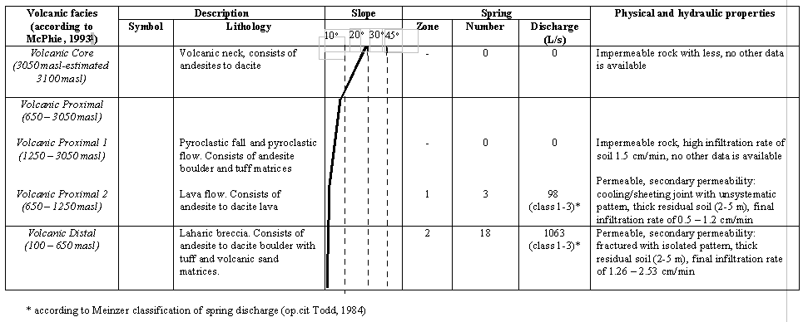
Summary of hydrogeological conditions.
Case study: Mt. Ciremai (Irawan, et.al, 2006)

Slide 36
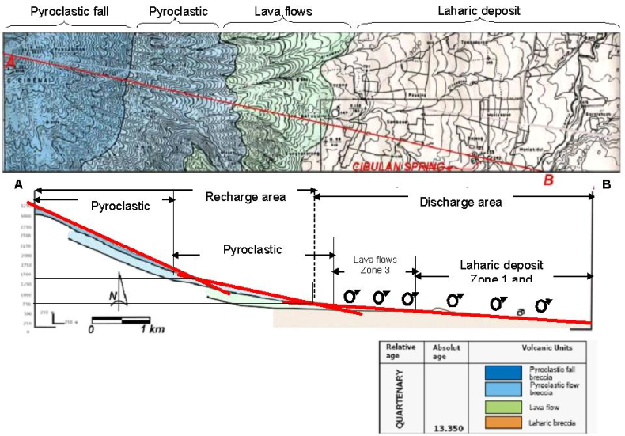
Sample of volcanic rocks cross section.
Case study: Mt. Ciremai (Irawan, et.al, 2006)

Slide 37
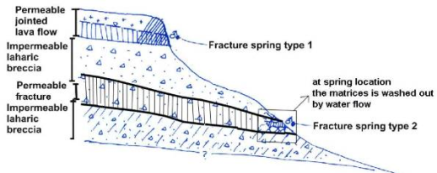
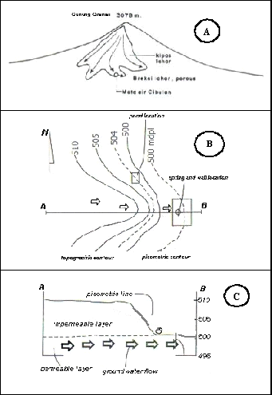
Sample of spring sections
Case study: Mt. Ciremai (Irawan, et.al, 2006)
Sample of spring sections
Case study: Mt. Ciremai (Irawan, et.al, 2006)

Slide 38
