Slide 1

GEOLOGI
AIR TANAH
Penulis: Dasapta Erwin Irawan dan Deny Juanda Puradimaja
Lisensi bebas pakai (CC-BY)

Slide 2
Minggu ke-3
Petrologi batuan sedimen dan metamorf
(Petrology of sedimentary and metamorphic rocks)‏
Reference:
Basic geology materials
Weight & Sonderegger, 2007, Manual of Applied Field Hydrogeology, McGraw-Hill online books
Mandel & Shiftan, 1981, Groundwater Resources: Investigation and Development, Academic Press

Slide 3
Sedimentary Rocks
Sediments are loose particles of former rocks; sediments form by weathering those previous rocks. Sediments can either be clastic particles (bits of rock ranging in size from mud grains to boulders) or material which was dissolved, then precipitated chemically or biochemically.
Sedimentary rocks come in two major classifications: clastic and chemical/biochemical. Clastic rocks are made from solid particles of previous rocks; examples of clastic rocks are sandstone, shale, and siltstones. Chemical/Biochemical rocks are made from sediments precipitated from water either chemically or biochemically; examples are limestone, chert, and rock salt.

Slide 4
GENESIS OF SEDIMENTARY ROCKS
1. Weathering
Material is worn off of existing rocks by wind, rain, and the like. The material can be either clastic particles or dissolved stuff.
2. Erosion
This weathered material is split away from the parent rock by mechanical and/or chemical means
3. Transport
The eroded material is moved downstream toward a lower elevation by wind, water, or ice.
4. Deposition
The material is deposited at another location.
5. Burial
If the sediment is left undisturbed long enough, and sedimentation continues, it will be buried by more sediment later. If this process continues for a long time and the sediments remain undisturbed, quite thick stacks of sediment can be built up.
6. Lithification
Through various physical and chemical means, sediments are hardened and turned into sedimentary rocks. We say the sediments have been lithified.

Slide 5
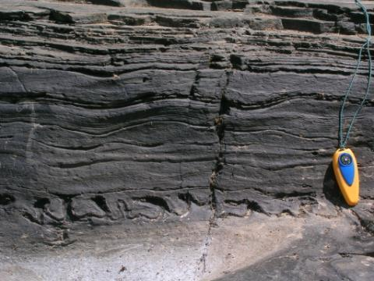
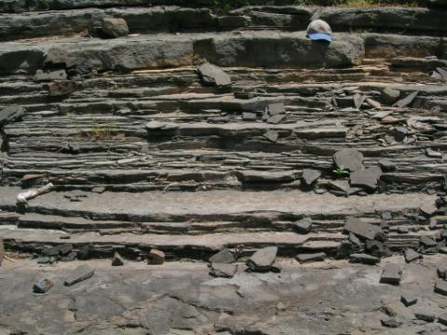
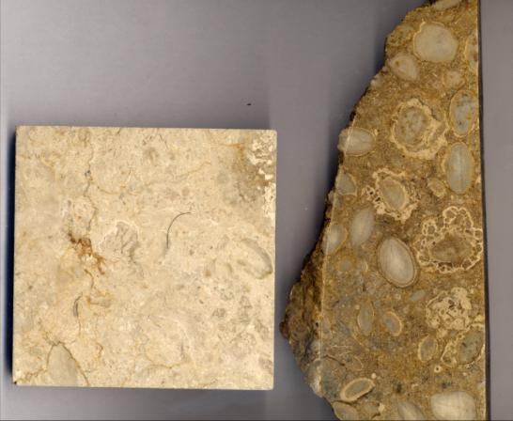
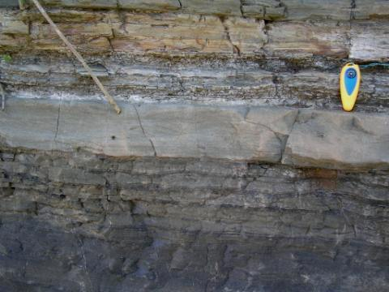

Slide 6
Metamorphic Rocks
Metamorphic rocks are formed when the mineralogy, and/or texture of previously-existing rocks are changed. The primary agents which change rocks are:
Heat (temperature)‏
Pressure (aka stress)‏
Fluids (hydrothermal)‏
There are many different kinds of metamorphism. A few of the more common are:
Regional
Caused by moderate-to-high pressures and/or temperatures over a large region; found in continent/continent collision zones, subduction zones, and such.
Contact
High temperature/low pressure environment found when an igneous body intrudes pre-existing rocks.
Hydrothermal
Changes caused by fluids circulating through rocks; found commonly at mid-ocean ridges. These occur in different pressure/temperature/fluid environments and over different length scales.

Slide 7
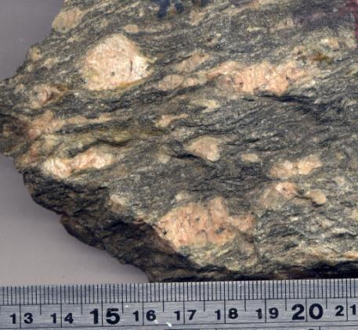
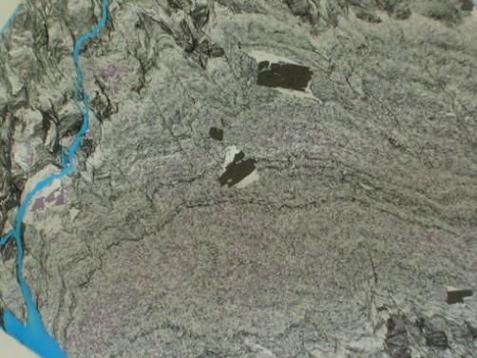
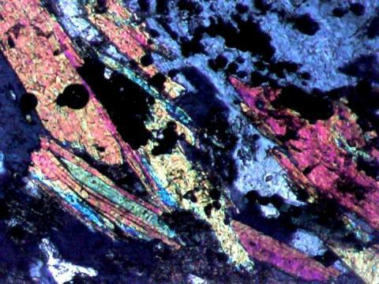
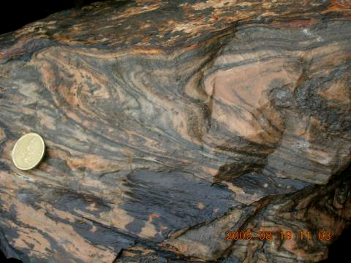

Slide 8
Definition
Hydrostratigraphy is the identification of mappable-units on the basis of hydraulic properties (aquifer / aquitard) that have considerable lateral extent and that also form a geologic framework for a reasonably distinct hydrogeologic system.
        MJR

Slide 9
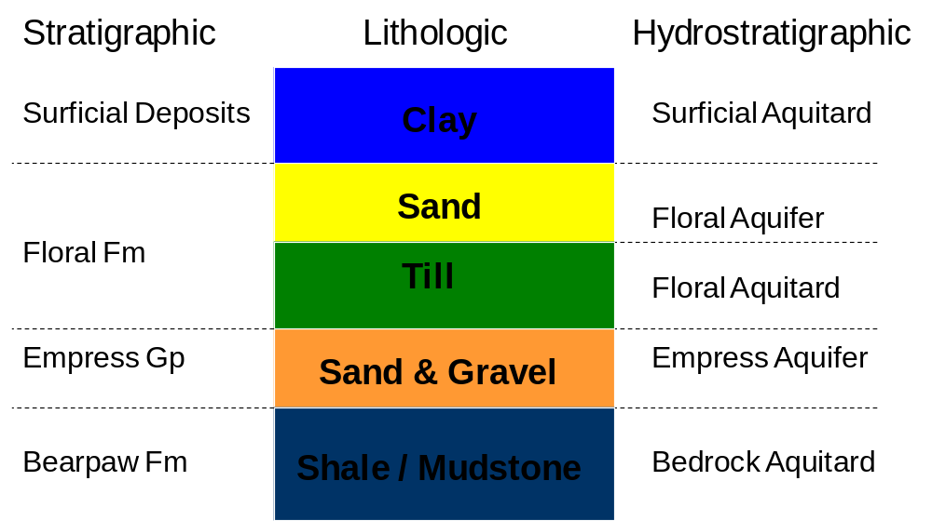
Hydrostratigraphy

Slide 10
Hydrostratigraphic Units
Unit #1: Isotropic Aquitard
Unit #2a: Anisotropic Aquitard K_{v}>>K_{h}
Unit #2b: Isotropic Aquitard
Unit #3: Isotropic Aquifer
Unit #4: Isotropic Aquitard
Unit #5a: Fractured Bedrock Aquifer
Unit #5b: Unfractured Bedrock Aquifer

