Slide 1
VISUALISASI POSISI RISET BEBERAPA PERGURUAN TINGGI DI INDONESIA
Berdasarkan Scopus, search affiliation, limit to 2019
Tanggal pengunduhan 25-26 Agt 2020
Dasapta Erwin Irawan

Slide 2
MAP TEXT DATA
Menggunakan Vosviewer
Create map based on text data > Title and abstract > Full counting > Min number of occurences (5) > Show all network

Slide 3
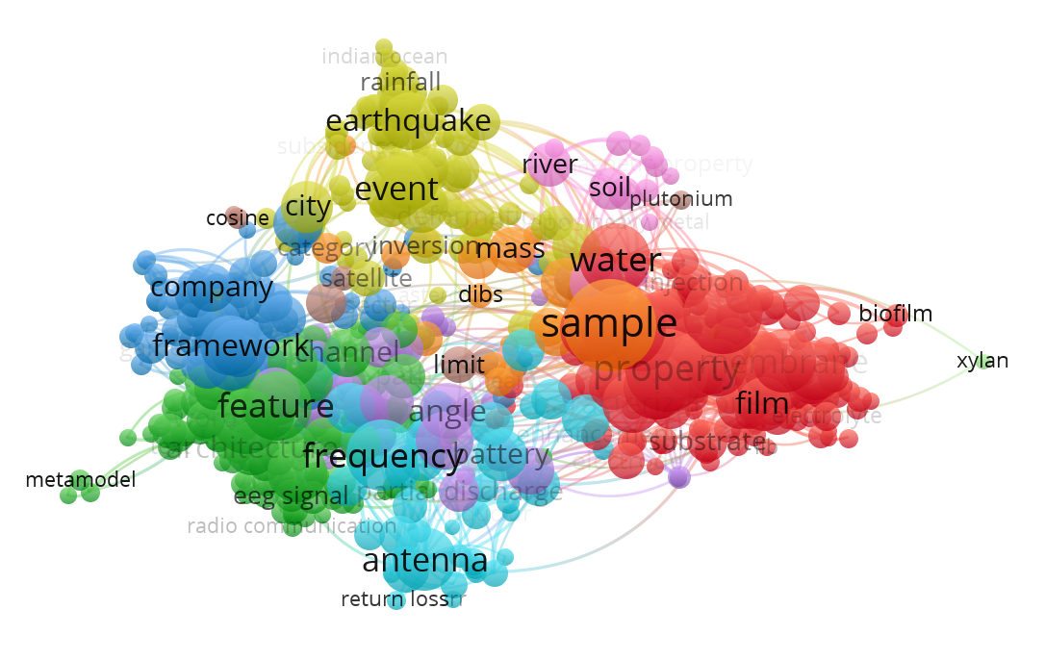
ITB

Slide 4
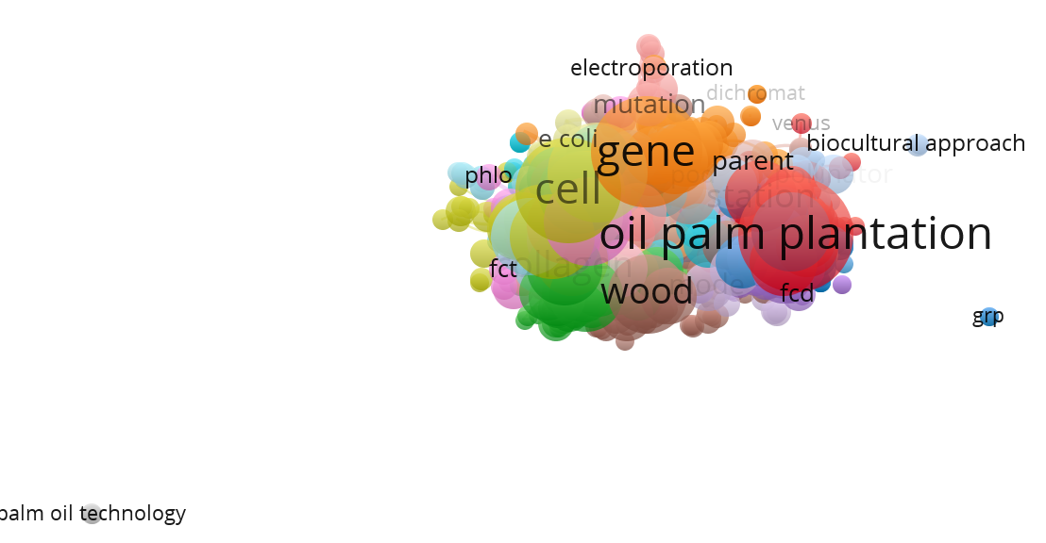
IPB

Slide 5
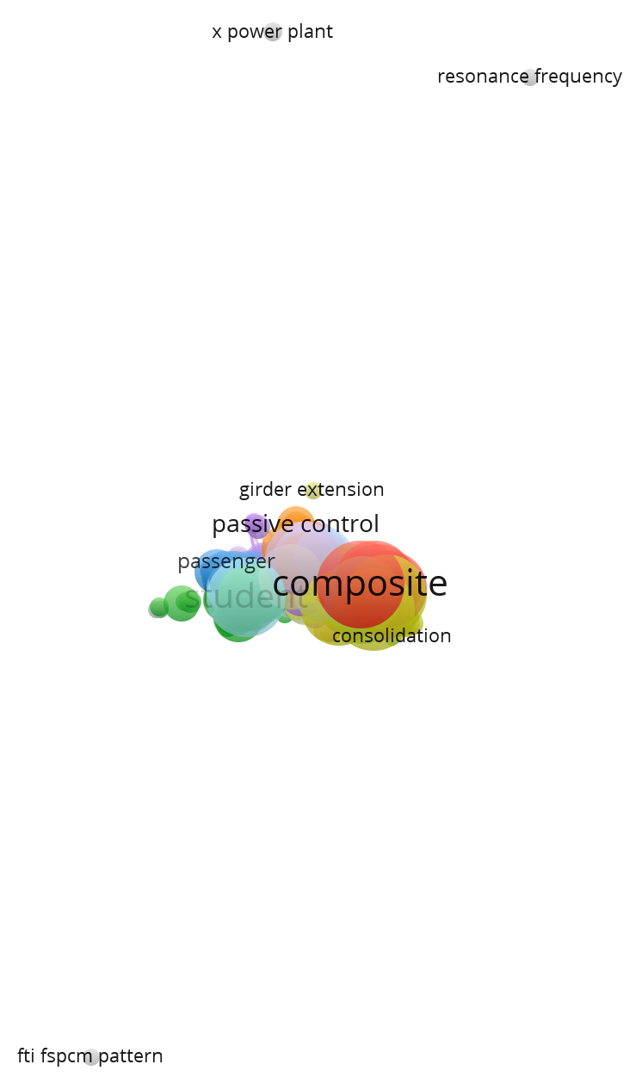
ITS

Slide 6
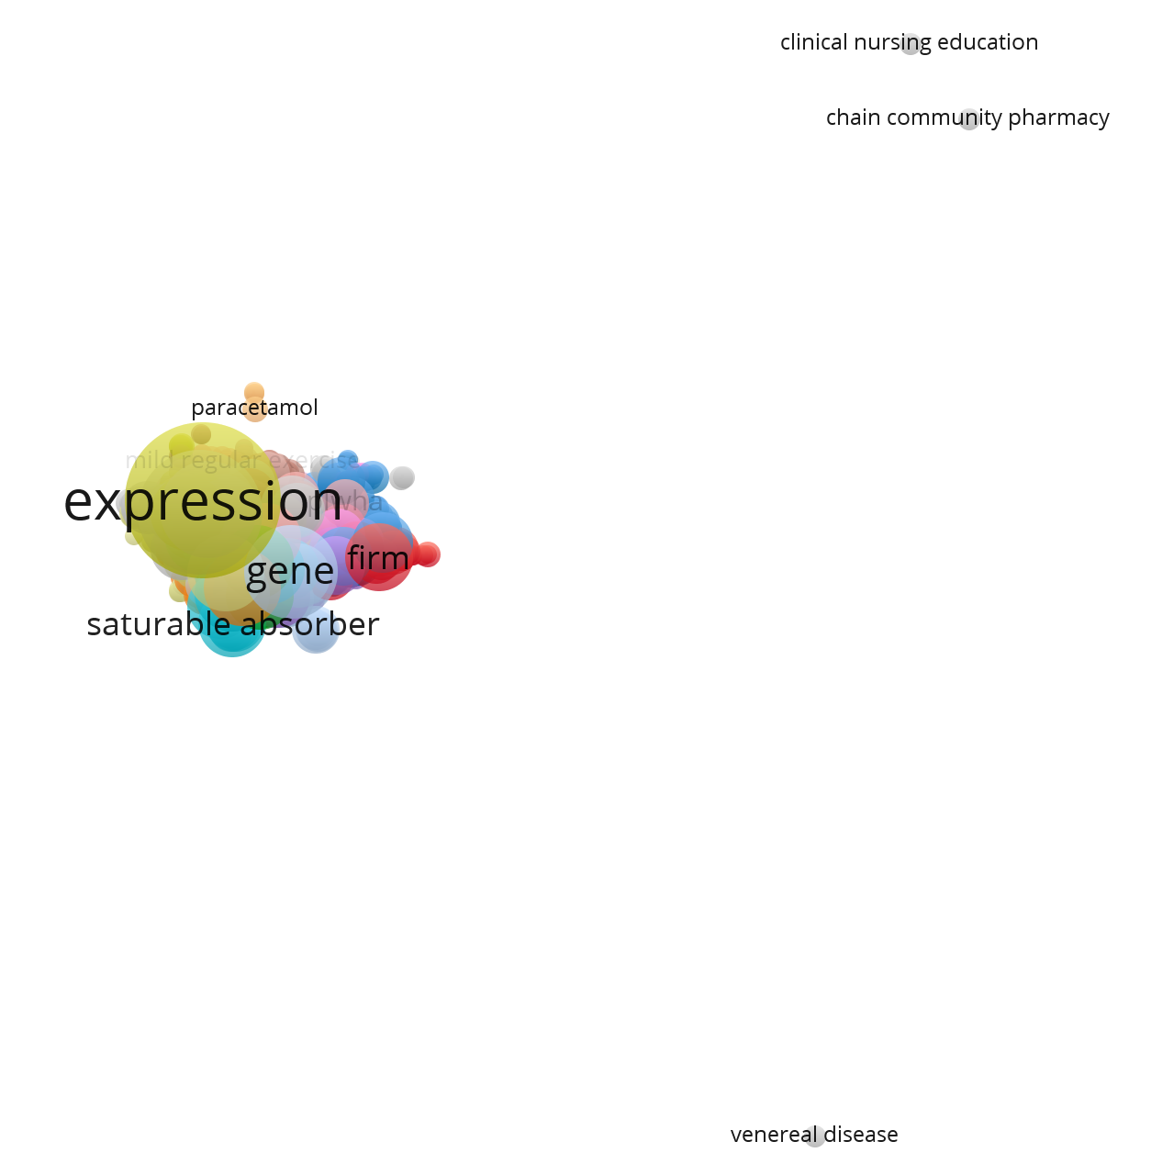
UNAIR

Slide 7
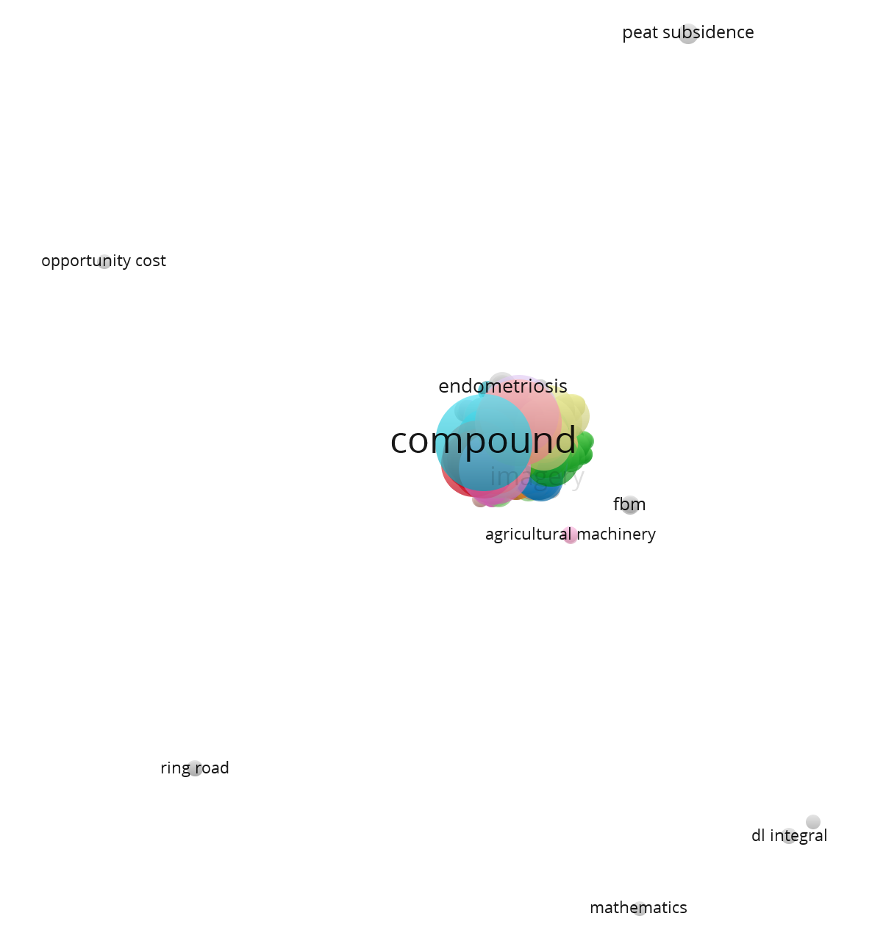
UGM

Slide 8
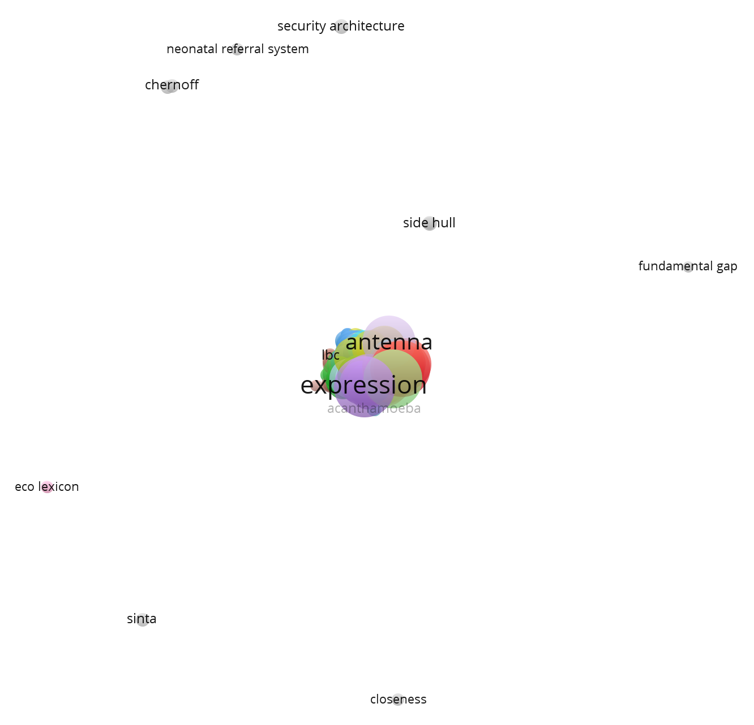
UI

Slide 9
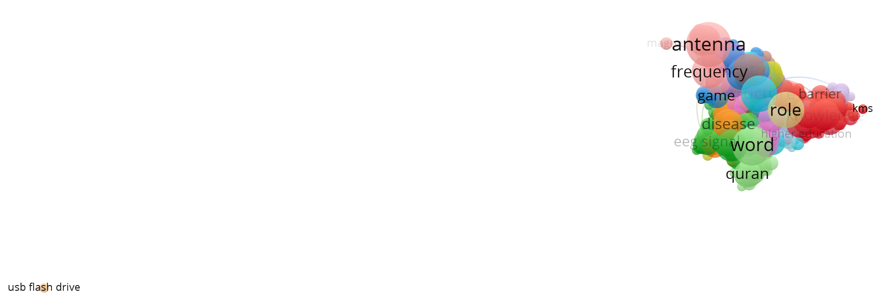
TEL-U

Slide 10
CO-AUTHORSHIP
Menggunakan Vosviewer
Create map based on bibliometric data > Co-authorship > Full counting > ... > ...

Slide 11
ITB

Slide 12
IPB

Slide 13
ITS

Slide 14
UNAIR

Slide 15
UGM

Slide 16
UI

Slide 17
TEL-U

