Slide 1
Course Introduction
Web Programming and Testing

Slide 2
General Information
Full Name: 12S3101 Pemrograman dan Pengujian Aplikasi Web
Credits: 4 sks (~12 hours/week)
Lecturer: MSS (mario@del.ac.id)
Course delivery method: project-based learning (PjBL).
For detailed description, please read the course study plan.

Slide 3

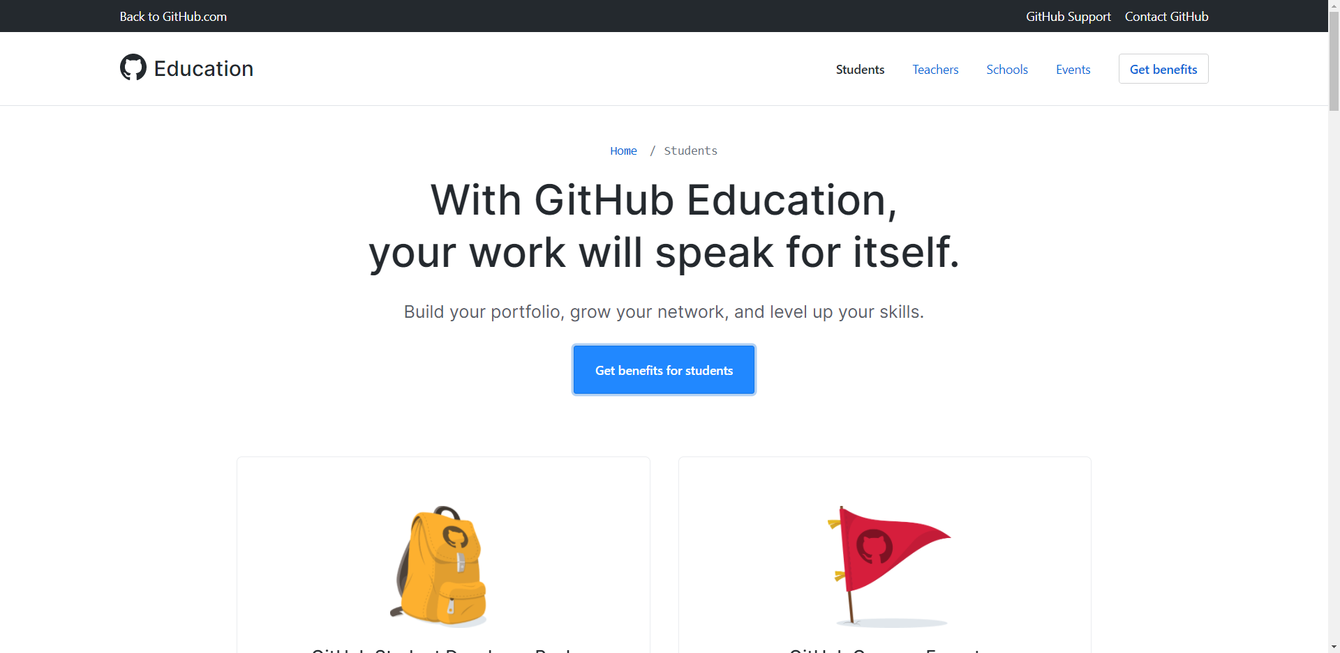
Requirements: GitHub
We will extensively utilize GitHub.
Familiarize yourself with Git and GitHub.
Register yourself to GitHub Student Developer Pack.

Slide 4
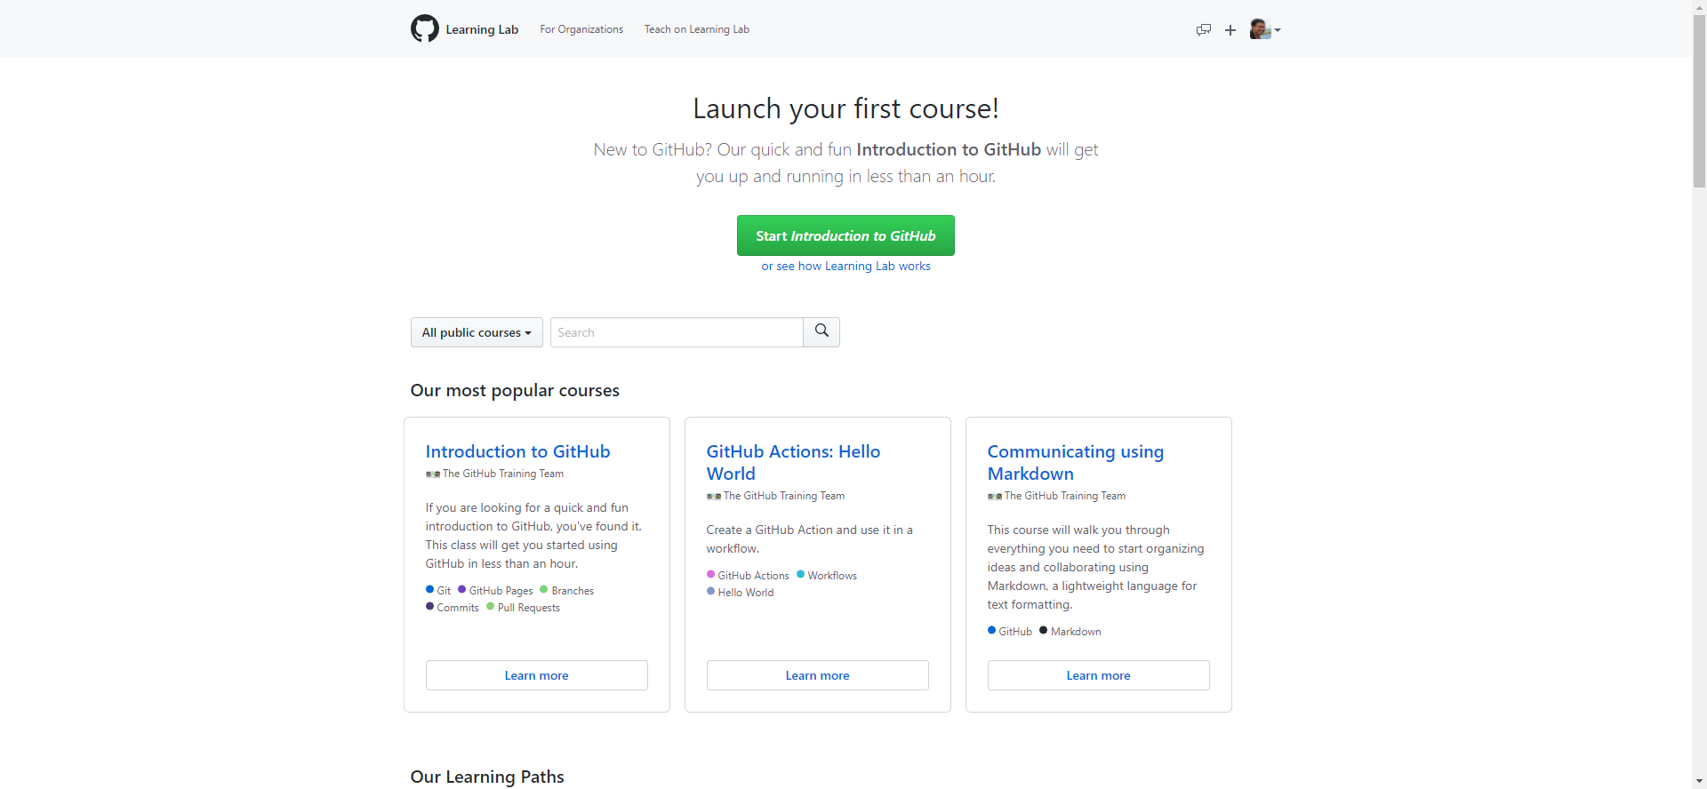
Requirements: GitHub
Learn how to use Git and GitHub effectively.
Register yourself to GitHub Learning Lab.
Finish the Introduction to GitHub course.

Slide 5

Exploring Mentality
We don’t teach you the technical.
Make use of “uncle” Google.
Find the relevant documentations.
Try it yourself.
Collaborate.
Discuss.

