Slide 1
Accepting User Input
Web Programming and Testing

Slide 2
Objectives
The objective of this session is the following:
The students are able to elaborate the needs of user interaction.
The students are able to distinguish methods to interact with the user.

Slide 3
Outlines
Evolution of web application.
Dynamic web.
Accepting user input with GET and POST methods.

Slide 4
Evolution of Web Apps

Slide 5
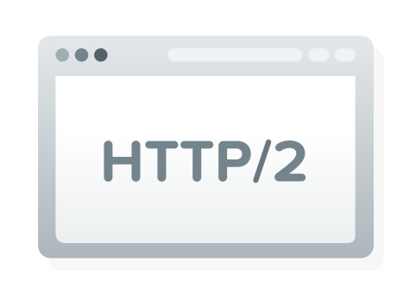
Evolution of Web Apps
Web 1.0:
The web is static with push direction.
HTML + CSS + JavaScript
Web 2.0:
The web turns into a dynamic space where the user can contribute.
Web 1.0 + server-side processing engine + DB.
Web 3.0
The web becomes smarter with suggestion, forecasting, etc.
Web 2.0 + AI and the likes.

Slide 6

Web 2.0 Is Minimal
In some cases, 1.0 is still there.
For documentation, static wiki pages, etc.
Today’s web apps should be at the 2.0 state (minimal).
Blogs, official websites, etc.
Reaching 3.0 would be great.
Youtube, Facebook, E-Commerce, etc.
Key: its users are the content creator.

Slide 7
Dynamic Web Application

Slide 8
Dynamic Web Application
Dynamic web means:
Two-way communication.
The web provides information that it stores.
The user contributes new information to the web apps.
Key: user interaction
The web apps get richer of information.

Slide 9

Interacting With User
The question is, how do web apps interact with its users?
Or how the user could send information to the web app?
The HTTP provides several methods:
GET, DELETE, POST, PUT, PATCH.
HEAD and OPTIONS are not very common in this scenario.
Requirement to enable user interaction:
A backend engine that reads and process the input accordingly.

Slide 10
GET and POST Methods
Interactions could be categorized as:
Reading or retrieving interaction.
Reading must not affect the resource states (idempotent).
When the web apps users are asking for a resource.
In this case, GET method is used.
Writing interaction.
When the web apps users are keen to create, modify, or remove a resource.
In this case, POST method is used.
Why PUT, PATCH, and DELETE methods are not used?

Slide 11
Retrieving with the GET Method

Slide 12
GET Method
GET method is aimed to be used for reading a resource.
Since resource retrieval has to be idempotent, hence it is qualified to be shareable.
Since it is qualified to be shareable, browsers tend to display GET request at the address bar.
Parameters attached to an HTTP request with GET method are written as in the URL query.

Slide 13
An HTTP Request with GET Method
http://example.com/get.php?param1=tra&param2=lala&param3=parampampam

Slide 14
GET Request Distilled
http://example.com/get.php?param1=tra&param2=lala&param3=parampampam
The URL consists of:
Protocol scheme: http
Domain name: example.com
Port: 80 (implicit)
Path: /get.php
Query: param1=tra&param2=lala&param3=parampampam
1st parameter named param1 with value tra.
2nd parameter named param2 with value lala.
3rd parameter named param3 with value parampampam.
http://example.com:88/ ← explicit

Slide 15
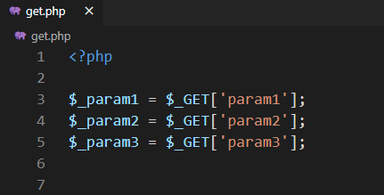
Reading GET Parameters
http://example.com/get.php?param1=tra&param2=lala&param3=parampampam
Let’s focus on the query part.
1st parameter named param1 with value tra.
2nd parameter named param2 with value lala.
3rd parameter named param3 with value parampampam.
In PHP, parameters sent through GET method are accessible via $_GET super global array.
super global array

Slide 16
GET Method: Getting Dirty

Slide 17
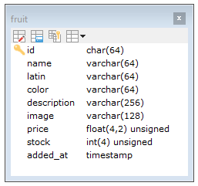
Case Study: Simple Fruit Shop
There is an online fruit shop accessible through the Internet.
It has information about fruits sold through the website.
The information about a fruit is a resource.
A fruit has some attributes:
id, name, latin, color, description, image, price, stock, and added_at.
A fruit is identified by an id.

Slide 18
Case Study: Simple Fruit Shop
What we are going to see:
How to retrieve a fruit by its identifier field.
Display all available fruits (resources).
Create links.

Slide 19
Modifying A Resource with the POST Method

Slide 20
POST Method
POST method is aimed to be used for creating a new resource.
But, in most situation it is also used to modify or even removing an existing resource.
Since resource modification and removal affect the resource state, hence it is not qualified to be shareable.
Since it is not qualified to be shareable, browsers tend to hides POST request.
Parameters attached to an HTTP request with POST method are unseen by the user.

Slide 21
Remember!
Creation is only for inexistent resource!
Retrieval, modification, and removal actions are only for existing resource!

Slide 22
POST Method: Getting Dirty

Slide 23
Case Study: Simple Fruit Shop
What we are going to see:
Create a form to modify resource data (price).
How to retrieve a fruit (resource) by its identifier field and modify it.
Display the modified fruits (resources).

Slide 24
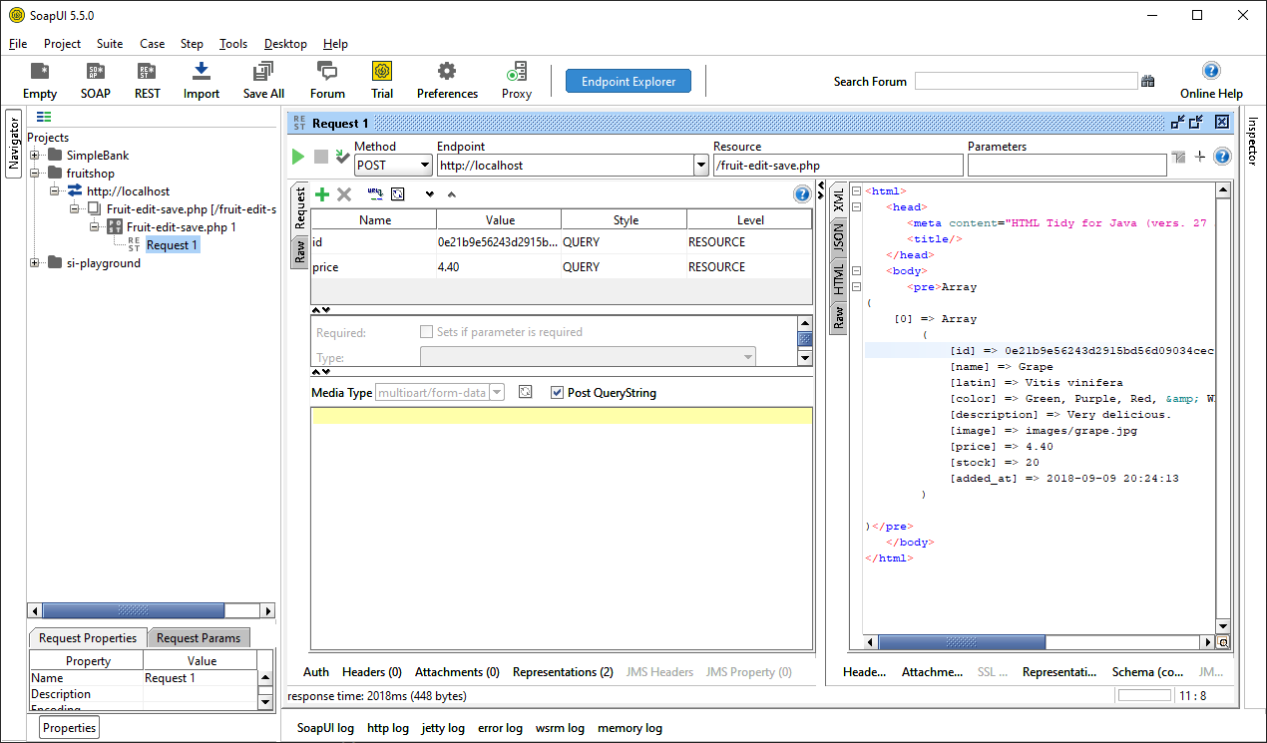
Request
Response

Slide 25

To-dos
Can we create a link with POST method?
Why do we use POST for modification? Shouldn’t it only be used for resource creation?
Is it possible to create a use GET, PUT or PATCH in the form’s method attribute?

Slide 26
References
Srinivasan, M. (2012). Web Technology: Theory and Practice. Pearson.
Mozilla. HTML Element Reference. https://developer.mozilla.org/en-US/docs/Web/HTML/Element

