Slide 1
State Management
Web Programming and Testing

Slide 2

Objectives
The objective of this session is the following:
The students are able to elaborate the role of state and the importance of state management.
The students are able to manage states in either server or client side.

Slide 3
Outlines
Motivation
Storing state in the client-side (cookies)
Storing state in the server-side (session)

Slide 4
Motivation

Slide 5

Do I know you?

Slide 6
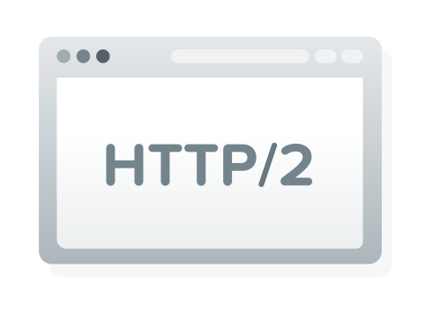
The Protocols
HTTP/S protocol is working in request-response cycle.
Every cycle is independent.
The protocols are stateless.
Do not store any state whatsoever between the two communicating parties.

Slide 7

What is State?
State is a value associated to a particular user.
One or more states are generated due to the interaction between the two parties.
Achieving the best user experience.
To track what have been done during the interactivity.
To temporarily record some generated data during the interactivity.
Personalization.

Slide 8
What is State?
HTTP/S is robust enough to enable state to be created and transmitted between the parties.
User state management (RFC 6265):
The web server – called session,
The client (user agent, i.e. browser) – called cookies,
Or combination of both at the same time.
Please visit: https://tools.ietf.org/html/rfc6265

Slide 9
Storing State in The Client-Side

Slide 10

Cookie (RFC 6265)
A state is stored inside the browser as a key-value pair (cookie).
The key has to be unique.
The value should be short (space limitation).
An encryption is needed to avoid security issue.
An expiration time.

Slide 11
Cookie (RFC 6265)
To set a cookie, the server put a Set-Cookie entry in the response header.
The cookie configuration consists of some attributes.
Configuration with multiple attributes are written with semi-colon as the separator.
Set-Cookie: name=value; attribute; attribute

Slide 13
Cookie Attributes
Name-value
name=value
Expires
The time when the cookie will be destroyed.
Path
Pattern that must exist in order to send the cookie.
Domain
List of domain that is allowed to receive the cookie.
Secure
Boolean, default: false.
To enforce cookie to be sent though HTTPS only.
HttpOnly
Boolean , default: false.
To avoid access via JavaScript.
SameSite
Restriction level for cross-origin request.

Slide 14
Storing State in The Server-Side

Slide 15

Session (RFC 6265)
Storing state in the client-side bring some drawbacks:
Prone to security problem (confidentiality and integrity)
Overhead in data transmission.
As an alternative, state could be stored in the server.
The client will only need to store its session identifier (SESSID)
The SESSID is treated as a cookie.
User’s session is transparent from others.

Slide 16
Session
Some consideration of using session over cookies.
States are temporarily stored in the server’s main memory.
Server capacity might be a concern.
Way much faster processing.
Can be stored in the database for scalability.

Slide 18

To-dos
Understand deeply the difference between
managing state in the client-side and in the server-side.
Path and Domain attributes in the cookies.
Secure, HttpOnly, and SameSite attributes.
Read the RFC 6265 about the weakness of cookies:
Weak Confidentiality (chapter 8.5)
Weak Integrity (chapter 8.6)
REST Application uses different approach. What is it?

Slide 19
References
Srinivasan, M. (2012). Web Technology: Theory and Practice. Pearson.
Tatroe, K., et. al. (2020). Programming PHP. O'Reilly.
PHP Manual https://www.php.net/manual/en/
RFC 6265, HTTP State Management Mechanism. https://tools.ietf.org/html/rfc6265#section-8.4

