Slide 1
Web Framework: MVC Pattern
Web Programming and Testing

Slide 2
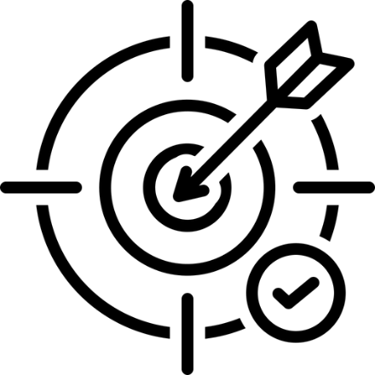
Objectives
The objective of this session is the following:
The students are able to elaborate the benefit of developing solution on top of web framework.
The students are able to select and use contemporary web framework.

Slide 3
Outlines
Motivation
MVC architectural pattern.
Web framework.

Slide 4
Motivation

Slide 5
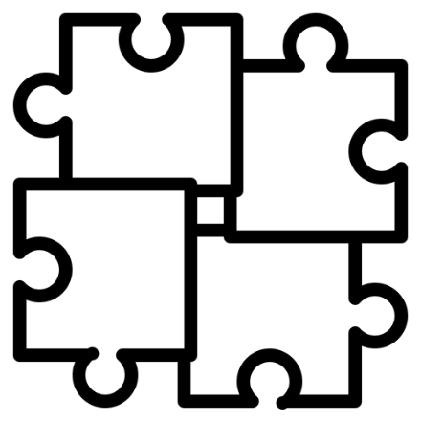
Web Dev in the Age of Dinosaur
Years ago, web developers tend to use in house components to construct their application.
Developed on top of experiences.
Components get polished through time.
Well tested, proven, and production ready,
Problems:
Less standard, convention, rules, etc.
Component are reused only in the internal dev team.
New boy needs time to learn.

Slide 6
Driven by Community
Community grows and working together to ease the development process.
Avoid reinventing the wheel.
Use the existing components.
Focus on the business.
Specific language ecosystems.
e.g. https://www.php-fig.org/

Slide 7
MVC Architectural Pattern

Slide 8
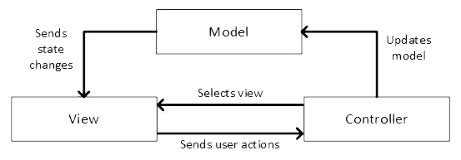
Model-View-Controller Pattern
MVC is a popular pattern that commonly applied to application with graphical user interface (GUI).
Segregating components based on their responsibilities.
Web and desktop applications.
Image source: Ingeno, J. (2018). Software Architect's Handbook. Packt

Slide 9
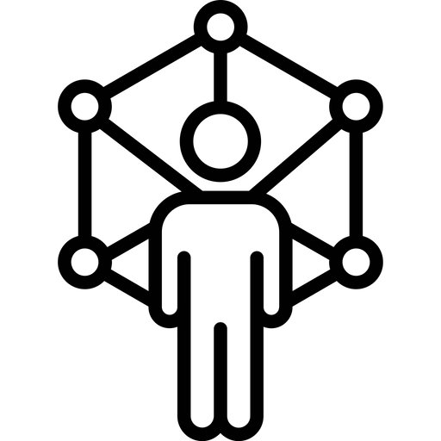
Model-View-Controller Pattern
Model represents business data, record, or states.
The actual data are stored in persistence storage (e.g. database).
Operations that related to business data are also defined here.
Incld. adding, modifying, removing data, and other specific operations.
Patterns related to data:
Active Record, Data Mapper, Data Gateway

Slide 10
Model-View-Controller Pattern
View takes care of how the state (data) should be presented.
Different audience might require different presentation.
structure, format, etc.
It directly interacts with the application users.
User interactions are received by view and forwarded to the controller.
Image source: Ingeno, J. (2018). Software Architect's Handbook. Packt

Slide 11
Model-View-Controller Pattern
Controller orchestrates the application behavior based on the events and the accompanying data.
Business logic is defined here.
It decides which models and views should be used.
Image source: Ingeno, J. (2018). Software Architect's Handbook. Packt

Slide 12
Advantages and Disadvantages
Advantages:
Modular solution with loosely coupled components.
Isolated problem.
Changes to particular aspect is way simpler.
Developer specialization.
Frontend and backend developers.
A chance for rapid development cycle.
Disadvantages:
In the case of simple project, MVC might be too much.

Slide 13
Web Framework

Slide 14

Web Framework
It is a set of toolkit that provides a skeleton for web application.
Most of today’s framework follows the MVC architectural pattern.
Either full-featured MVC or partial.

Slide 15
Advantages and Disadvantages
Advantages:
Accelerate application development.
Solid structure, well tested, and community-baked.
Best practices and standards compliance (e.g. PSR).
Disadvantages:
Might take some time to learn.
Too complex for simple problem.

Slide 16
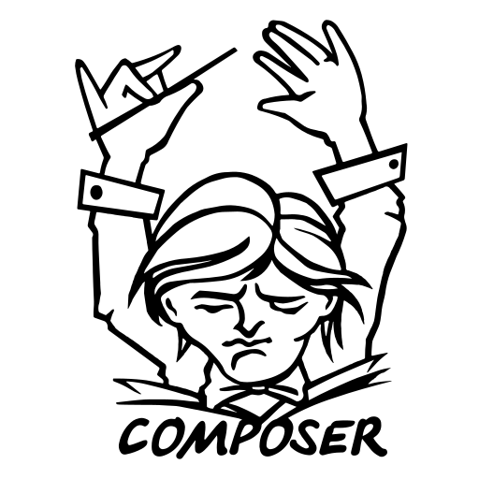
Partial vs. Fullstack
Partial framework concentrates on a specific layer:
Focus on the controlling (Lumen, Silex, Slim).
Focus on the view aspect (Twig, Blade).
Focus on the data layer (Doctrine, CycleORM, Medoo).
Fullstack handles every part of a web architecture.
Yii, Symfony, Laravel, Spring, Django, etc.

Slide 17

To-dos
Choose your web framework and use it in your project.
Consult with your TA for insights.
Read the documentation before choosing.

Slide 18
References
Srinivasan, M. (2012). Web Technology: Theory and Practice. Pearson.
Ingeno, J. (2018). Software Architect's Handbook. Packt

