Slide 1
Web Services
Web Programming and Testing

Slide 2

Objectives
The objective of this session is the following:
the students are able to elaborate the use of services and the motivation behind it.

Slide 3
Outlines
Motivation
What is service?
When to use service?

Slide 4
Motivation

Slide 5
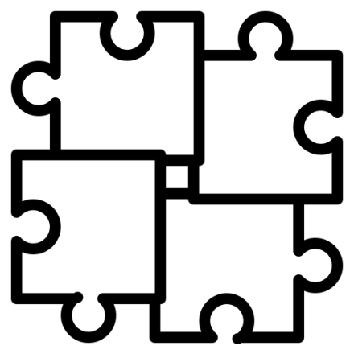
Distributed Data and Capabilities
No super enterprise, no super-app.
An application must be focused on its own specific business.
Other functionalities, outside its domain expertise shouldn’t be handled.
Needs for data exchange and accessible capabilities.
for authentication → Google, GitHub OAuth services.
money exchange rate → central bank’s services.

Slide 6

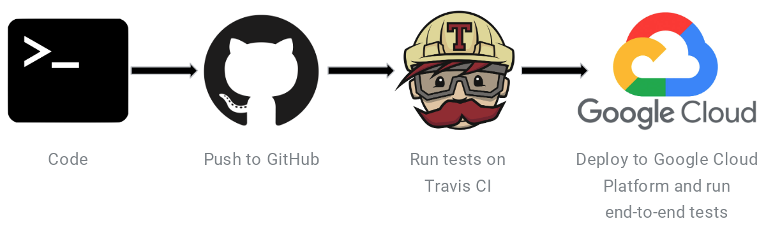

Distributed Data and Capabilities
An illustration
Each individual has a specific responsibility in life.
These responsibilities are chained or orchestrated in a specific order to provide a greater, more complex service with higher value.
The individual, joined in the orchestration, must do his/her job properly to achieve the goal.

Slide 7
What is A (Web) Service?

Slide 8
What is A Service?
A service is a functionality with a specific goal.
In our context, it is in the form of software that is available via an clearly defined API.
The definition is specified in a contract.

Slide 9

What is A Web Service?
A web service is a service that is made available through web protocols.
Uses HTTP/S and its standards.
Most of web services are implemented in the forms of
either SOAP or REST-based services.

Slide 10

What is A Contract?
A service is available for consumers via API.
The API specification is explicitly defined in a contract. It contains:
How to consume the API,
The parameters specifications, and
What kind of output is expected.
Both SOAP and REST-based services have a different way to expose its contract.

Slide 11
Transparent Business Logic
A service contains a specific business logic inside it. It may be a composed of multiple smaller services.
The business logic of a service is not visible (transparent) to its consumers or agnostic.
e.g. paying a bill via a mobile banking app, how does it work? Who cares :p

Slide 12
When to Use Services?

Slide 13

From A Consumer’s Perspective
A consumer is a party that uses a service.
Decision to consume a services is taken when:
the required capability/data is not our main business or managed by another application.
by not making our-own capability is much cost-effective.

Slide 14
From A Provider’s Perspective
A provider is a party that makes a service available for others.
Decision to consume a services is taken when:
the data/capability is in our domain.
we want to share it or make it accessible.

Slide 15

To-dos
In the next meeting we would discuss about SOAP and REST-based services.
Your project will go with REST-based services.
Some APIs will be designed and tested.

Slide 16
References
Srinivasan, M. (2012). Web Technology: Theory and Practice. Pearson.
Erl T. (2016). Service-Oriented Architecture: Analysis and Design for Services and Microservices. Pearson

