Slide 1
REST-Based Services
Web Programming and Testing

Slide 2

Objectives
The objective of this session is the following:
The students are able to elaborate the concept behind the REST-based services.

Slide 3
Outlines
Flashback.
REST-based service.
REST services around us.

Slide 4
Flashback

Slide 5
Service and API Contract
A service is a software program that makes its functionality available via a published API that is part of a service contract.
The API specification is defined in a contract. It contains:
How to consume the API,
The parameters specifications, and
What kind of output is expected.

Slide 6
REST-based Services

Slide 7
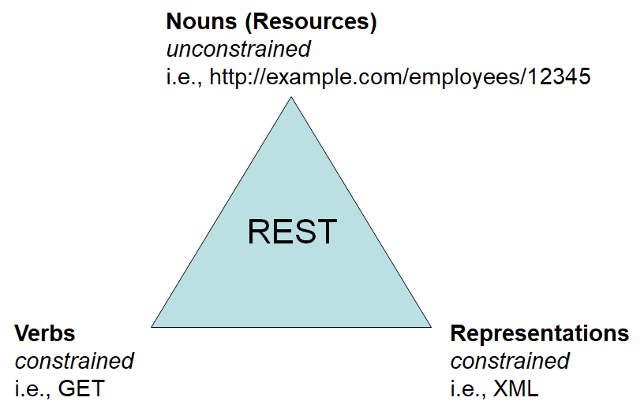
REST
REST: REpresentational State Transfer.
Is an architectural pattern.
It runs on top of the HTTP infrastructure.
REST can be perceived as:
A mechanism to exchange data.
The state of the data being exchanged is represented in a standard format (e.g. JSON, XML, etc.)

Slide 8

REST: Semantics
Compared to the traditional approach (e.g. SOAP service), REST promotes semantics. The semantics is reached by:
utilizing HTTP verbs and HTTP response code to ‘self-explain’ the request and the response.
HTTP verbs are methods available in the protocol.
GET, POST, PUT, PATCH, DELETE, and OPTION, etc.
HTTP response code to represent the outcome.
200 – OK, 403 – Unauthorized, etc.

Slide 9
REST: Stateless
Interaction between the two communicating parties is stateless.
Because it runs on top of HTTP which is stateless.
No session at all. The client is the sole party to keep track of its own session.
Due to this, in the case of sensitive data request, the client must embed its authentication token along with the request.
In what case statelessness is a good thing?
Servers do not need to keep a tab for its user.
It promotes scalability since the client is responsible for its own session.

Slide 10
Where Is The Contract?
Contract is essential and a service must obey the contract.
In the traditional services, SOAP-based services, the contract is written in a well-formatted WSDL document.
What about REST?
Unlike the traditional services, the specification of a REST service is defined in the API documentation.
Not in a specification from which the service is derived.
It simplify things, but may raise an inconsistency.

Slide 11
REST Services Around Us

Slide 12
REST Services Around Us?
In most cases, mobile apps do not store its entire content locally. It is very likely that most of the data is stored in the server and only the most recent lives locally in cache.
The communication between the app and the server is very likely implemented in REST.
Today’s social media websites, like Facebook, LinkedIn, etc. retrieves data from the servers seamlessly though REST services.

Slide 13
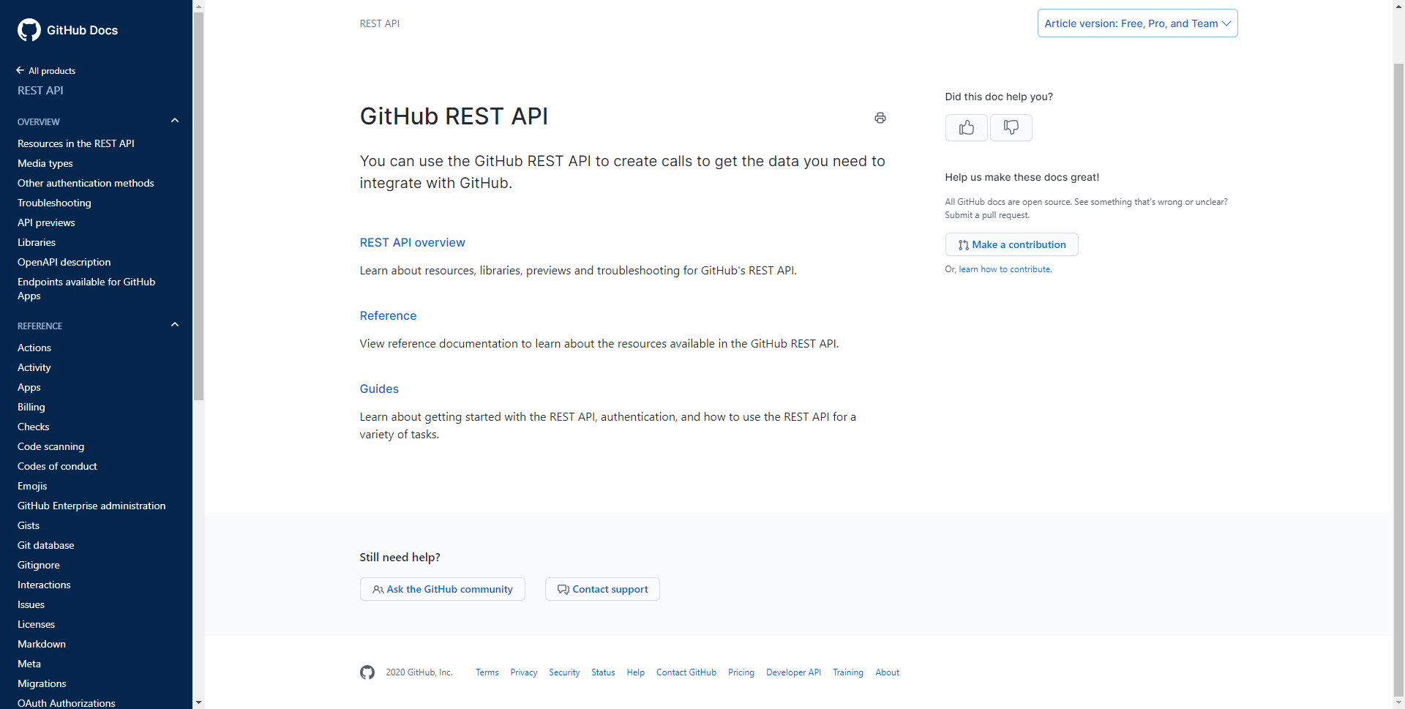
APIs provided by GitHub

Slide 14
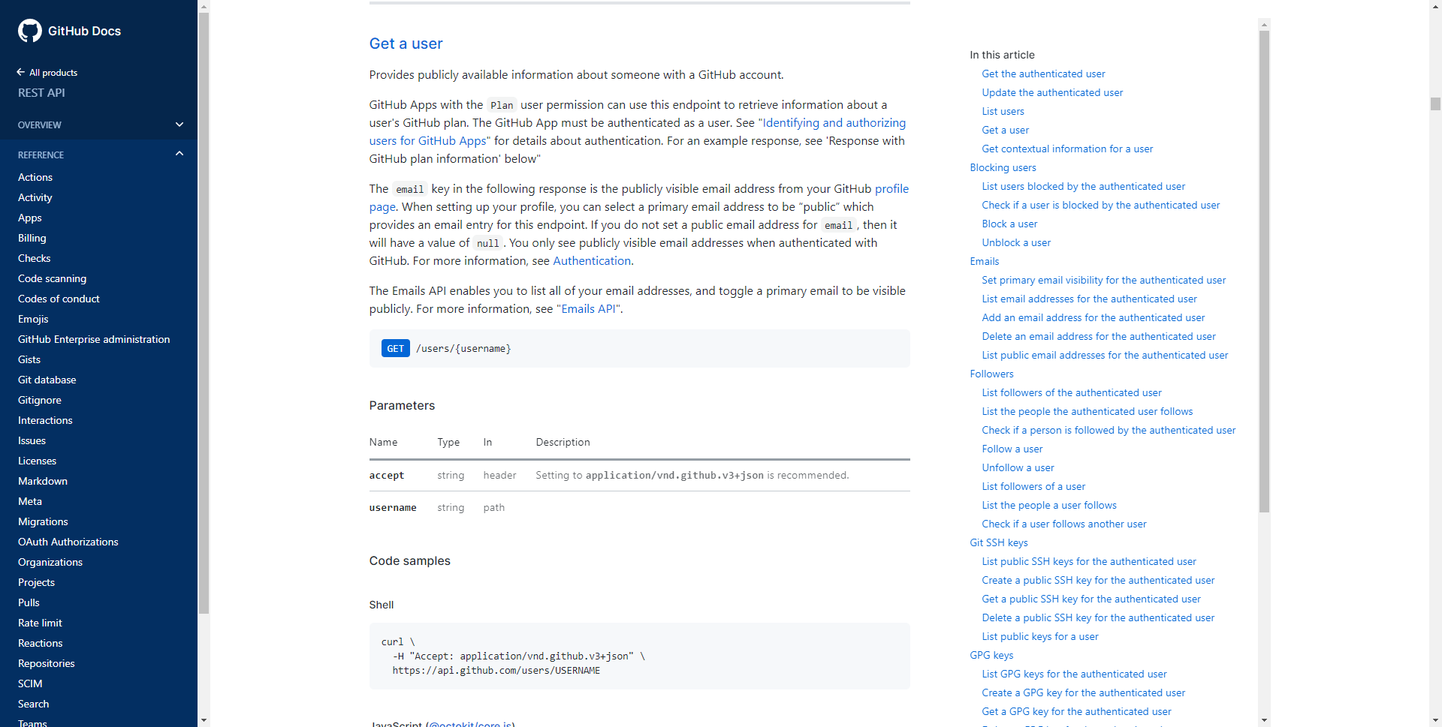
verb
URL format
API to retrieve a user information
https://docs.github.com/en/free-pro-team@latest/rest/reference/users

Slide 15
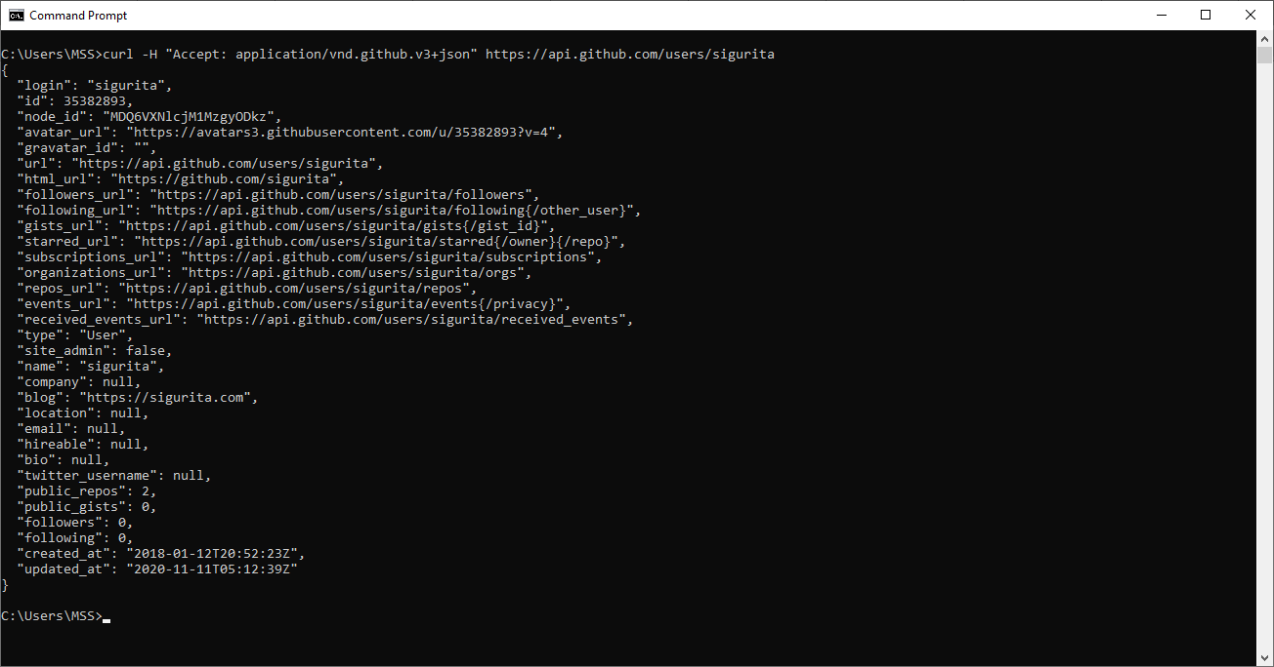
Consuming the API via cURL

Slide 16
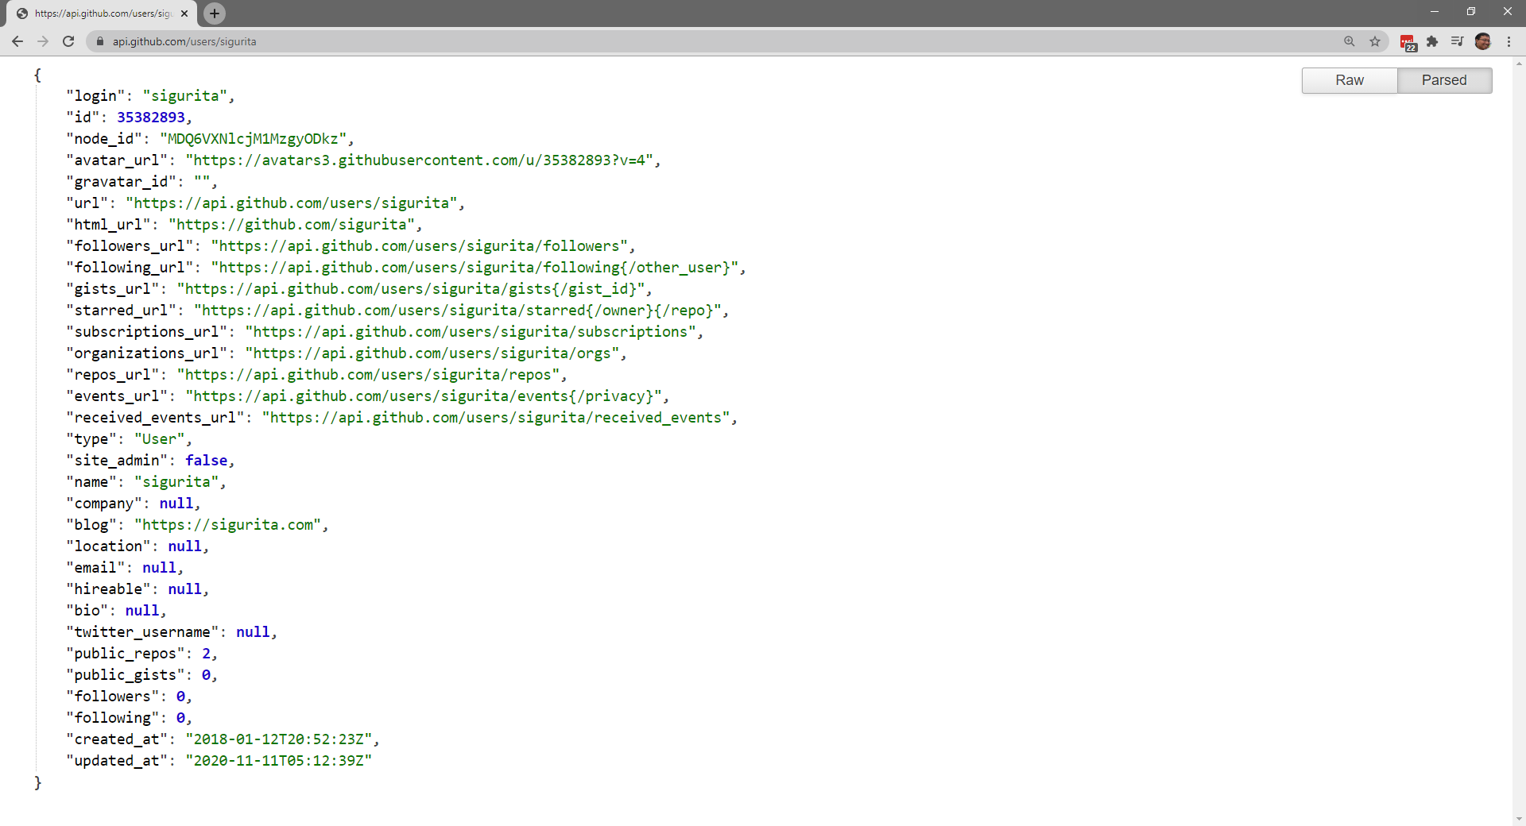
Since the API requires a GET, we could use browser to consume it

Slide 17
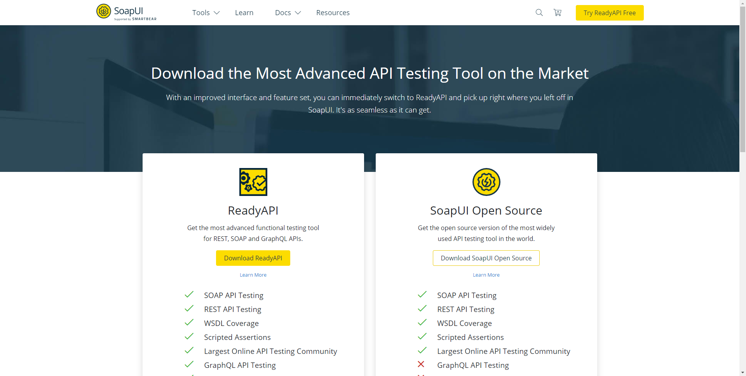
Use API testing tool, e.g. SoapUI or Postman

Slide 18
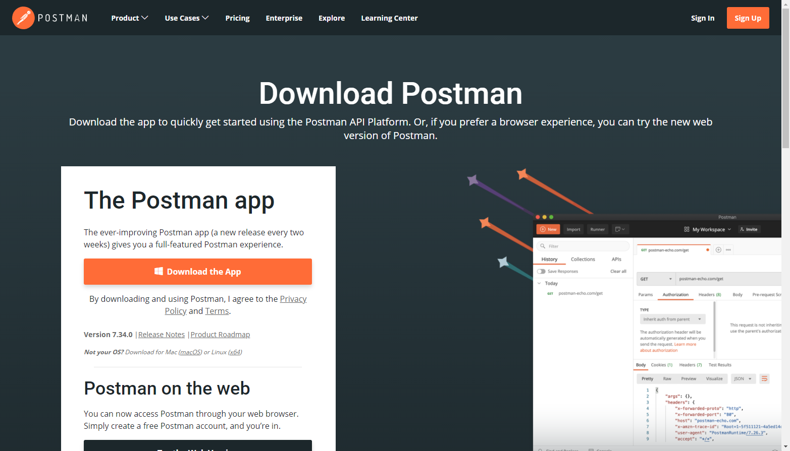
Use API testing tool, e.g. SoapUI or Postman

Slide 19
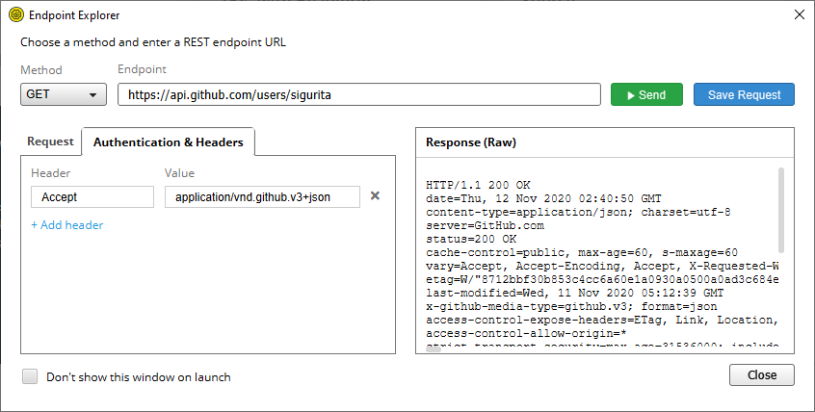

Slide 20
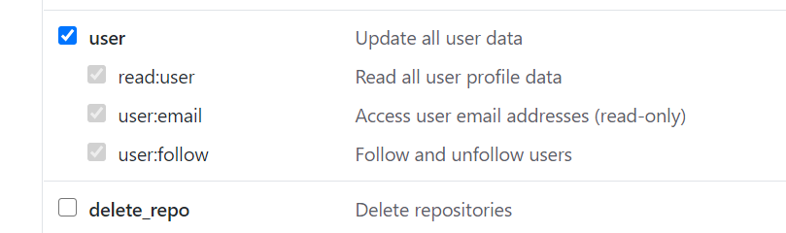

Authorized Access
There is a situation where the API requires the consumer to be authorized first.
Authorization is manifested in the form of tokens.
The token should be attached to the request.
Do NOT share the token!
Settings > Developer Settings > Personal access tokens

Slide 21
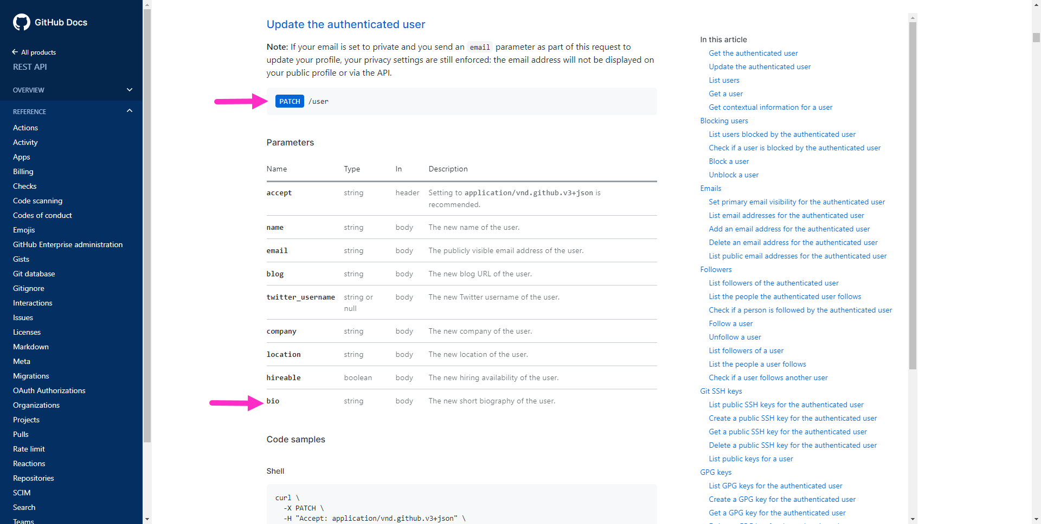
Updating user information

Slide 22
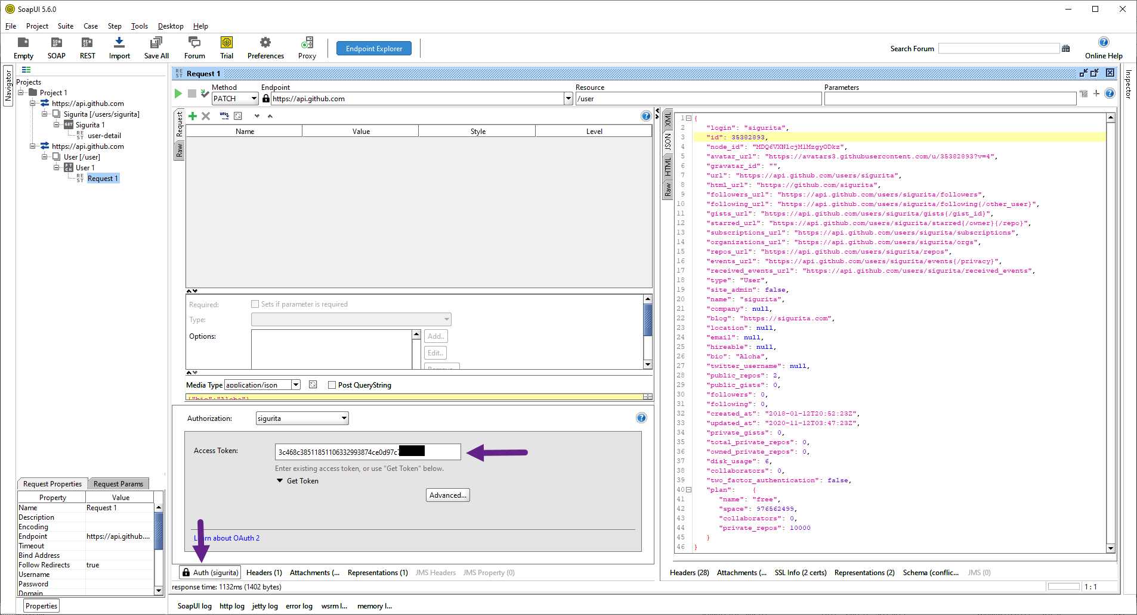
Updating user information

Slide 23


Slide 24

To-dos
Next time we will discuss more on the semantic aspects, both the HTTP request verbs and HTTP response codes.
Explore the GitHub APIs.

Slide 25
References
Srinivasan, M. (2012). Web Technology: Theory and Practice. Pearson.
Erl T. (2016). Service-Oriented Architecture: Analysis and Design for Services and Microservices. Pearson
GitHub REST API Documentation. https://docs.github.com/

