Slide 1
Designing REST Services: Representational Format
Web Programming and Testing

Slide 2

Objectives
The objective of this session is the following:
The students are able to develop REST-based services. On this session, we focus on the design phase especially the representational format.

Slide 3
Outlines
Semantic in REST Request-Response Interactivity.
Representational Formats.
XML.
JSON.
Representational Rules.

Slide 4
Semantic in REST Request-Response Interactivity

Slide 5

Request-Response Cycle
1xx, 2xx, 3xx, 4xx, 5xx
web application server
response
browser
HTTP Response
database
request
https
://
example
.
com
/
dir
/
index
.
html
HTTP Request
client
server
HEAD, GET, POST, PUT, DELETE, …

Slide 6
Representational Formats

Slide 7

State Representation
A resource state is exchanged between the two parties.
The state describe the resource at a moment in time.
In REST, the state are written in a format described in the contract (documentation).
The consumers agree with the format.
Commonly used representational format:
JSON and XML.
Other? RDF, YAML, etc.

Slide 8
XML

Slide 9
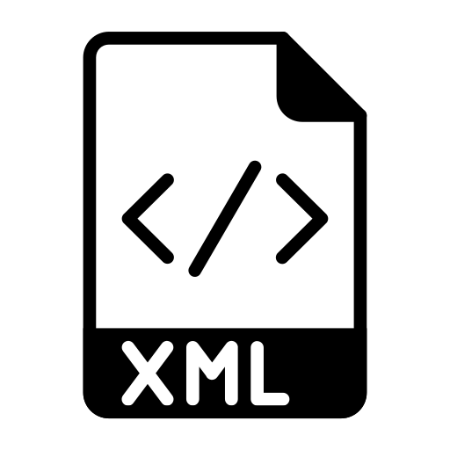
XML
eXtensible Markup Language
Traditional state wrapper.
Commonly used in:
legacy systems with SOAP-based services.
configuration files.
To read an XML document, a parser is used.
e.g. XPATH, XSLT, Xquery, etc.

Slide 10
XML Formatting
States are wrapped in a nested nodes.
A node may have one or more attributes.
No standard tags.
A node is written in an open-closed tag.
<tag attribute=“attribute-value”>value</tag>

Slide 11
XML: An Example
An node with a value
Root node
<?xml version="1.0" encoding="UTF-8"?>
<profile>
<display>Sigurita Tralala</display>
<age>22</age>
<favourite-fruits>
<fruit>Apple</fruit>
<fruit>Cherry</fruit>
</favourite-fruits>
<phones>
<phone active="true" type="private">085262211212</phone>
<phone active="true" type="office">0632331234</phone>
</phones>
</profile>
An array of values
Node attribute

Slide 12
JSON

Slide 13
JSON
JavaScript Object Notation
A way to represent an object in JavaScript.
Later, it is used as data exchange format.
Why JSON?
Most of the REST clients are in the form of web pages. This makes JSON is a friendlier format compared to XML.
Plain and interoperable (cross-platform).
See: https://tools.ietf.org/html/rfc8259

Slide 14
JSON Formatting
Key formatting:
An object is described in a curly braces {}.
Attributes are written in a key-value pair, with key name written in a double quotes "".
An array of values are written in a square braces [].
Nested object and nested array are allowed.
MediaType
To let another application about the JSON formatting use the application/json MIME type.

Slide 15
Attribute name
Attribute value
{
"display": "Sigurita Tralala",
"github_username": "@sigurita",
"age": 22,
"favourite_fruit": [
"Apple",
"Cherry"
],
"phone": [
{
"no": "085262211212",
"type": "private",
"active": true
},
{
"no": "0632331234",
"type": "office",
"active": true
}
]
}
JSON: An Example
An array
An array of objects
It is possible to have a nested object or nested array.

Slide 16
Representational Rules

Slide 17
Representational Rules
Rule #42: JSON Should be the default representational format.
Rule #43: JSON must be well-formed. Follow the standard described in RFC 8259.
Rule #44: Other formats, beside JSON are optional to be supported.

Slide 18

To-dos
Next time we will discuss REST as a hypermedia.
Design your REST APIs.

Slide 19
References
Srinivasan, M. (2012). Web Technology: Theory and Practice. Pearson.
Erl T. (2016). Service-Oriented Architecture: Analysis and Design for Services and Microservices. Pearson
Massé, M. (2012). REST API Design Rulebook. O’Reilly

