Slide 1
Implementing REST Services
Web Programming and Testing

Slide 2

Objectives
The objective of this session is the following:
The students are able to develop REST-based services. On this session, we focus on implementing API design.

Slide 3
Outlines
Case Study.
Limitation.
Demo.

Slide 4
Case Study

Slide 5
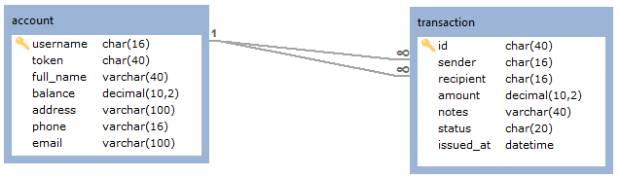
Service Provider: Simple Bank
Simple Bank exposes some APIs:
To see the detail of a specific account ;
To issue a transaction;
To see the detail of a specific transaction;
To retrieve all transactions related to a customer;
See https://github.com/itdel-ppw/simple-bank

Slide 6

Request-Response Cycle
1xx, 2xx, 3xx, 4xx, 5xx
web application server
response
browser
HTTP Response
database
request
https
://
example
.
com
/
dir
/
index
.
html
HTTP Request
simple-bank-client
simple-bank
HEAD, GET, POST, PUT, DELETE, …

Slide 7
Limitations

Slide 8

Limitations
The application was developed on top of Lumen, a PHP-based framework.
The client (service consumer) was developed on top of Guzzle HTTP client.
See
See https://github.com/itdel-ppw/simple-bank-client

Slide 9
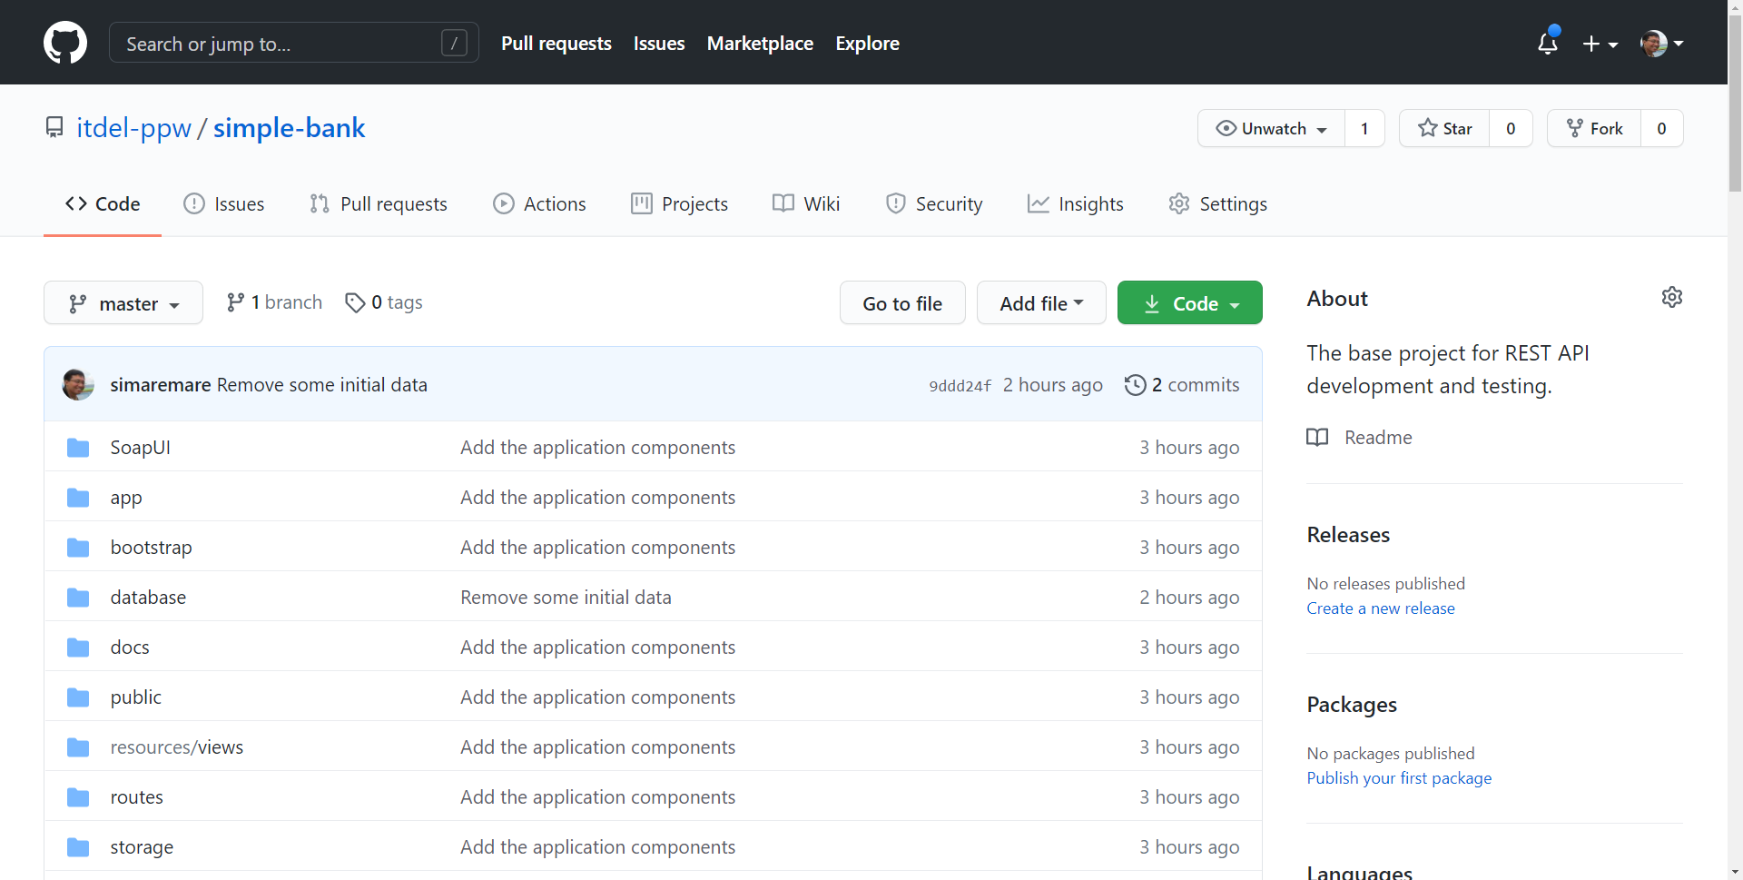

Slide 10
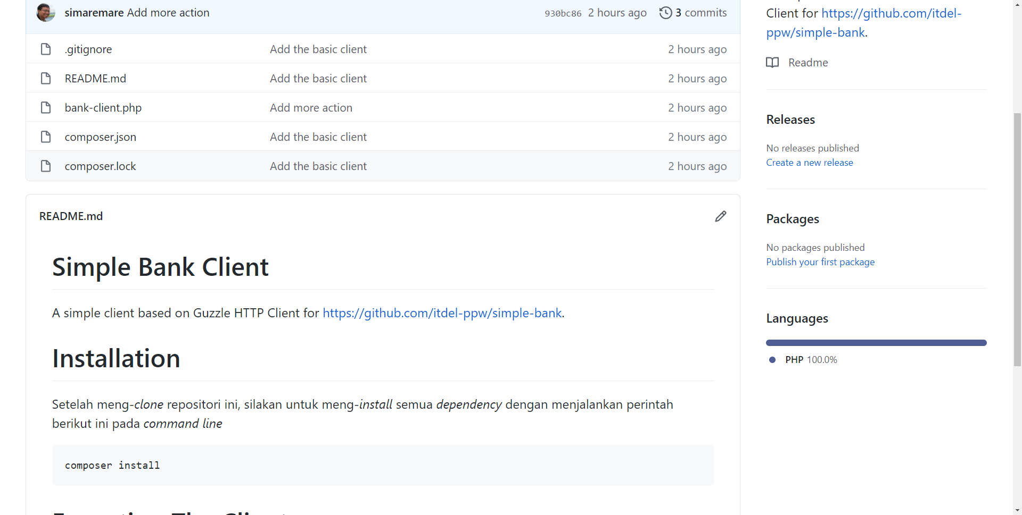

Slide 11

To-dos
Implement your API design.
Next time we will discuss about testing methods and API testing.

