Slide 1
HTTP and HTML
Web Programming and Testing

Slide 2
Objectives
The objective of this session is the following:
The students are able to distinguish the role of HTTP and HTML.
The students are able to elaborate the role of HTML.
The students are able to structure information using HTML.

Slide 3
Outlines
HTTP Protocol.
HTML.

Slide 4
HTTP: A Little Deeper

Slide 5
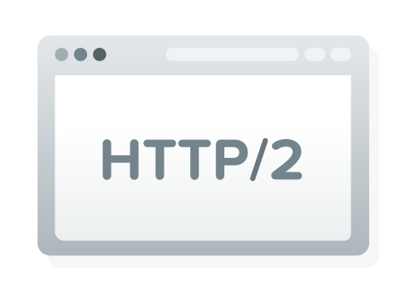
HTTP
Hypertext Transfer Protocol (HTTP).
It runs on top of TCP/IP’s Application Layer.
HTTP/2 compared to HTTP/1.1:
It has compression and reuse connection features.
HTTP/1.1 is the default protocol.
Hypertext: meaningful text, it may have links to create a chain of information.

Slide 6

HTTP
HTTP is responsible to handle data exchange in the form of hypertext.
HTTPS is the secure version of HTTP.
It encrypts the transmitted data with RSA.
HTTP uses port number 80, whereas HTTPS uses 443.
Use the combination of HTTPS and HTTP/2 every time possible.

Slide 7
HTTP Methods
GET: to retrieve a resource.
POST: to store a new resource.
PUT: to replace an existing resource(partially or wholly).
PATCH: to modify an existing resource.
DELETE: to remove an existing resource.
HEAD: to retrieve the head-only response.
OPTIONS: to get the available methods for a specific resource.
In general context, GET and POST are the most used methods.

Slide 8
Request-Response Cycle
HTTP Response
HTTP Request

Slide 9

HTTP Request and Response
HTTP Request and HTTP Response are ‘mails’, they have:
The metadata contains information about both the sender and the targeted recipient (header).
A payload to store the actual data being transmitted (body).
The body can be empty sometimes. When?
Is it possible to send an HTTP Request without any header?

Slide 10
HTTP Response Codes
We will discuss about the HTTP Response Codes a little bit later.
For those who are impatient, please see:
https://developer.mozilla.org/en-US/docs/Web/HTTP/Status

Slide 11
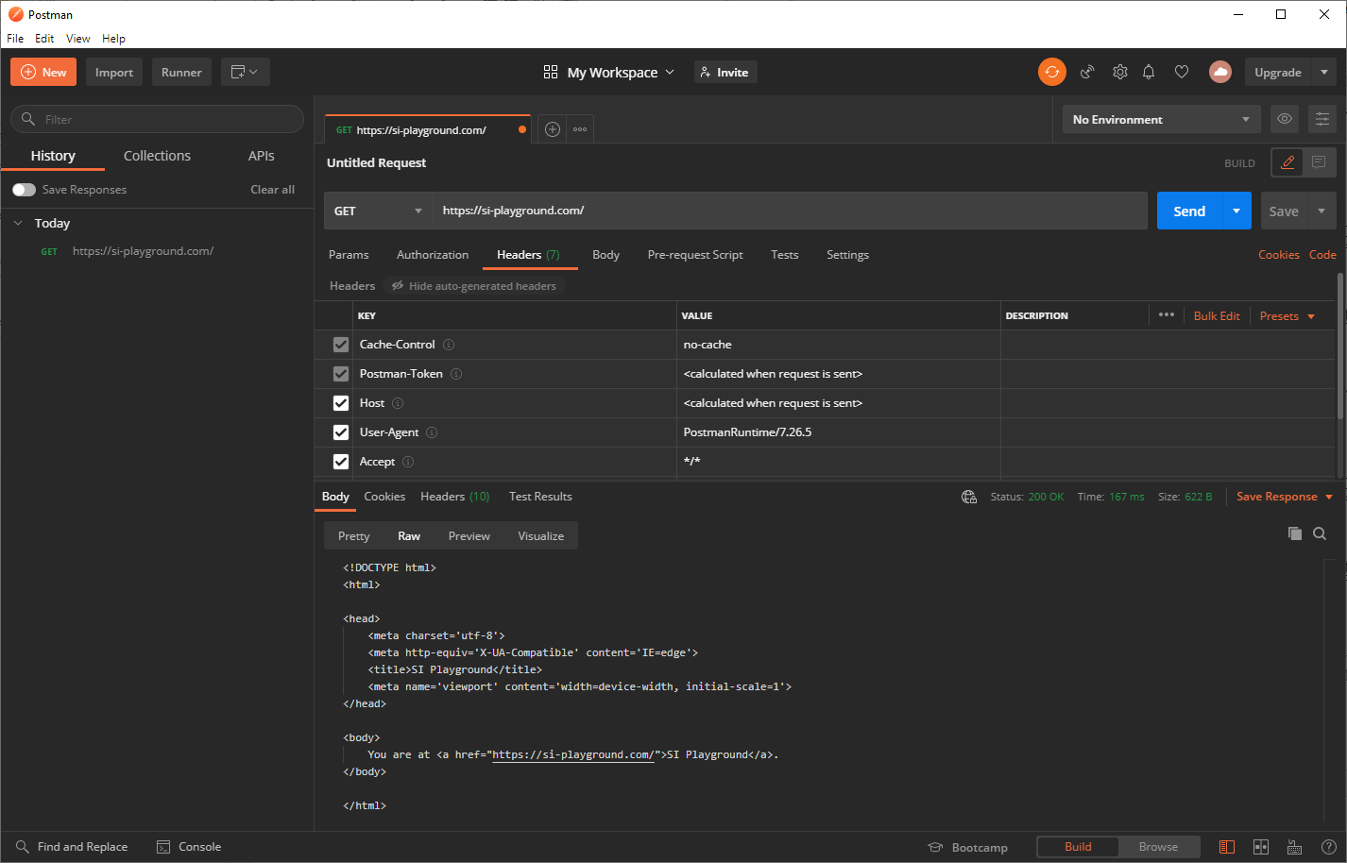
Request
Response

Slide 12
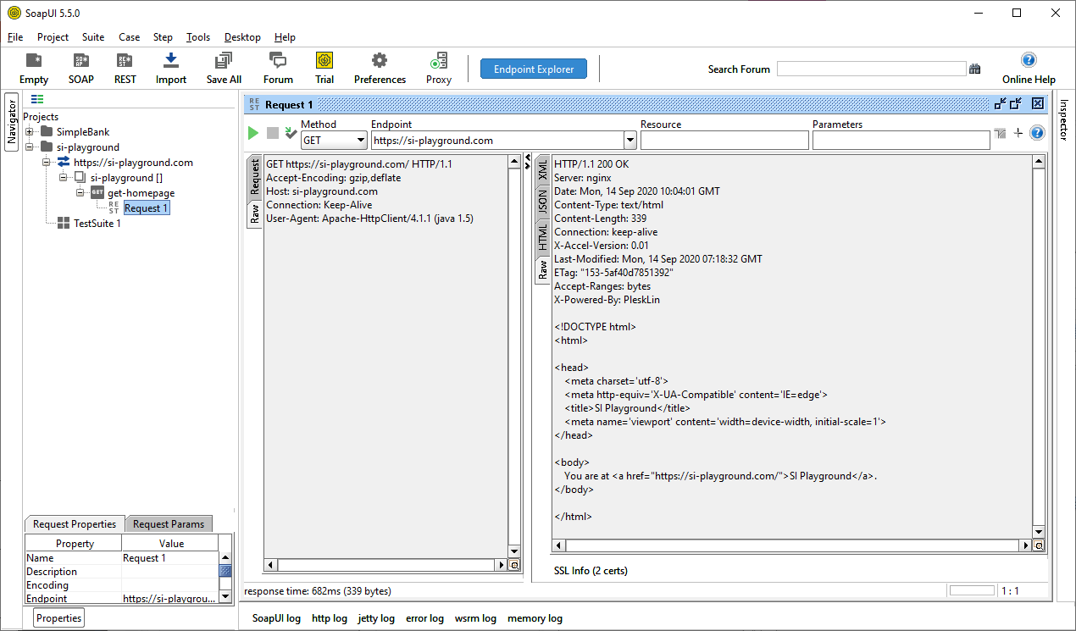

Slide 13
HTML

Slide 14

HTML
Hypertext Markup Language (HTML)
Is a language to structure information.
It marks up (styles) the look and feel.
The today’s version is called HTML5.
The language is very similar to XML (eXtensible Markup Language)
Unlike XML, HTML tags are predefined.

Slide 15
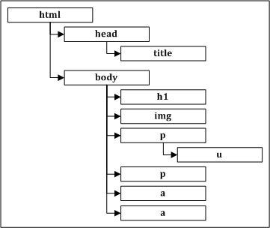
HTML Element
Information are structured in elements.
An element may have one or more child elements.
The structure may looks like a tree.
An element is written in a tag.
A tag may have one or more attributes.
<tag attribute="attributevalue">elementvalue</tag>

Slide 16
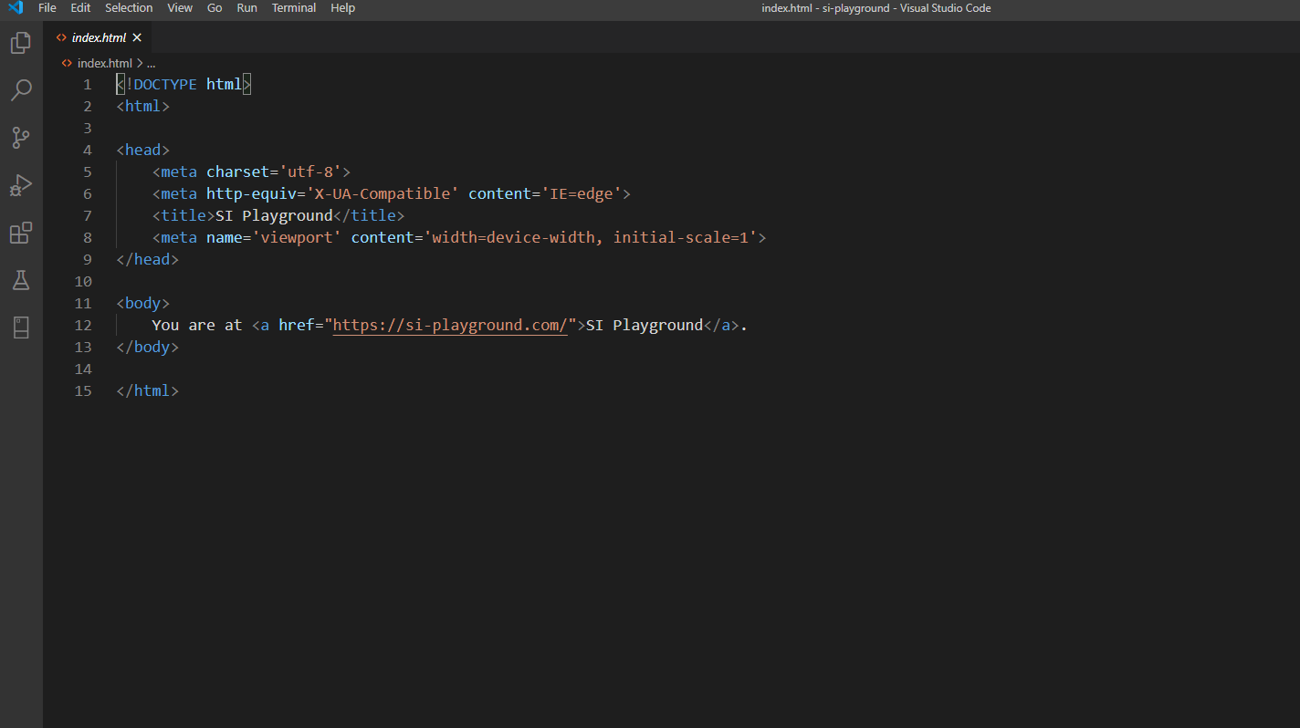
A Simple HTML Document

Slide 17
External Resources
An HTML document may refers to one or more external resources.
CSS styling, JS, or a set of images.
What would happen if the external resources are unavailable?
The page will still be loaded, but:
Doesn’t look pretty.
Doesn’t have a fancy features.

Slide 18

HTML Document Object Model
When an HTML document is loaded by a browser, it creates an abstract model that structures the page.
This abstract model is called as Document Object Model.
or simply DOM.
When there is a dynamic manipulation, the browser manipulates the DOM.

Slide 19
HTTP vs HTML

Slide 20
HTTP vs. HTML
HTTP is about the data transmission between hosts.
HTML is about structuring and formatting information.
HTTP is the mailing ecosystem
HTML is the mail being sent

Slide 21

To-dos
Understand the role of:
HTTP and HTML in a web application.
Element value and attribute.
Find out the feature that:
The HTTP/2 has but HTTP/1.1 doesn’t.
The HTML5 has but HTML4 doesn’t.
Try some basic tags by building a simple page.

Slide 22
References
Srinivasan, M. (2012). Web Technology: Theory and Practice. Pearson.
RFC7303. XML Media Types. https://www.rfc-editor.org/rfc/rfc7303.txt
HTML Standard https://html.spec.whatwg.org/
HTML5 Differences from HTML4. https://www.w3.org/TR/html5-diff/
Mozilla. HTML Element Reference. https://developer.mozilla.org/en-US/docs/Web/HTML/Element

