Slide 1
HTML and CSS
Web Programming and Testing

Slide 2
Objectives
The objective of this session is the following:
The students are able to elaborate the role of CSS.
The students are able to distinguish the difference of CSS selector.
The students are able to style web pages by using CSS.

Slide 3
Outlines
CSS and CSS Selectors.
Styling Methods.
CSS Framework.

Slide 4
CSS and CSS Selectors

Slide 5

Cascading Style Sheet (CSS)
CSS is a way to style HTML page.
The browser is responsible to read and apply the rules.
The style is written in rules.
A style can be applied to one or more type selectors.
A type selector might be use multiple styles.

Slide 6
CSS Selectors
CSS selector is a patterns used to select element(s) to which the style is going to be applied.
Selector could be in the form of:
Type selector: based on the element tag name.
ID selector: based on the element’s id attribute.
Class selector: based on the element’s class attribute.
etc.
Please visit: https://www.w3schools.com/cssref/css_selectors.asp

Slide 7
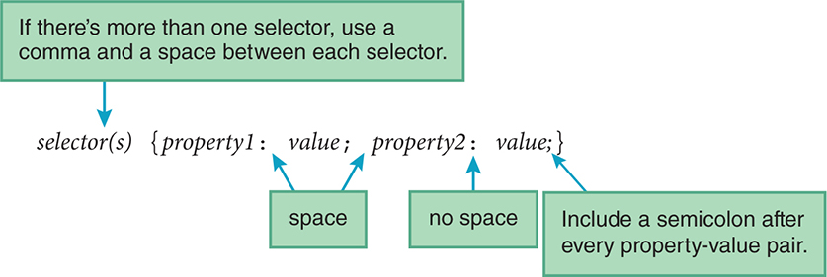
CSS Rule
Source: Dean, J. (2018). Web Programming with HTML5, CSS, and JavaScript. Jones & Bartlett Learning

Slide 8
CSS Type Selector
An element type selector is used for matching element tag.
The style will be applied to any matched elements.
On the example:
The style will be applied to h2 and p tags on the page.
The style will target both font-style and color attributes.
h2, p {
font-style: italic;
color: blue;
}

Slide 9
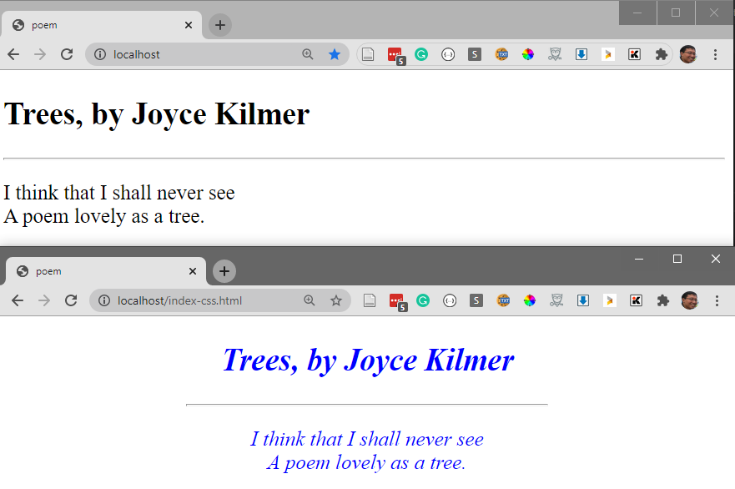
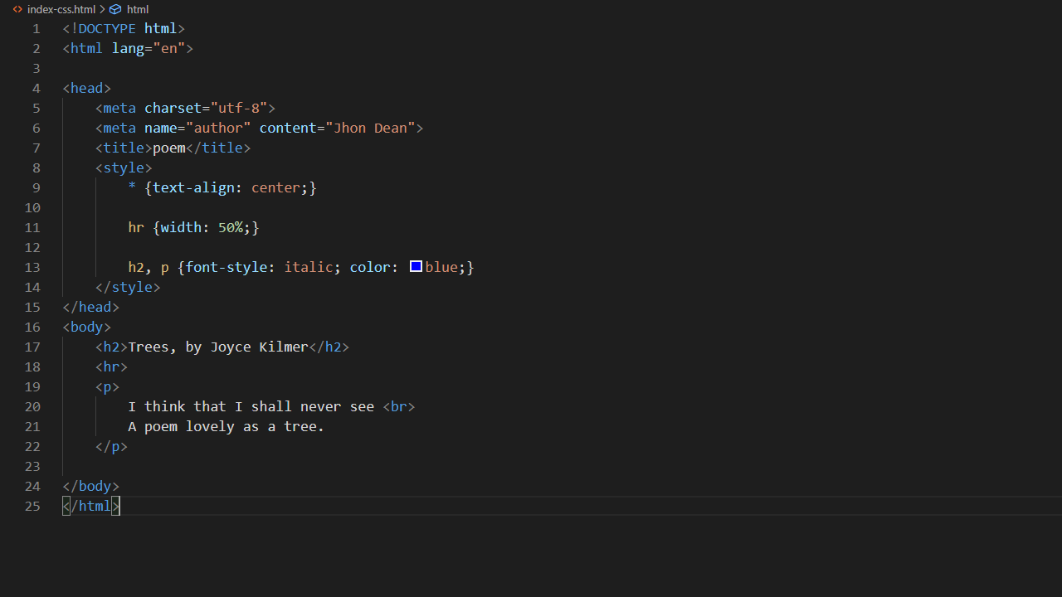

Slide 12
CSS Class Selector
A class selector will be applied to any element with matched class attribute value.
On the example:
The style will be applied to elements with class value red.
The style will target background-color attributes.
.red {
background-color: tomato;
}
<q class="red">
It is better to keep your mouth closed and let people think you are a fool than
to open it and remove all doubt.
</q>
Source: Dean, J. (2018). Web Programming with HTML5, CSS, and JavaScript. Jones & Bartlett Learning

Slide 13
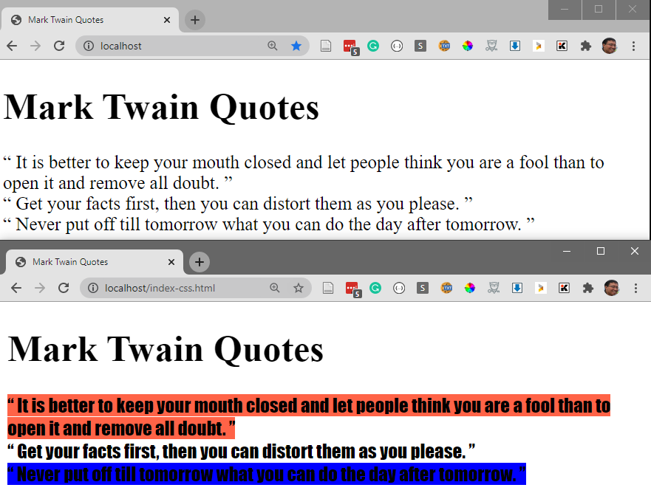

Slide 14
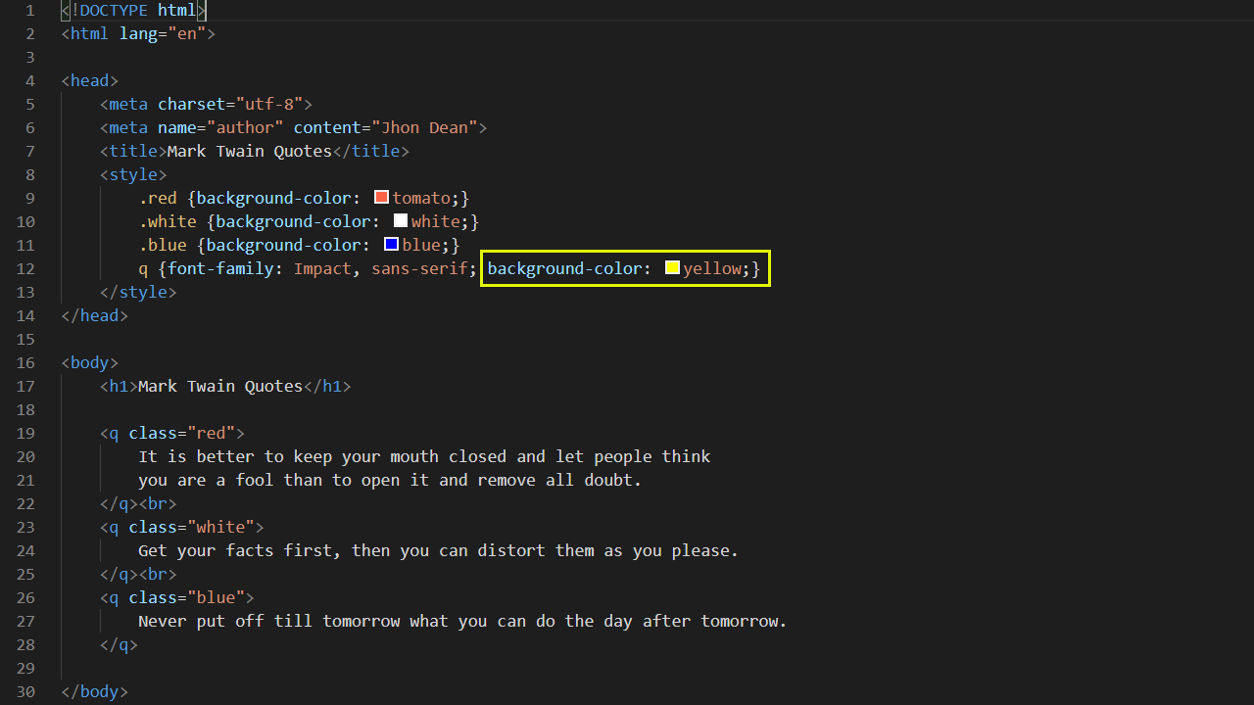

Slide 15
CSS ID Selector
A class selector will be applied to any element with matched class attribute value.
On the example:
The style will be applied to elements with class value red.
The style will target background-color attributes.
#lizards-lounge {
color: green;
}
<h3 id="lizards-lounge">Lizards Lounge</h3>
Source: Dean, J. (2018). Web Programming with HTML5, CSS, and JavaScript. Jones & Bartlett Learning

Slide 16
Styling Method

Slide 17
Inline Styling Method
Styles can be defined right at the element.
Using the style attribute.
This styling is the highest priority.
<tag style=“attribute1:value1; attribute2:value2;">...</tag>

Slide 18
Embedded Styling Method
Styles are specified outside the targeted elements.
Using the style container.
The styles reside inside the page.
<style>
selector(s) {attribute1:value1; attribute2:value2;}
... {attribute1:value1; attribute2:value2;}
</style>

Slide 19
External Styling Method
Styles are specified independent from any page.
Using the style container.
To apply the styles a linking needs to be made.
The URL could be relative or absolute.
<link rel="stylesheet" href="external-css-URL" type="text/css">

Slide 20
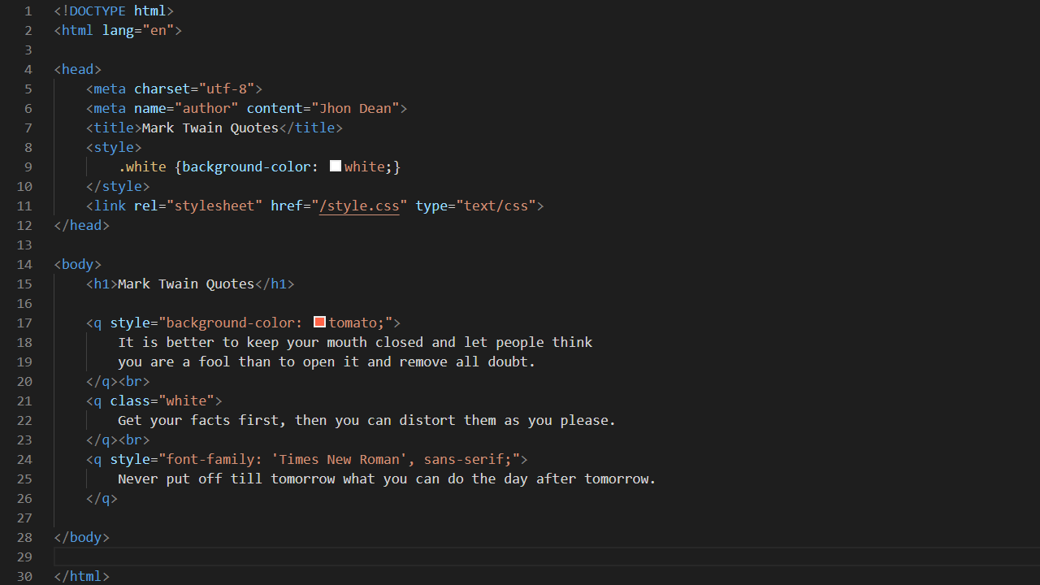

Slide 21
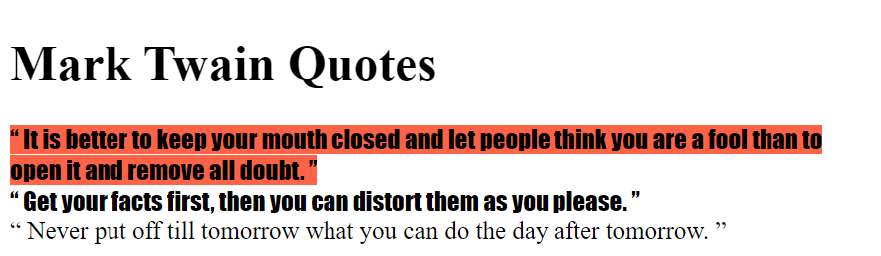
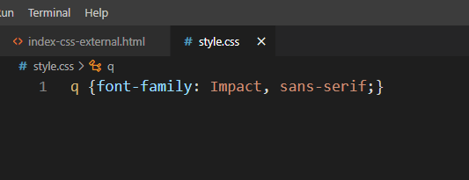

Slide 22
CSS Frameworks

Slide 23
CSS Frameworks
CSS frameworks enable developer to:
Use it immediately.
Have some standards.
Drawbacks:
Increase project dependency.
Might be too much for small projects.
Very common CSS frameworks:
Bootstrap, Bulma, and Zurb Foundation.

Slide 24
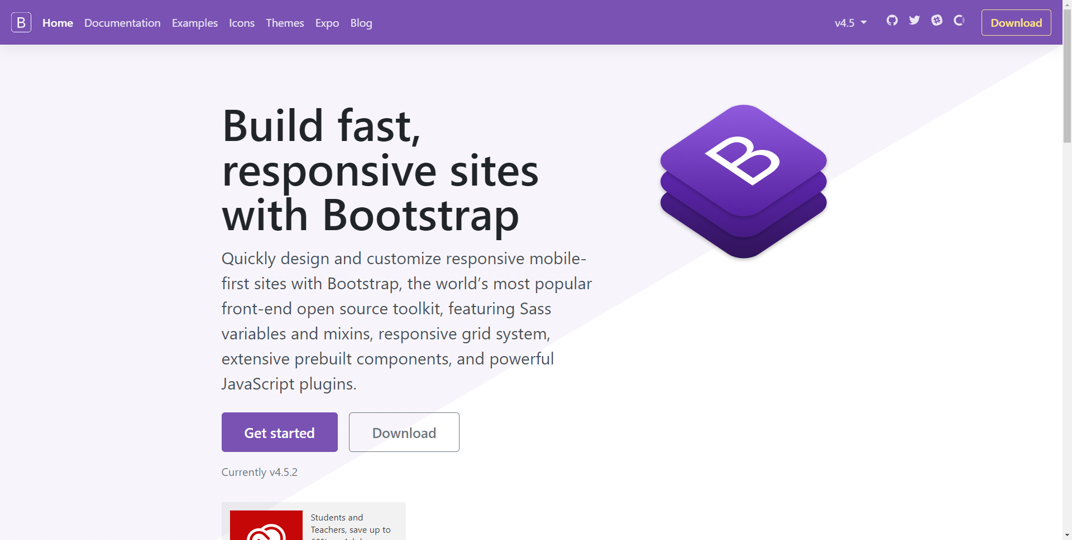

Slide 25


Slide 26

To-dos
What are the differences between:
Element’s class and id attribute?
Absolute and relative URL.
What is the benefit of using:
Embedded styling compared to inline styling?
External styling compared to embedded styling?
What if you create two exact styling?
What should we expect to happen?
What if the external styling is missing?

Slide 27
References
Srinivasan, M. (2012). Web Technology: Theory and Practice. Pearson.
Dean, J. (2018). Web Programming with HTML5, CSS, and JavaScript. Jones & Bartlett Learning.
Mozilla. HTML Element Reference. https://developer.mozilla.org/en-US/docs/Web/HTML/Element

