Slide 1
Server-side Processing
Web Programming and Testing

Slide 2
Objectives
The objective of this session is the following:
The students are able to elaborate the role of server-side processing.
The students get to know one instance of server-side programming language.

Slide 3
Outlines
Motivation
Server-side Programming Language

Slide 4
Motivation

Slide 5
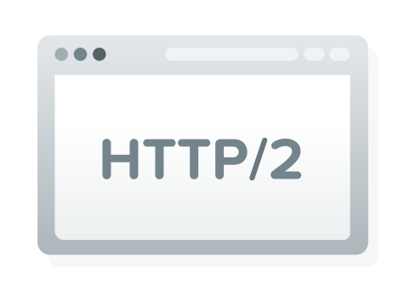
Web 2.0: Interactivity
Web 2.0 is minimal: dynamic content.
User should be able to contribute.
Server-side processing is needed.
+ persistence data storage.

Slide 6
General Workflow

Slide 7
Server-side Programming Language

Slide 8
Server-side Programming Language
There are numerous programming languages that can work as server-side processor.
In this course, we will use PHP.
You can use other language.
Other platform offers a more broader ecosystem.
Jakarta EE, .NET, Node.JS, Phyton, Dart, etc.
Brace yourself, this course is NOT about PHP.

Slide 9
PHP, A Scripting Language
PHP Hypertext Preprocessor.
It is considered as relatively easy to learn.
Used in more than 60% web applications.
PHP module is registered in the web server.
Files with .php extension will be preprocessed.
Please visit: https://www.php.net/

Slide 10
PHP, A Scripting Language
PHP codes are embeddable.
It can be inserted any where.
PHP codes are written inside the PHP tag.
The parser would search for the tag and execute the codes inside the tag.
<?php
// codes
?>

Slide 11
Language Features
Variables, operators, data type.
Control structure (branching & iteration).
Function, magic methods, namespacing, etc.
File manipulation, accepting user input, and state management.
Database connectivity.
It supports both procedural and OO paradigm.
Dependency management (Composer).

Slide 12
Variables
PHP variable identifier follows these rules:
Started with a dollar ($) sign.
The first character of the identifier must be any alphabetic character or underscore.
The next character could be any alphanumeric character or underscore, but not white space character (tab, space, carriage-return).
Not case-sensitive.
e.g. $name, $_last_name, $_58

Slide 13
Data Types
Four scalar types:
boolean, integer, float (or double), and string.
Four compound types:
array, object, callable (and callback), iterable
Two special types:
resource, NULL

Slide 14
Operators
Arithmetic Operators
Assignment Operators
Bitwise Operators
Comparison Operators
Error Control Operators
Execution Operators
Incrementing/ Decrementing Operators
Logical Operators
String Operators
Array Operators
Type Operators
Operator Precedence

Slide 15
Array
In PHP, array is designed to be very flexible.
It support indexed, associative, or mixed array.
It accepts multiple data types.
$arr = [
“age” => 34
];
$arr[1] = 2;
$arr[“name”] = “Jaka Sembung”;
$arr[] = [];
$arr[2][] = “Nasi Padang”;

Slide 16
Control Structure: Branching
PHP supports if and switch-case variants.
$x = true;
$y = ...;
if($x && $y === 0){
// $y is a numeric with value equals to 0
} else {
// something else
}
$x = true;
$y = ...;
switch($y){
case 0:
// $y is 0
case 1:
// $y is 1
...
default:
// other things
}

Slide 17
Control Structure: Iteration
PHP supports for, foreach, while and do-while variants.
The foreach variant is very useful to iterate an array with key and value entry set.
$arr = [];
// filling $x with some values
foreach($arr as $key=>$value){
echo(“{$key}:{$value}”);
}

Slide 18
Function
Function is a callable type.
A function may have parameters (with type hinting).
Some parameters could have its default value.
Such parameters are specified later in the parameter list.
function f(string $_param1, $_param2 = []){
// do something
}
f(“Jaka Sembung”);

Slide 19
Function
Function is a callable type.
Anonymous function.
$g = function(...$_params){
foreach($_params as $value){
// do something
}
}
$g(1, “hallo”, true, 3.14, []);

Slide 20
Function
Function is a callable type.
Callback function.
$g = function(...$_params){
// do something
}
function f($_callme){
$_callme();
}
f($g);

Slide 21
File Handling
Reading file content.
file(), file_get_contents(), fopen(), … and many more.
Writing string into file.
file_put_contents(), fwrite(), … and many more.

Slide 22
Object-Orientation
Initially, PHP was not designed to be used in OO approach.
As time goes, it now fully supports OO without leaving out procedural approach.
All OO principles are applicable.
Encapsulation, polymorphism, and inheritance.

Slide 23
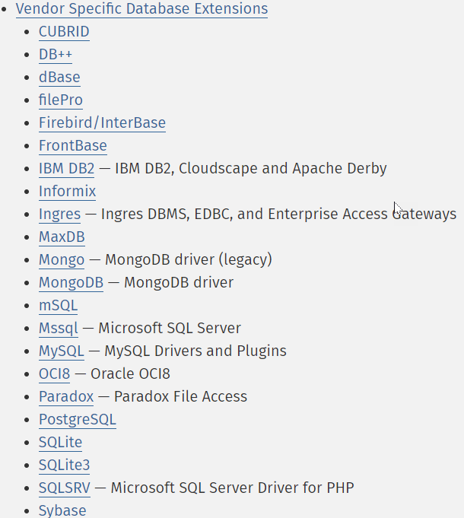
Database Connectivity
Capability to interact with database is crucial.
PHP supports tons of industry standard database platforms.

Slide 24
Database Connectivity
Connectivity can be achieved via two approach:
Native driver, plainly using the vendor’s library.
PDO (PHP Data Object), an extra layer on top of the native driver to promote higher level of abstraction.
Benefit of using PDO:
Feature rich and vendor agnostic.
Fully object-oriented, foundation for Object relational mapping (ORM).

Slide 25
Some Useful Function
Debugging:
var_dump() – to see what’s inside a variable.
print_r() – like var_dump() with a better formatting.
die() to stop script execution.
Sending HTTP Header:
header() – to send HTTP Header to the client.
E.g. 'Location: http://www.example.com/index.php');

Slide 26

To-dos
Understand how the server-side processing works.
Dig the documentation.
This session is surely not enough.
In the near feature:
We will use some frameworks.

Slide 27
References
Srinivasan, M. (2012). Web Technology: Theory and Practice. Pearson.
Tatroe, K., et. al. (2020). Programming PHP. O'Reilly.
PHP Manual https://www.php.net/manual/en/

